Slide 1
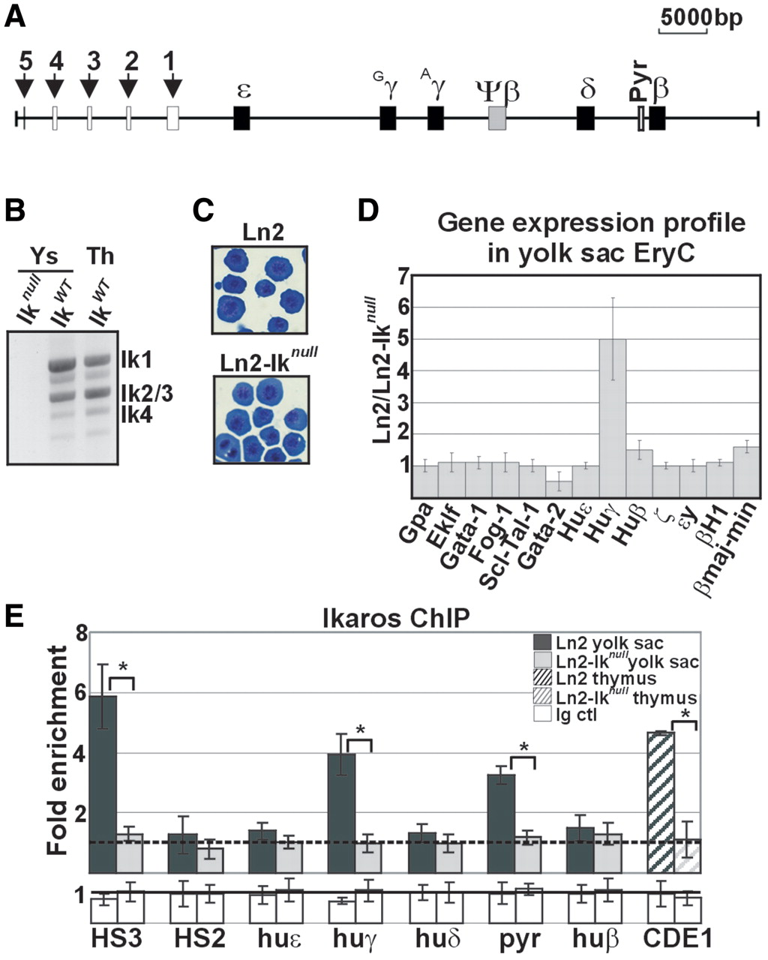
Figure 1. Morphological and molecular characterization of ln2 and ln2-Ik^{null} yolk sac EryC. (A) Map of the ...
Notes:
Figure 1. Morphological and molecular characterization of ln2 and ln2-Iknull yolk sac EryC. (A) Map of the human β-globin locus; black arrows indicate βLCR HSs; genes are indicated by black boxes; (B) RT–PCR performed on ln2-Iknull (Iknull), ln2 (IkWT) yolk sac EryC or ln2 (IkWT) thymus (Th) cells; (C) Wright-Giemsa staining of ln2 or ln2-Iknull yolk sac cells; (D) RT–qPCR of hematopoietic as well as globin gene transcripts performed on equal amounts of ln2 and ln2-Iknull yolk sac EryC; transcript quantification was calculated according to Pfaffl (73) using mouse Actin cDNA as internal control; ln2/ln2-Iknull ratios are plotted as the mean ± SD of the measurements; n ≥ 4; (E) ChIP on ln2 and ln2-Iknull yolk sac EryC or thymus cells carried out with Ikaros antibodies; immunoprecipitated and input chromatin samples were used as template in qPCR; quantification was carried out according to the 2−ΔΔCt method, using mouse kidney-specific Tamm-Horsfall protein (Thp) promoter as internal control; fold enrichments (y-axis) of globin regions relative to the control and the input samples are plotted as the mean ± SD of the measurements; a value of 1 (dashed line) indicates no enrichment; *P ≤ 0.05 by Student’s t-test; huε, huε-promoter; huγ, huγ-promoters; huδ, huδ-promoter; pyr, Pyr region; and huβ, huβ-promoter; dark gray bars: ln2 yolk sac EryC; light gray bars: ln2-Iknull yolk sac EryC; dark gray dashed bars: ln2 thymus cells; light gray dashed bars: ln2-Iknull thymus cells; white bars: isotype-matched Ig (Ig ctl).
Unless provided in the caption above, the following copyright applies to the content of this slide: © The Author(s) 2011. Published by Oxford University Press.This is an Open Access article distributed under the terms of the Creative Commons Attribution Non-Commercial License (http://creativecommons.org/licenses/by-nc/2.5), which permits unrestricted non-commercial use, distribution, and reproduction in any medium, provided the original work is properly cited.

Slide 2
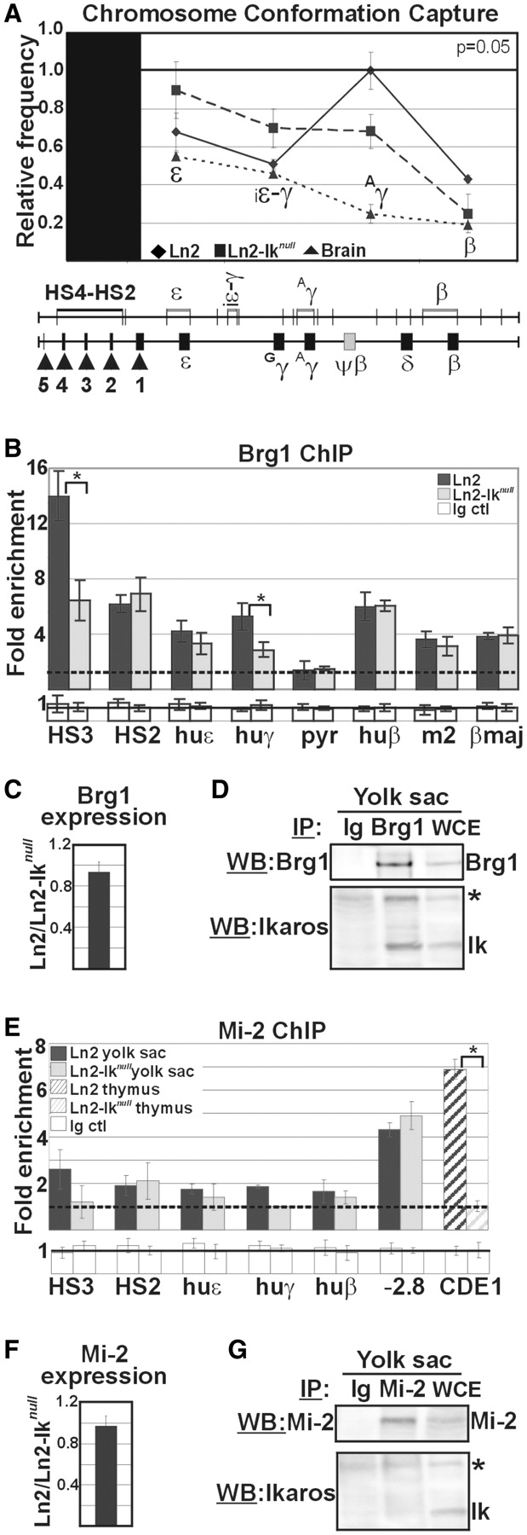
Figure 2. Brg1 and Mi-2 recruitment to the huβ-globin locus in ln2 and ln2-Ik^{null} yolk sac EryC. (A) Ln2 and ...
Notes:
Figure 2. Brg1 and Mi-2 recruitment to the huβ-globin locus in ln2 and ln2-Iknull yolk sac EryC. (A) Ln2 and ln2-Iknull yolk sac EryC were subjected to 3C assay; nuclei were digested with EcoRI and genomic DNA was ligated and used as template for qPCR; βLCR HS4-HS2 EcoRI fragment was used as ‘fixed’ point and primer sets were designed in order to amplify the genomic regions corresponding to the ε, ε-gene; iε-γ, inter-ε-γ region; Aγ, Aγ-gene and β-gene region; relative crosslinking frequencies (y-axis) of the ‘fixed’ fragment with globin fragments were defined using naked DNA encompassing the whole huβ-globin as control and normalized to endogenous mouse Actin; a value of 1 was attributed to the highest crosslinking frequency; the data are plotted as the mean ± SD of the measurements of five independent experiments; x-axis: position across the locus; rhomboids: ln2 yolk sac EryC; squares: ln2-Iknull yolk sac EryC; triangles: brain cells; (B and E) ChIP on ln2 and ln2-Iknull yolk sac EryC or thymus cells carried out with Brg1 or Mi-2 antibodies; fold enrichments (y-axis) were calculated as described in Figure 1E and are plotted as the mean ± SD of the measurements; a value of 1 (dashed line) indicates no enrichment; *P ≤ 0.05 by Student’s t-test; huε, huε-promoter; huγ, huγ-promoters; pyr, Pyr region; huβ, huβ-promoter; m2, mouse HS2; βmaj, βmajor promoter; −2.8: −2.8 kb region upstream of the Gata-2 promoter and CD4E1: CD4 enhancer 1 region; dark gray bars: ln2 yolk sac EryC; light gray bars: ln2-Iknull yolk sac EryC; dark gray dashed bars: ln2 thymus cells; light gray dashed bars: ln2-Iknull thymus cells; white bars: isotype-matched Ig (Ig ctl); (C and F) RT–qPCR of Brg1 and Mi-2 gene transcripts performed on equal amounts of ln2 and ln2-Iknull yolk sac EryC; transcript quantification was calculated according to Pfaffl (73) using mouse Actin cDNA as internal control; ln2/ln2-Iknull ratios are plotted as the mean ± SD of the measurements; n = 6; (D and G) Protein co-IP of total cell lysates prepared from ln2 yolk sac EryC; cell lysates were immunoprecipitated with Mi-2 or Brg1 antibodies as well as isotype-matched Ig; samples were resolved on SDS–PAGE, immunoblotted and WB membranes were cut in half; the higher half was probed with either Mi-2 or Brg1 antibodies, whereas the lower half was probed with Ikaros antibodies; asterisks indicate non-specific bands; WCE: yolk sac EryC total cell lysate.
Unless provided in the caption above, the following copyright applies to the content of this slide: © The Author(s) 2011. Published by Oxford University Press.This is an Open Access article distributed under the terms of the Creative Commons Attribution Non-Commercial License (http://creativecommons.org/licenses/by-nc/2.5), which permits unrestricted non-commercial use, distribution, and reproduction in any medium, provided the original work is properly cited.

Slide 3
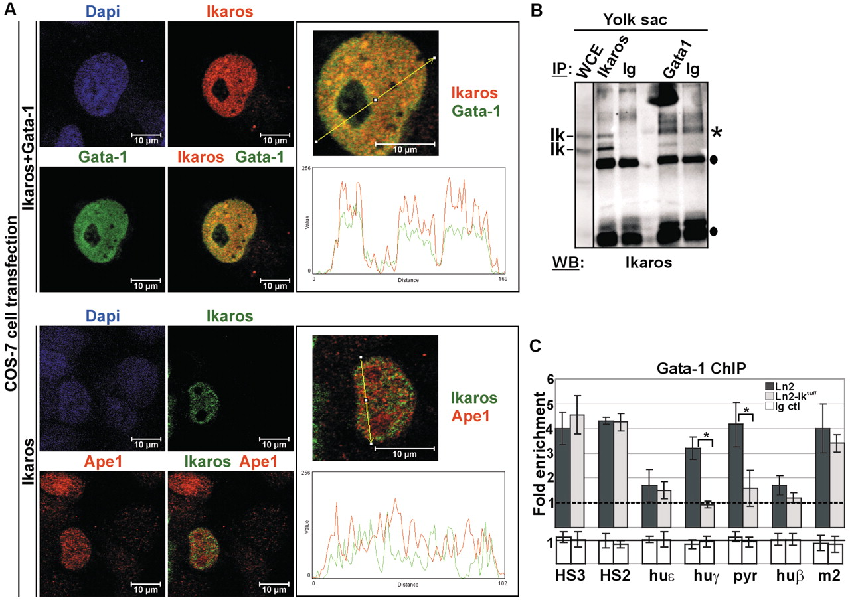
Figure 3. Ikaros-Gata-1 cooperative binding. (A) Confocal immunofluorescence of COS-7 cells expressing Flag/HA-Ikaros ...
Notes:
Figure 3. Ikaros-Gata-1 cooperative binding. (A) Confocal immunofluorescence of COS-7 cells expressing Flag/HA-Ikaros and Gata-1 proteins (Ikaros+Gata-1) or Flag/HA-Ikaros only (Ikaros); Ikaros+Gata-1 transfected cells were stained with mouse antibodies to the HA tag and with rat antibodies to Gata-1; the secondary staining was carried out with TR-conjugated anti-mouse as well as FITC-conjugated anti-rat antibodies; a single COS-7 cell is shown where Ikaros is detected as red signals, Gata-1 as green signals and Ikaros-Gata-1 co-localization as yellow signals in the magnified merged image; Ikaros-transfected cells were stained with rabbit antibodies to the HA tag and with mouse antibodies to Ape1; the secondary staining was carried out with FITC-conjugated anti-rabbit as well as TR-conjugated anti-mouse antibodies; a single COS-7 cell is shown where Ikaros is detected as green signals and Ape1 as red signals; line profile plots were obtained by the WCIF ImageJ(®) program (NIH); (B) Protein co-IP of total cell lysates prepared from ln2 yolk sac EryC; cell lysates were immunoprecipitated with Ikaros or Gata-1 antibodies as well as isotype-matched rabbit (for Ikaros co-IP) or rat (for Gata-1 co-IP) Ig and WB was carried out with Ikaros antibodies; filled circles represent Ig bands; asterisks indicate non-specific bands; WCE: yolk sac EryC total cell lysate; (C) ChIP on ln2 and ln2-Iknull yolk sac EryC carried out with Gata-1 antibodies; fold enrichments (y-axis) were calculated as described in Figure 1E and are plotted as the mean ± SD of the measurements; a value of 1 (dashed line) indicates no enrichment; *P ≤ 0.05 by Student’s t-test; huε, huε-promoter; huγ, huγ-promoters; pyr, Pyr region; huβ, huβ-promoter; m2, mouse HS2; dark gray bars: ln2 yolk sac EryC; light gray bars: ln2-Iknull yolk sac EryC; white bars: isotype-matched Ig (Ig ctl).
Unless provided in the caption above, the following copyright applies to the content of this slide: © The Author(s) 2011. Published by Oxford University Press.This is an Open Access article distributed under the terms of the Creative Commons Attribution Non-Commercial License (http://creativecommons.org/licenses/by-nc/2.5), which permits unrestricted non-commercial use, distribution, and reproduction in any medium, provided the original work is properly cited.

Slide 4
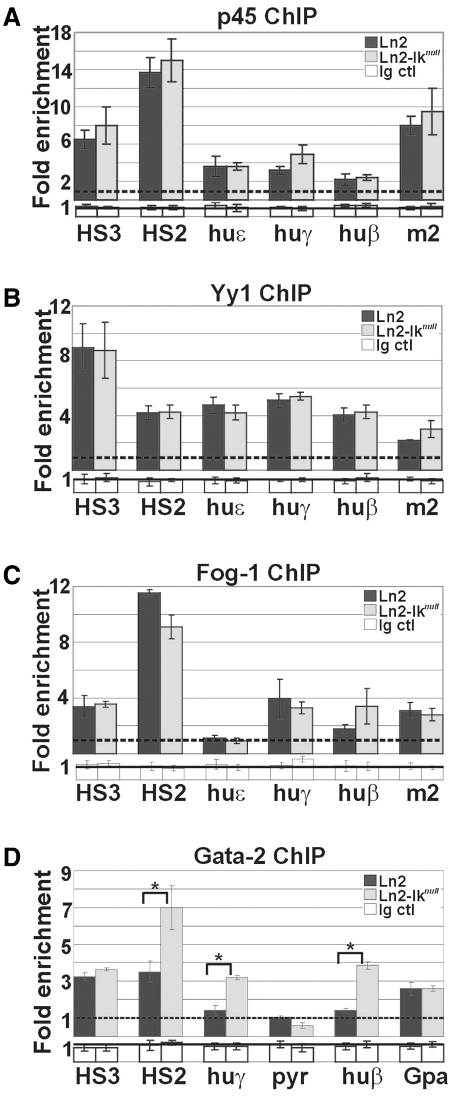
Figure 4. Recruitment of transcriptional regulators to the huβ-globin locus in yolk sac EryC. (A–D) ChIP on ln2 and ...
Notes:
Figure 4. Recruitment of transcriptional regulators to the huβ-globin locus in yolk sac EryC. (A–D) ChIP on ln2 and ln2-Iknull yolk sac EryC carried out with p45/Nf-e2 (p45), Yy1, Fog-1 and Gata-2 antibodies; fold enrichments (y-axis) were calculated as described in Figure 1E and are plotted as the mean ± SD of the measurements; a value of 1 (dashed line) indicates no enrichment; *P ≤ 0.05 by Student’s t-test; huε, huε-promoter; huγ, huγ-promoters; huβ, huβ-promoter; m2, mouse HS2; Gpa, Glycophorin A promoter; dark gray bars: ln2 yolk sac EryC; light gray bars: ln2-Iknull yolk sac EryC; white bars: isotype-matched Ig (Ig ctl).
Unless provided in the caption above, the following copyright applies to the content of this slide: © The Author(s) 2011. Published by Oxford University Press.This is an Open Access article distributed under the terms of the Creative Commons Attribution Non-Commercial License (http://creativecommons.org/licenses/by-nc/2.5), which permits unrestricted non-commercial use, distribution, and reproduction in any medium, provided the original work is properly cited.

Slide 5
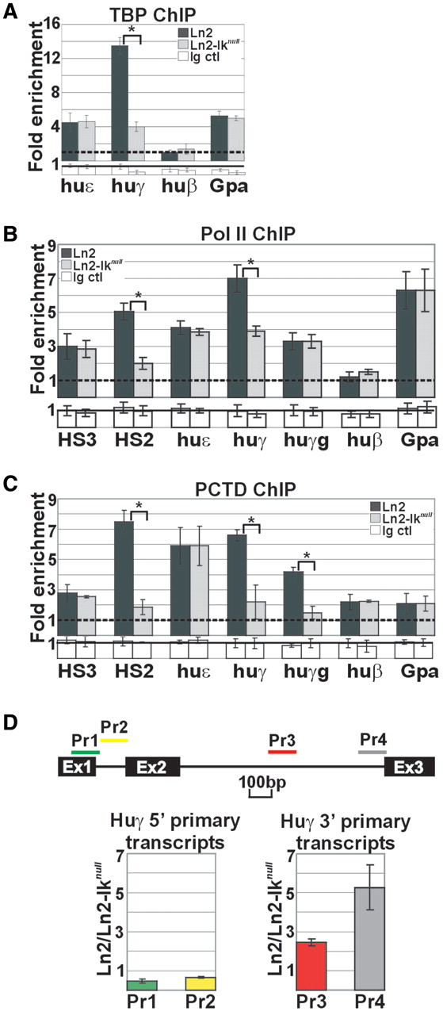
Figure 5. PIC assembly at huγ-genes in ln2 and ln2-Ik^{null} yolk sac EryC. (A–C) ChIP on ln2 and ...
Notes:
Figure 5. PIC assembly at huγ-genes in ln2 and ln2-Iknull yolk sac EryC. (A–C) ChIP on ln2 and ln2-Iknull yolk sac EryC carried out with TBP, Pol II and Pol II phospho Ser2 (PCTD) antibodies; fold enrichments (y-axis) were calculated as described in Figure 1E and are plotted as the mean ± SD of the measurements; a value of 1 (dashed line) indicates no enrichment; *P ≤ 0.05 by Student’s t-test; huε, huε-promoter; huγ, huγ-promoters; huγg, huγ-genes; huβ, huβ-promoter; Gpa, Glycophorin A promoter; dark gray bars: ln2 yolk sac EryC; light gray bars: ln2-Iknull yolk sac EryC; white bars: isotype-matched Ig (Ig ctl); (D) RT–qPCR of huγ-gene 5′- and 3′-primary transcripts performed on equal amounts of ln2 and ln2-Iknull yolk sac EryC using random primers for cDNA synthesis; transcript quantification was calculated according to Pfaffl (73) using the huγ-globin specific primer sets (Pr) depicted as colored bars and mouse Gapdh primary transcripts as internal control; ratios are plotted as the mean ± SD of the measurements; n ≥ 3; P ≤ 0.05; Ex: indicates the three exons of the huγ-gene.
Unless provided in the caption above, the following copyright applies to the content of this slide: © The Author(s) 2011. Published by Oxford University Press.This is an Open Access article distributed under the terms of the Creative Commons Attribution Non-Commercial License (http://creativecommons.org/licenses/by-nc/2.5), which permits unrestricted non-commercial use, distribution, and reproduction in any medium, provided the original work is properly cited.

Slide 6
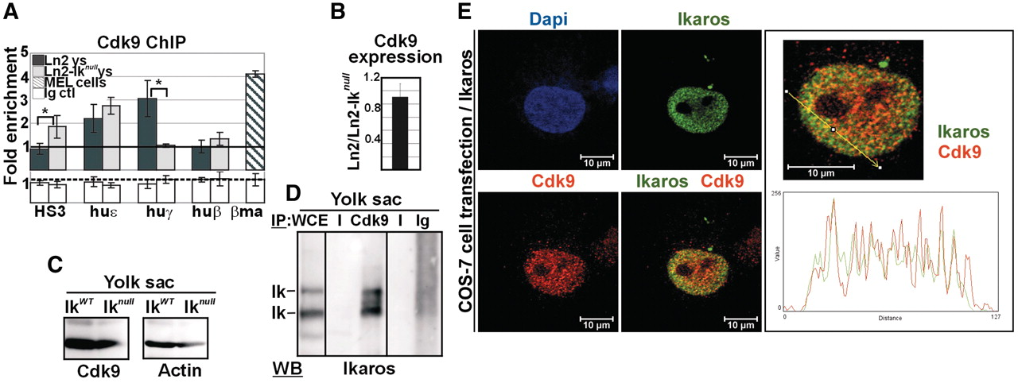
Figure 6. Ikaros-mediated recruitment of Cdk9 to the huγ-genes in yolk sac EryC. (A) ChIP on ln2 and ...
Notes:
Figure 6. Ikaros-mediated recruitment of Cdk9 to the huγ-genes in yolk sac EryC. (A) ChIP on ln2 and ln2-Iknull yolk sac EryC carried out with Cdk9 antibodies; fold enrichments (y-axis) were calculated as described in Figure 1E and are plotted as the mean ± SD of the measurements; a value of 1 (dashed line) indicates no enrichment; *P ≤ 0.05 by Student’s t-test; huε, huε-promoter; huγ, huγ-promoters; huβ, huβ-promoter; βma, βmajor promoter; dark gray bars: ln2 yolk sac EryC; light gray bars: ln2-Iknull yolk sac EryC; dark gray dashed bars: MEL cells; white bars: isotype-matched Ig (Ig ctl); (B) RT–qPCR of Cdk9 gene transcripts performed on equal amounts of ln2 and ln2-Iknull yolk sac EryC; transcript quantification was calculated according to Pfaffl (73) using mouse Actin cDNA as internal control; ln2/ln2-Iknull ratios are plotted as the mean ± SD of the measurements; n = 6; (C) WB performed on total cell lysates prepared from wild type or Iknull yolk sac EryC with Cdk9 or Actin antibodies; (D) protein co-IP of total cell lysates prepared from ln2 yolk sac EryC; cell lysates were immunoprecipitated with Cdk9 antibodies or isotype-matched Ig and WB were carried out with Ikaros antibodies; WCE: yolk sac EryC total cell lysate; (E) Confocal immunofluorescence of COS-7 cells expressing Flag/HA-Ikaros protein; cells were stained with mouse antibodies to the HA tag and with rabbit antibodies to Cdk9; the secondary staining was carried out with FITC-conjugated anti-mouse as well as TR-conjugated anti-rabbit antibodies; a single COS-7 cell is shown where Ikaros is detected as green signals, Cdk9 as red signals, and Ikaros-Cdk9 co-localization as yellow signals in the magnified merged image; line profile plots of Ikaros (in green) and Cdk9 (in red) were obtained by the WCIF ImageJ(®) program (NIH).
Unless provided in the caption above, the following copyright applies to the content of this slide: © The Author(s) 2011. Published by Oxford University Press.This is an Open Access article distributed under the terms of the Creative Commons Attribution Non-Commercial License (http://creativecommons.org/licenses/by-nc/2.5), which permits unrestricted non-commercial use, distribution, and reproduction in any medium, provided the original work is properly cited.

Slide 7
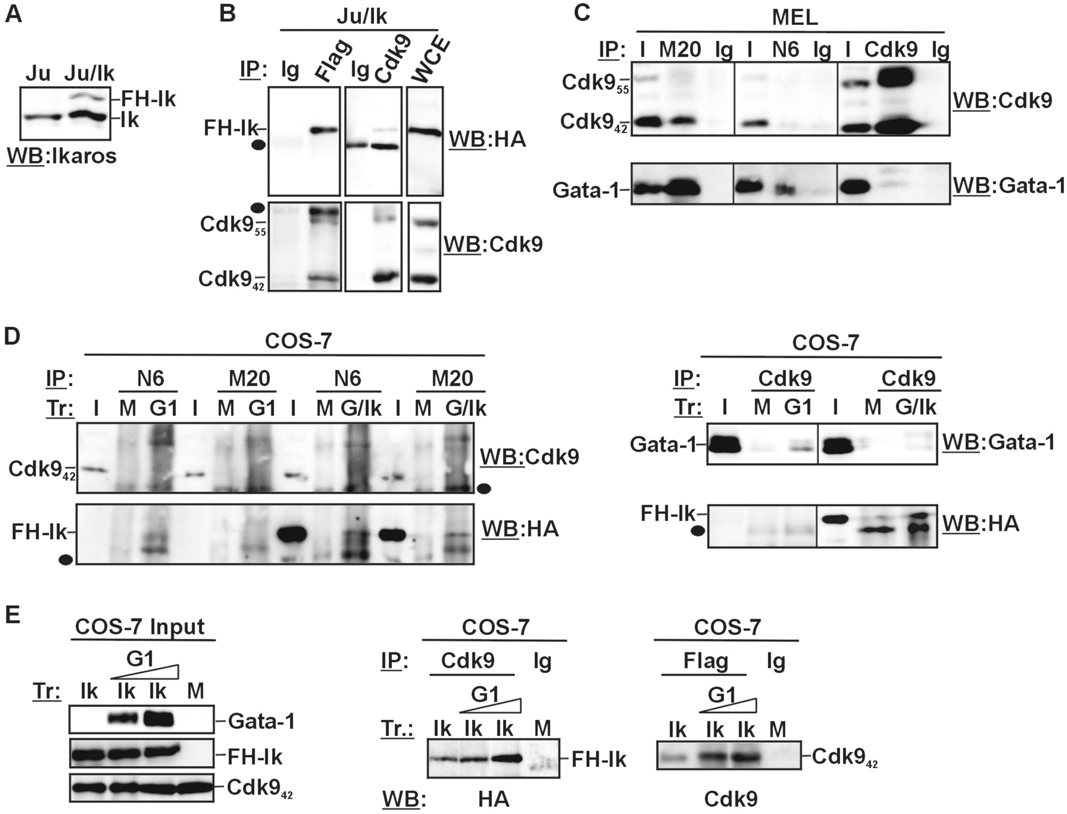
Figure 7. Ikaros interacts with Cdk9 in Jurkat and COS-7 cell lines. (A) WB performed on total cell lysates prepared ...
Notes:
Figure 7. Ikaros interacts with Cdk9 in Jurkat and COS-7 cell lines. (A) WB performed on total cell lysates prepared from Jurkat cells (Ju) or Jurkat cells stably transfected with the pOZN-FH-Ik expression vector (Ju/Ik); endogenous (Ik) as well as double Flag/HA-Ikaros-specific bands (FH-Ik) are indicated; (B) Protein co-IP of total cell lysates prepared from Ju/Ik cells; filled circles represent Ig bands; WCE: Ju/Ik total cell lysate; (C) Protein co-IP of total cell lysates prepared from MEL cells; I, Input; M20, anti-Gata-1 antibodies, clone M20; N6, anti-Gata-1 antibodies, cloneN6; Ig, isotype-matched Ig; (D and E) Protein co-IP of total cell lysates prepared from COS-7 cells transfected (Tr) with empty vector (mock, M), Flag/HA-Ikaros (Ik), Gata-1 (G1) or Flag/HA-Ikaros together with Gata-1 (G/Ik); antibodies used for protein co-IP (IP) and WB are indicated on each panel; I, Input; M20, anti-Gata-1 antibodies, clone M20; N6, anti-Gata-1 antibodies, cloneN6; filled circles represent Ig bands.
Unless provided in the caption above, the following copyright applies to the content of this slide: © The Author(s) 2011. Published by Oxford University Press.This is an Open Access article distributed under the terms of the Creative Commons Attribution Non-Commercial License (http://creativecommons.org/licenses/by-nc/2.5), which permits unrestricted non-commercial use, distribution, and reproduction in any medium, provided the original work is properly cited.

