Slide 1
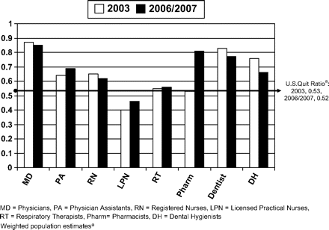
Figure 1. Ratio (weighted population estimates) of former smokers to ever-smokers among health care providers, 2003 and ...
Notes:
Figure 1. Ratio (weighted population estimates) of former smokers to ever-smokers among health care providers, 2003 and 2006/2007 Tobacco Use Supplement-Current Population Survey.
Unless provided in the caption above, the following copyright applies to the content of this slide: © The Author 2010. Published by Oxford University Press on behalf of the Society for Research on Nicotine and Tobacco. All rights reserved. For permissions, please e-mail: journals.permissions@oxfordjournals.org

