Slide 1
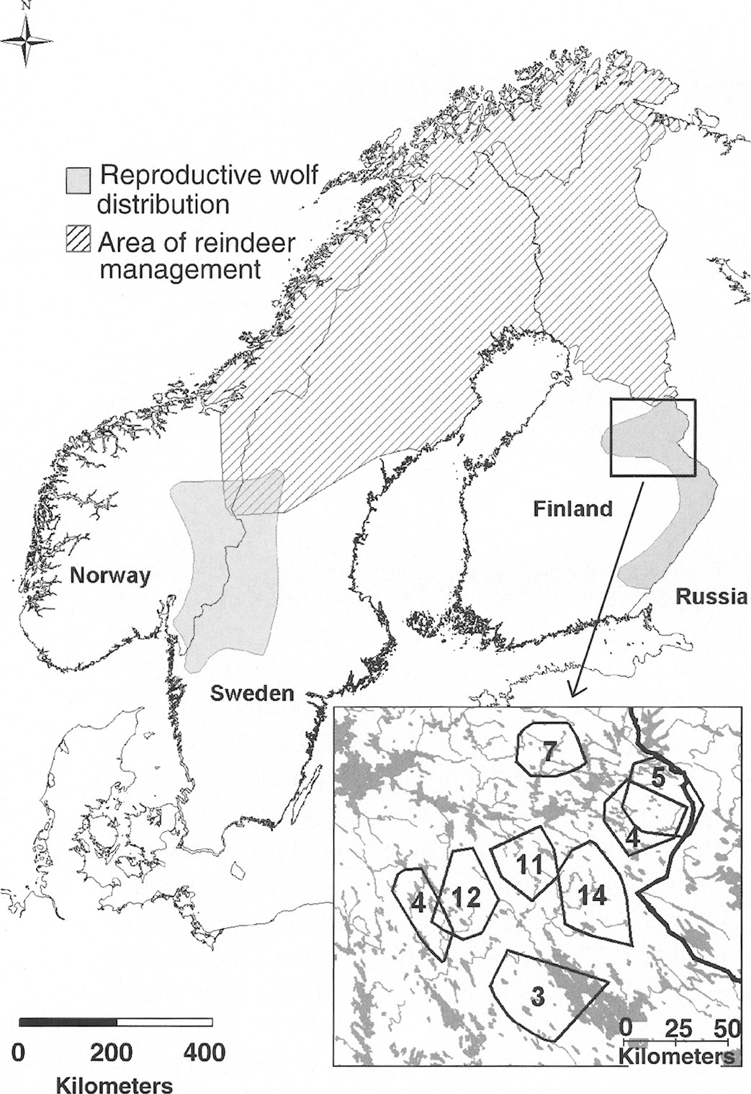
Fig. 1 The range of reproductive wolf packs (Aronson et al. 2001) and reindeer husbandry region of Fennoscandia, and ...
Notes:
Fig. 1 The range of reproductive wolf packs (Aronson et al. 2001) and reindeer husbandry region of Fennoscandia, and wolf territories (as 100% multiple convex polygons) in the study area with number of wolves radiocollared.
Unless provided in the caption above, the following copyright applies to the content of this slide: © 2006 American Society of Mammalogists

Slide 2
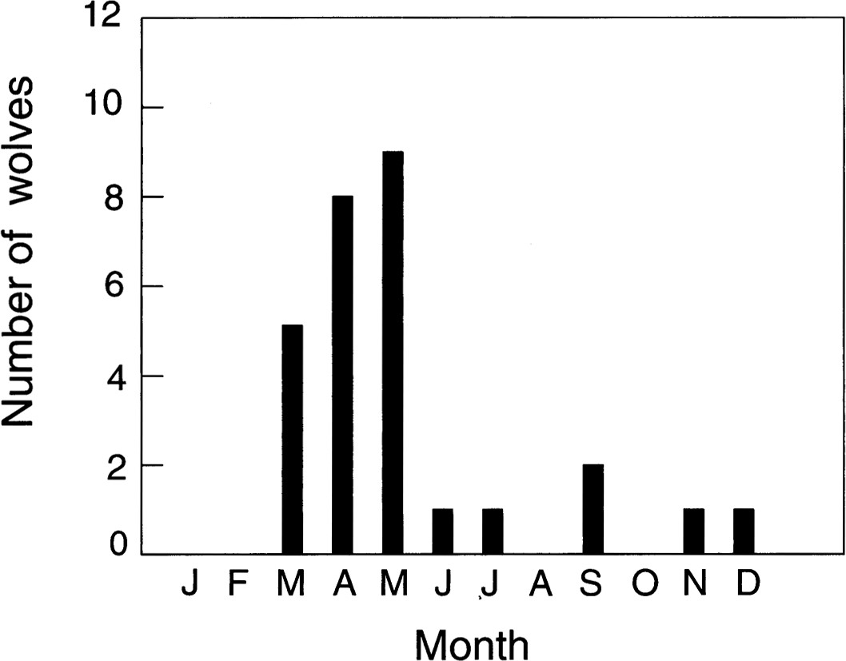
Fig. 2 Month of wolf departures from their home territory, Finland, drawn for wolves that were estimated to be pups ...
Notes:
Fig. 2 Month of wolf departures from their home territory, Finland, drawn for wolves that were estimated to be pups when captured (2000–2004).
Unless provided in the caption above, the following copyright applies to the content of this slide: © 2006 American Society of Mammalogists

Slide 3
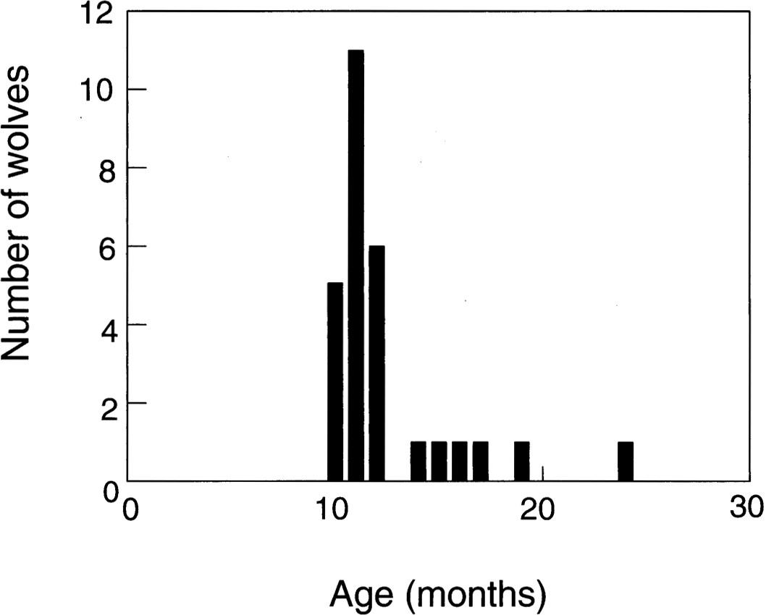
Fig. 3 Estimated age of wolves at departure from home territory, Finland, drawn for wolves that were estimated to be ...
Notes:
Fig. 3 Estimated age of wolves at departure from home territory, Finland, drawn for wolves that were estimated to be pups when captured (2000–2004).
Unless provided in the caption above, the following copyright applies to the content of this slide: © 2006 American Society of Mammalogists

Slide 4
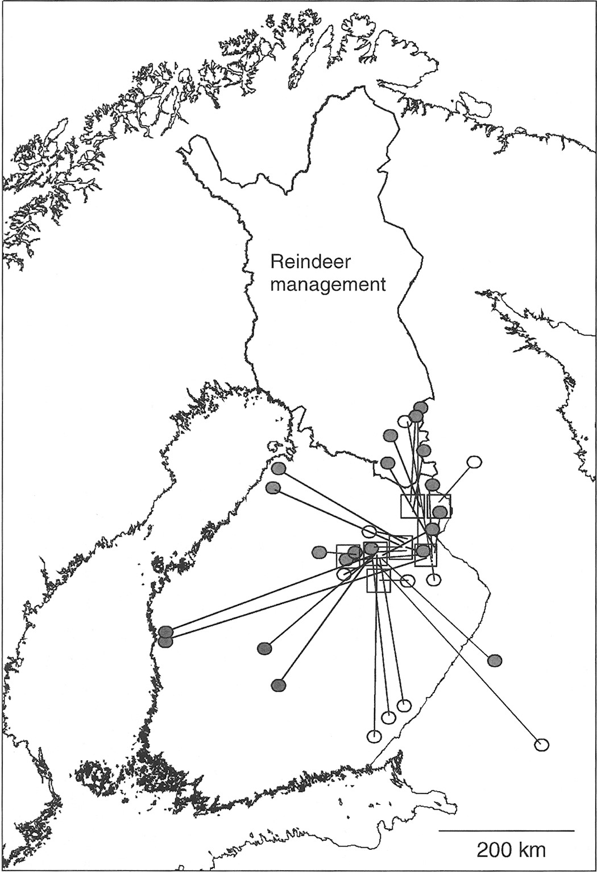
Fig. 4 Dispersal of wolves in Finland, 2000–2004. Squares indicate territories where wolves were fitted with ...
Notes:
Fig. 4 Dispersal of wolves in Finland, 2000–2004. Squares indicate territories where wolves were fitted with transmitters, black circles indicate defined and assumed new territories, and open circles delineate the last location or site of death for cases in which establishment of the new territory was not apparent.
Unless provided in the caption above, the following copyright applies to the content of this slide: © 2006 American Society of Mammalogists

