Slide 1
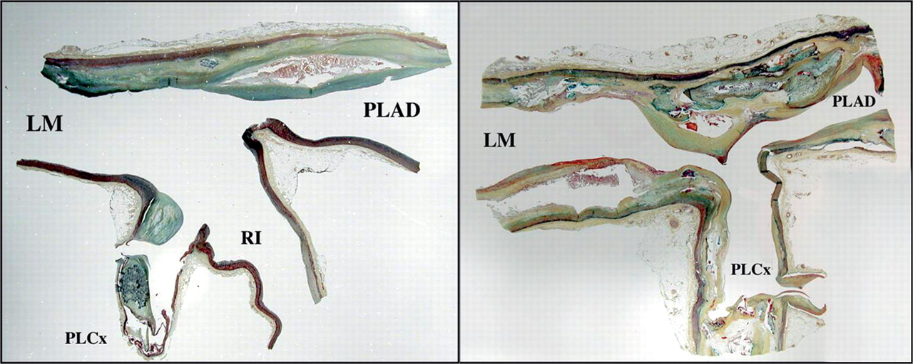
Figure 1 Longitudinal section of bifurcation of the left main coronary artery showing distribution of the ...
Notes:
Figure 1 Longitudinal section of bifurcation of the left main coronary artery showing distribution of the atherosclerotic plaque. Note plaque is located in the lateral wall (area of low shear stress) while sparing the flow divider region (high shear). PLAD, proximal left anterior descending artery; PLCx, proximal left circumflex artery; RI, ramus intermedius.
Unless provided in the caption above, the following copyright applies to the content of this slide: Published on behalf of the European Society of Cardiology. All rights reserved. © The Author 2011. For permissions please email: journals.permissions@oup.com

Slide 2
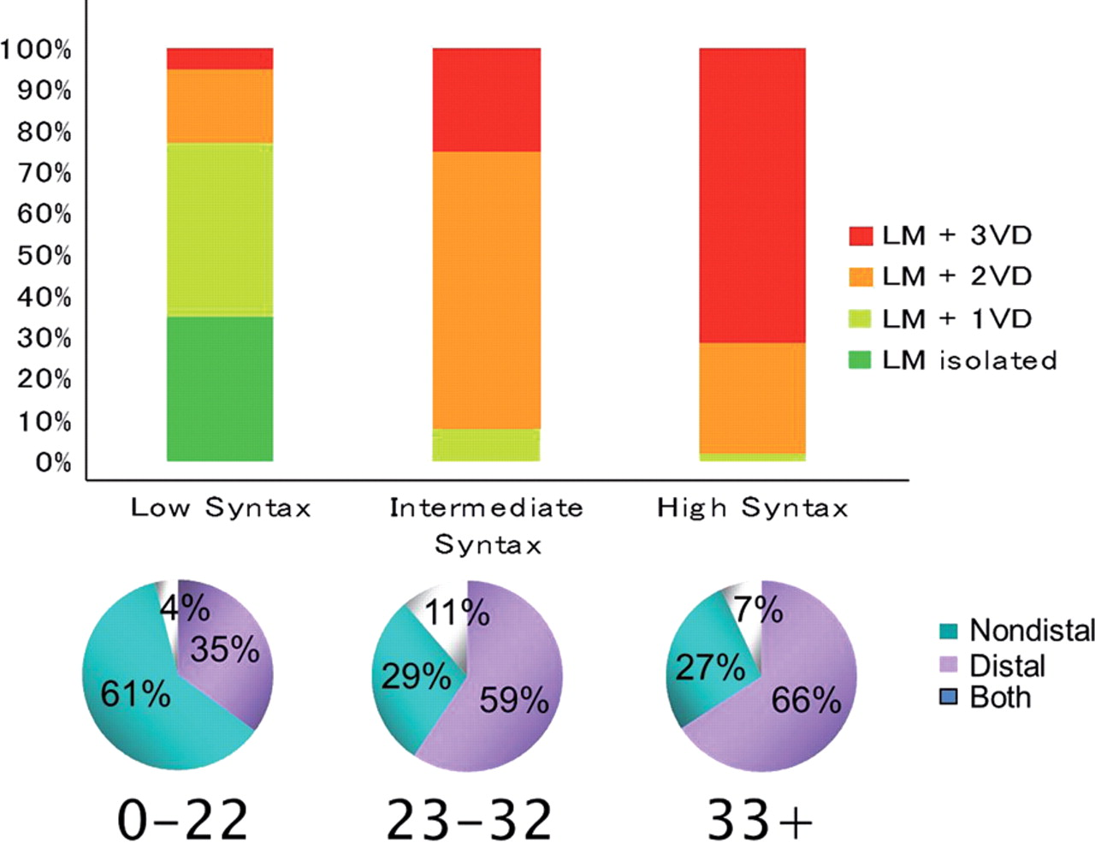
Figure 2 Vessel distribution in left main population according to SYNTAX score terciles.
Notes:
Figure 2 Vessel distribution in left main population according to SYNTAX score terciles.
Unless provided in the caption above, the following copyright applies to the content of this slide: Published on behalf of the European Society of Cardiology. All rights reserved. © The Author 2011. For permissions please email: journals.permissions@oup.com

Slide 3
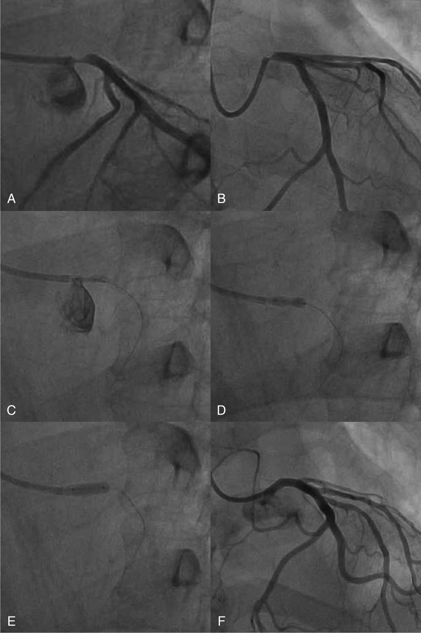
Figure 3 Stenting of isolated ostial left main stenosis. (A and B) Initial appearance. (C) Positioning stent with ...
Notes:
Figure 3 Stenting of isolated ostial left main stenosis. (A and B) Initial appearance. (C) Positioning stent with guide disengaged. (D) Stent deployment with proximal stent protruding into the aorta. (E) High pressure post-dilatation. (F) Final appearance.
Unless provided in the caption above, the following copyright applies to the content of this slide: Published on behalf of the European Society of Cardiology. All rights reserved. © The Author 2011. For permissions please email: journals.permissions@oup.com

Slide 4
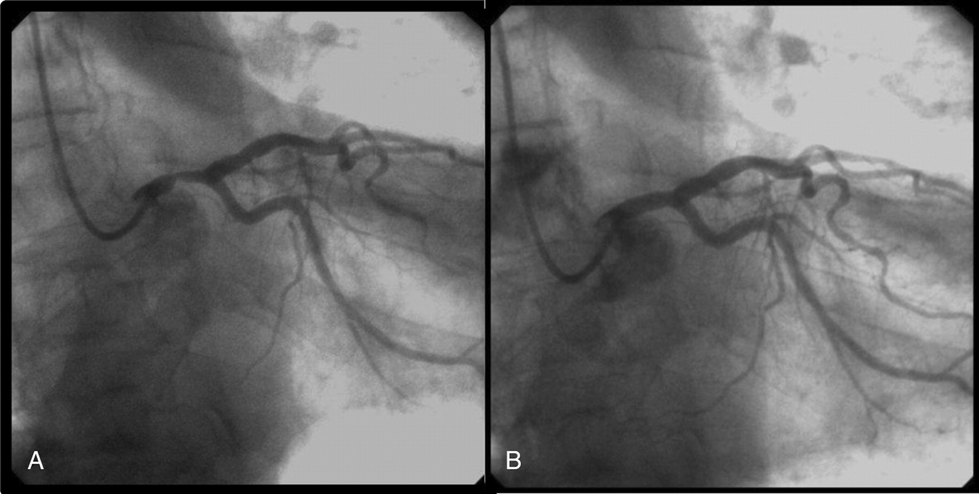
Figure 4 Direct stenting of isolated mid-shaft left main stenosis. (A) Baseline angiography: short, non-calcified ...
Notes:
Figure 4 Direct stenting of isolated mid-shaft left main stenosis. (A) Baseline angiography: short, non-calcified lesion of mid-left main treated by direct stenting. (B) Final angiographic result.
Unless provided in the caption above, the following copyright applies to the content of this slide: Published on behalf of the European Society of Cardiology. All rights reserved. © The Author 2011. For permissions please email: journals.permissions@oup.com

Slide 5
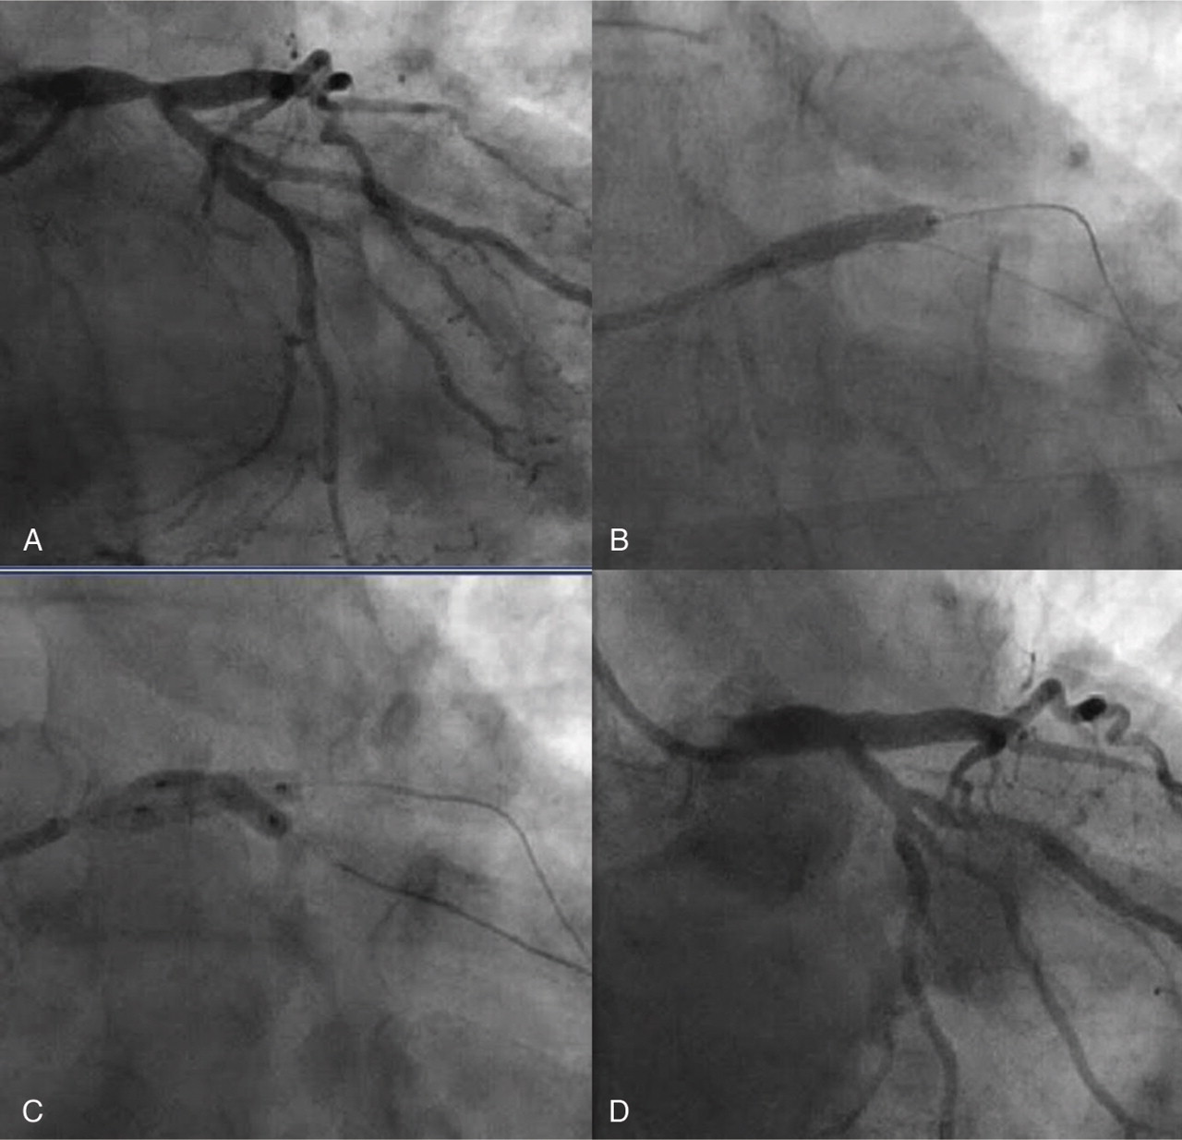
Figure 5 Provisional stenting. (A) Initial appearance. (B) Stent to left main-left anterior descending. (C) Kissing ...
Notes:
Figure 5 Provisional stenting. (A) Initial appearance. (B) Stent to left main-left anterior descending. (C) Kissing balloon post-stent deployment. (D) Final result.
Unless provided in the caption above, the following copyright applies to the content of this slide: Published on behalf of the European Society of Cardiology. All rights reserved. © The Author 2011. For permissions please email: journals.permissions@oup.com

Slide 6
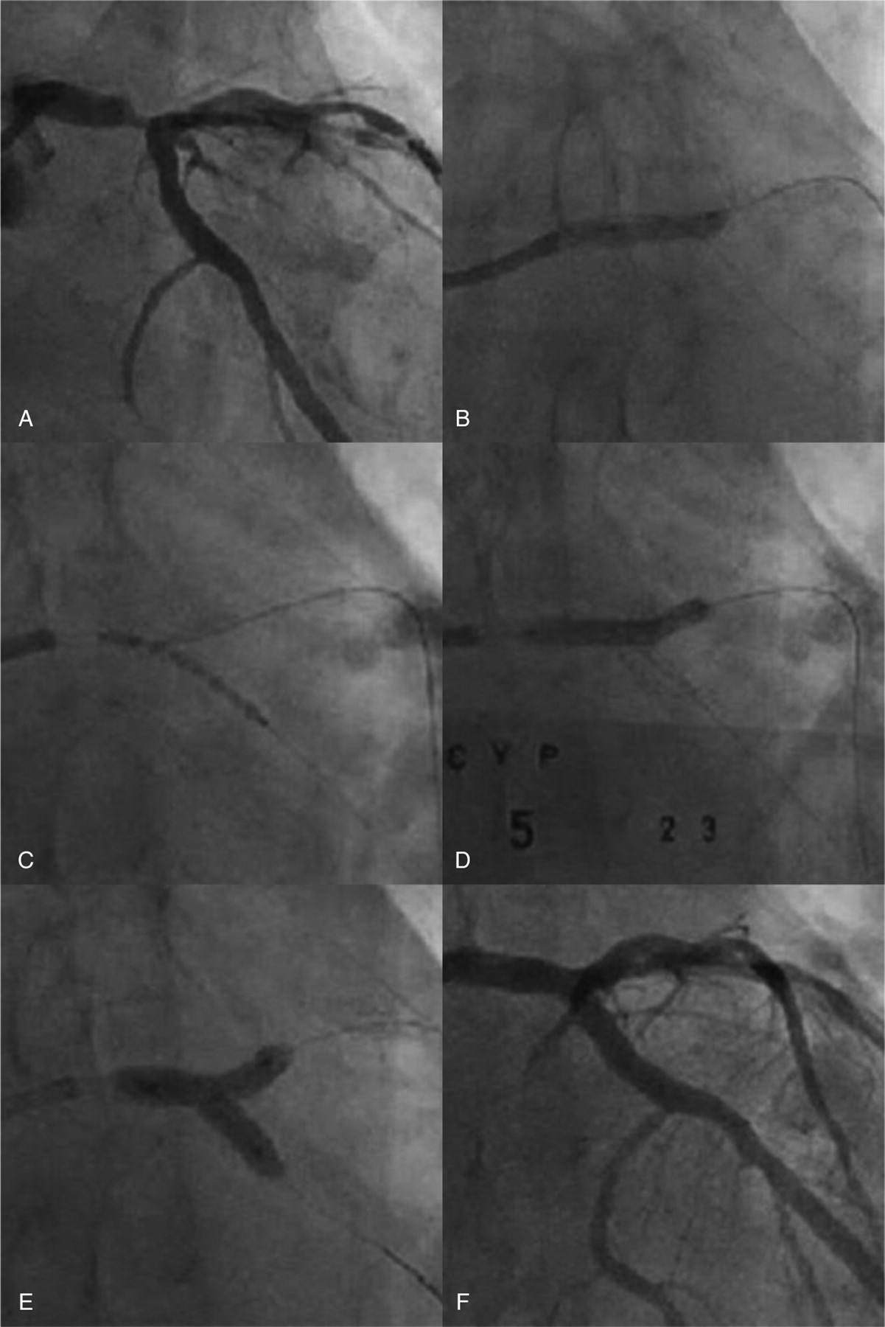
Figure 6 Culotte stenting. (A) Initial appearance. (B) Pre-dilatation of the left anterior descending. (C) First stent ...
Notes:
Figure 6 Culotte stenting. (A) Initial appearance. (B) Pre-dilatation of the left anterior descending. (C) First stent deployed in the left circumflex. (D) Second stent deployed in the left anterior descending after recrossing with wire and pre-dilatation. (E). Kissing balloon post-dilatation. (F) Final result.
Unless provided in the caption above, the following copyright applies to the content of this slide: Published on behalf of the European Society of Cardiology. All rights reserved. © The Author 2011. For permissions please email: journals.permissions@oup.com

Slide 7
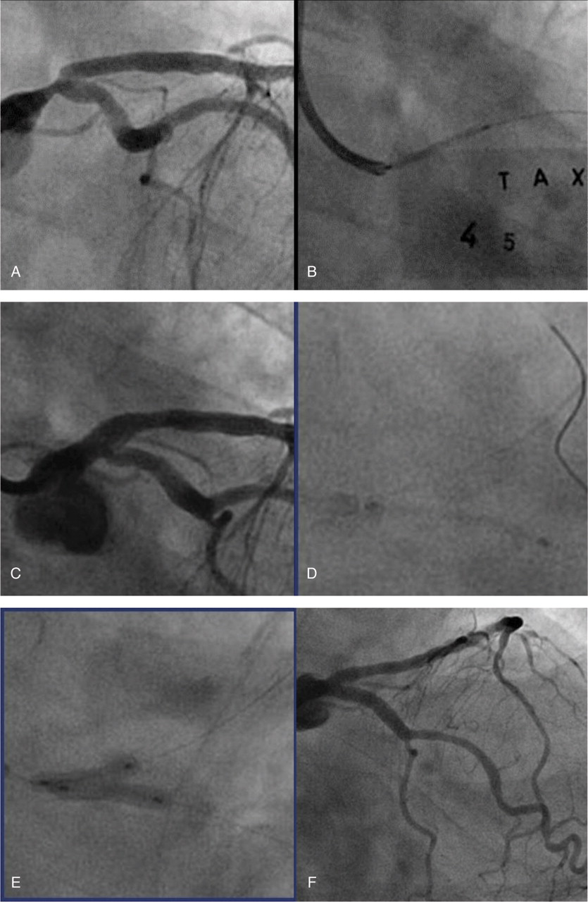
Figure 7 T stenting. (A) Initial appearance. (B) Stent to left main-left anterior descending. (C) Dissection of ostial ...
Notes:
Figure 7 T stenting. (A) Initial appearance. (B) Stent to left main-left anterior descending. (C) Dissection of ostial left circumflex. (D) Advancement of the stent into left circumflex. (E) Kissing balloons. (F) Final result.
Unless provided in the caption above, the following copyright applies to the content of this slide: Published on behalf of the European Society of Cardiology. All rights reserved. © The Author 2011. For permissions please email: journals.permissions@oup.com

Slide 8
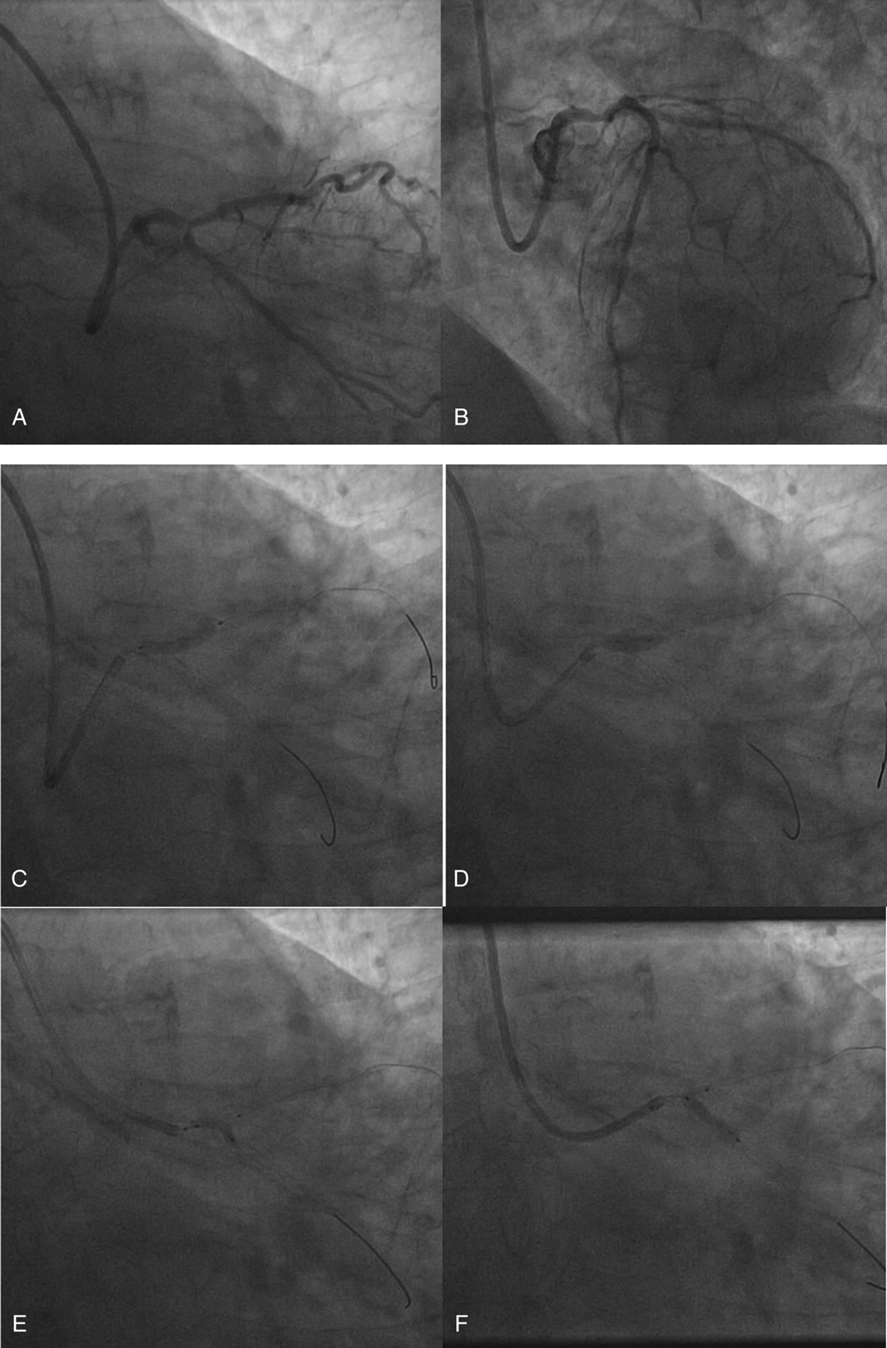
Figure 8 T and protrusion technique. (A and B) Baseline angiography: severe eccentric distal left main stenosis. (C ...
Notes:
Figure 8 T and protrusion technique. (A and B) Baseline angiography: severe eccentric distal left main stenosis. (C and D) 3.5 × 18 mm DES implanted in left main-left anterior descending. Post-dilatation with a 4.0 mm balloon. (E) 2.5 mm balloon inflated in left main-left circumflex through the stent struts. (F) 3.5 × 18 mm drug-eluting stents placed in left circumflex with proximal edge inside the left main and a deflated 3.5 mm balloon in the left main. (G) Final kissing balloon. (H and I) Final angiographic result.
Unless provided in the caption above, the following copyright applies to the content of this slide: Published on behalf of the European Society of Cardiology. All rights reserved. © The Author 2011. For permissions please email: journals.permissions@oup.com

Slide 9
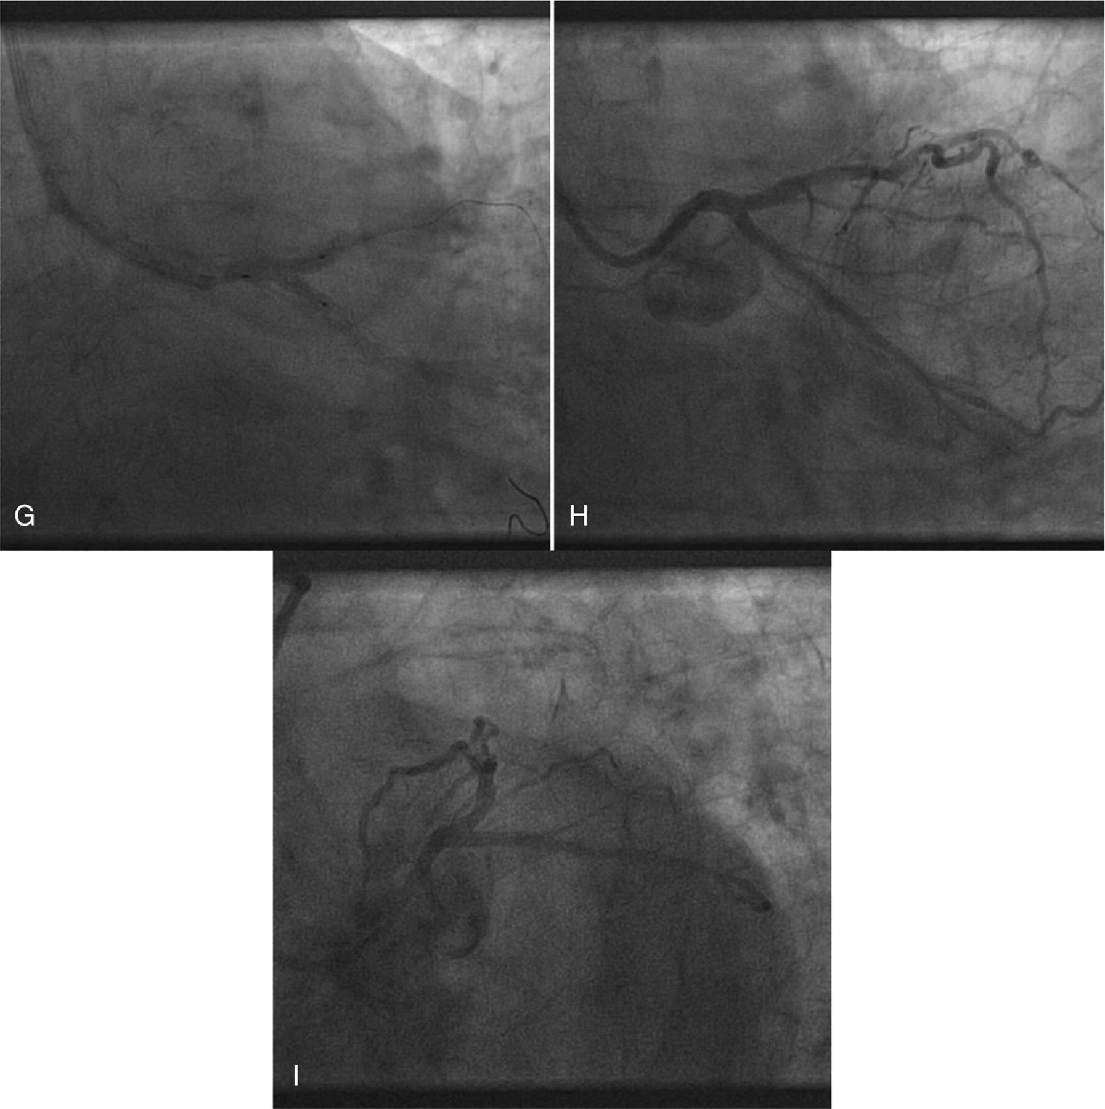
Figure 8 T and protrusion technique. (A and B) Baseline angiography: severe eccentric distal left main stenosis. (C ...
Notes:
Figure 8 T and protrusion technique. (A and B) Baseline angiography: severe eccentric distal left main stenosis. (C and D) 3.5 × 18 mm DES implanted in left main-left anterior descending. Post-dilatation with a 4.0 mm balloon. (E) 2.5 mm balloon inflated in left main-left circumflex through the stent struts. (F) 3.5 × 18 mm drug-eluting stents placed in left circumflex with proximal edge inside the left main and a deflated 3.5 mm balloon in the left main. (G) Final kissing balloon. (H and I) Final angiographic result.
Unless provided in the caption above, the following copyright applies to the content of this slide: Published on behalf of the European Society of Cardiology. All rights reserved. © The Author 2011. For permissions please email: journals.permissions@oup.com

Slide 10
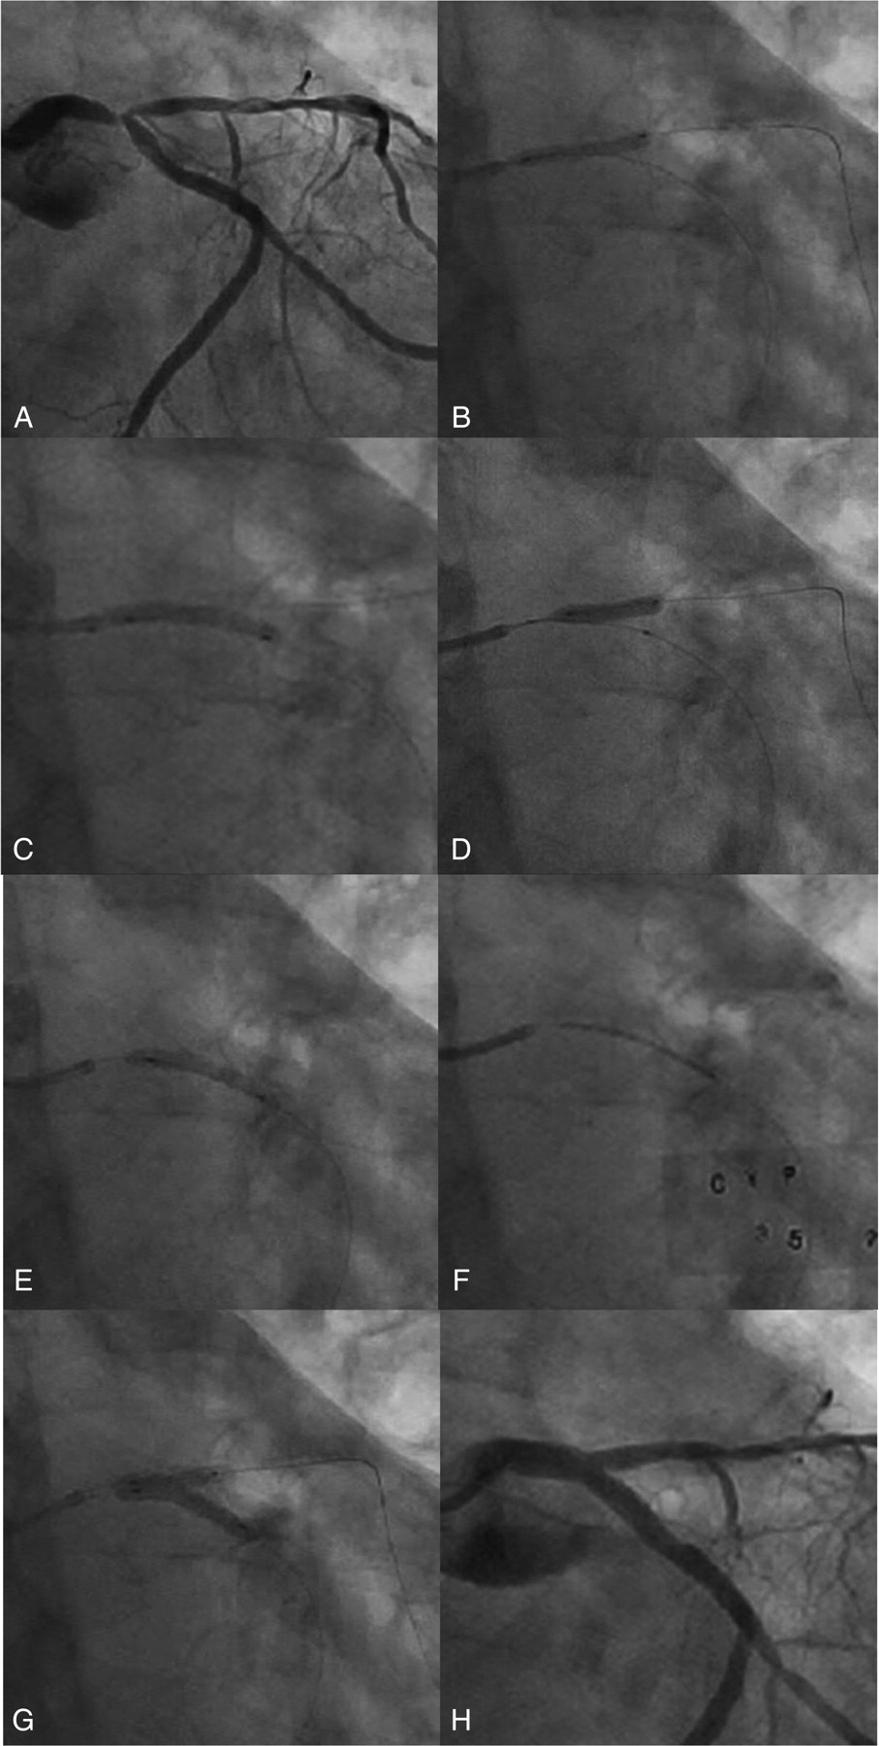
Figure 9 Crush technique. (A) Initial appearance. (B) Pre-dilatation of left anterior descending. (C) Pre-dilatation ...
Notes:
Figure 9 Crush technique. (A) Initial appearance. (B) Pre-dilatation of left anterior descending. (C) Pre-dilatation of left circumflex. (D) Stent to left anterior descending ('side branch' due to large dominant left circumflex). (E) Remove side branch wire and balloon to dilate main vessel (left circumflex) and ‘crush’ side vessel stent. (F) Deploy main vessel. (G) Rewire side branch and ‘kissing balloon’ post-dilate. (H) Final appearance.
Unless provided in the caption above, the following copyright applies to the content of this slide: Published on behalf of the European Society of Cardiology. All rights reserved. © The Author 2011. For permissions please email: journals.permissions@oup.com

Slide 11
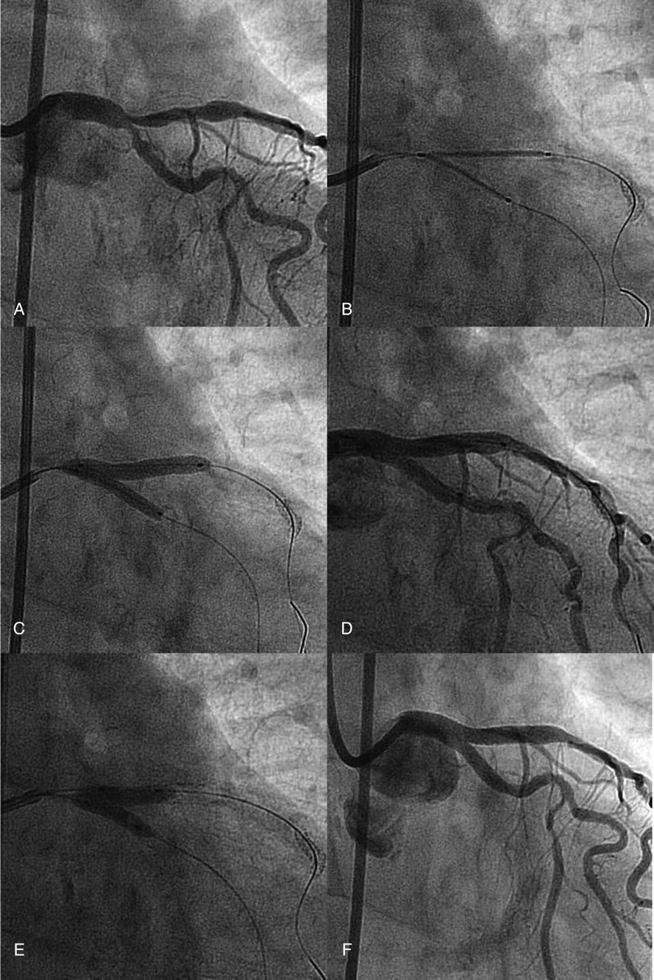
Figure 10 V stenting. (A) Initial appearance (Medina 0,1,1). (B and C) Two drug-eluting stents implanted in left ...
Notes:
Figure 10 V stenting. (A) Initial appearance (Medina 0,1,1). (B and C) Two drug-eluting stents implanted in left anterior descending and left circumflex. (D) Intermediate result. (E) Post-dilatation (kissing). (F) Final angiographic result.
Unless provided in the caption above, the following copyright applies to the content of this slide: Published on behalf of the European Society of Cardiology. All rights reserved. © The Author 2011. For permissions please email: journals.permissions@oup.com

