Slide 1
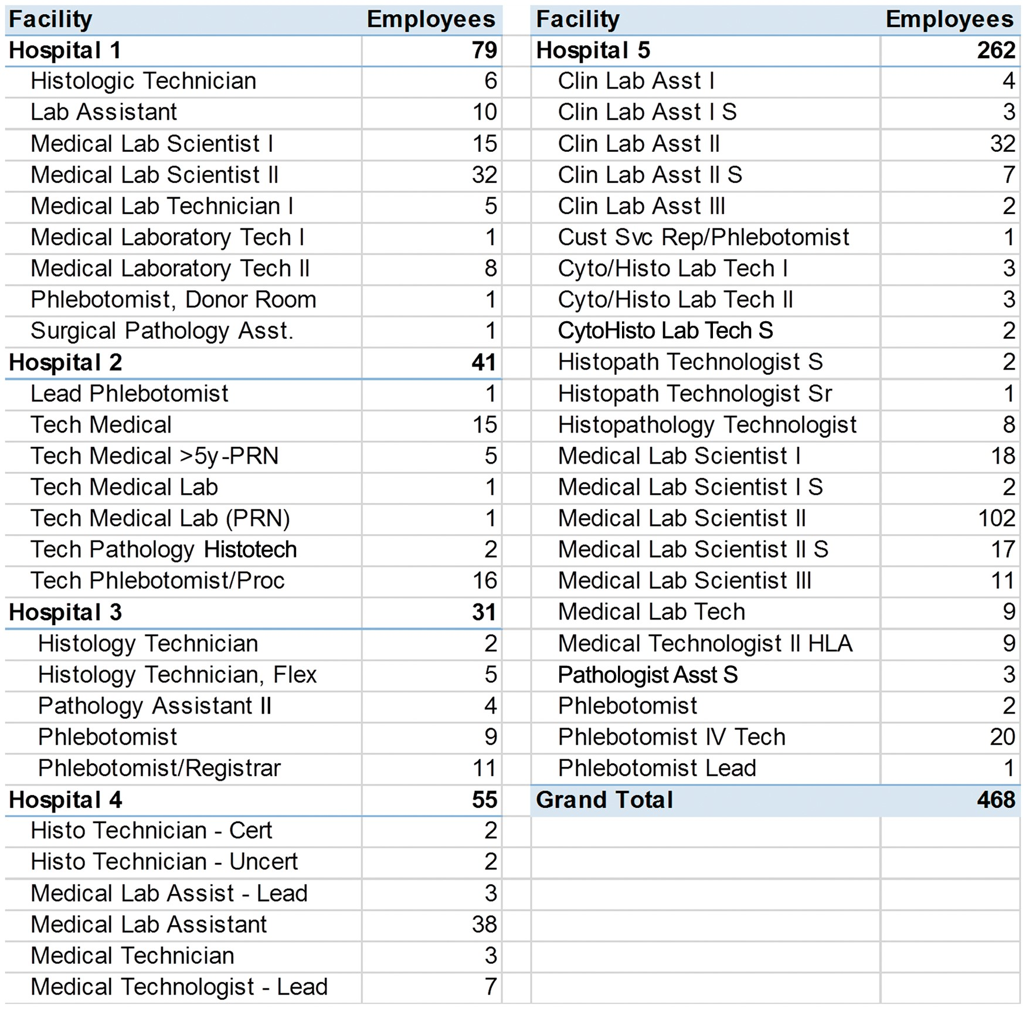
Figure 1 List of combined job titles and full-time employees across the University of Maryland Medical System, ...
Notes:
Figure 1 List of combined job titles and full-time employees across the University of Maryland Medical System, Baltimore, MD.
Unless provided in the caption above, the following copyright applies to the content of this slide: © American Society for Clinical Pathology, 2016. All rights reserved. For permissions, please e-mail: journals.permissions@oup.com

Slide 2
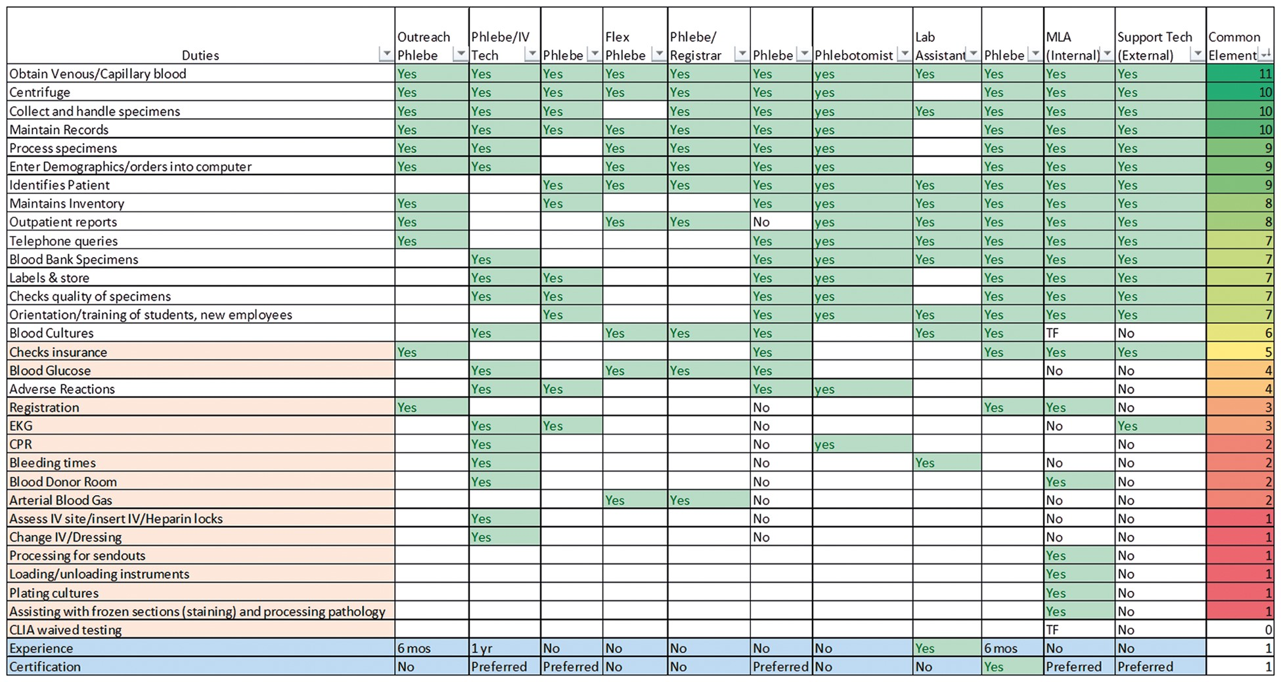
Figure 2 Similarity of tasks among job descriptions for the same type of position across the University of Maryland ...
Notes:
Figure 2 Similarity of tasks among job descriptions for the same type of position across the University of Maryland Medical System, Baltimore, MD.
Unless provided in the caption above, the following copyright applies to the content of this slide: © American Society for Clinical Pathology, 2016. All rights reserved. For permissions, please e-mail: journals.permissions@oup.com

Slide 3
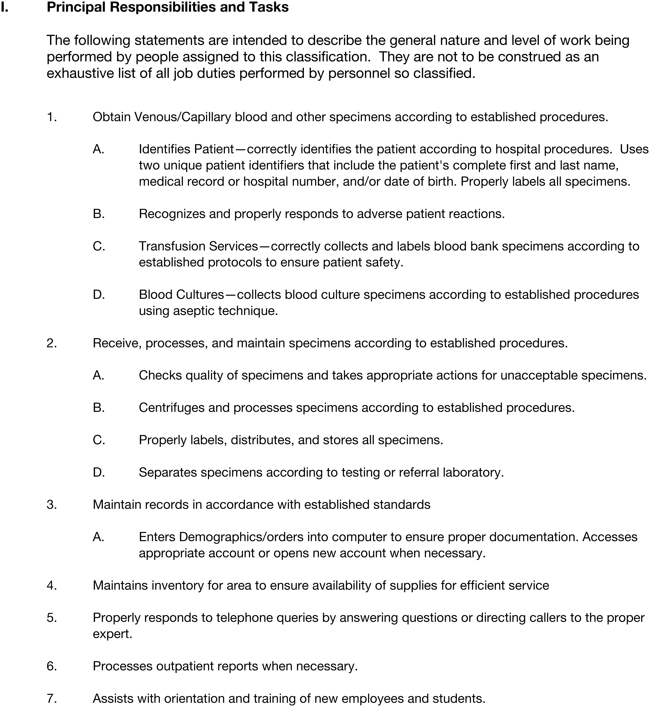
Figure 3 Primary duties of phlebotomists across the University of Maryland Medical System, Baltimore, MD.
Notes:
Figure 3 Primary duties of phlebotomists across the University of Maryland Medical System, Baltimore, MD.
Unless provided in the caption above, the following copyright applies to the content of this slide: © American Society for Clinical Pathology, 2016. All rights reserved. For permissions, please e-mail: journals.permissions@oup.com

Slide 4
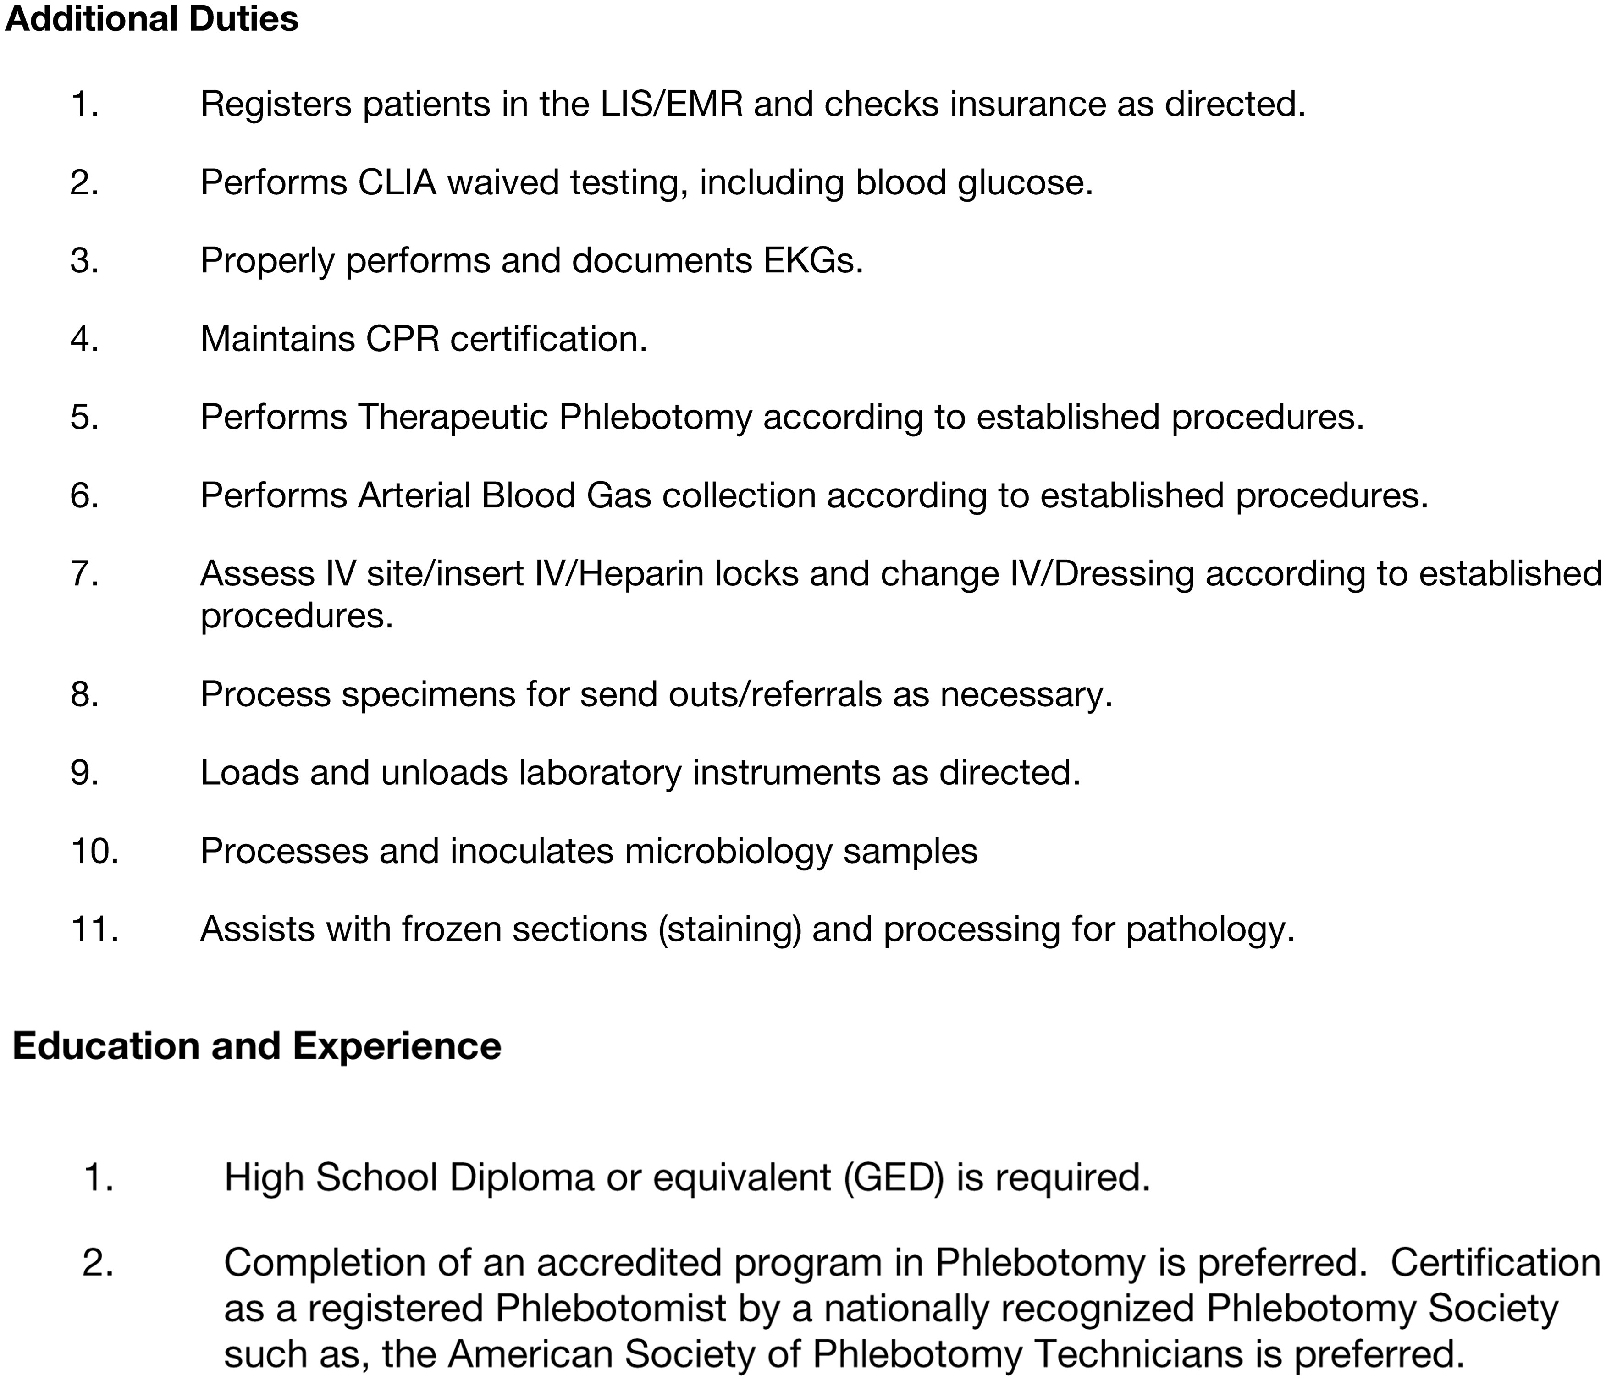
Figure 4 Additional duties that were removed from the primary task in the job description of Phlebotomist for the ...
Notes:
Figure 4 Additional duties that were removed from the primary task in the job description of Phlebotomist for the University of Maryland Medical System, Baltimore, MD, as decided by on consensus of the research group.
Unless provided in the caption above, the following copyright applies to the content of this slide: © American Society for Clinical Pathology, 2016. All rights reserved. For permissions, please e-mail: journals.permissions@oup.com

Slide 5
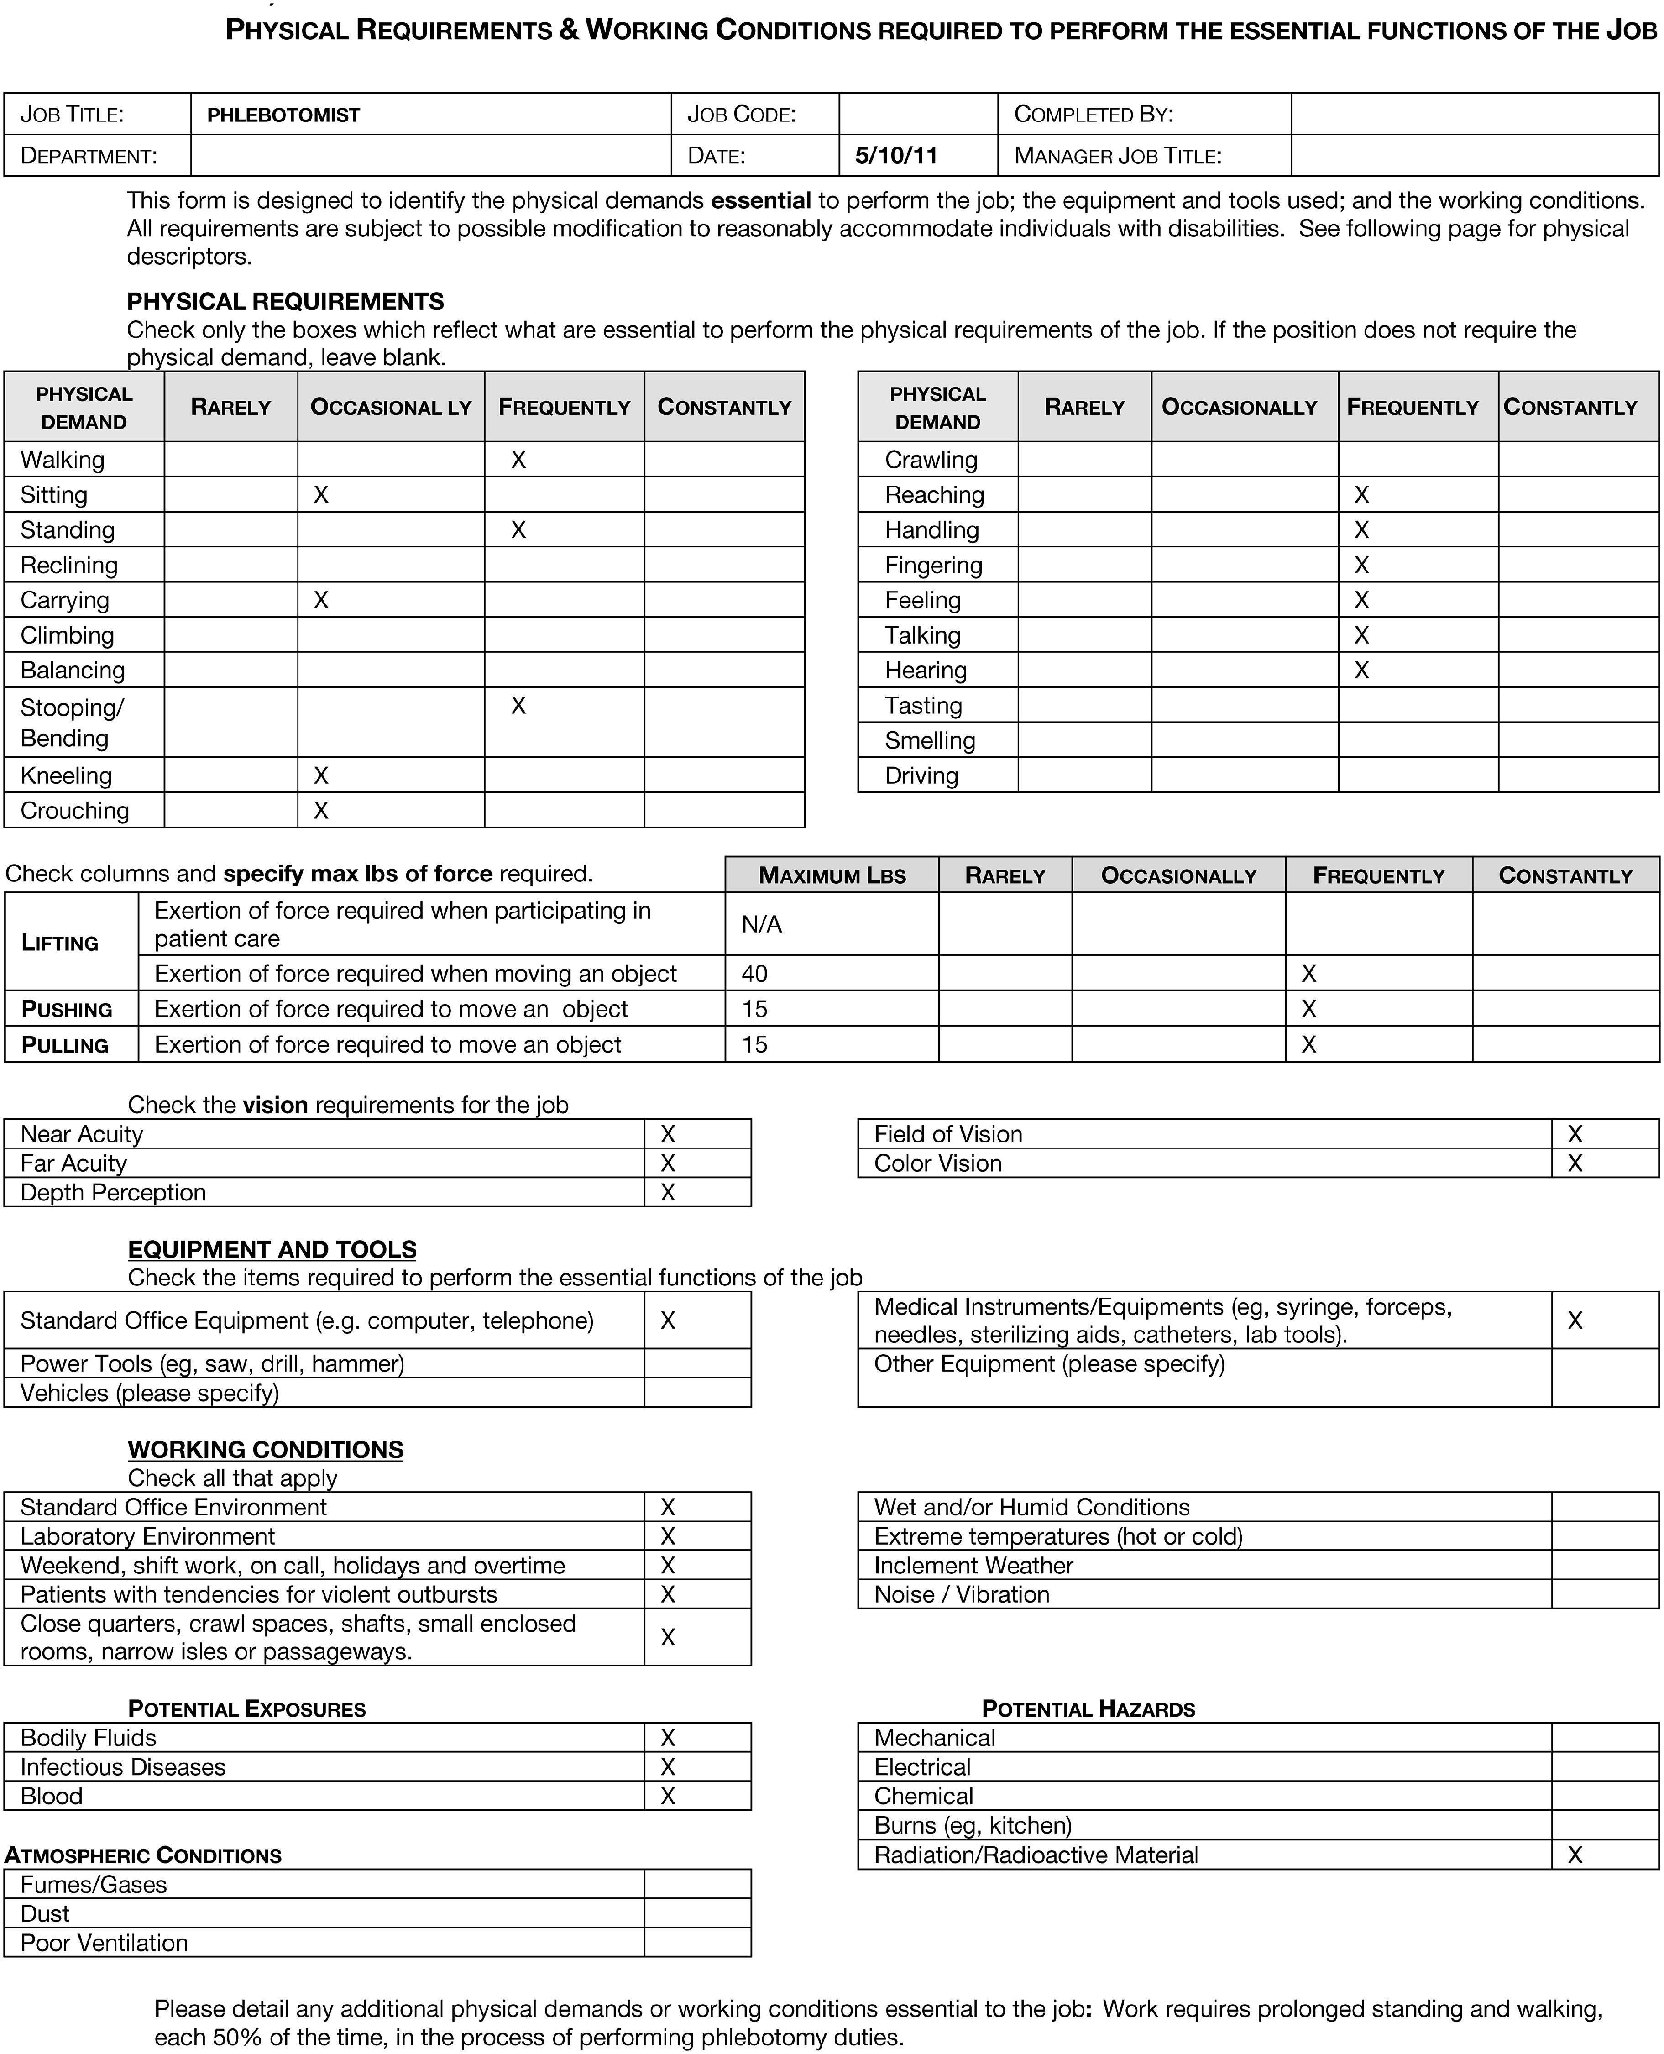
Figure 5 New requirements for the standardized Phlebotomist job description for the University of Maryland Medical ...
Notes:
Figure 5 New requirements for the standardized Phlebotomist job description for the University of Maryland Medical System, Baltimore, MD, as decided by consensus of the research group.
Unless provided in the caption above, the following copyright applies to the content of this slide: © American Society for Clinical Pathology, 2016. All rights reserved. For permissions, please e-mail: journals.permissions@oup.com

Slide 6
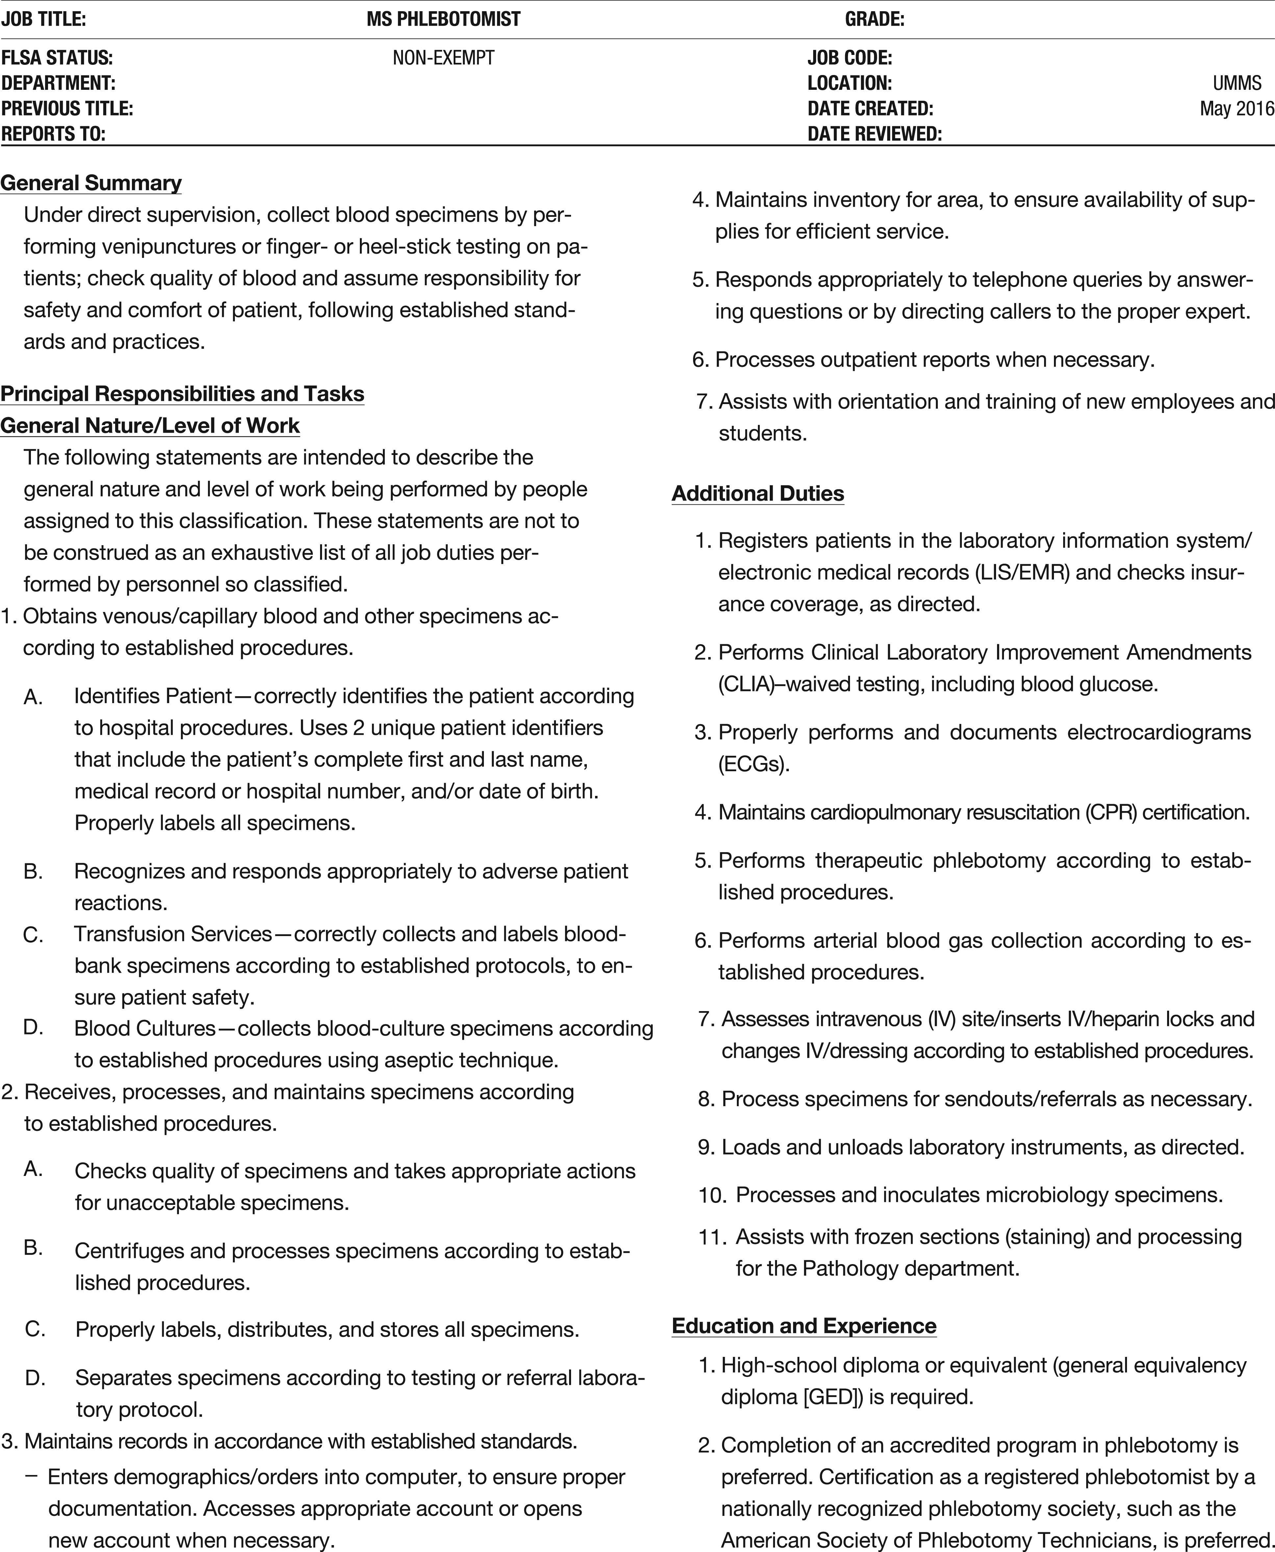
Figure 6 Full job description for the role of Phlebotomist, as standardized based on synthesis of job-description ...
Notes:
Figure 6 Full job description for the role of Phlebotomist, as standardized based on synthesis of job-description language for this position across the University of Maryland Medical System, Baltimore, MD.
Unless provided in the caption above, the following copyright applies to the content of this slide: © American Society for Clinical Pathology, 2016. All rights reserved. For permissions, please e-mail: journals.permissions@oup.com

Slide 7
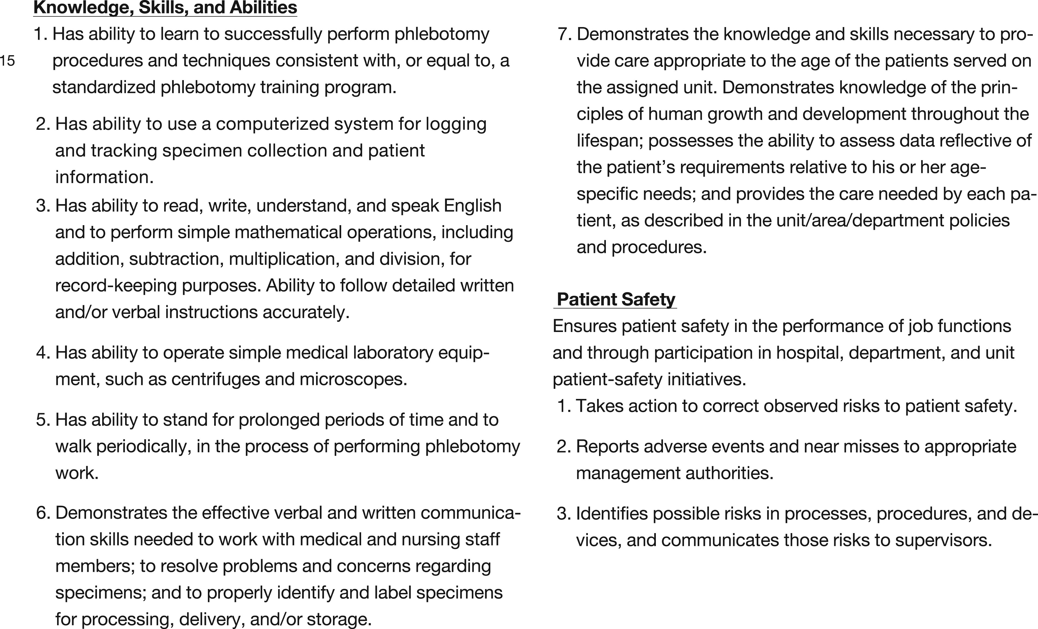
Figure 6 Full job description for the role of Phlebotomist, as standardized based on synthesis of job-description ...
Notes:
Figure 6 Full job description for the role of Phlebotomist, as standardized based on synthesis of job-description language for this position across the University of Maryland Medical System, Baltimore, MD.
Unless provided in the caption above, the following copyright applies to the content of this slide: © American Society for Clinical Pathology, 2016. All rights reserved. For permissions, please e-mail: journals.permissions@oup.com

