Slide 1
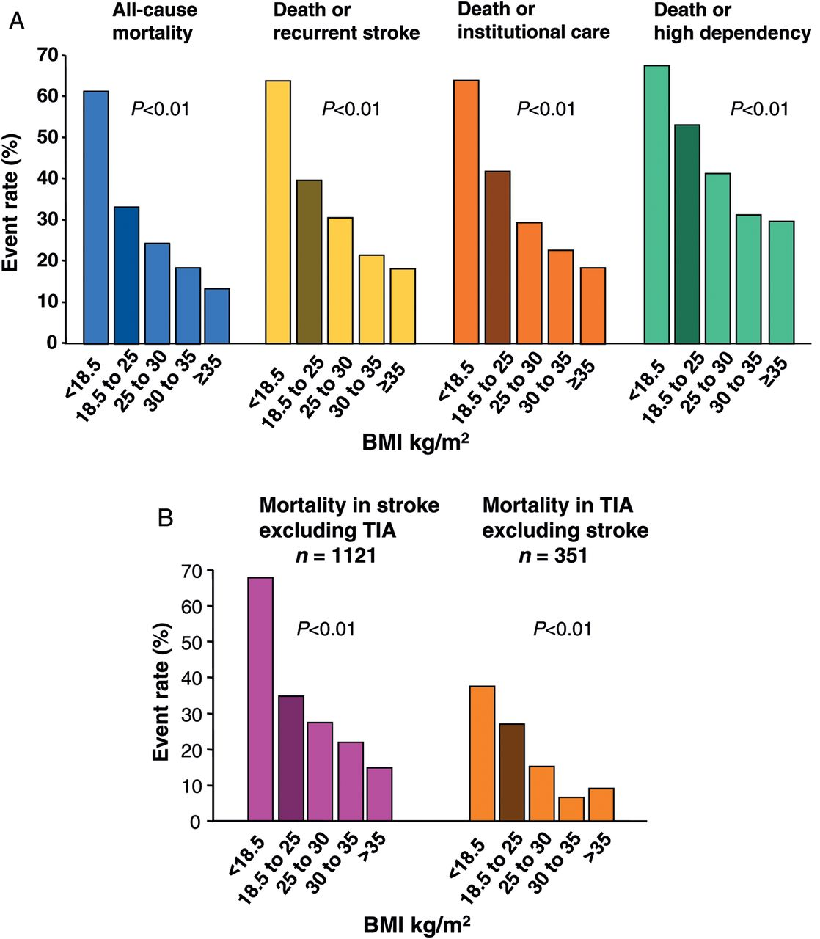
Figure 1 Event rates of outcome variables in patients with stroke or transient ischaemic attack in body mass index ...
Notes:
Figure 1 Event rates of outcome variables in patients with stroke or transient ischaemic attack in body mass index subgroups (A) and mortality separated for patients with stroke and with transient ischaemic attack (B). Normal body mass index range: 18.5–25 kg/m2, dark colour.
Unless provided in the caption above, the following copyright applies to the content of this slide: Published on behalf of the European Society of Cardiology. All rights reserved. © The Author 2012. For permissions please email: journals.permissions@oup.com

Slide 2
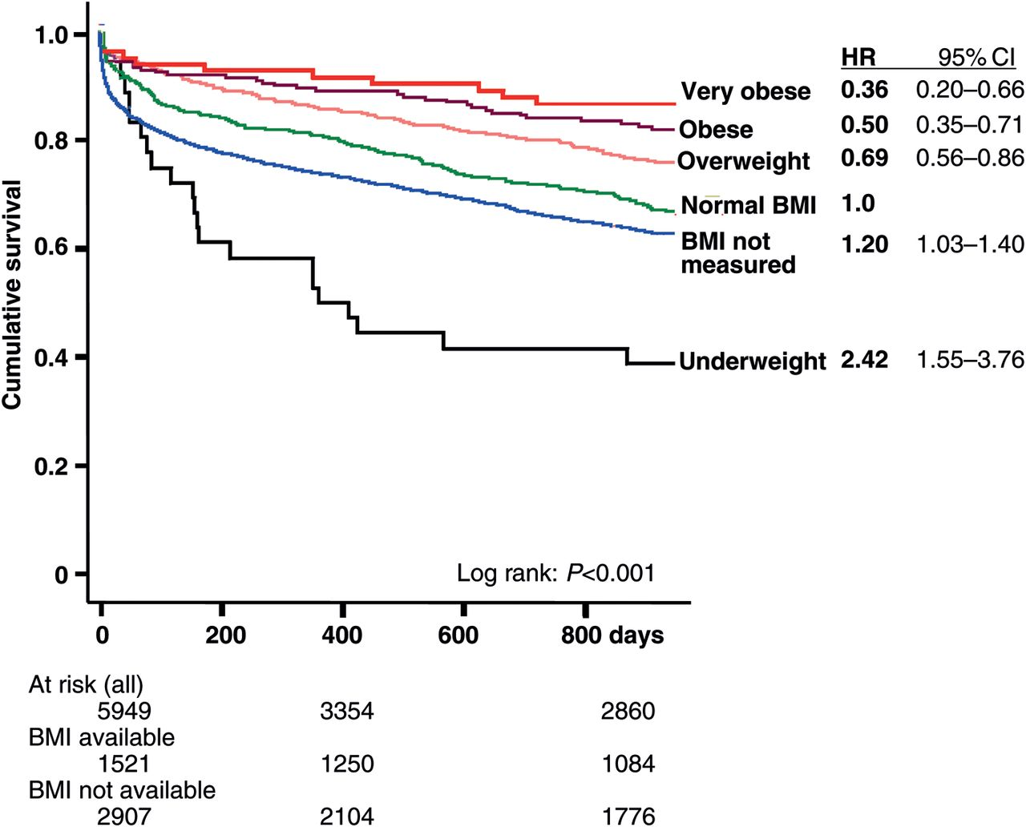
Figure 2 Survival probability over time since stroke for body mass index subgroups (univariable analysis). The ...
Notes:
Figure 2 Survival probability over time since stroke for body mass index subgroups (univariable analysis). The Kaplan–Meyer survival plot and odds ratios with 95% CI are presented.
Unless provided in the caption above, the following copyright applies to the content of this slide: Published on behalf of the European Society of Cardiology. All rights reserved. © The Author 2012. For permissions please email: journals.permissions@oup.com

