Slide 1
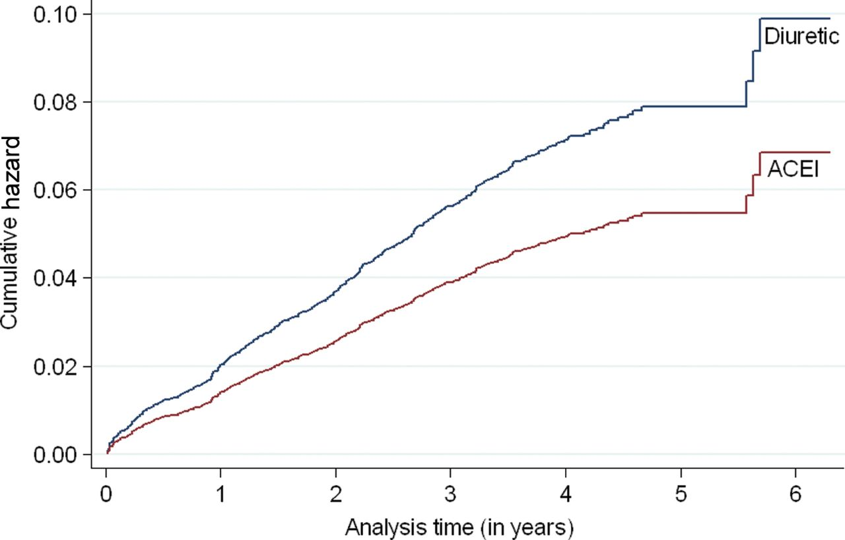
Figure 1. Hazards of developing newly diagnosed diabetes by treatment group in elderly hypertensive patients during the ...
Notes:
Figure 1. Hazards of developing newly diagnosed diabetes by treatment group in elderly hypertensive patients during the Second Australian National Blood Pressure clinical trial. Abbreviation: ACEI, angiotensin-converting enzyme inhibitor.
Unless provided in the caption above, the following copyright applies to the content of this slide: © American Journal of Hypertension, Ltd 2013. All rights reserved. For Permissions, please email: journals.permissions@oup.com

Slide 2
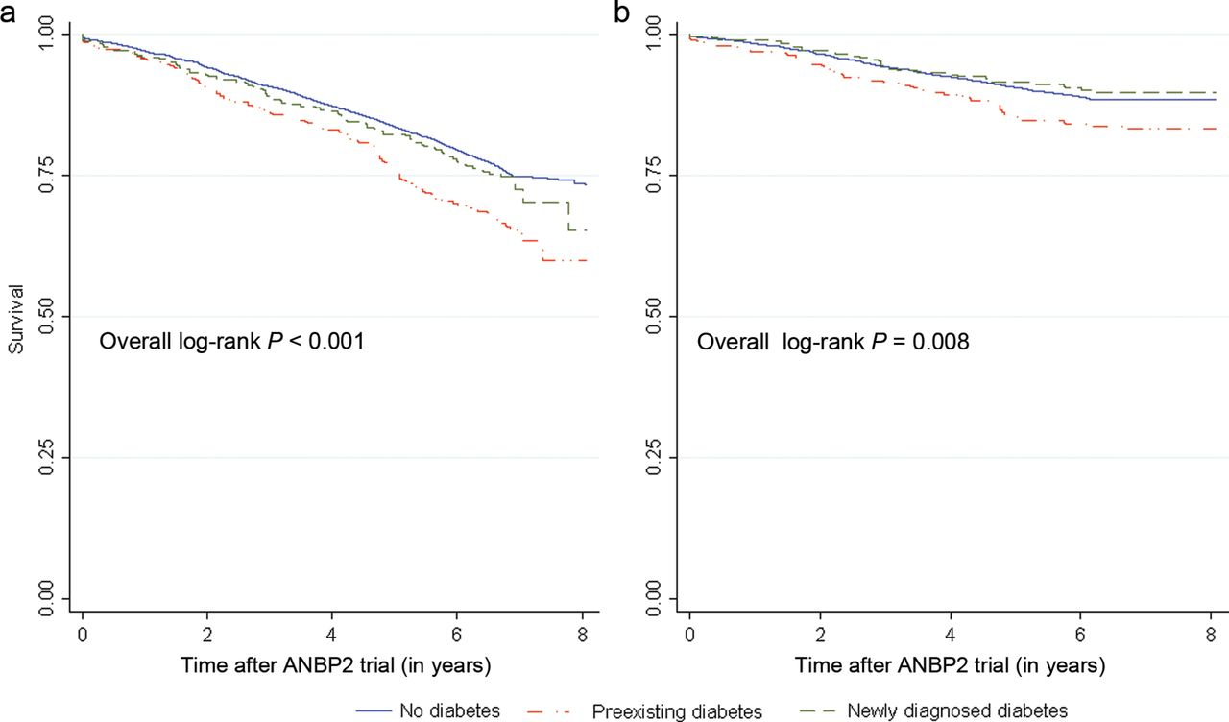
Figure 2. Kaplan–Meier survival curves for all-cause (a) and cardiovascular (b) mortality among the elderly cohort ...
Notes:
Figure 2. Kaplan–Meier survival curves for all-cause (a) and cardiovascular (b) mortality among the elderly cohort after the Second Australian National Blood Pressure (ANBP2) clinical trial by diabetes status.
Unless provided in the caption above, the following copyright applies to the content of this slide: © American Journal of Hypertension, Ltd 2013. All rights reserved. For Permissions, please email: journals.permissions@oup.com

