Slide 1
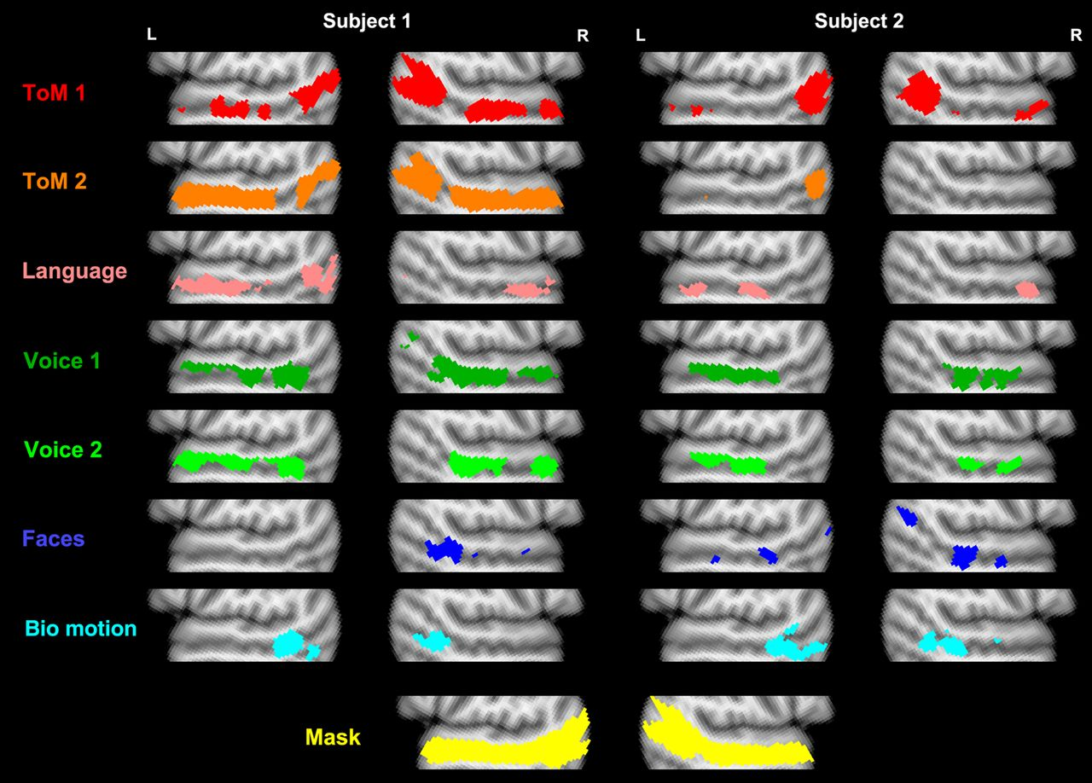
Figure 1. Individual-subject activations to 7 different contrasts in 2 representative example subjects. Analyses were ...
Notes:
Figure 1. Individual-subject activations to 7 different contrasts in 2 representative example subjects. Analyses were restricted to the bilateral STS mask shown in yellow at the bottom, and were thresholded at a false discovery rate of q < 0.01. The slices displayed are at MNI x-coordinate ± 52 .
Unless provided in the caption above, the following copyright applies to the content of this slide: © The Author 2015. Published by Oxford University PressThis is an Open Access article distributed under the terms of the Creative Commons Attribution Non-Commercial License (http://creativecommons.org/licenses/by-nc/4.0/), which permits non-commercial re-use, distribution, and reproduction in any medium, provided the original work is properly cited. For commercial re-use, please contact journals.permissions@oup.com

Slide 2
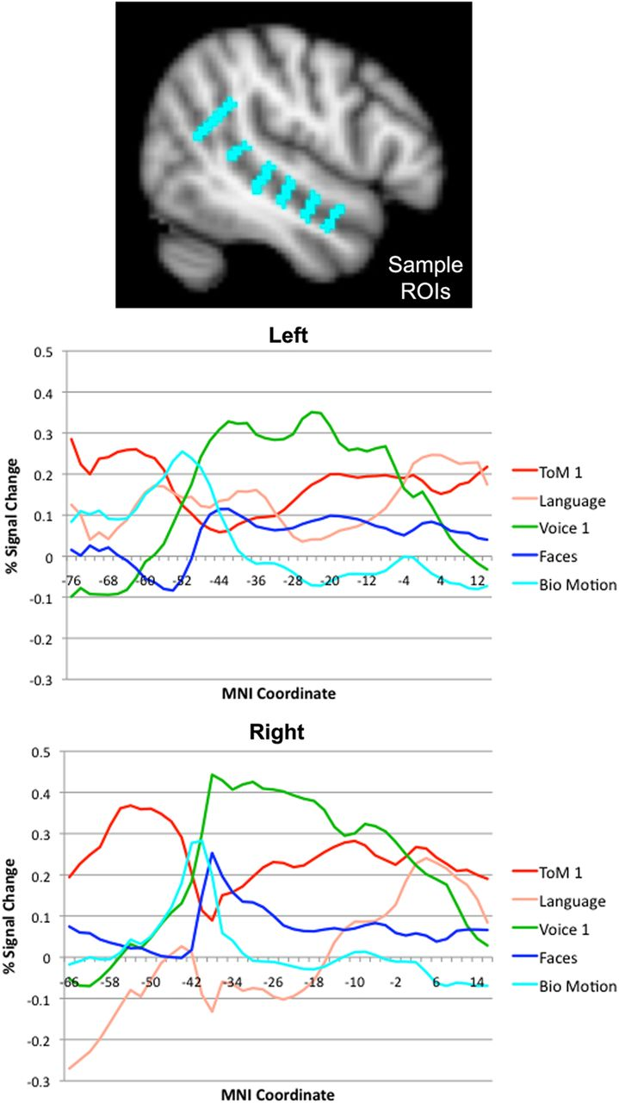
Figure 2. Responses to each task as a function of position along the length of the STS. The upper figure shows the ROIs ...
Notes:
Figure 2. Responses to each task as a function of position along the length of the STS. The upper figure shows the ROIs that were used to extract responses at each position. The lower 2 graphs show left and right STS responses (percent signal change) for each task, as a function of y-coordinate in MNI space.
Unless provided in the caption above, the following copyright applies to the content of this slide: © The Author 2015. Published by Oxford University PressThis is an Open Access article distributed under the terms of the Creative Commons Attribution Non-Commercial License (http://creativecommons.org/licenses/by-nc/4.0/), which permits non-commercial re-use, distribution, and reproduction in any medium, provided the original work is properly cited. For commercial re-use, please contact journals.permissions@oup.com

Slide 3
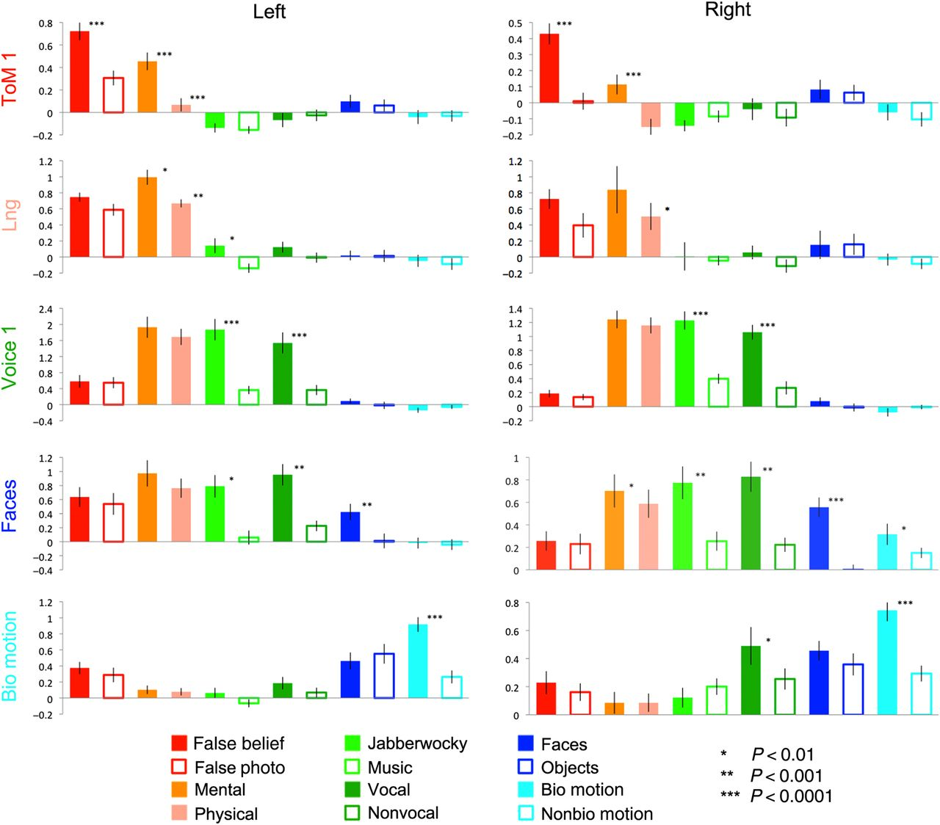
Figure 3. Responses (in percent signal change) of maximally sensitive regions for each contrast, across all conditions. ...
Notes:
Figure 3. Responses (in percent signal change) of maximally sensitive regions for each contrast, across all conditions. Responses were measured in data independent of those used to define the ROIs.
Unless provided in the caption above, the following copyright applies to the content of this slide: © The Author 2015. Published by Oxford University PressThis is an Open Access article distributed under the terms of the Creative Commons Attribution Non-Commercial License (http://creativecommons.org/licenses/by-nc/4.0/), which permits non-commercial re-use, distribution, and reproduction in any medium, provided the original work is properly cited. For commercial re-use, please contact journals.permissions@oup.com

Slide 4
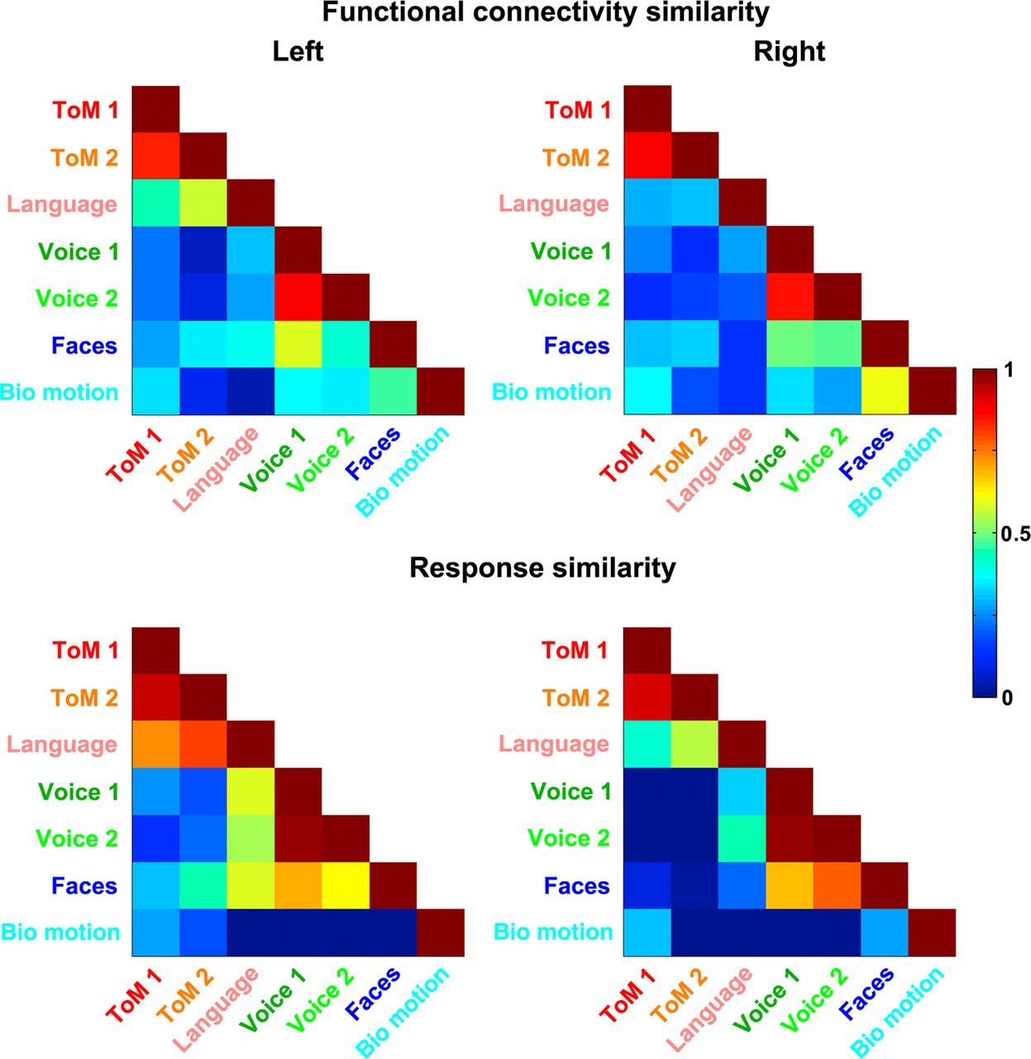
Figure 4. Matrices of functional connectivity similarity (correlations between whole-brain resting-state functional ...
Notes:
Figure 4. Matrices of functional connectivity similarity (correlations between whole-brain resting-state functional connectivity maps of seed ROIs defined by each contrast) and response similarity (correlations between vectors of task responses from each seed ROI). ROIs are defined to consist of a focal region of maximal activation to a given contrast.
Unless provided in the caption above, the following copyright applies to the content of this slide: © The Author 2015. Published by Oxford University PressThis is an Open Access article distributed under the terms of the Creative Commons Attribution Non-Commercial License (http://creativecommons.org/licenses/by-nc/4.0/), which permits non-commercial re-use, distribution, and reproduction in any medium, provided the original work is properly cited. For commercial re-use, please contact journals.permissions@oup.com

Slide 5
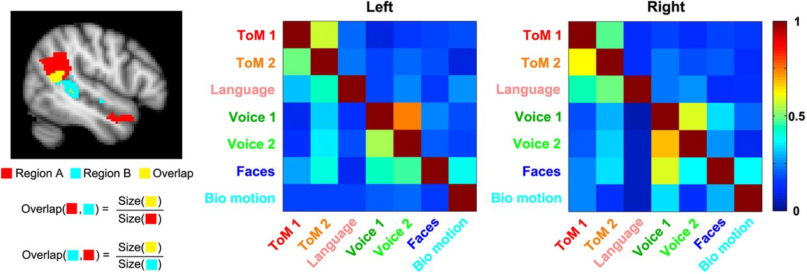
Figure 5. Overlap matrices for regions of activation defined by each task contrast. Each cell in a given overlap matrix ...
Notes:
Figure 5. Overlap matrices for regions of activation defined by each task contrast. Each cell in a given overlap matrix is equal to the size of the overlapping region for the tasks on the corresponding row and column, divided by the size of the region of activation for the task on that row, as shown in the graphic on the left-hand side.
Unless provided in the caption above, the following copyright applies to the content of this slide: © The Author 2015. Published by Oxford University PressThis is an Open Access article distributed under the terms of the Creative Commons Attribution Non-Commercial License (http://creativecommons.org/licenses/by-nc/4.0/), which permits non-commercial re-use, distribution, and reproduction in any medium, provided the original work is properly cited. For commercial re-use, please contact journals.permissions@oup.com

Slide 6
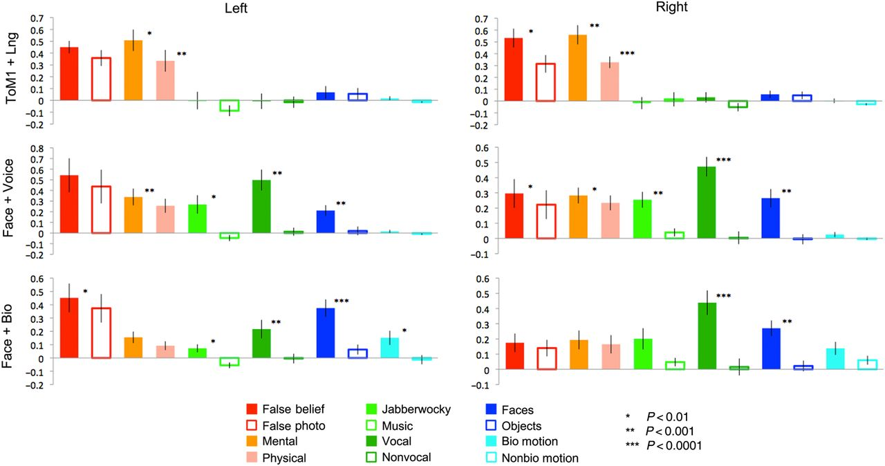
Figure 6. Responses (in percent signal change) of overlapping regions responsive to multiple contrasts, across all ...
Notes:
Figure 6. Responses (in percent signal change) of overlapping regions responsive to multiple contrasts, across all conditions. Responses were measured in data independent of those used to define the ROIs.
Unless provided in the caption above, the following copyright applies to the content of this slide: © The Author 2015. Published by Oxford University PressThis is an Open Access article distributed under the terms of the Creative Commons Attribution Non-Commercial License (http://creativecommons.org/licenses/by-nc/4.0/), which permits non-commercial re-use, distribution, and reproduction in any medium, provided the original work is properly cited. For commercial re-use, please contact journals.permissions@oup.com

