Slide 1
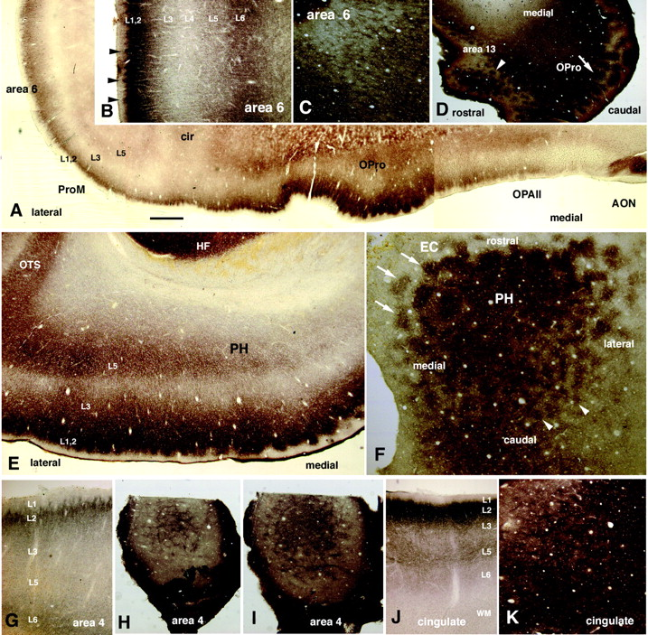
Figure 1. Micromodular organization at the border of layers 1 and 2 visualized by zinc histochemistry. (A) ...
Notes:
Figure 1. Micromodular organization at the border of layers 1 and 2 visualized by zinc histochemistry. (A) Caudal part of orbitofrontal cortex [rostrocaudal (RC) level is indicated by line in Fig. 2D]. The largest modules occur in proisocortex (OPro) and the module size becomes smaller laterally, at left. (B) Higher magnification of ventral area 6 (premotor cortex) on the lateral surface (coronal section). Arrowheads point to several small patches of Zn+ terminations protruding into layer 1. (C) Tangential section of thin patches of Zn+ terminations in ventral area 6. (D) Tangential section of Zn+ patches in the caudal part of orbitofrontal cortex. The arrow points to large patches in OPro and the arrowhead to a field of smaller patches in area 13. (E) Coronal section of the parahippocampal area just caudal to entorhinal cortex (RC level is indicated by line in Fig. 2F). (F) Tangential section through the parahippocampal area. Large patches (arrows) occur in area TH immediately caudal to the EC, but further caudally these grade into a smaller scale pattern (arrowheads). (G) Coronal section of primary motor cortex (area 4). (RC level is indicated by short line in Fig. 2D.) (H, I) Serial tangential sections of small scale pattern in area 4. (J) Coronal section of the rostral cingulate cortex. (RC level is indicated by short line in Fig. 2E.) (K) Tangential sections of a small scale periodicity in the rostral cingulate cortex. Abbreviations: AON, anterior olfactory nucleus; cir; circular sulcus; EC, entorhinal cortex; HF, hippocampal formation; OPAll, orbitofrontal periallocortex; OTS, occipitotemporal sulcus; PH, parahippocampal cortex; ProM, area ProM. Scale bars = 1 mm (A, D); 500 µm (B, C, G–K); 220 µm (E, F).
Unless provided in the caption above, the following copyright applies to the content of this slide:

Slide 2
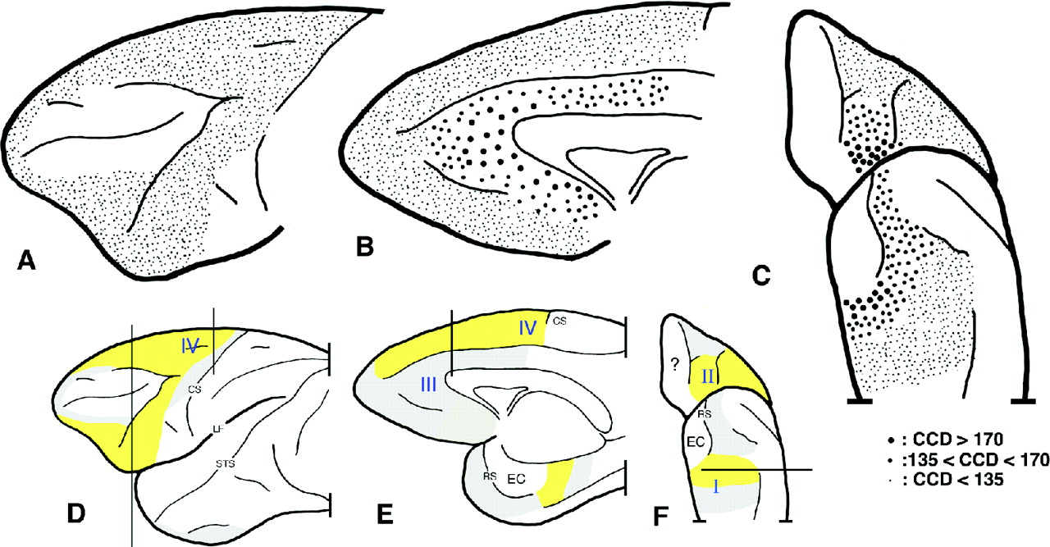
Figure 2. Schematic brain diagrams (A, D, lateral view; B, E, medial view; C, F, ventral view). (A–C) Size ...
Notes:
Figure 2. Schematic brain diagrams (A, D, lateral view; B, E, medial view; C, F, ventral view). (A–C) Size distribution of Zn+ modules according to large, medium and smaller size (large filled circle = CCD > 170 µm; medium sized filled circle = 170 µm > CCD > 135 µm; small dots = CCD < 135 µm). (D–F) Areas with a conspicuous modularity of Zn+ terminations are indicated in yellow shading and those where the modularity is more subtle are in gray. Subtle modularity may only be detected in tangential sections. Regions without perceptible Zn+ modularity are in white. In the lateral part of gyrus rectus, high curvature (owing to its location at the hemispheric edge) hindered confident assessment of periodicity (marked by ?). The full and short lines in D–F show RC level of coronal section in Fig. 1A, E, G and J. Roman numbers I–IV indicate the four regions described in detail in the Results. Abbreviations: CS, central sulcus; EC, entorhinal cortex; LF, lateral fissure; RS, rhinal sulcus; STS, superior temporal sulcus.
Unless provided in the caption above, the following copyright applies to the content of this slide:

Slide 3
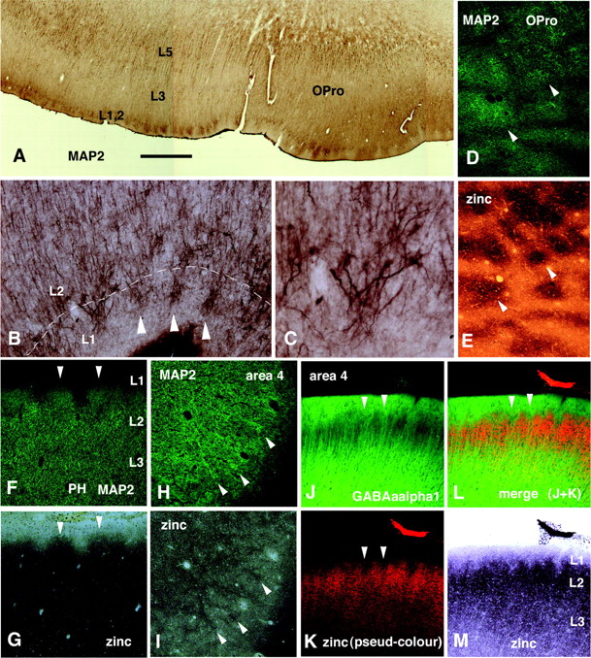
Figure 3. Micromodular organization at the border of layers 1 and 2 visualized by dendritic markers (MAP2 and ...
Notes:
Figure 3. Micromodular organization at the border of layers 1 and 2 visualized by dendritic markers (MAP2 and GABAaα1). (A–C) Coronal sections showing MAP2 positive dendritic clusters (arrowheads in B) at the caudal part of orbitofrontal cortex (the section in A is adjacent to that illustrated in Fig. 1A). C is higher magnification of B. (D, E) Tangential section from area OPro, double labeled with MAP2 (D) and zinc (E). (F, G) Coronal section through area TH, double-labeled for MAP2(F) and zinc (G). (H, I) Semi-tangential section through area 4, double labeled for MAP2 (H) and zinc (I). (J–M) Coronal section through area 4 double-labeled for zinc and GABAaα1. For convenience, in K, zinc images were converted to pseudo-red-colour. In D–M, arrowheads point to the same locations in the pairs of double-labeled images. Scale bars = 1 mm (A); 160 µm (B, D–M), 80 µm (C).
Unless provided in the caption above, the following copyright applies to the content of this slide:

Slide 4
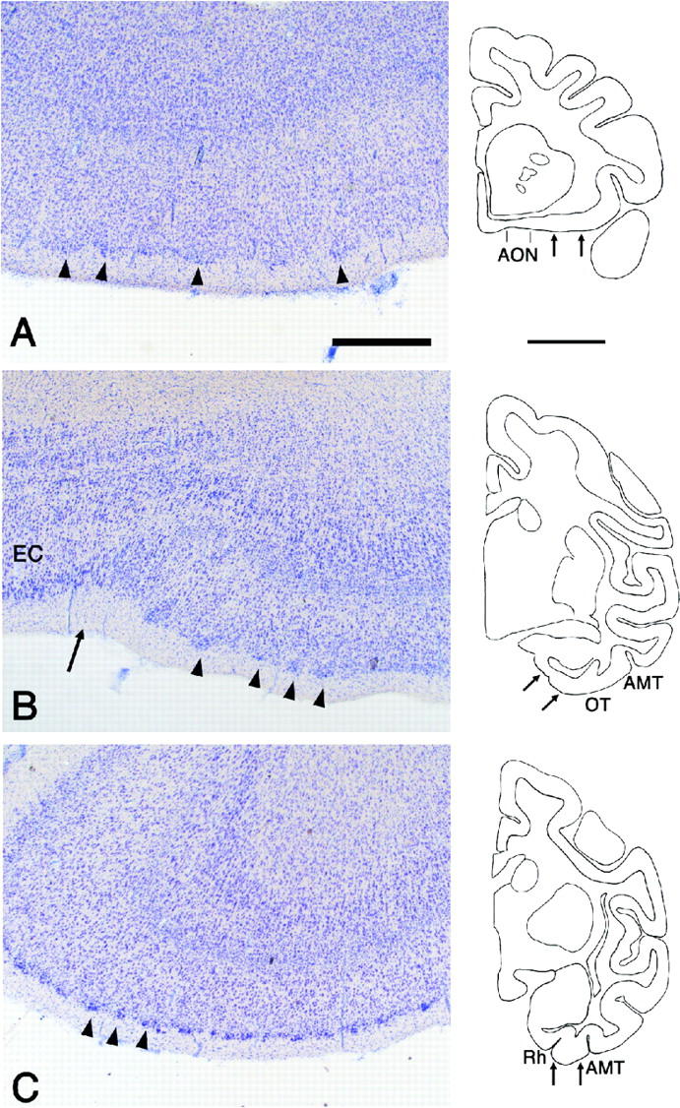
Figure 4. Three areas with prominent aggregations of cell bodies in layer 2. Coronal section outlines in the ...
Notes:
Figure 4. Three areas with prominent aggregations of cell bodies in layer 2. Coronal section outlines in the right column show the areas (arrows) from which the pictures were taken. (A) OPro. (B) Perirhinal cortex (area 36) adjacent to the caudal border of the entorhinal cortex (EC). An arrow (left column) points to the caudal tip of the rhinal sulcus. (C) Rostral perirhinal cortex (area 36). For all three images in the left column, medial is to the left and dorsal at the top (as in the section outlines). Arrowheads point to cell clusters. Abbreviations: AMT, anterior middle temporal sulcus; AON, anterior olfactory nucleus; OT, occipitotemporal sulcus; Rh, rhinal sulcus. Scale bars = 1 mm (left column); 5 mm (right column).
Unless provided in the caption above, the following copyright applies to the content of this slide:

Slide 5
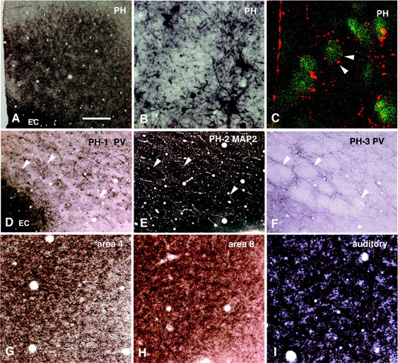
Figure 5. Micromodularity in layers 1 and 2, visualized by PV and MAP2. Images are from the border between ...
Notes:
Figure 5. Micromodularity in layers 1 and 2, visualized by PV and MAP2. Images are from the border between layers 1 and 2, except for F, which does not involve layer 2. (A) Tangential section through the parahippocampal area (PH) stained for PV. Rostral is to left, and lateral at the top. Low magnification is intended to show size gradation. (B) Higher magnification of tangential section of the PH to show PV-ir elements. (C) Merged confocal images from the border between layers 1 and 2 of PH (red, PV; green, neurotrace labeled neuronal somata). Arrowheads point to PV-ir basket-like terminals surrounding somata. A vertically ascending PV-ir dendrite is visible at left. (D–F) Serial tangential sections of PH to show spatial relationship of PV-ir and MAP2-ir modular organization. Rostral is to the left and lateral at the top. Two tangential sections are stained for PV (D, F) and the intervening section for MAP2 (E). D is deepest (at the uppermost part of layer 2) and F is more superficial (middle of layer 1). Arrowheads point to corresponding patches in all three sections. Note correspondence of PV (D) and MAP2 (E) and interdigitation of MAP2 dendrites (E) with PV-ir fiber plexus (F). (G–I) Tangential sections through area 4 (G), area 8 (H) and primary auditory cortex (I). Abbreviation: EC, entorhinal cortex; PH, parahippocampal area. Scale bars = 300 µm (A); 100 µm (B); 20 µm (C); 200 µm (D–F); 160 µm (G–I).
Unless provided in the caption above, the following copyright applies to the content of this slide:

Slide 6
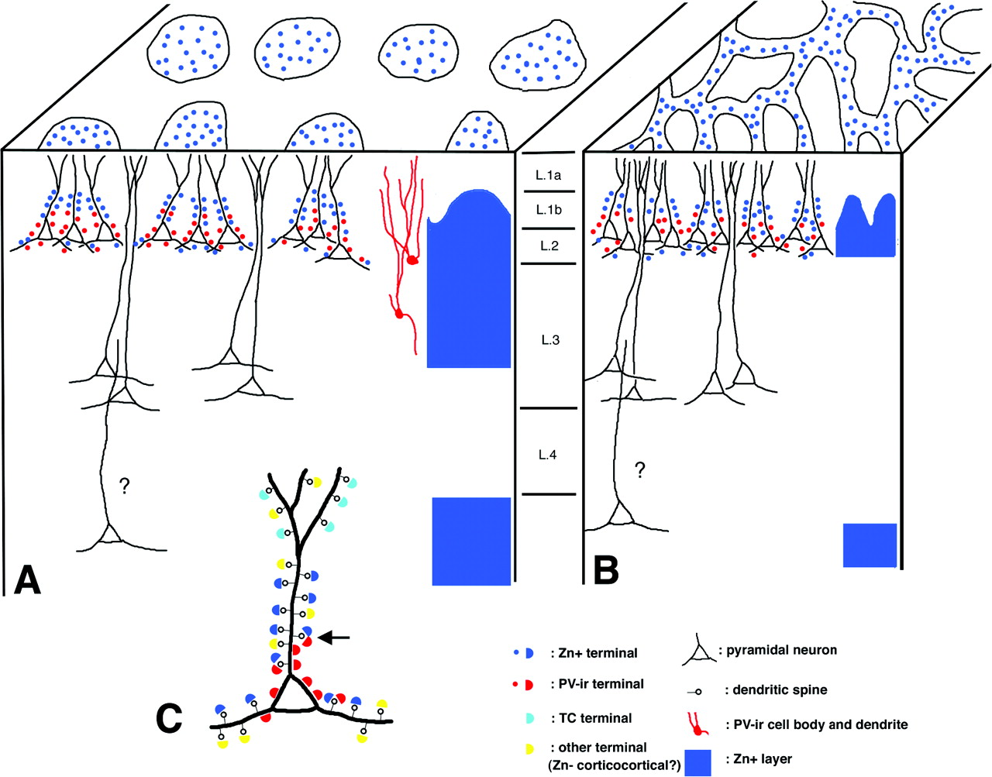
Figure 6. Highly schematic summary of the micromodularity of layers 1 and 2 of the monkey cerebral cortex. ...
Notes:
Figure 6. Highly schematic summary of the micromodularity of layers 1 and 2 of the monkey cerebral cortex. Cubes in A and B represent coronal views (en face) and tangential views (top surface) of two areas, with larger-scale (A) and smaller-scale (B) modularity. The laminar distribution of Zn+ terminals is represented at the right edge of each cube in solid blue. An important factor in the size and shape of the modularity may be the arrangement of the apical dendritic bundles of layer 2 pyramidal neurons, which are suggested to be a segregated system. This may range from conspicuous aggregation (in A) to a semi-covert aggregation (in B). Dendrites, labeled by GABAaα1 and arising from layer 3 (and/or layer 5, indicated by ?), may also be segregated. In the figure, PV-ir and Zn+ modularity are shown as co-localized, although this is not always the case. The PV-ir modularity is comprised largely of GABAergic terminations. In the monkey cortex, it is frequently obscured by interpenetrating vertically-oriented dendrites from the deeper layers (neurons at right in A, in red). As shown at higher magnification in C, a dendritic compartmentalization of layer 2 pyramidal neurons is suggested, where Zn+ and PV-ir terminations avoid the most distal apical dendrite (targeted instead by TC and other terminations) and partially co-mingle in the more proximal dendritic portion. There, a single spine (arrow) may be targeted by both Zn+ and PV-ir terminals.
Unless provided in the caption above, the following copyright applies to the content of this slide:

