Slide 1
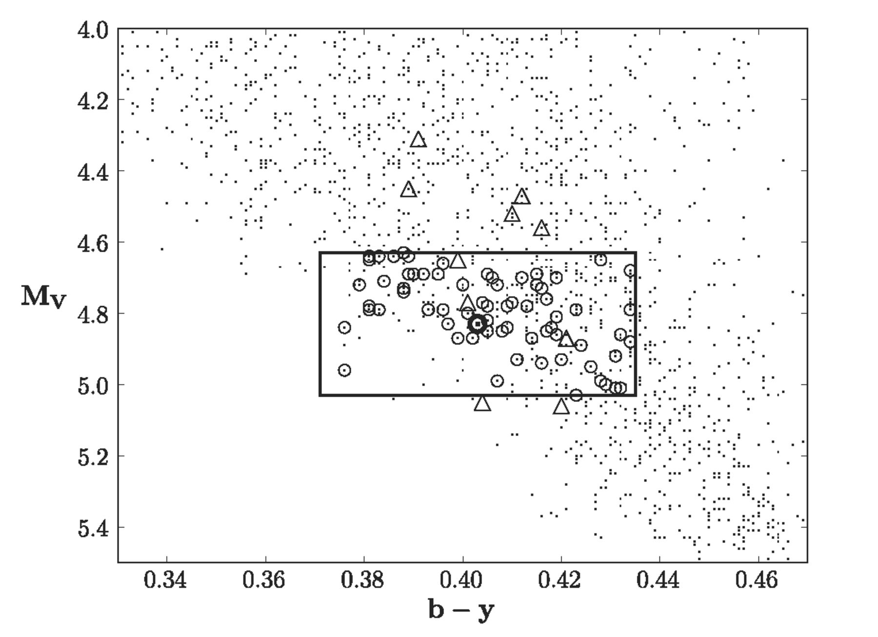
Figure 1. Stars from the Nordström et al. (2004) catalogue (GCS-I) (dots), in the metallicity range of −0.15 < [Fe/H] < ...
Notes:
Figure 1. Stars from the Nordström et al. (2004) catalogue (GCS-I) (dots), in the metallicity range of −0.15 < [Fe/H] < 0.15, together with our initial twin candidates (circles) and the candidates from Soubiran & Triaud (2004) (triangles). The Sun is marked in the middle of the box. The solar twin candidates of the Soubiran & Triaud (2004) sample (triangles) tend to lie redward (cooler) and tend to be intrinsically brighter than the Sun.
Unless provided in the caption above, the following copyright applies to the content of this slide: © 2012 The Authors

Slide 2
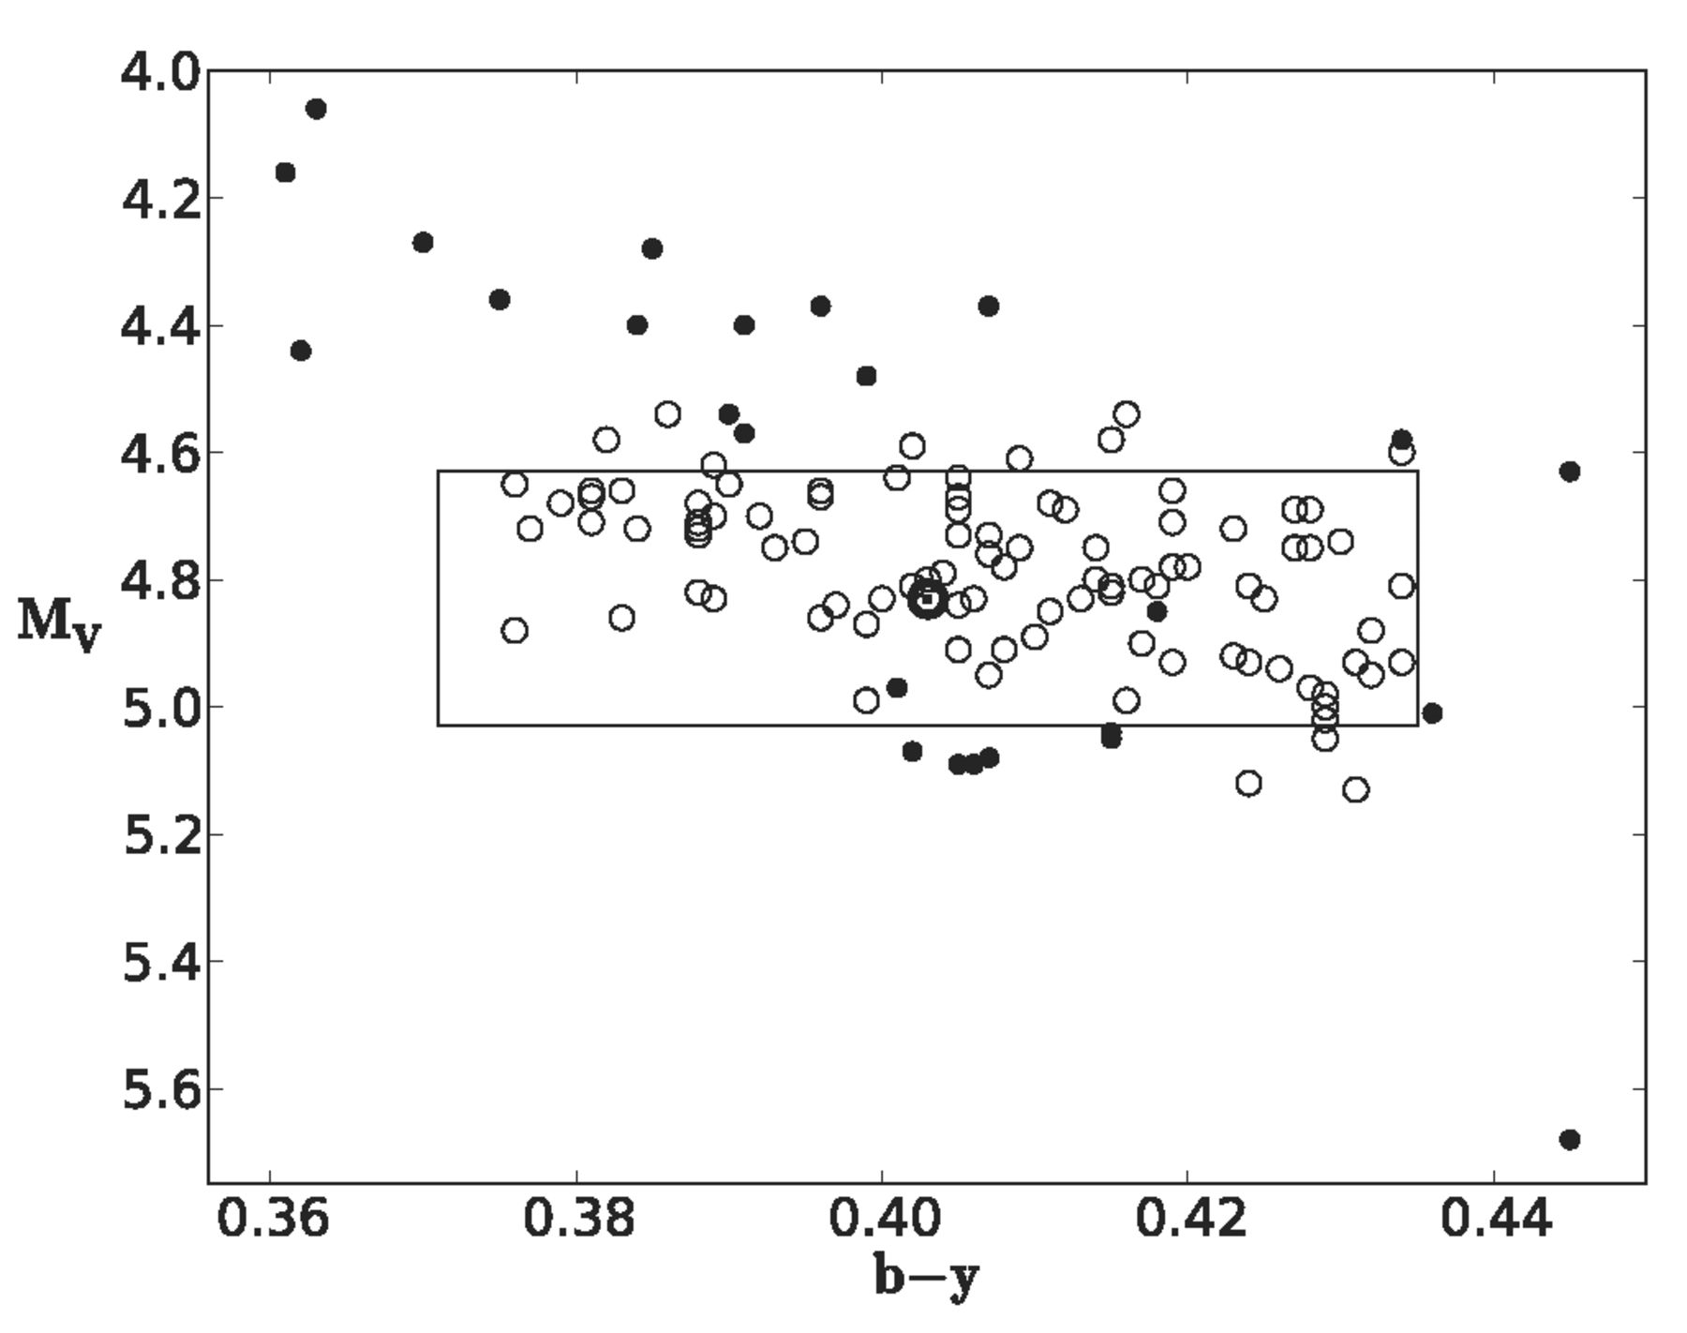
Figure 2. Same as Fig. 1, showing our target sample as open circles (from GCS-I and GCS-III) and the targets taken from ...
Notes:
Figure 2. Same as Fig. 1, showing our target sample as open circles (from GCS-I and GCS-III) and the targets taken from other papers (filled circles). The Sun is shown in the middle of the box, which represents our original selection window.
Unless provided in the caption above, the following copyright applies to the content of this slide: © 2012 The Authors

Slide 3
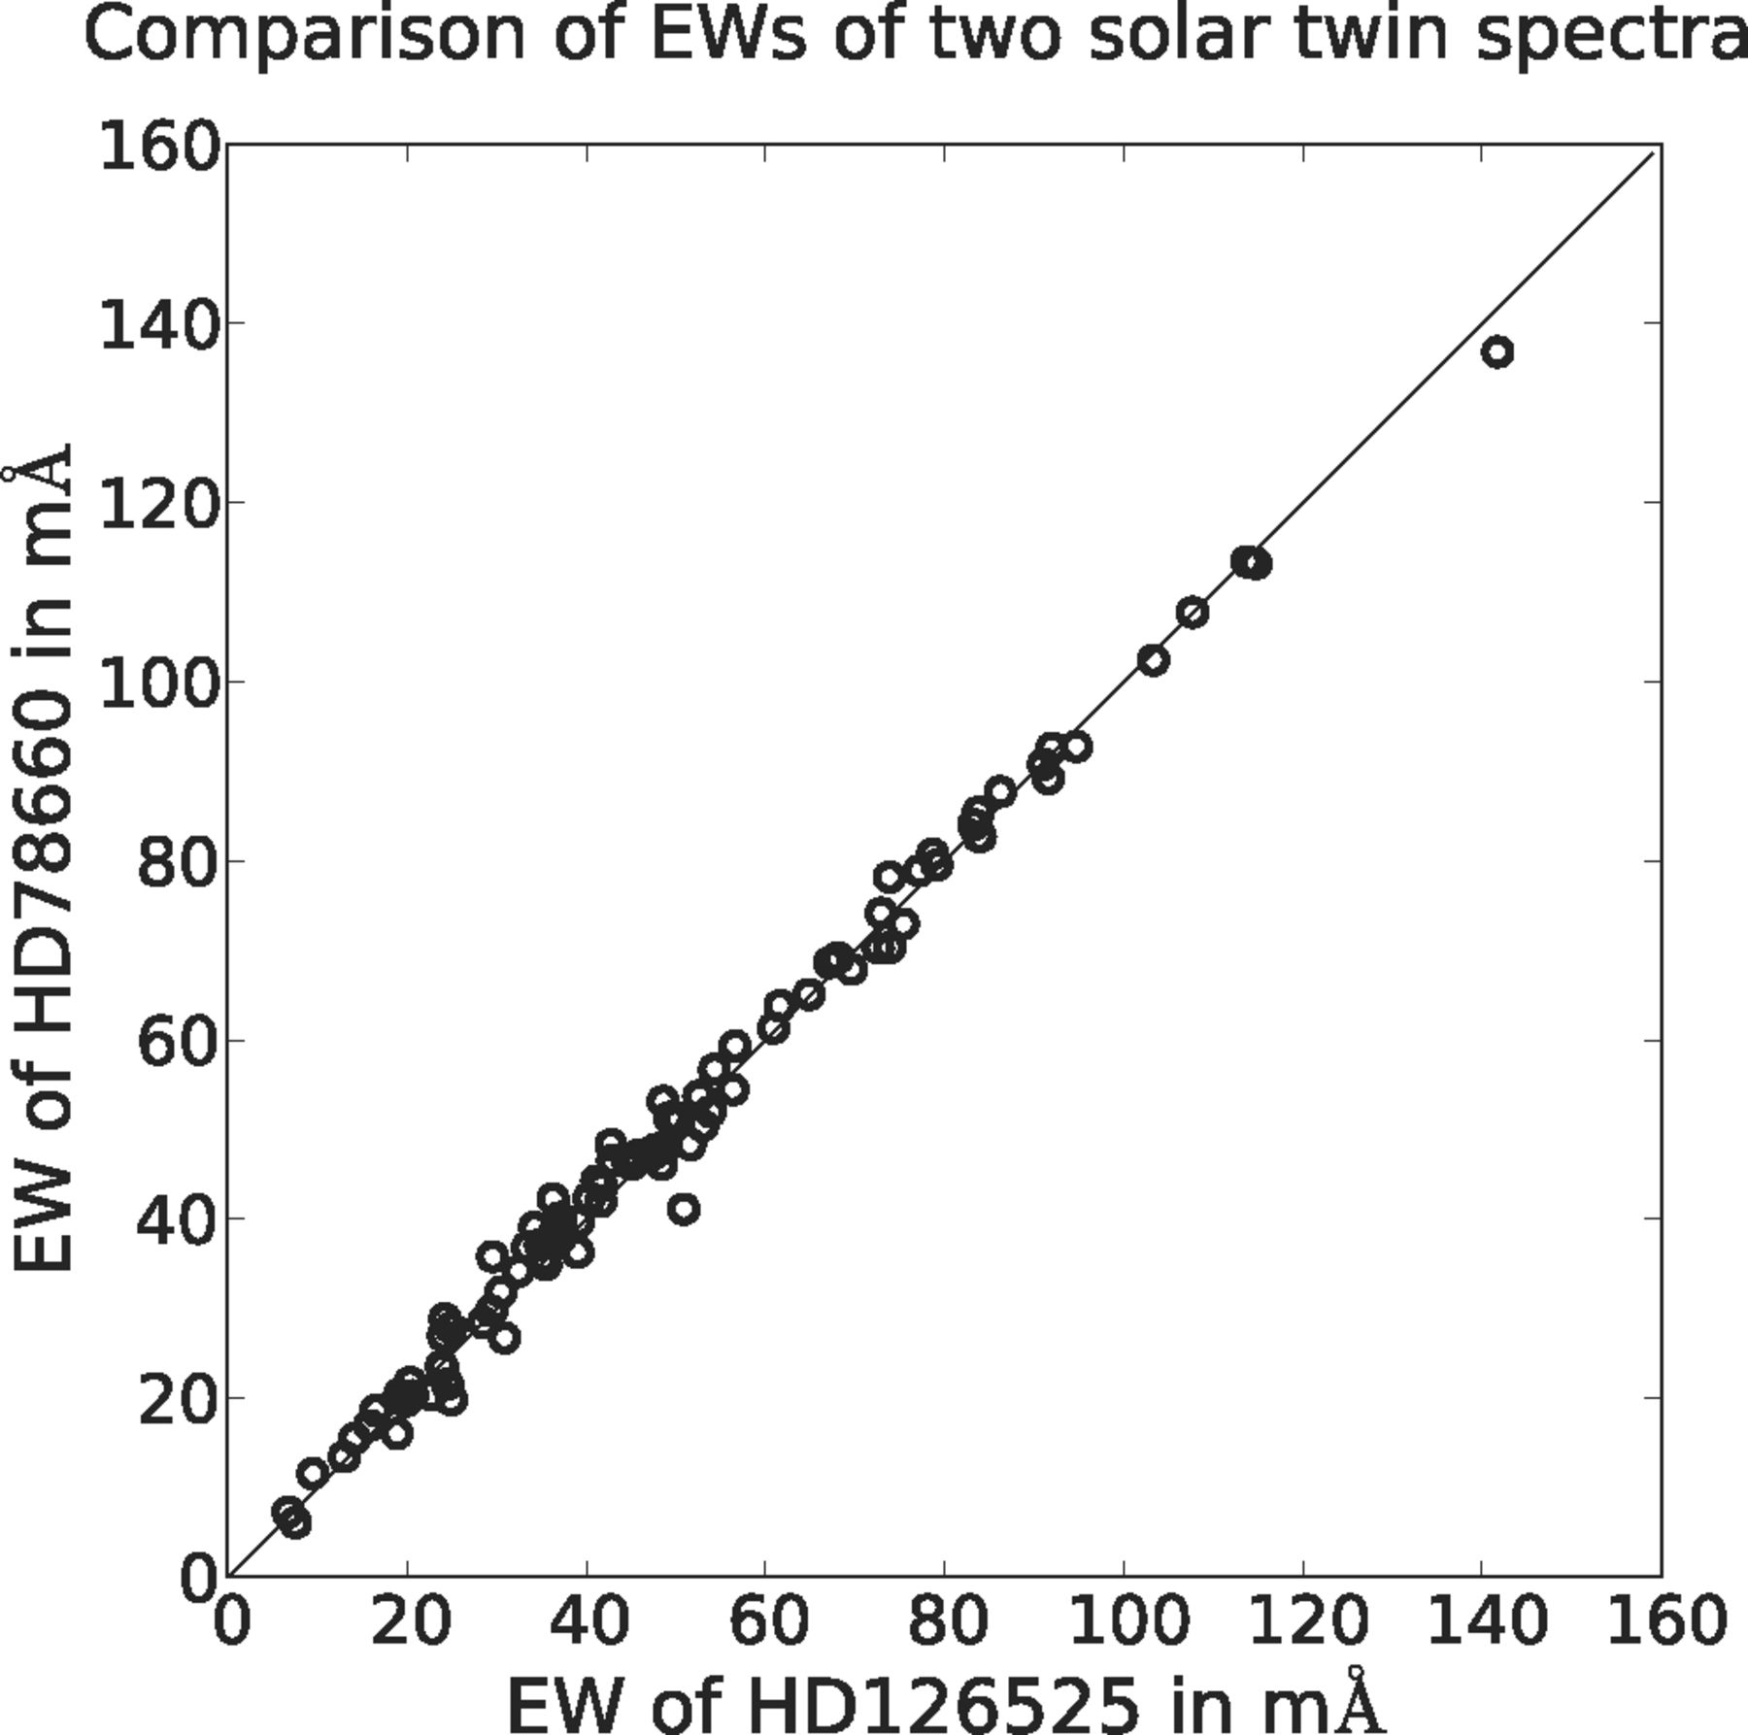
Figure 3. A comparison of measured EWs for the two stars HD 126525 and HD 78660. The line is the 1:1 relation.
Notes:
Figure 3. A comparison of measured EWs for the two stars HD 126525 and HD 78660. The line is the 1:1 relation.
Unless provided in the caption above, the following copyright applies to the content of this slide: © 2012 The Authors

Slide 4
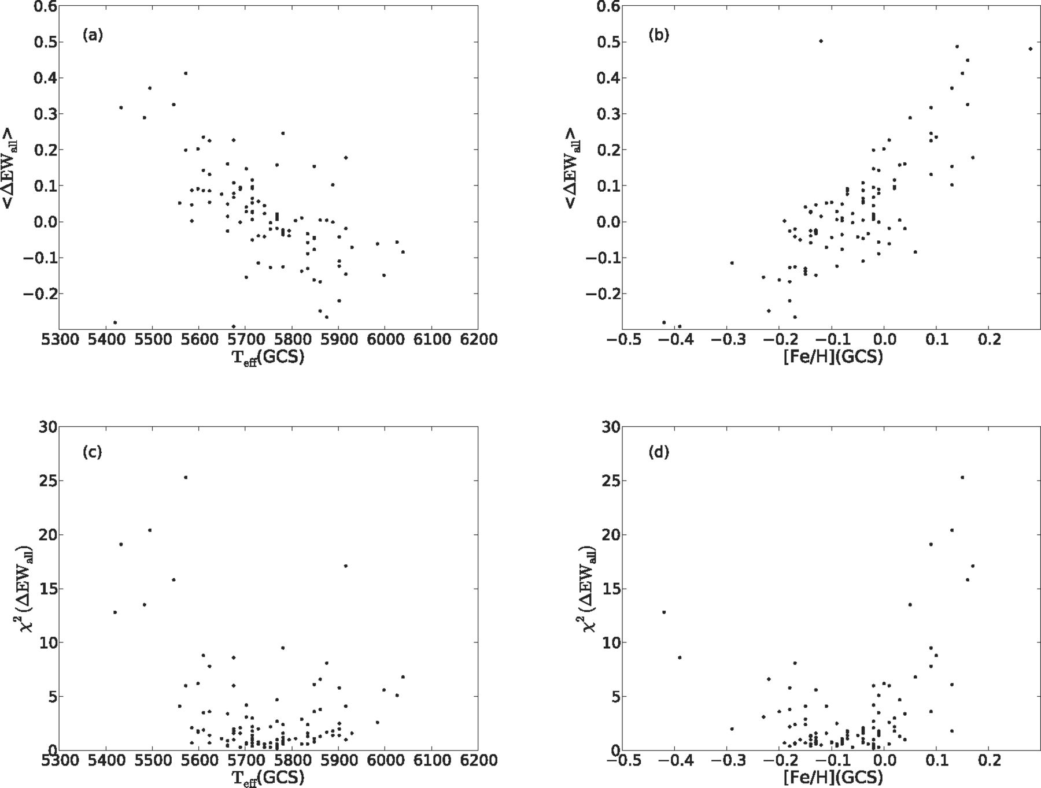
Figure 4. Method (i). (a) Median relative difference of 109 lines of various species in our 100 target stars in ...
Notes:
Figure 4. Method (i). (a) Median relative difference of 109 lines of various species in our 100 target stars in comparison to Ceres, plotted as a function of the effective temperature from GCS-III. 〈ΔEWall〉 is anticorrelated with temperature. (b) Same as (a), but plotted against the metallicities of the stars from GCS-III. 〈ΔEWall〉 is correlated with [Fe/H], as one would expect. (c) Scatter of the relative EWs of the stars compared to Ceres, shown as a function of temperature from GCS-III. The scatter in the relative EWs of the lines increases very rapidly as one moves to cooler or hotter stars relative to the Sun at 5777 K. (d) Same as (c), but plotted versus the stellar metallicities. The scatter increases rapidly as the stellar metallicities depart from solar in either direction. Note that one can see here already that the scatter is least at a metallicity below the solar value, indicating that the GCS-III metallicity scale might be too metal-poor for solar-type stars (as analysed in depth in Section 5). [We have excluded four stars with high χ2(ΔEWall) for clarity.]
Unless provided in the caption above, the following copyright applies to the content of this slide: © 2012 The Authors

Slide 5
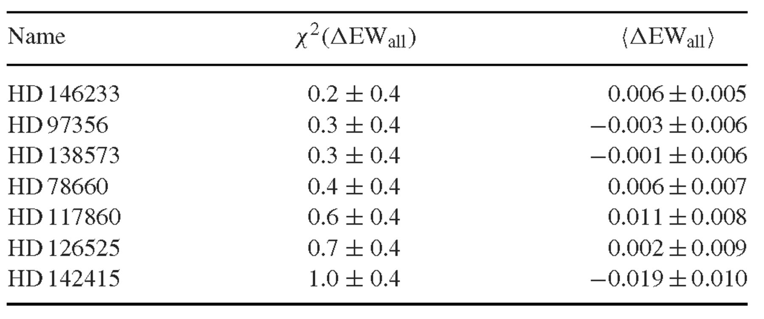
Table 1. List of solar twins using χ²(ΔEW_{all}) [i.e. method (i)], ordered by ...
Notes:
Table 1. List of solar twins using χ2(ΔEWall) [i.e. method (i)], ordered by χ2(ΔEWall) (see also Fig. 4)
Unless provided in the caption above, the following copyright applies to the content of this slide: © 2012 The Authors

Slide 6
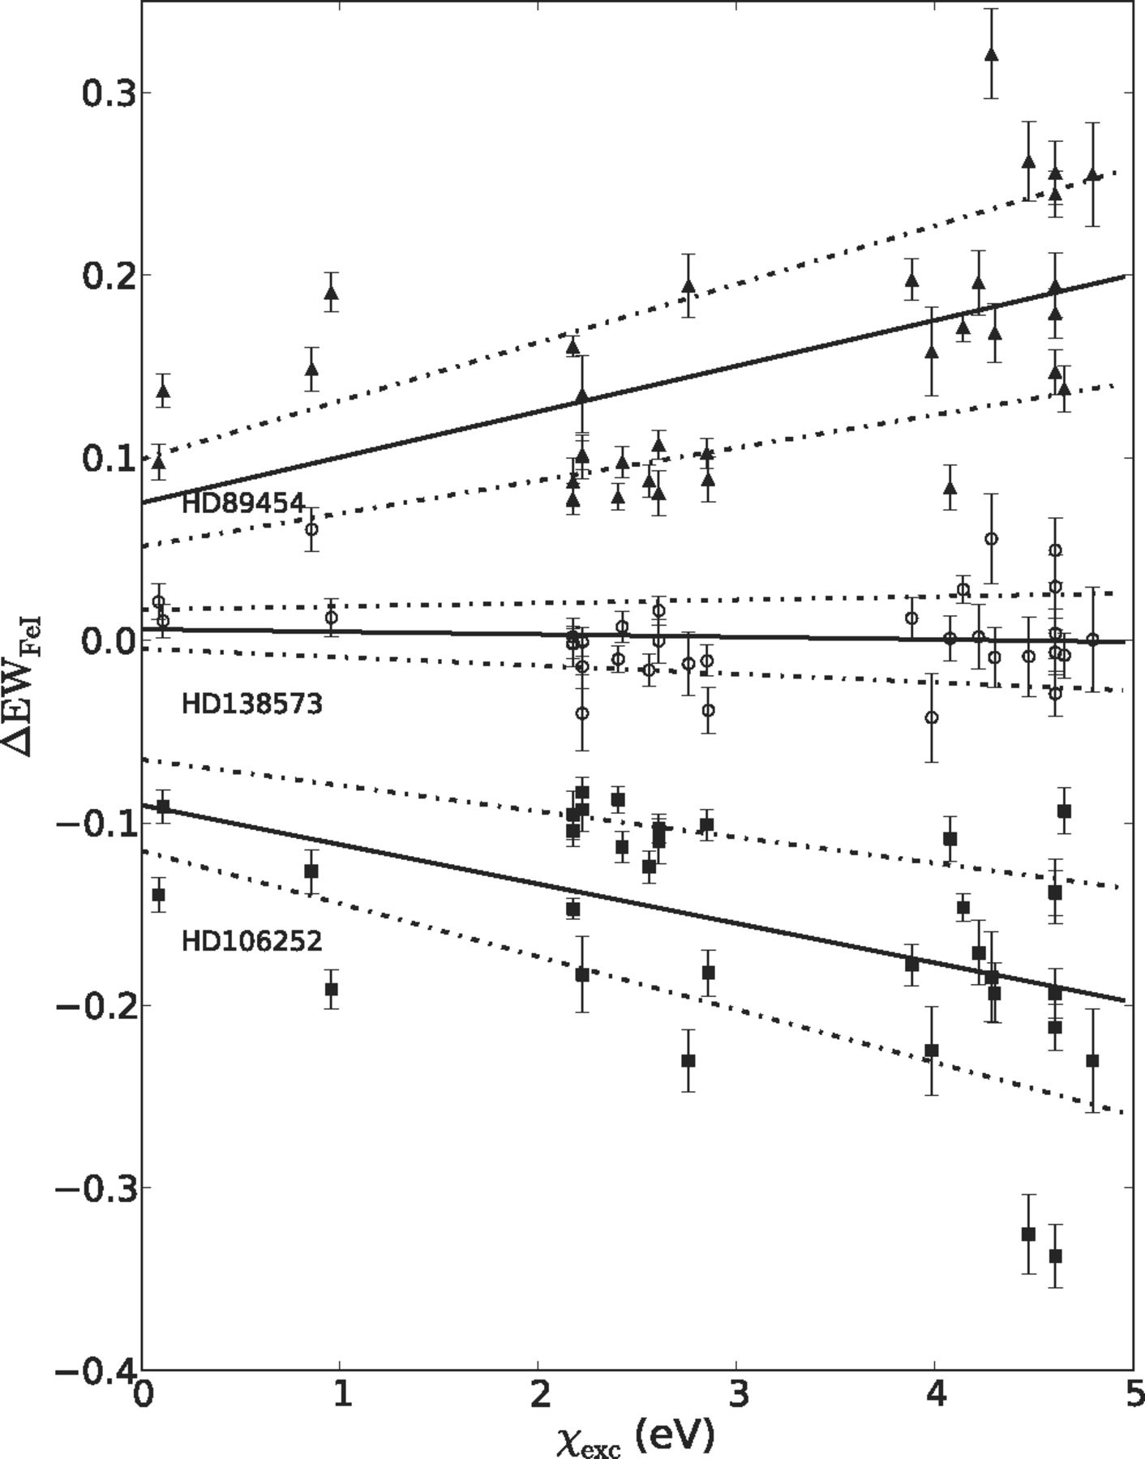
Figure 5. Method (ii). The relative difference in EW of 33 Fe i lines compared to Ceres, plotted as a function of the ...
Notes:
Figure 5. Method (ii). The relative difference in EW of 33 Fe i lines compared to Ceres, plotted as a function of the excitation potential of the lines for three example stars. The solid line shows the least-squares fit, and the dotted lines are the 1σ error limits, for each star. HD 138573 is an excellent solar twin, having, within observational error, no median difference in the EW of the lines relative to Ceres and no dependence on the excitation potential. For comparison, HD 89454 and HD 106252 are poor solar twins, as the EWs of the lines show a clear dependence on excitation potential. The relative difference in EWs and the slope[(Δ EW Fe I) versus χexc] are thus good proxies for the metallicity and temperature of the star relative to the Sun (as extensively discussed by Meléndez et al. 2006; Meléndez & Ramírez 2007).
Unless provided in the caption above, the following copyright applies to the content of this slide: © 2012 The Authors

Slide 7
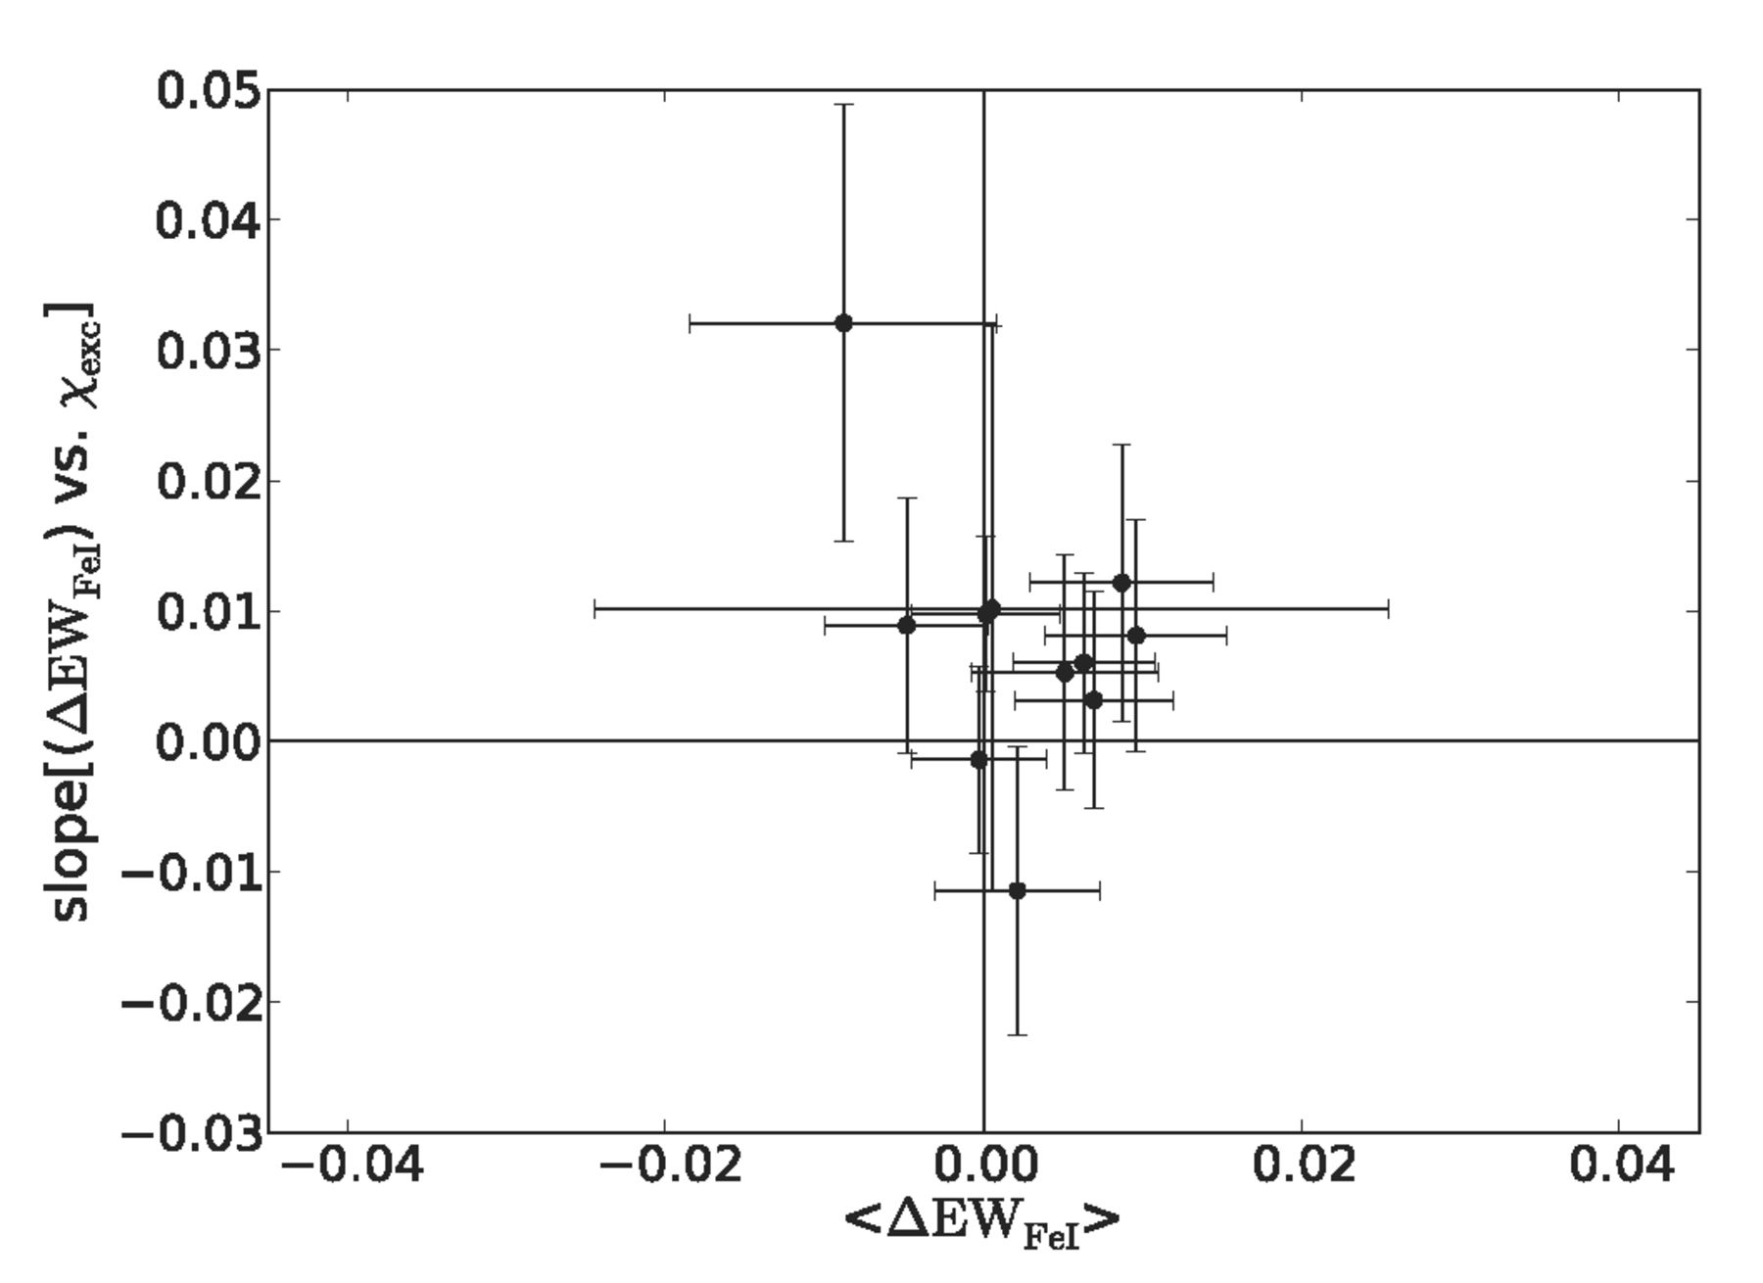
Figure 6. A close-up of the best targets for method (ii). These stars have 〈 Δ EW _{Fe I}〉 and slope[(Δ EW ...
Notes:
Figure 6. A close-up of the best targets for method (ii). These stars have 〈 Δ EW Fe I〉 and slope[(Δ EW Fe I) versus χexc] of 0 within 2σ, here plotted with error bars of 1σ for clarity.
Unless provided in the caption above, the following copyright applies to the content of this slide: © 2012 The Authors

Slide 8
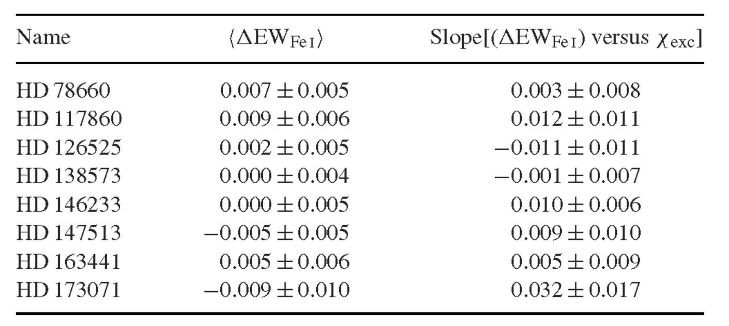
Table 2. List of solar twins from method (ii), ordered by name (see also Fig. 6)
Notes:
Table 2. List of solar twins from method (ii), ordered by name (see also Fig. 6)
Unless provided in the caption above, the following copyright applies to the content of this slide: © 2012 The Authors

Slide 9
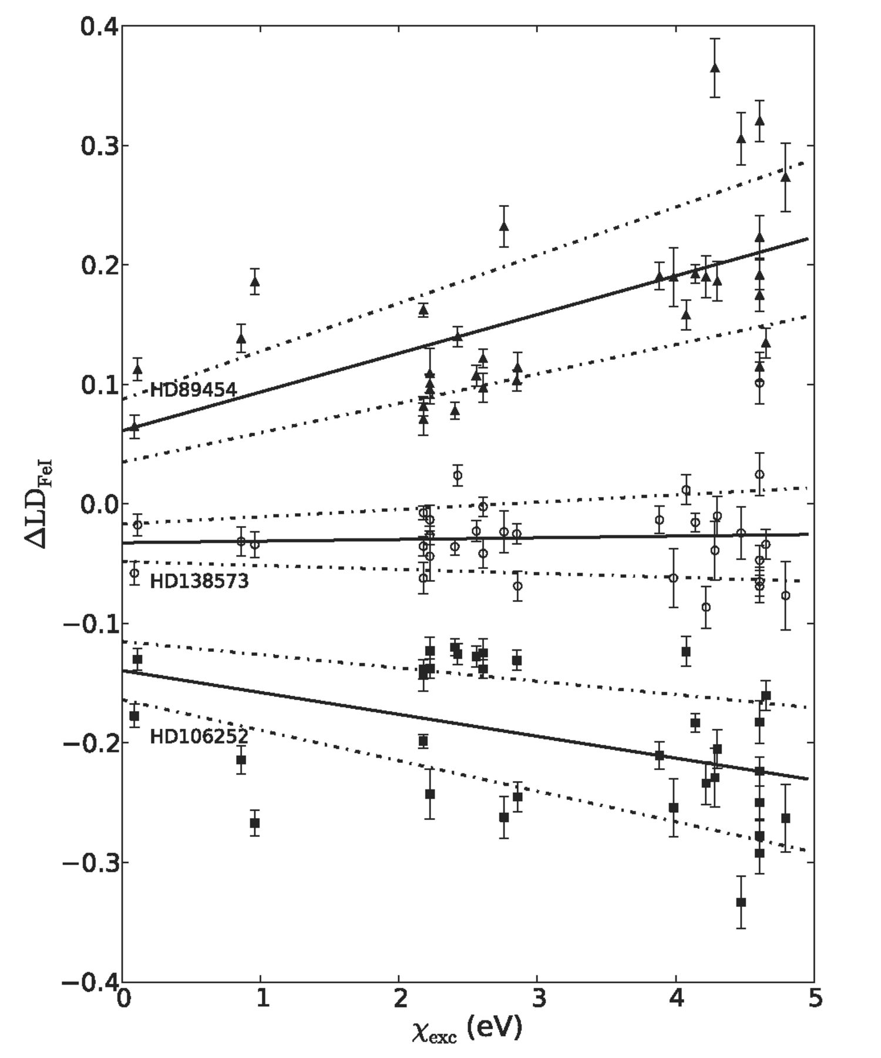
Figure 7. Method (iii) uses the depths of 33 Fe i lines in the target star relative to the lines in the Ceres spectrum, ...
Notes:
Figure 7. Method (iii) uses the depths of 33 Fe i lines in the target star relative to the lines in the Ceres spectrum, and the excitation potential of the lines, to search for solar twins. We show here the relative difference between the star and Ceres for all 33 Fe i lines as a function of excitation potential, for three stars: HD 138573, a very close match to the Sun according to method (iii), and two poor matches to the Sun (HD 89454 and HD 106252).
Unless provided in the caption above, the following copyright applies to the content of this slide: © 2012 The Authors

Slide 10
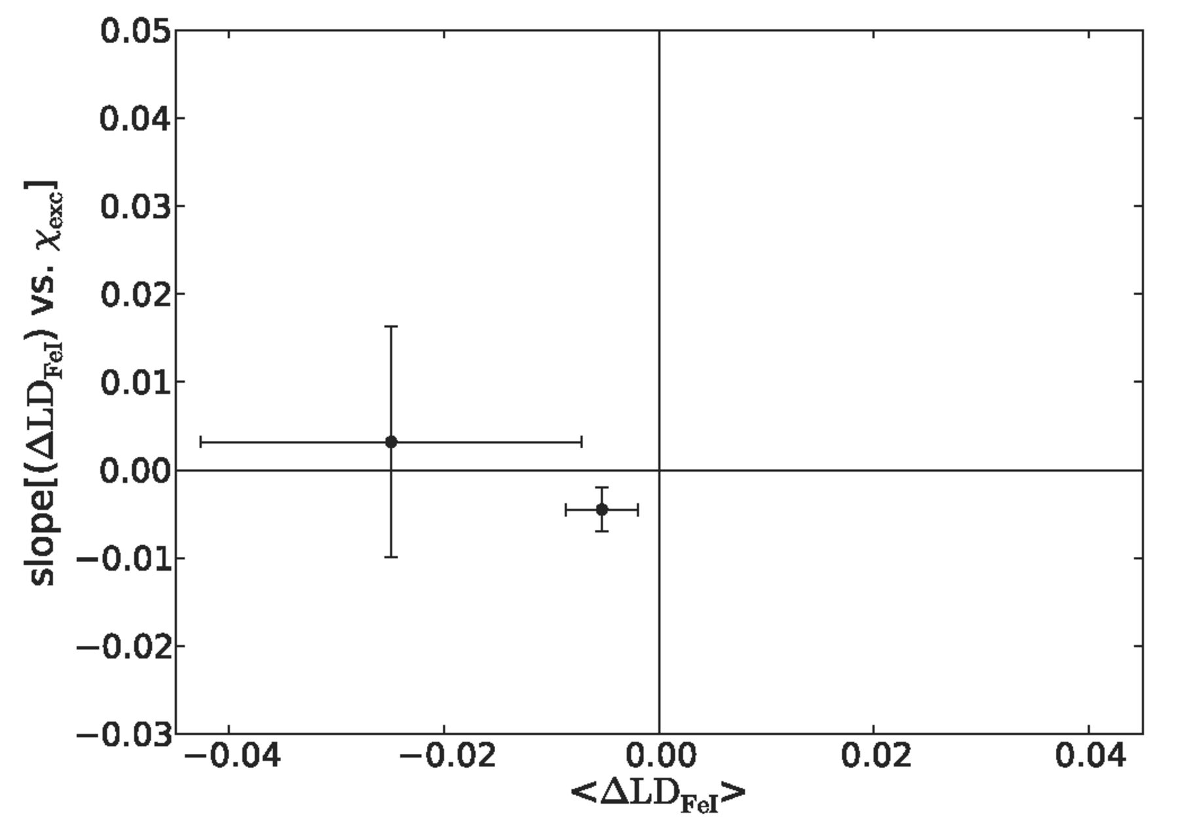
Figure 8. A close-up of the best targets using method (iii). These stars have median 〈 Δ LD _{Fe I}〉 and ...
Notes:
Figure 8. A close-up of the best targets using method (iii). These stars have median 〈 Δ LD Fe I〉 and slope[(Δ LD Fe I) versus χexc] of 0 within 2σ, here plotted with error bars of 1σ for clarity.
Unless provided in the caption above, the following copyright applies to the content of this slide: © 2012 The Authors

Slide 11
Table 3. List of solar twins from method (iii), see also Fig. 8
Notes:
Table 3. List of solar twins from method (iii), see also Fig. 8
Unless provided in the caption above, the following copyright applies to the content of this slide: © 2012 The Authors

Slide 12
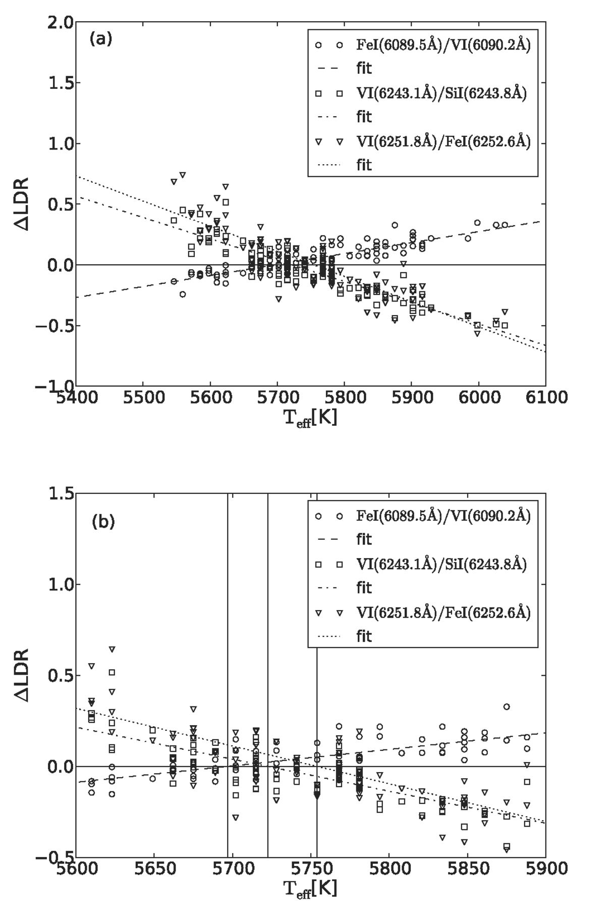
Figure 9. (a) LDRs for the three line pairs, relative to Ceres, shown as a function of GCS temperature and ...
Notes:
Figure 9. (a) LDRs for the three line pairs, relative to Ceres, shown as a function of GCS temperature and corresponding fits. (b) Same LDRs, but zoomed into the temperature range of 5600–5900 K. The vertical black lines guide the eye to the three crossing points with the zero line of the ratios.
Unless provided in the caption above, the following copyright applies to the content of this slide: © 2012 The Authors

Slide 13
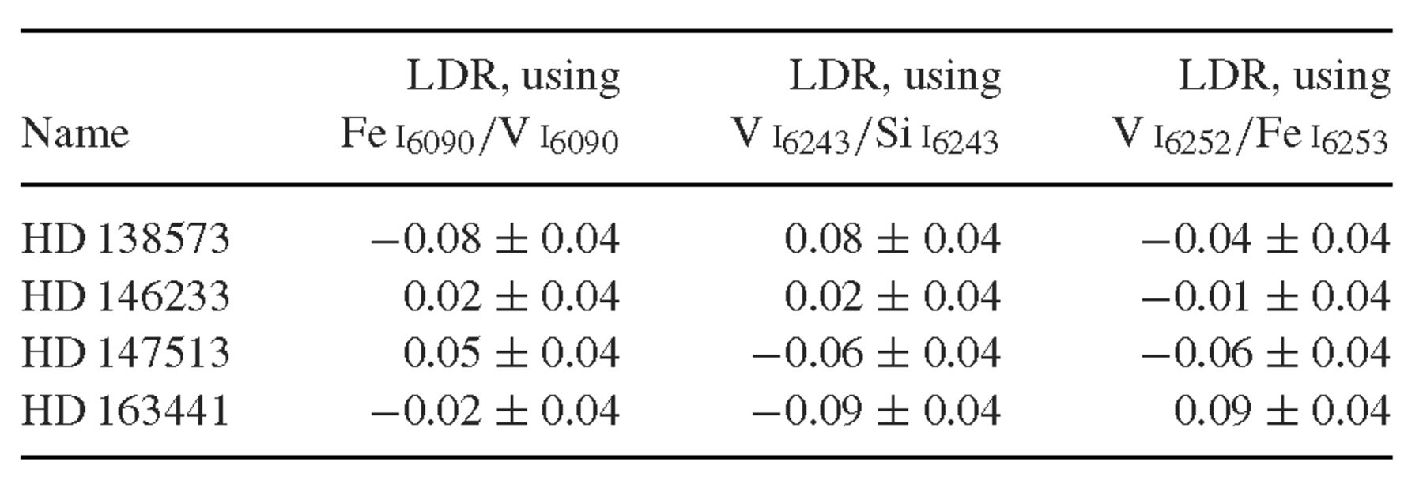
Table 4. List of solar twins, confirmed by method (iv)
Notes:
Table 4. List of solar twins, confirmed by method (iv)
Unless provided in the caption above, the following copyright applies to the content of this slide: © 2012 The Authors

Slide 14
Table 5. Comparison of multiple spectra of the same object. Column 1 shows the HD number and column 2 shows the ...
Notes:
Table 5. Comparison of multiple spectra of the same object. Column 1 shows the HD number and column 2 shows the spectrum running number. Columns 3 and 4 show the results for each spectrum using method (i), columns 5 and 6 for method (ii) and columns 7 and 8 for method (iii) (see Section 4.6 for discussion of the typical errors of each method as derived from these multiple spectra)
Unless provided in the caption above, the following copyright applies to the content of this slide: © 2012 The Authors

Slide 15
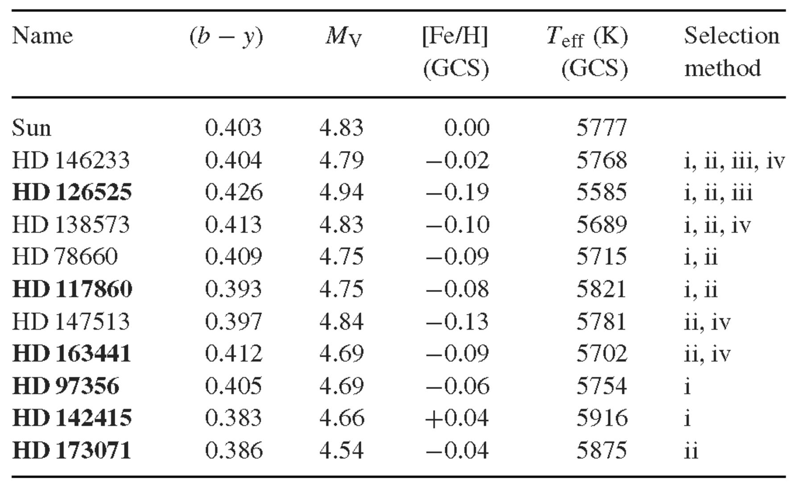
Table 6. Our solar twins compared to the Sun. Note that the solar (b − y) are as estimated indirectly from Sun-like ...
Notes:
Table 6. Our solar twins compared to the Sun. Note that the solar (b − y) are as estimated indirectly from Sun-like stars by Holmberg et al. (2006). New twins are shown in bold face
Unless provided in the caption above, the following copyright applies to the content of this slide: © 2012 The Authors

Slide 16
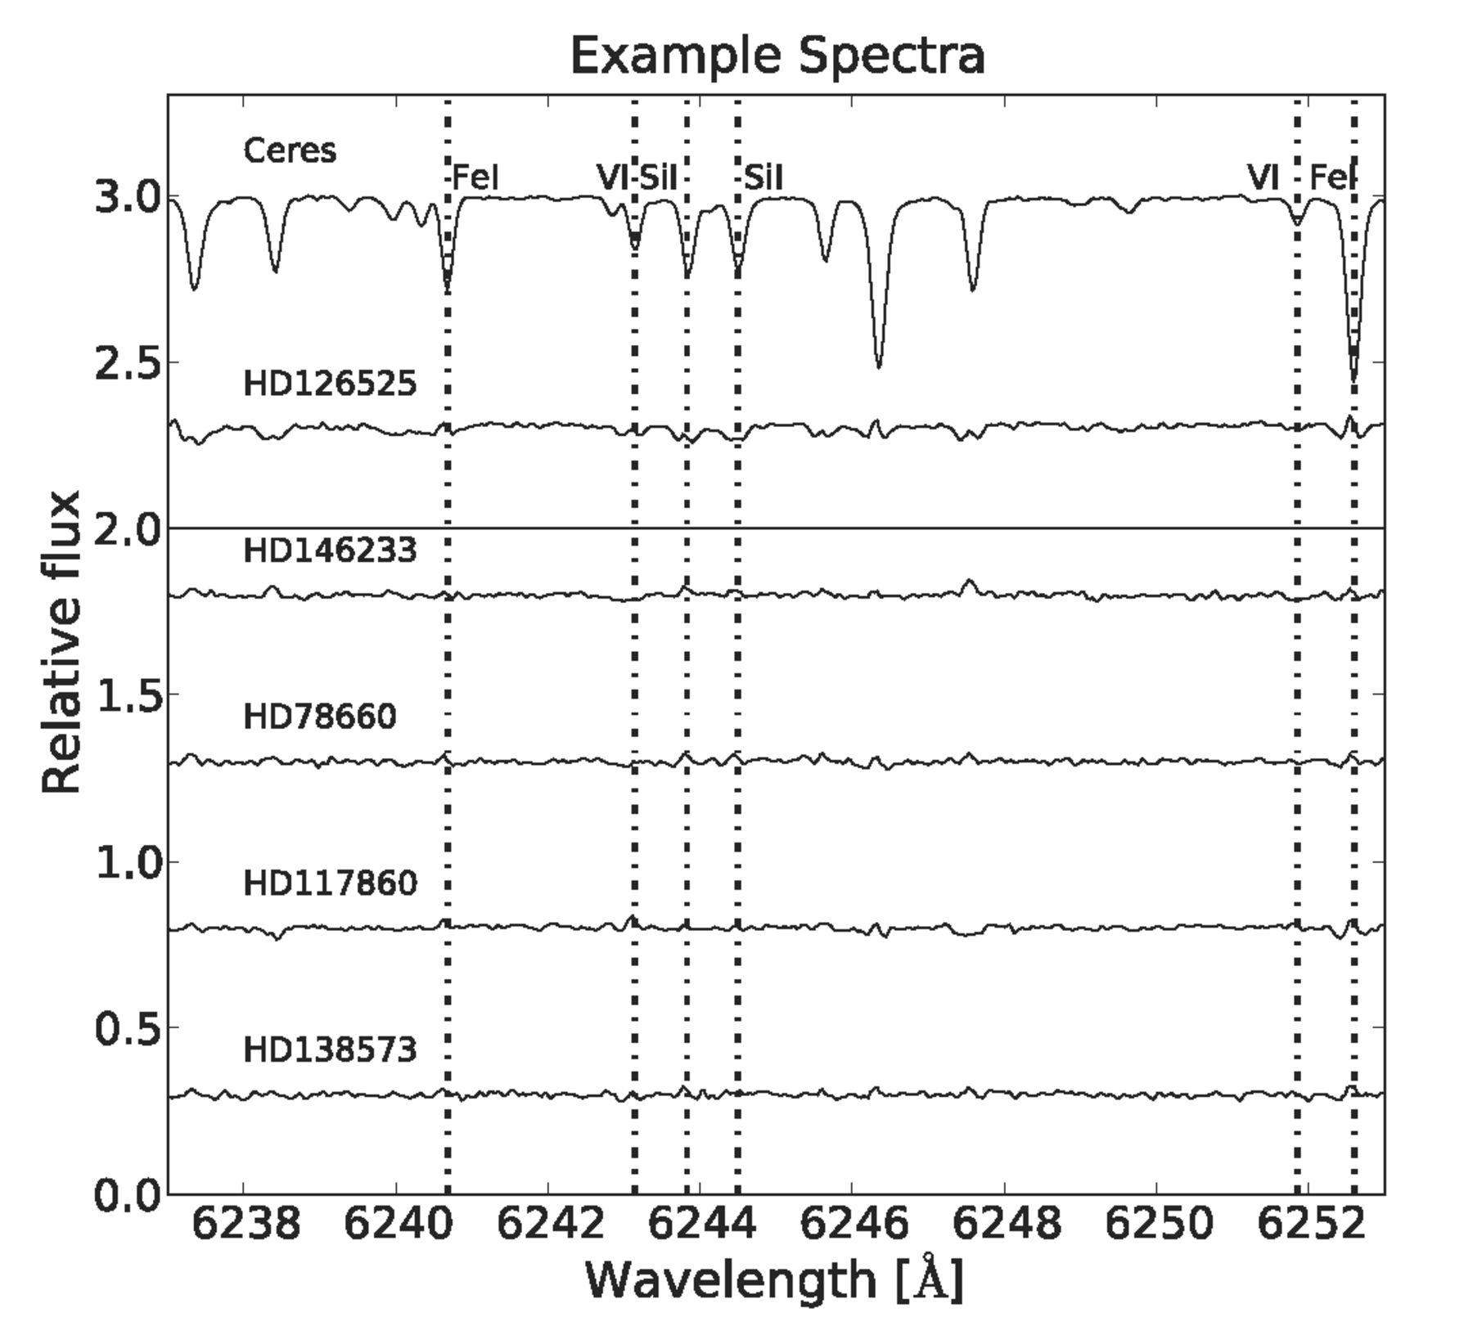
Figure 10. Comparison of the solar spectrum (Ceres) to some of our twins for an example region of the spectrum, ...
Notes:
Figure 10. Comparison of the solar spectrum (Ceres) to some of our twins for an example region of the spectrum, including six of our lines (two Fe i, two Si i and two V i). Each spectrum is shown as the residual relative to Ceres.
Unless provided in the caption above, the following copyright applies to the content of this slide: © 2012 The Authors

Slide 17
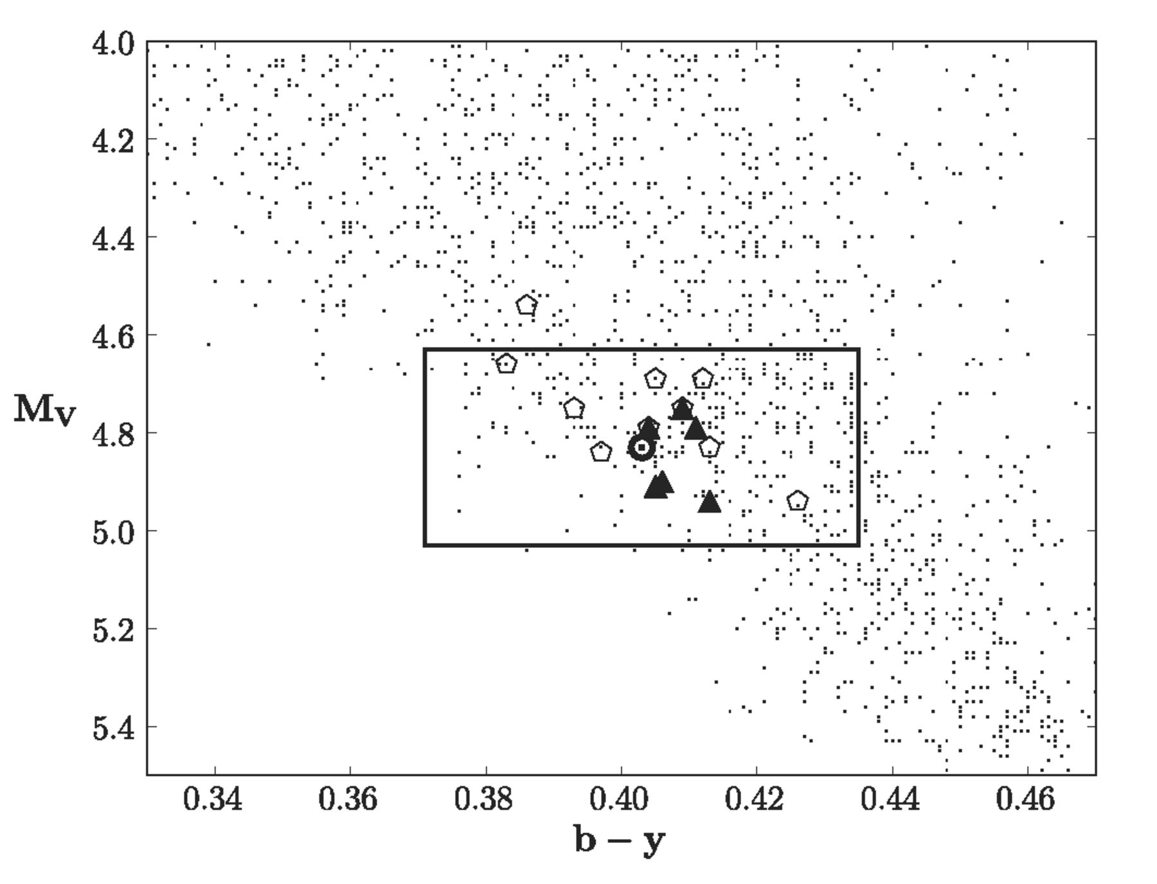
Figure 11. Same as Fig. 1, but showing the locations of our solar twins as open pentagons. Dots show stars from the ...
Notes:
Figure 11. Same as Fig. 1, but showing the locations of our solar twins as open pentagons. Dots show stars from the Nordström et al. (2004) catalogue (GCS-I) and the box is our original selection window. The Sun is marked in the middle of the box, using the (b − y) colour estimated indirectly by Holmberg et al. (2006) via solar analogues. The filled triangles show six of the 11 solar twins by Meléndez et al. (2009), available in the GCS, for comparison.
Unless provided in the caption above, the following copyright applies to the content of this slide: © 2012 The Authors

Slide 18
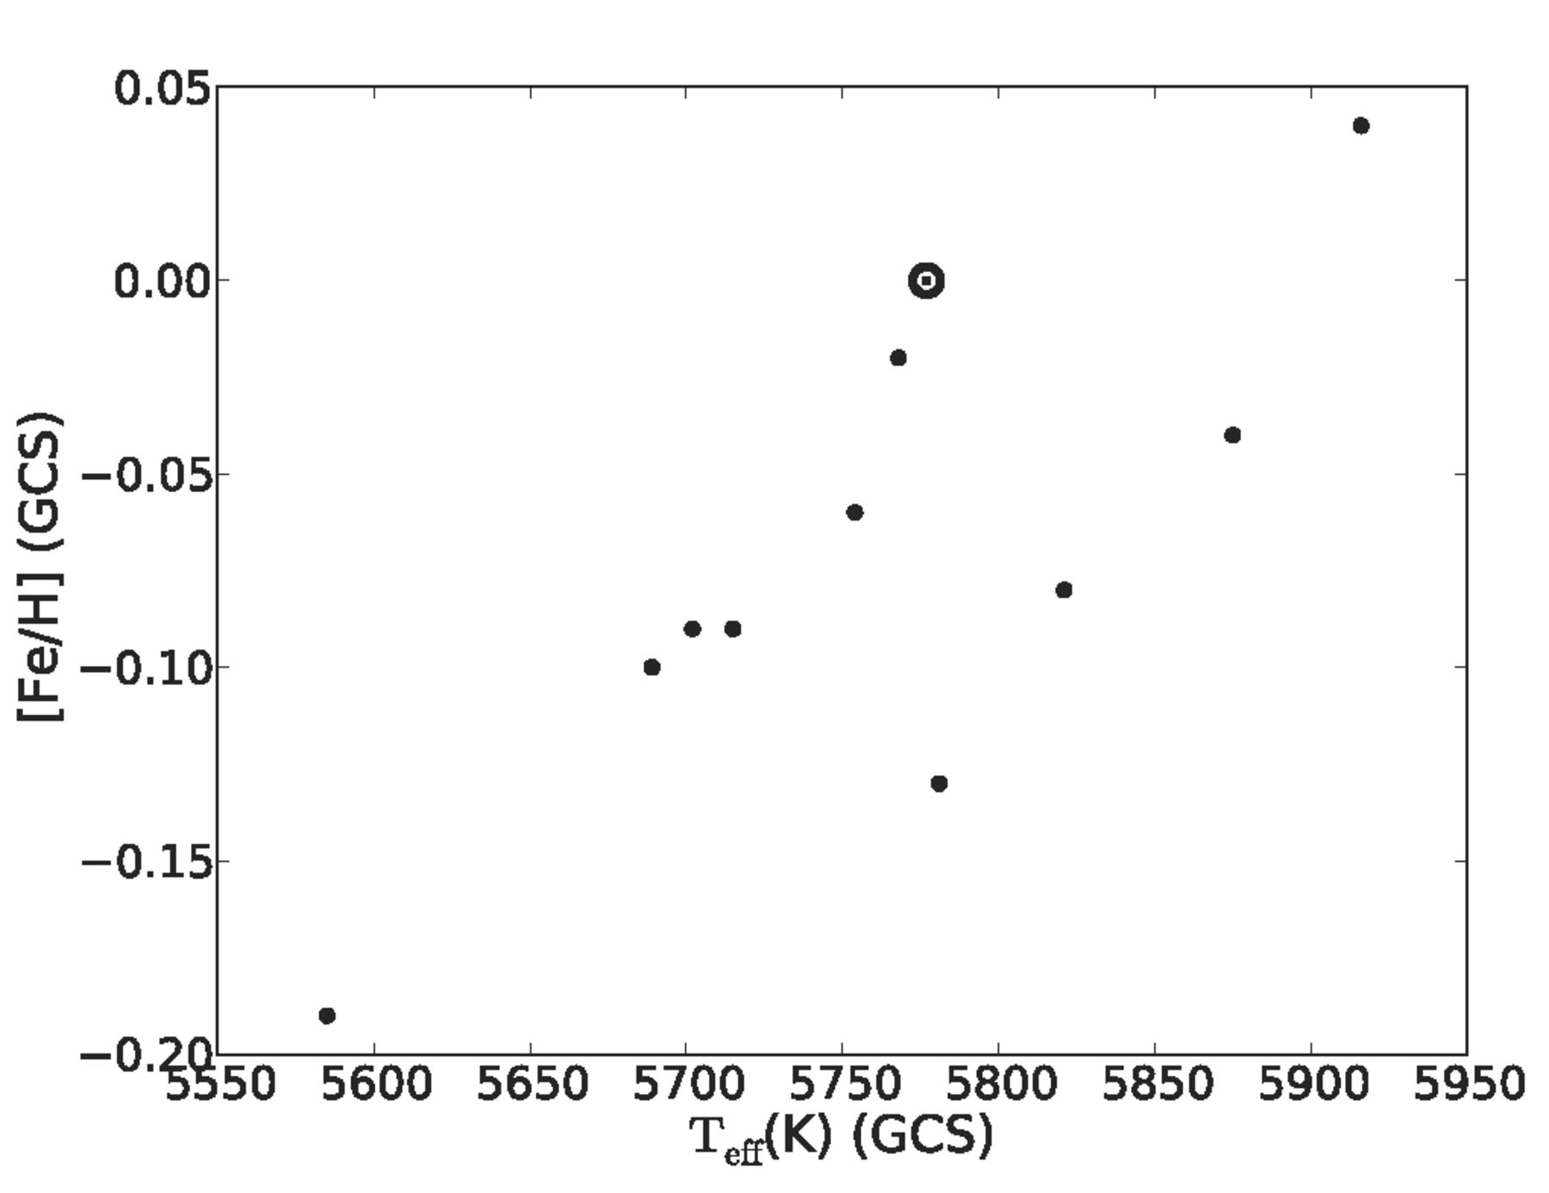
Figure 12. Effective temperatures and metallicities (from GCS-III) of our best solar twins (filled circles), compared to ...
Notes:
Figure 12. Effective temperatures and metallicities (from GCS-III) of our best solar twins (filled circles), compared to the solar values (dot with circle). There is a trend to lower metallicities than solar in the sample of twins, while the mean temperature is close to the expected value of the Sun of 5777 K.
Unless provided in the caption above, the following copyright applies to the content of this slide: © 2012 The Authors

Slide 19
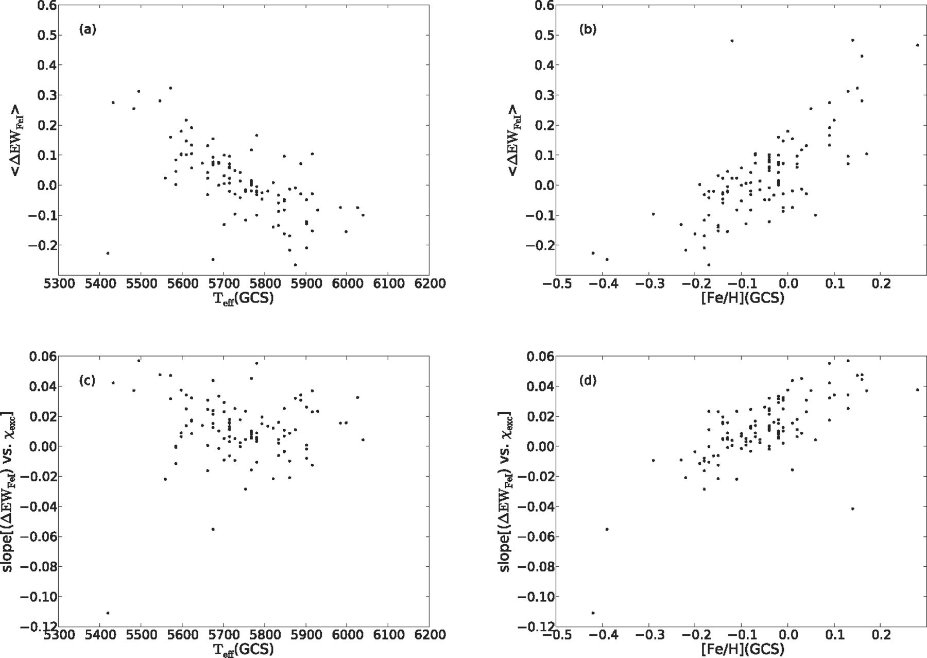
Figure 13. For method (ii) (Section 4.3), we show in panels (a) and (b) the dependencies of 〈 Δ EW _{Fe I}〉 on ...
Notes:
Figure 13. For method (ii) (Section 4.3), we show in panels (a) and (b) the dependencies of 〈 Δ EW Fe I〉 on temperature and metallicity. In panels (c) and (d), the same for slope[(Δ EW Fe I) versus χexc]. We find no correlation of the slope with temperature. Planar fits of the form a [Fe/H] + bTeff + c to the measured quantities allow us to solve for effective temperature and metallicity of the Sun in the GCS-III (Section 5).
Unless provided in the caption above, the following copyright applies to the content of this slide: © 2012 The Authors

Slide 20
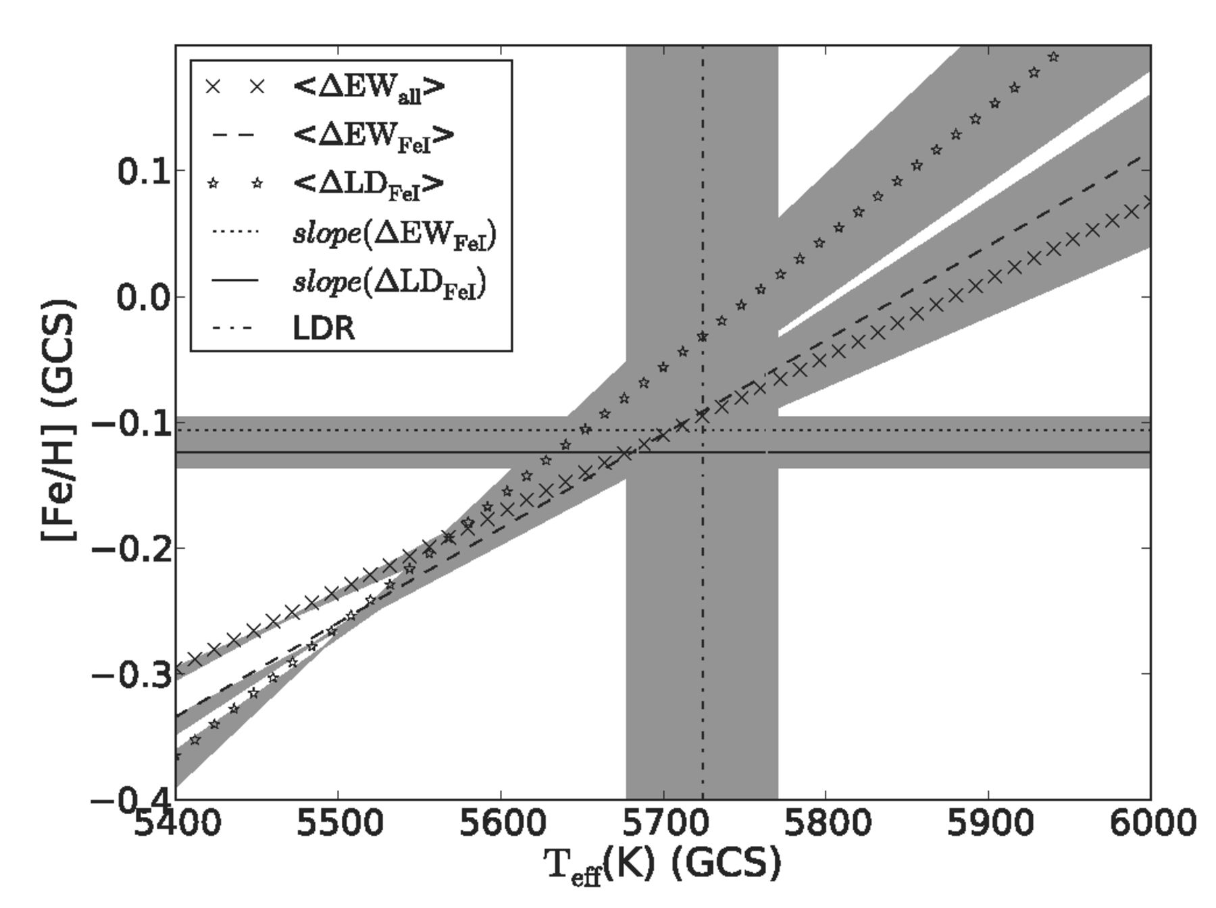
Figure 14. Derived relations for the various measured indices in the GCS-III temperature–metallicity plane. Grey areas ...
Notes:
Figure 14. Derived relations for the various measured indices in the GCS-III temperature–metallicity plane. Grey areas mark the uncertainties in the fits. The solar values of the GCS scale are estimated to lie where the lines converge. We estimate this to lie at a metallicity of ∼− 0.12 dex and a temperature of approximately 5680 K, providing evidence that the GCS-III metallicity and temperature scales are shifted by about 0.1 dex and 100 K from the Sun.
Unless provided in the caption above, the following copyright applies to the content of this slide: © 2012 The Authors

Slide 21
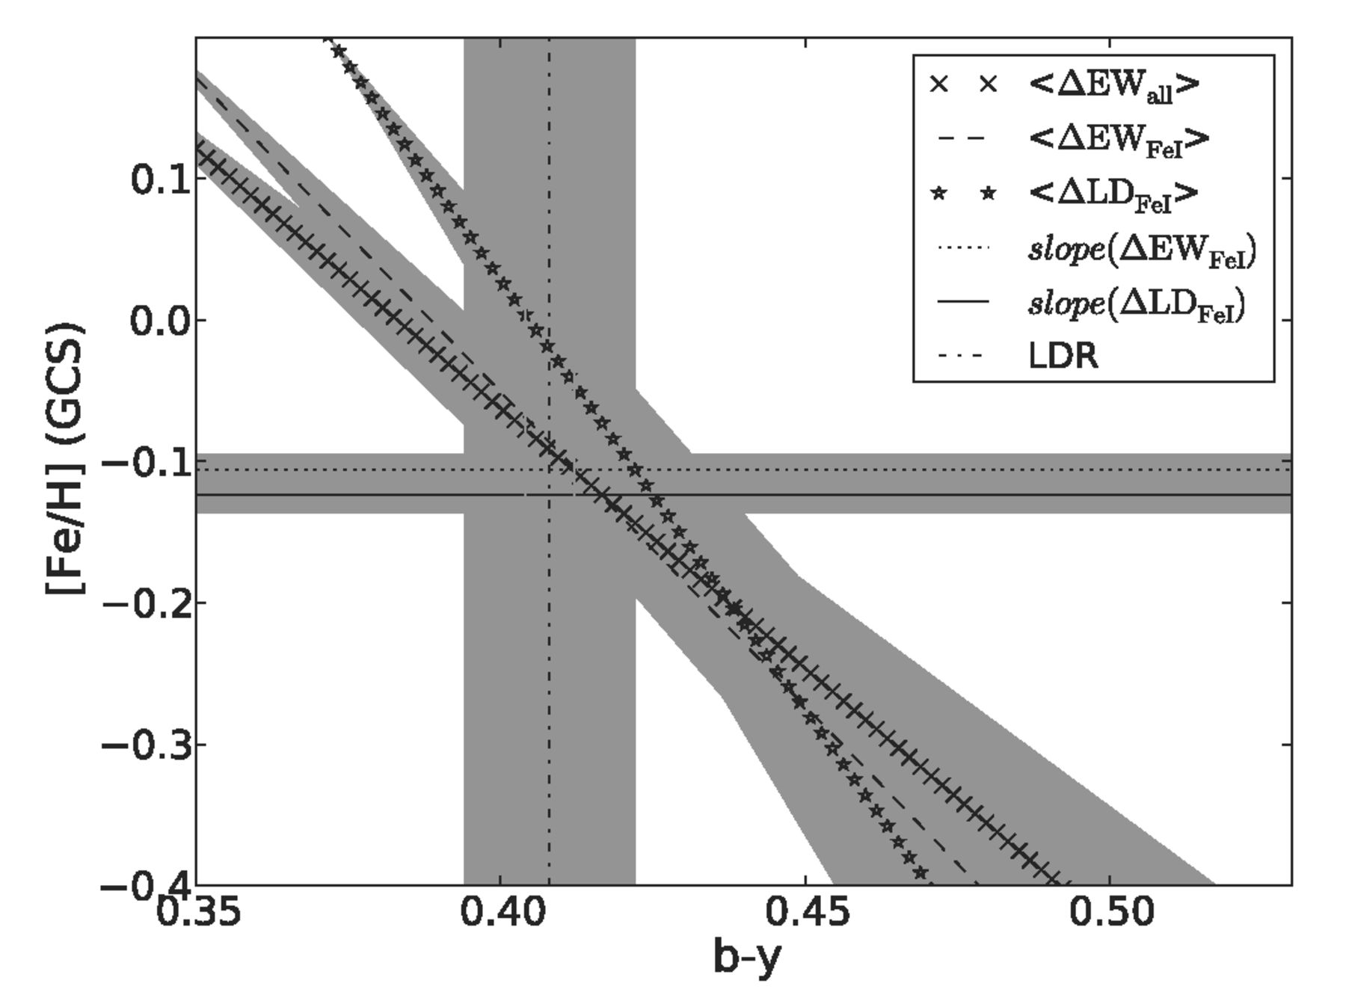
Figure 15. Degeneracy lines between metallicity and temperature for the quantities in the various methods in Section 4, ...
Notes:
Figure 15. Degeneracy lines between metallicity and temperature for the quantities in the various methods in Section 4, shown in the (b − y)–metallicity plane; the solar values lie where the degeneracy relations converge. We estimate a solar (b − y) of 0.414 ± 0.007 from this plot, in good agreement with the recent estimate by Meléndez et al. (2010) of 0.411 ± 0.002.
Unless provided in the caption above, the following copyright applies to the content of this slide: © 2012 The Authors

Slide 22
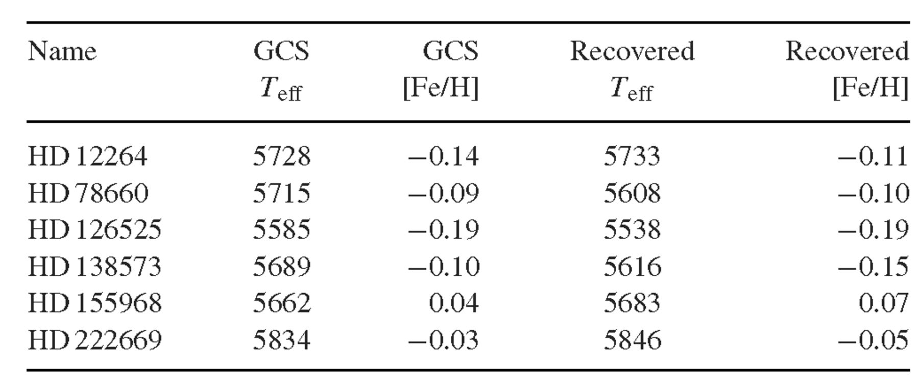
Table 7. Tests of the degeneracy relations method. Column 1 shows the reference star and columns 2 and 3 show its GCS ...
Notes:
Table 7. Tests of the degeneracy relations method. Column 1 shows the reference star and columns 2 and 3 show its GCS temperatures and metallicities. Columns 4 and 5 show the values recovered from our degeneracy line fitting, by comparing the reference star to the rest of the sample stars
Unless provided in the caption above, the following copyright applies to the content of this slide: © 2012 The Authors

