Slide 1
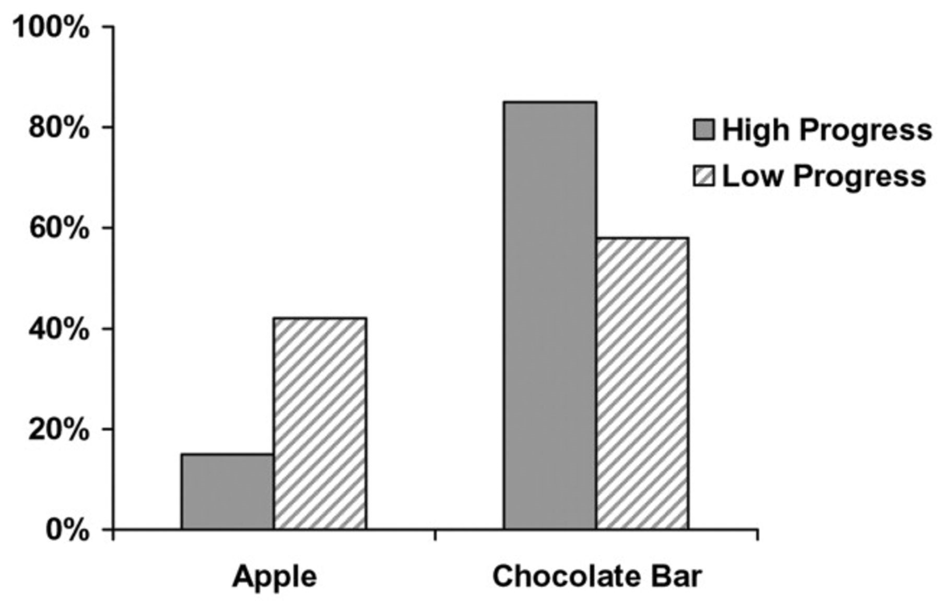
Figure 1 Choosing an apple versus a chocolate bar as a function of perceived progress toward the goal of weight loss
Notes:
Figure 1 Choosing an apple versus a chocolate bar as a function of perceived progress toward the goal of weight loss
Unless provided in the caption above, the following copyright applies to the content of this slide: © 2005 by JOURNAL OF CONSUMER RESEARCH, Inc.

