Slide 1
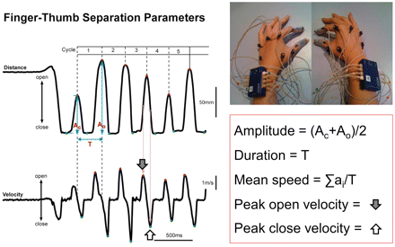
Figure 1 Infrared-emitting diodes fixed to eight designated regions. Motion was recorded in 3D (Coda) and key ...
Notes:
Figure 1 Infrared-emitting diodes fixed to eight designated regions. Motion was recorded in 3D (Coda) and key parameters were measured for each cycle of finger tap.
Unless provided in the caption above, the following copyright applies to the content of this slide: © The Author (2012). Published by Oxford University Press on behalf of the Guarantors of Brain. All rights reserved. For Permissions, please email: journals.permissions@oup.com

Slide 2
Figure 2 Handwriting performed by a healthy 65-year-old female (mean script size = 0.86 cm², slope ...
Notes:
Figure 2 Handwriting performed by a healthy 65-year-old female (mean script size = 0.86 cm2, slope 1 = 0.28, slope 2 = −0.06).
Unless provided in the caption above, the following copyright applies to the content of this slide: © The Author (2012). Published by Oxford University Press on behalf of the Guarantors of Brain. All rights reserved. For Permissions, please email: journals.permissions@oup.com

Slide 3
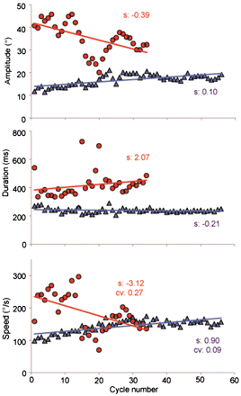
Figure 3 Kinematic parameters during the first 15-s right finger tap trial in a Parkinson's disease patient during the ...
Notes:
Figure 3 Kinematic parameters during the first 15-s right finger tap trial in a Parkinson's disease patient during the ‘OFF’ condition represented by red circle plots (UPDRSIII-OFF = 32) and a patient with PSP represented by blue triangle plots (UPDRSIII = 69; Frontal Assessment Battery = 14). The slopes (S) for amplitude, duration and speed, and coefficient of variation (CV) for speed are shown. Lack of decrement and fatigue in the patient with PSP is reflected by the positive amplitude slope and speed slope. The speed coefficient of variation in the patient with Parkinson's disease is three times greater than PSP, suggesting high irregularity in speed.
Unless provided in the caption above, the following copyright applies to the content of this slide: © The Author (2012). Published by Oxford University Press on behalf of the Guarantors of Brain. All rights reserved. For Permissions, please email: journals.permissions@oup.com

Slide 4
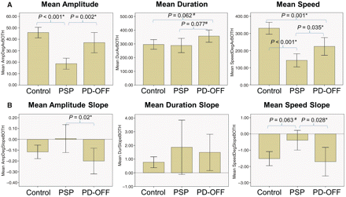
Figure 4 (A) Mean amplitude, duration and speed of control, PSP and PD-OFF groups and P-values by post hoc analysis. ...
Notes:
Figure 4 (A) Mean amplitude, duration and speed of control, PSP and PD-OFF groups and P-values by post hoc analysis. Error bars represent 95% confidence intervals. *P < 0.05 indicates statistical significance and #P = 0.05–0.10 indicates borderline significance by Tukey HSD post hoc analysis. (B) Mean slope values for amplitude, duration and speed of control, PSP and PD-OFF groups and P-values by post hoc analysis. Error bars represent 95% confidence intervals. Dotted reference lines represent zero, values below which represent progressive downward negative slope across the 15-s finger tap trial. *P < 0.05 indicates statistical significance and #P = 0.05–0.10 indicates borderline significance by Tukey HSD post hoc analysis.
Unless provided in the caption above, the following copyright applies to the content of this slide: © The Author (2012). Published by Oxford University Press on behalf of the Guarantors of Brain. All rights reserved. For Permissions, please email: journals.permissions@oup.com

Slide 5
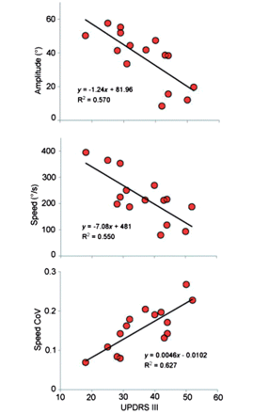
Figure 5 Among PD-OFF subgroup, a more severe UPDRSIII-OFF score was correlated with smaller mean amplitude, slower ...
Notes:
Figure 5 Among PD-OFF subgroup, a more severe UPDRSIII-OFF score was correlated with smaller mean amplitude, slower mean speed and greater variability in speed.
Unless provided in the caption above, the following copyright applies to the content of this slide: © The Author (2012). Published by Oxford University Press on behalf of the Guarantors of Brain. All rights reserved. For Permissions, please email: journals.permissions@oup.com

Slide 6
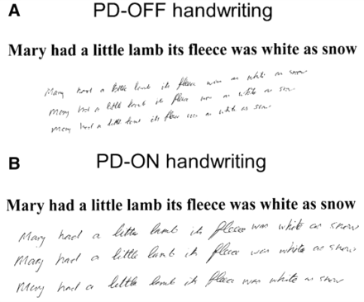
Figure 6 (A) Handwriting performed by a 58-year-old right-handed patient when in the ‘OFF’ condition (UPDRS = 18, mean ...
Notes:
Figure 6 (A) Handwriting performed by a 58-year-old right-handed patient when in the ‘OFF’ condition (UPDRS = 18, mean script size = 0.66 cm2, slope 1 = −0.01, slope 2 = −0.16). (B) Handwriting by the same patient with Parkinson's disease when in the ‘ON’ condition (UPDRS = 13, mean script size = 1.14 cm2, slope 1 = −0.08, slope 2 = −0.46).
Unless provided in the caption above, the following copyright applies to the content of this slide: © The Author (2012). Published by Oxford University Press on behalf of the Guarantors of Brain. All rights reserved. For Permissions, please email: journals.permissions@oup.com

Slide 7
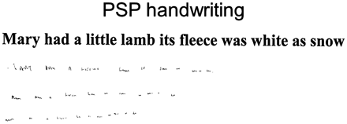
Figure 7 An example of micrographia from a patient with advanced PSP who had the smallest script size in the PSP group ...
Notes:
Figure 7 An example of micrographia from a patient with advanced PSP who had the smallest script size in the PSP group (UPDRSIII = 69, mean script size = 0.14 cm2, slope 1 = 0.23, slope 2 = −0.01).
Unless provided in the caption above, the following copyright applies to the content of this slide: © The Author (2012). Published by Oxford University Press on behalf of the Guarantors of Brain. All rights reserved. For Permissions, please email: journals.permissions@oup.com

