Slide 1
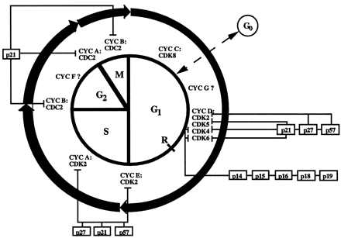
Fig. 1 Diagram to show the progression of the mammalian cell cycle and the phases that are regulated by specific ...
Notes:
Fig. 1 Diagram to show the progression of the mammalian cell cycle and the phases that are regulated by specific cyclin–CDK complexes (unboxed) and CDKIs (boxed).
Unless provided in the caption above, the following copyright applies to the content of this slide: Copyright © 1998, European Society of Cardiology

Slide 2
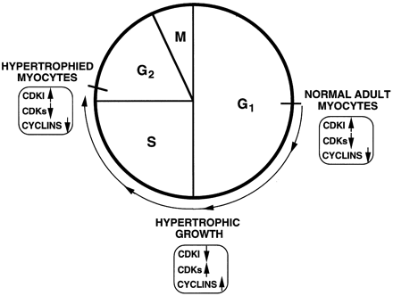
Fig. 2 Hypothesis for the involvement of cell cycle regulatory molecules in the development of cardiac myocyte ...
Notes:
Fig. 2 Hypothesis for the involvement of cell cycle regulatory molecules in the development of cardiac myocyte hypertrophic growth.
Unless provided in the caption above, the following copyright applies to the content of this slide: Copyright © 1998, European Society of Cardiology

