Slide 1
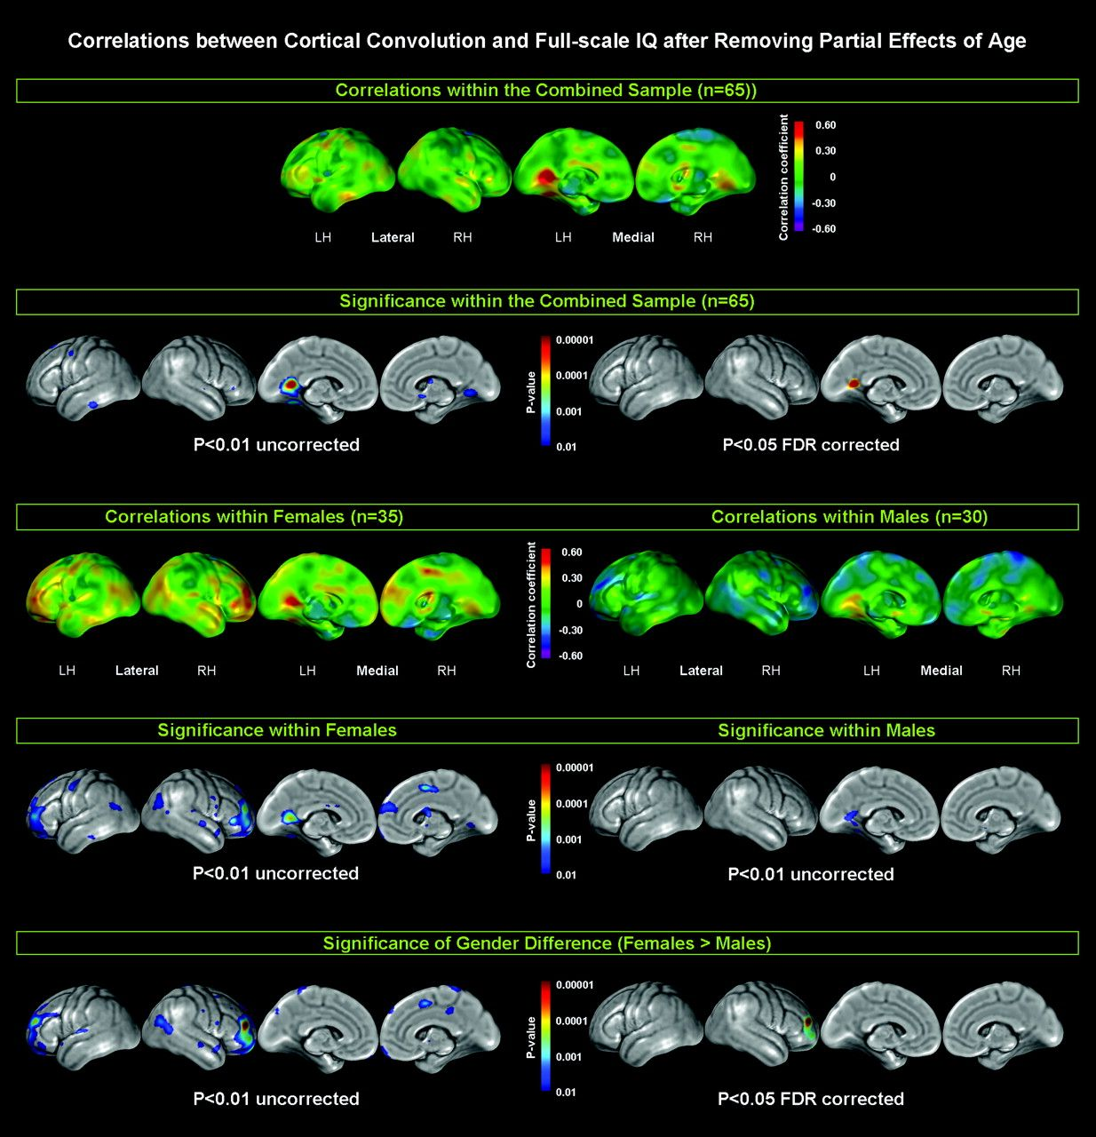
Figure 1. Relationships between cortical convolution and full-scale IQ, after removing the variance associated with ...
Notes:
Figure 1. Relationships between cortical convolution and full-scale IQ, after removing the variance associated with age. Larger positive values of correlation coefficients are color-coded in yellow, orange, and red; negative values appear in light blue, dark blue, and purple (1st and 3rd row). Significance values, both uncorrected at P < 0.01 and FDR corrected at P males).
Unless provided in the caption above, the following copyright applies to the content of this slide: © The Author 2007. Published by Oxford University Press. All rights reserved. For permissions, please e-mail: journals.permissions@oxfordjournals.org

Slide 2
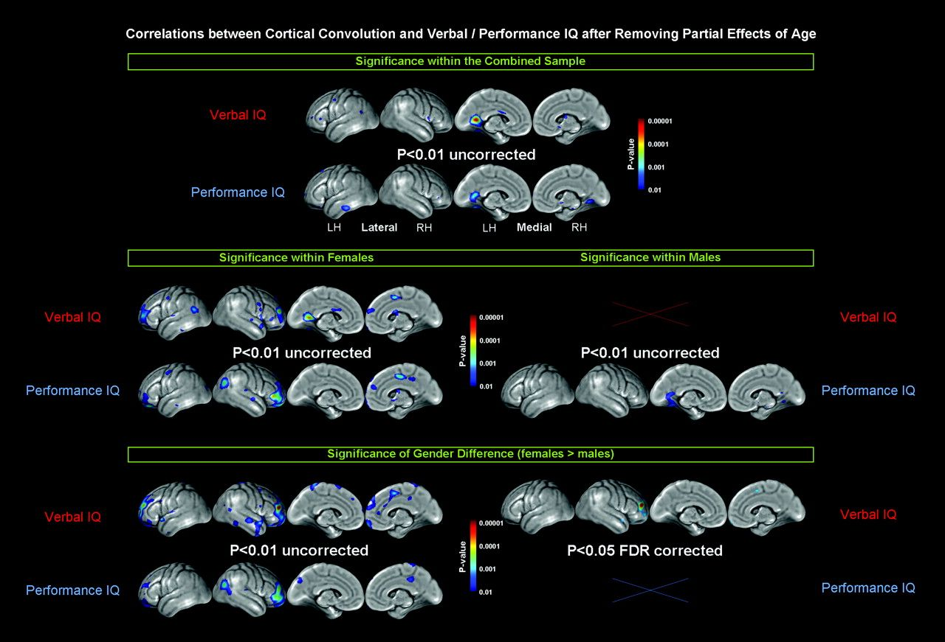
Figure 2. Relationships between cortical convolution and verbal/performance IQ, after removing the variance associated ...
Notes:
Figure 2. Relationships between cortical convolution and verbal/performance IQ, after removing the variance associated with age. Illustrated are uncorrected findings at P < 0.01 (if significant) and FDR corrected findings at P males).
Unless provided in the caption above, the following copyright applies to the content of this slide: © The Author 2007. Published by Oxford University Press. All rights reserved. For permissions, please e-mail: journals.permissions@oxfordjournals.org

