Slide 1
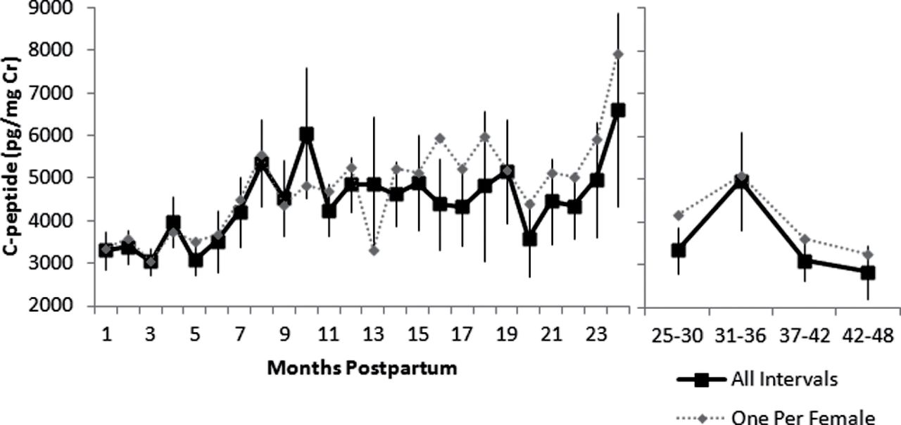
Figure 1. Profiles of C-peptide of insulin during lactational amenorrhea, with each point indicating the mean ± ...
Notes:
Figure 1. Profiles of C-peptide of insulin during lactational amenorrhea, with each point indicating the mean ± standard error across all intervals (bold line, 7–24 intervals sampled per point). Thin line depicts profile when only one interval from each female is considered(4–10 intervals per point). The left panel indicates monthly averages for the first 2 years of lactation; to maintain a sufficient sample size at each time point, data beyond 2 years are averaged by 6-month blocks in the right panel.
Unless provided in the caption above, the following copyright applies to the content of this slide: © The Author 2012. Published by Oxford University Press on behalf of the International Society for Behavioral Ecology. All rights reserved. For permissions, please e-mail: journals.permissions@oup.com

Slide 2
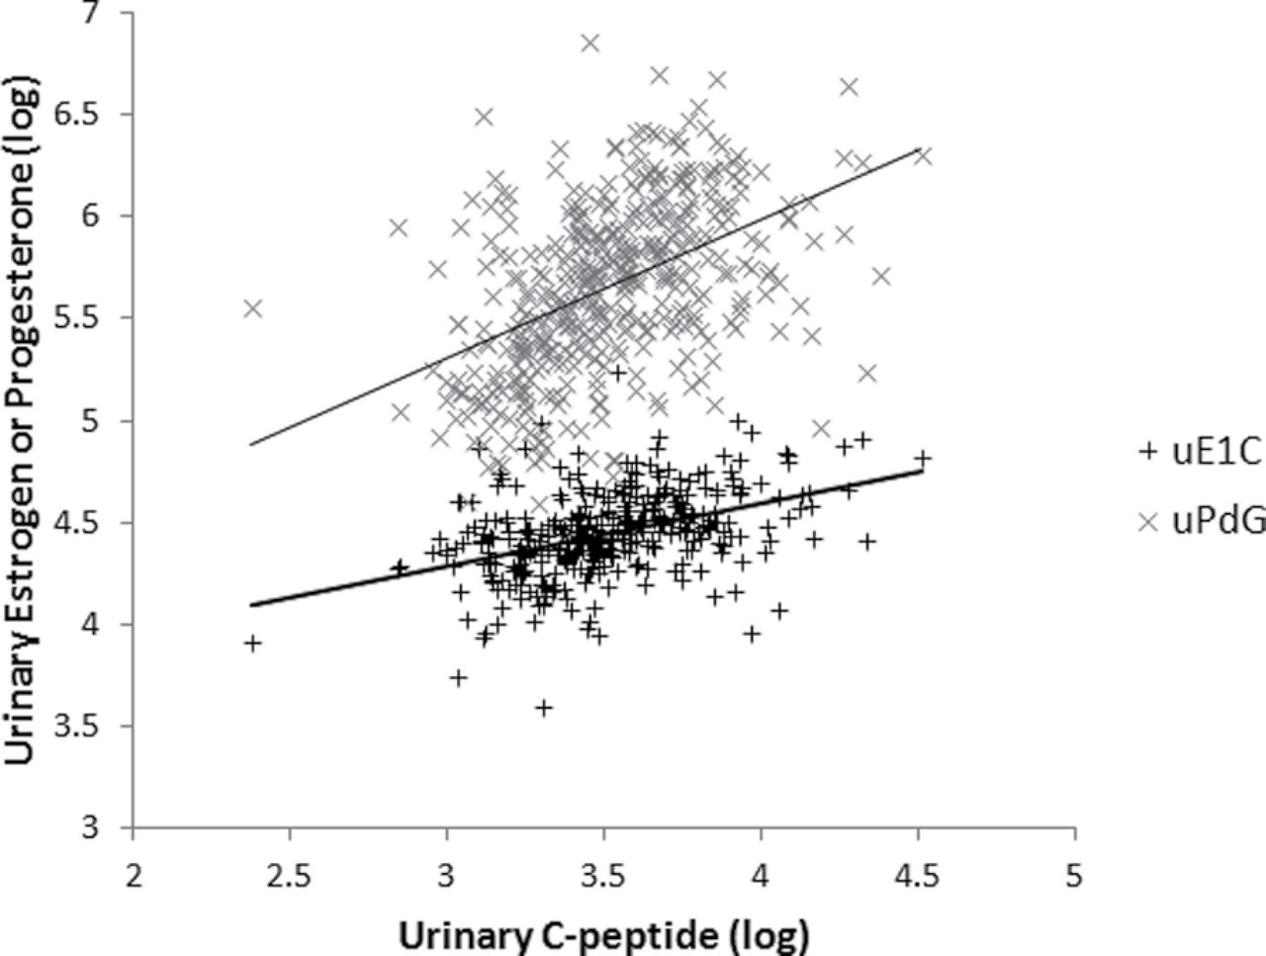
Figure 2. Relationship between C-peptide concentrations and urinary estrogen (E₁C, dark markers) and ...
Notes:
Figure 2. Relationship between C-peptide concentrations and urinary estrogen (E1C, dark markers) and progesterone (PdG, light markers) concentrations. Each marker indicates a monthly value for an individual female, log-transformed from pg/mg creatinine.
Unless provided in the caption above, the following copyright applies to the content of this slide: © The Author 2012. Published by Oxford University Press on behalf of the International Society for Behavioral Ecology. All rights reserved. For permissions, please e-mail: journals.permissions@oup.com

Slide 3
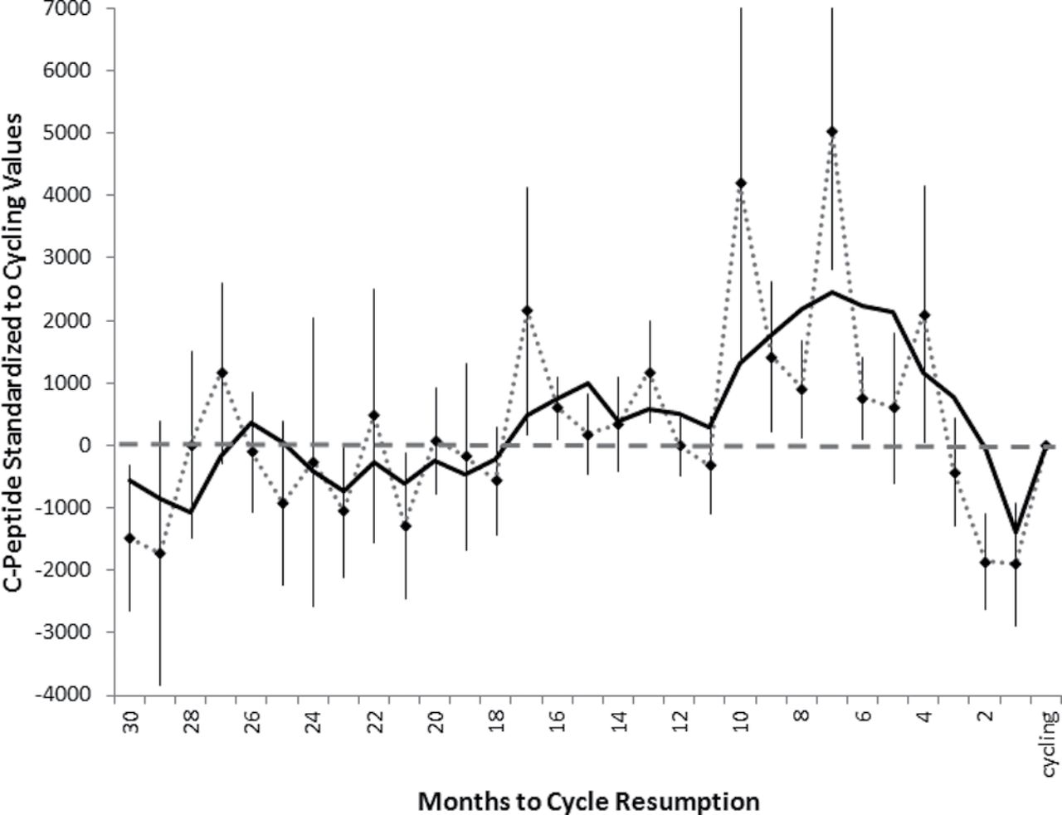
Figure 3. C-peptide concentrations aligned relative to the month of cycle resumption, standardized for the individual ...
Notes:
Figure 3. C-peptide concentrations aligned relative to the month of cycle resumption, standardized for the individual cycling value. Dotted line indicates monthly mean ± standard error across all intervals. Because approximately 40% of available intervals contributed data to a given point, we present an overlay of the smoothed data using 3-month running average (solid line, for visualization purposes only).
Unless provided in the caption above, the following copyright applies to the content of this slide: © The Author 2012. Published by Oxford University Press on behalf of the International Society for Behavioral Ecology. All rights reserved. For permissions, please e-mail: journals.permissions@oup.com

Slide 4
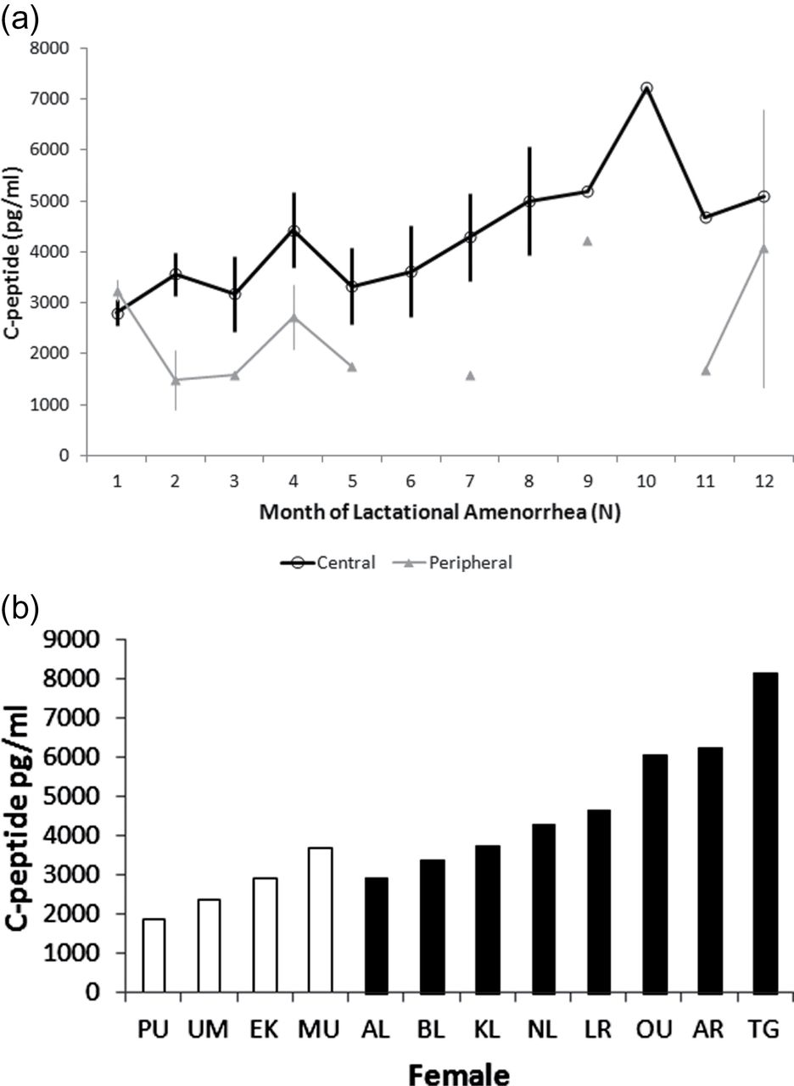
Figure 4. Contrast of early lactation C-peptide concentrations in females in high- and low-quality foraging areas. (a) ...
Notes:
Figure 4. Contrast of early lactation C-peptide concentrations in females in high- and low-quality foraging areas. (a) Early lactation C-peptide profiles of females in high-quality foraging areas (central, bold line)and low-quality areas (peripheral, thin line), with each point indicating the mean ± standard error all intervals. (b) Mean C-peptide levels of individual central (dark bars) and peripheral (white bars) females during the first year of lactation, selecting the most completely sampled postpartum individual per female.
Unless provided in the caption above, the following copyright applies to the content of this slide: © The Author 2012. Published by Oxford University Press on behalf of the International Society for Behavioral Ecology. All rights reserved. For permissions, please e-mail: journals.permissions@oup.com

