Slide 1
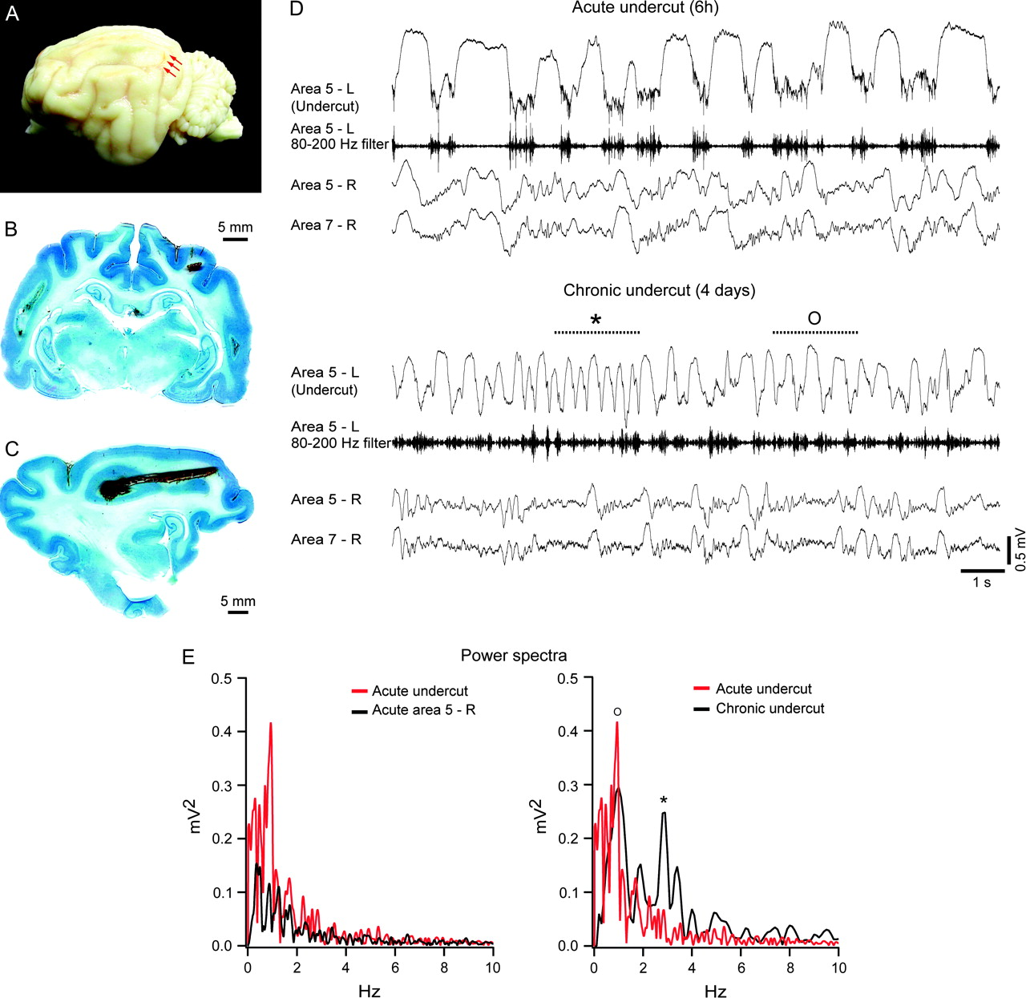
Figure 1 Experimental paradigm. (A) Lateral view of the left cerebral hemisphere. Experiments were performed on ...
Notes:
Figure 1 Experimental paradigm. (A) Lateral view of the left cerebral hemisphere. Experiments were performed on chronically implanted cats with complete transections of white matter below the suprasylvian gyrus. Red arrows indicate the place where the knife used to perform the undercut entered the cortex. (B) Frontal and (C) sagittal brain sections in Nissl staining used to ascertain the extent of cortical deafferentation. (D) EEG recordings in the deafferented (undercut) and intact cortex (areas 5 and 7 on the right side) 6 h after surgical proceeding (under anesthesia) and 4 days later (during SWS). Activity in the acutely partially deafferented cortex (area 5) is dominated by highly increased amplitude of the cortical slow oscillation (∼1 Hz), compared with normal slow oscillation in the opposite hemisphere (see also the left panel in E). (E) FFT power spectra. Four days later, during SWS, EEG in the undercut consists of a mixture of ∼1 Hz activity (O) and a faster activity of about 3–4 Hz (*).
Unless provided in the caption above, the following copyright applies to the content of this slide: © The Author 2006. Published by Oxford University Press. All rights reserved. For permissions, please e-mail: journals.permissions@oxfordjournals.org

Slide 2
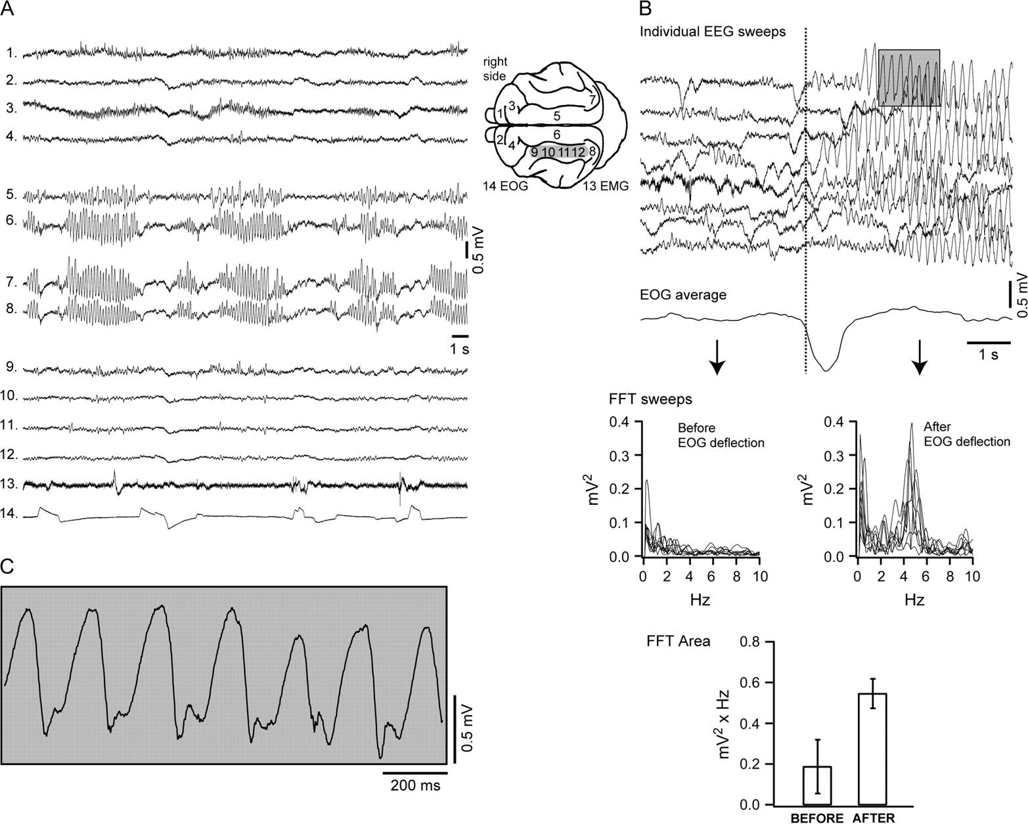
Figure 2 Relation of ictal events with eye movements. (A) Polygraphic recordings in a chronically implanted cat with a ...
Notes:
Figure 2 Relation of ictal events with eye movements. (A) Polygraphic recordings in a chronically implanted cat with a cortical undercut on the left side (depicted as a gray box on the schema) during wake. Ictal events with frequencies in the 3- to 4-Hz time domain are associated with ocular movements at the beginning and at the end of the seizure. (B) Multiple EEG individual sweeps obtained taking as reference the steepest drop in the EOG deflection. Spectral decompositions of single EEG trials (on 4 s windows before and after the EOG deflections) point out the occurrence of seizures after the eye movements both by the expression of a 4-Hz peak in the FFT and by the increase in the FFT area over the 2- to 6-Hz domain. (C) Ictal events expanded from the underlined gray box in (B) show typical spike-wave complexes.
Unless provided in the caption above, the following copyright applies to the content of this slide: © The Author 2006. Published by Oxford University Press. All rights reserved. For permissions, please e-mail: journals.permissions@oxfordjournals.org

Slide 3
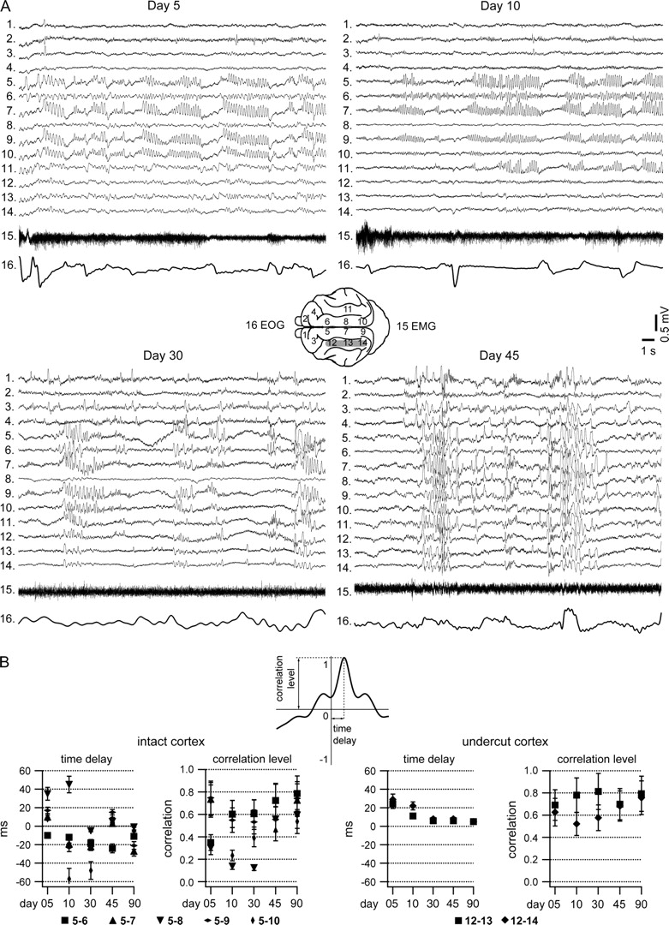
Figure 3 Topographic distributions of ictal events over the cortical surface from day 5 to day 45 during wake. (A) ...
Notes:
Figure 3 Topographic distributions of ictal events over the cortical surface from day 5 to day 45 during wake. (A) Polygraphic recordings in chronic cat with deafferented left suprasylvian gyrus (depicted as a gray box) indicate that paroxysmal activities are present initially in the cortical areas adjacent to the deafferented cortex, and they display a tendency toward generalization in time over the whole cortical surface. (B) Average time delays and peak level of cross-correlograms performed between different cortical EEG electrodes from day 5 to day 90 in 3 different experimental animals. In the intact cortex electrode 5 was taken as reference, whereas in the undercut the reference was the electrode 12. In the undercut the propagation of 4-Hz activities regularly displayed an anteroposterior pattern, whereas in the intact cortex seizures started around the deafferented cortex (electrodes 7 and 9). Data indicate a tendency toward faster propagation and increased correlation with time both in the intact and the undercut cortex.
Unless provided in the caption above, the following copyright applies to the content of this slide: © The Author 2006. Published by Oxford University Press. All rights reserved. For permissions, please e-mail: journals.permissions@oxfordjournals.org

Slide 4
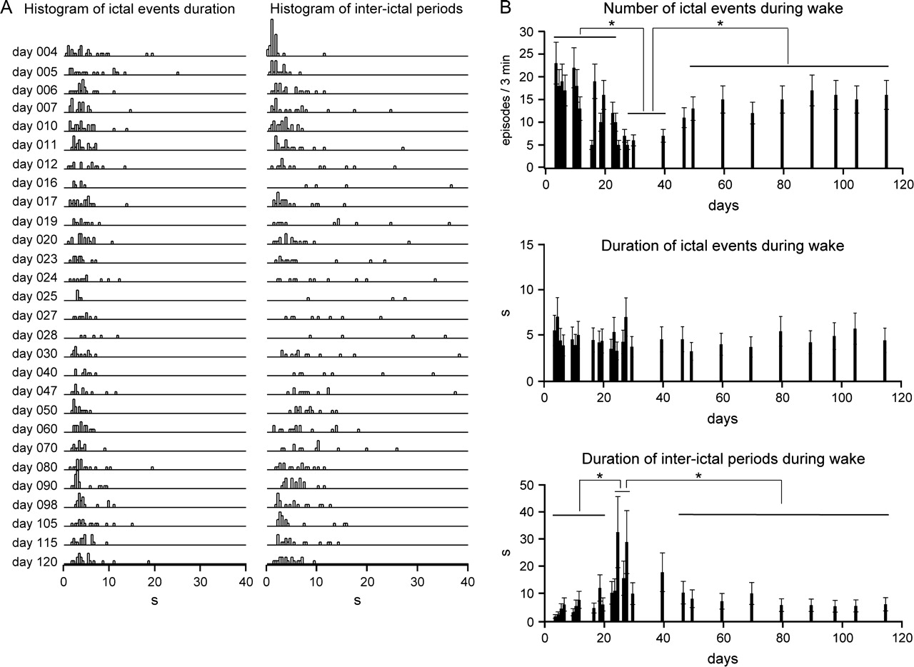
Figure 4 Incidence and duration of ictal events. (A) Histograms of ictal event duration and the length of interictal ...
Notes:
Figure 4 Incidence and duration of ictal events. (A) Histograms of ictal event duration and the length of interictal periods in a chronically implanted cat during waking state, in the left marginal gyrus. (B) Variation in time of the number of ictal events, the duration of ictal events and the length of the interictal during wake from recording day 3 to day 120. Although the duration of ictal event remained unchanged in time, the number is significantly diminished from day 25 to day 40, and it increases later up to a stable rate. Statistical differences (t-test, P < 0.05) are indicated with stars. This behavior was observed in 4/6 experimental animals.
Unless provided in the caption above, the following copyright applies to the content of this slide: © The Author 2006. Published by Oxford University Press. All rights reserved. For permissions, please e-mail: journals.permissions@oxfordjournals.org

Slide 5
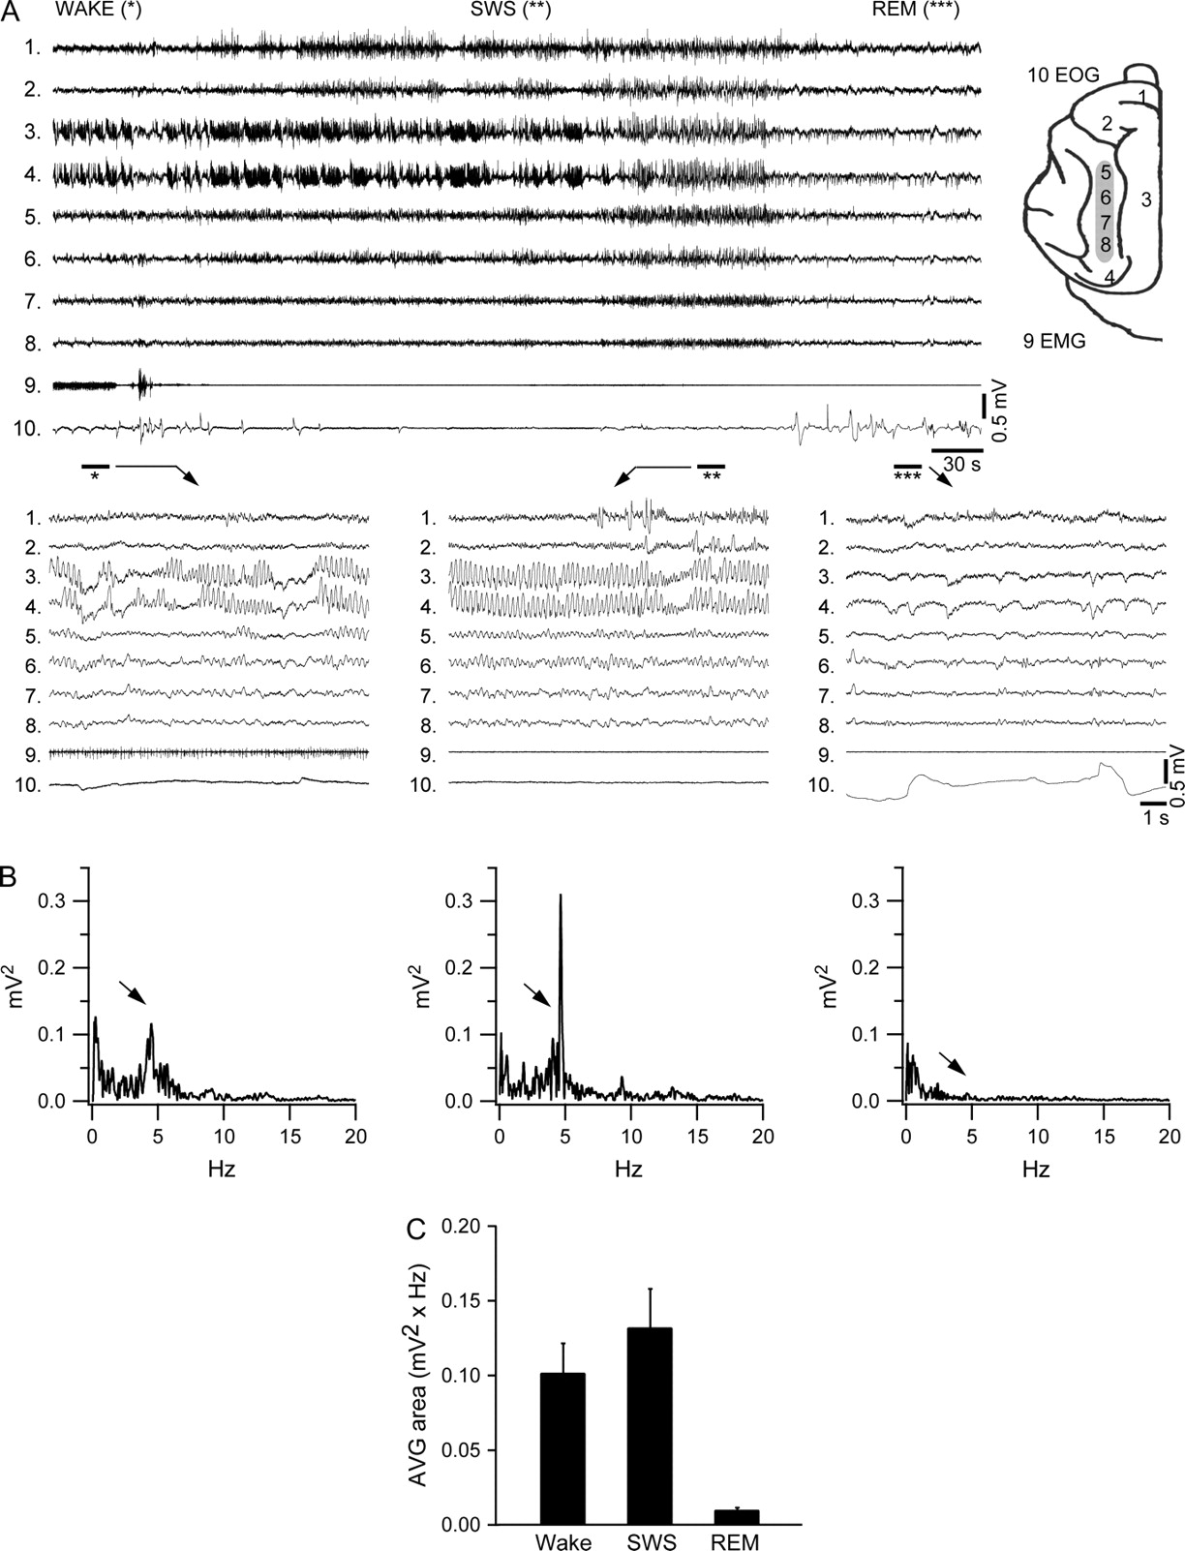
Figure 5 Sleep modulation of paroxysmal activities. (A) Top panel: polygraphic recording in a chronically implanted, ...
Notes:
Figure 5 Sleep modulation of paroxysmal activities. (A) Top panel: polygraphic recording in a chronically implanted, naturally awake and sleeping cat, 10 days after the undercut. The placement of recording electrodes is depicted on right scheme, and the undercut is represented as a gray box. Bottom panels: occurrence of paroxysmal (3–4 Hz) activities was consistently found during wake, quasi-continuous during SWS, and completely abolished during periods of REM sleep. (B) FFT power spectra of the field EEG from the left anterior marginal gyrus (electrode 3) during wake, SWS, and REM sleep. The peak of 4 Hz indicated by arrows is increased during SWS compared with wake and disappears during REM sleep. (C) Pool data from 6 chronic cats of the FFT area in the 3- to 5-Hz domain, corresponding to electrode 3, from recordings performed between day 5 and day 15.
Unless provided in the caption above, the following copyright applies to the content of this slide: © The Author 2006. Published by Oxford University Press. All rights reserved. For permissions, please e-mail: journals.permissions@oxfordjournals.org

Slide 6
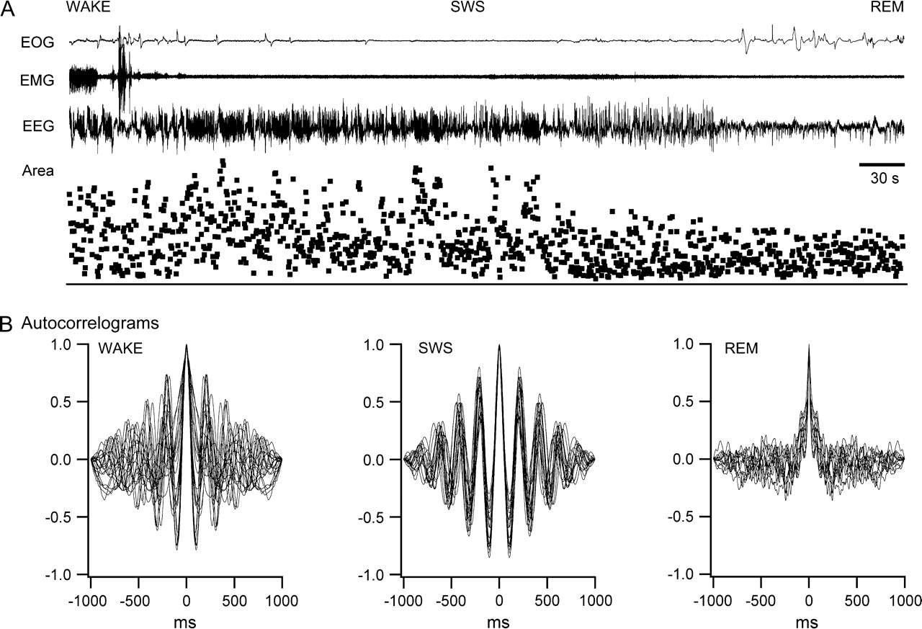
Figure 6 Quantification of sleep modulation of seizures. (A) Modulation by the state of vigilance of the area under ...
Notes:
Figure 6 Quantification of sleep modulation of seizures. (A) Modulation by the state of vigilance of the area under successive autocorrelograms measured over the window corresponding to the dominant frequency. (B) Autocorrelograms indicate a dominant frequency oscillation in the 4-Hz range during SWS and wake, more evident during SWS and abolished during REM sleep.
Unless provided in the caption above, the following copyright applies to the content of this slide: © The Author 2006. Published by Oxford University Press. All rights reserved. For permissions, please e-mail: journals.permissions@oxfordjournals.org

Slide 7
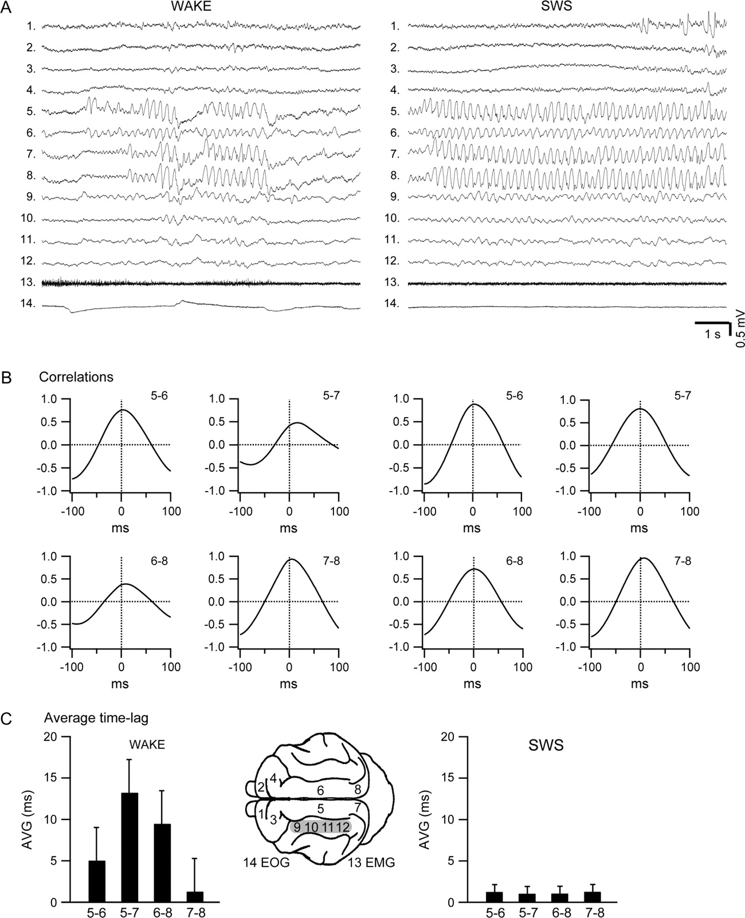
Figure 7 Spatiotemporal characteristics of ictal events. (A) Propagation of paroxysmal activities on the cortical ...
Notes:
Figure 7 Spatiotemporal characteristics of ictal events. (A) Propagation of paroxysmal activities on the cortical surface during wake and SWS in a chronic cat with a deafferented left suprasylvian gyrus in day 15 after the cortical undercut. The position of the recording electrodes is depicted on right scheme, and the undercut is represented as a gray box. Whereas during wake the ictal events appear consecutively in different EEG channels, during SWS they display a tendency toward a simultaneous occurrence. (B) Activities occurring in 4 EEG channels (anterior marginal left and right gyrus and posterior suprasylvian left and right gyrus) were correlated over 30 s and depicted as average correlations. (C) Average correlation time lag in 4 different chronic cats.
Unless provided in the caption above, the following copyright applies to the content of this slide: © The Author 2006. Published by Oxford University Press. All rights reserved. For permissions, please e-mail: journals.permissions@oxfordjournals.org

Slide 8
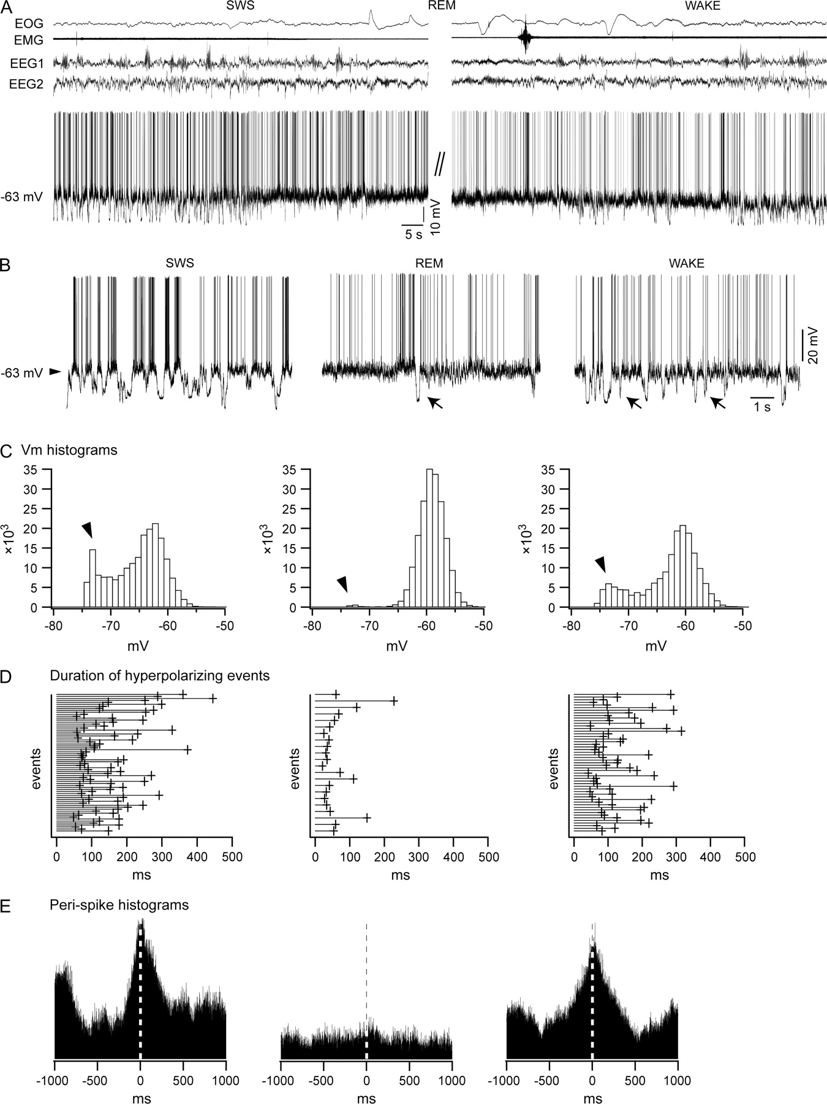
Figure 8 Intracellular correlates of seizures. (A) EEG in the marginal gyrus (EEG1) and local field (EEG2), EMG, EOG, ...
Notes:
Figure 8 Intracellular correlates of seizures. (A) EEG in the marginal gyrus (EEG1) and local field (EEG2), EMG, EOG, and intracellular recording of a regular-spiking neuron in a chronically implanted, naturally awake and sleeping cat, with a cortical undercut over the left suprasylvian gyrus, 15 days after deafferentation. (B) Patterns of neuronal activity during SWS, REM, and wake. Note the presence of hyperpolarizing events during both wake and REM sleep (pointed by arrows) that are expressed as the minor peak in the histograms of membrane potential (C). (C) Histograms of membrane potential distribution during SWS, REM, and wake. (D) Duration of the hyperpolarizations in the intracellular recording, during SWS, REM, and wake. These hyperpolarizing events are grouped in 2 clusters: short-length (<100 ms) and long-length (around 200–300 ms), and their occurrence is modulated by the state of vigilance. (E) Changes in the pattern of discharge of cortical neurons during various states of vigilance. Peri-spike histograms indicate a predilection for bursting behavior during SWS and wake, whereas during REM sleep neurons display a tonic-firing pattern.
Unless provided in the caption above, the following copyright applies to the content of this slide: © The Author 2006. Published by Oxford University Press. All rights reserved. For permissions, please e-mail: journals.permissions@oxfordjournals.org

