Slide 1
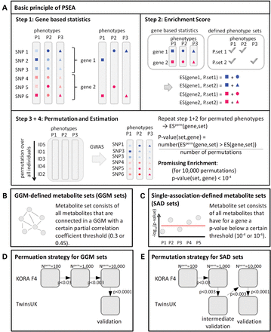
Figure 1. Schematic overview of the general method of PSEA (A), the definition of metabolite sets in this study (B and ...
Notes:
Figure 1. Schematic overview of the general method of PSEA (A), the definition of metabolite sets in this study (B and C) and the applied permutation schemes (D and E). In part (A), different shapes represent different phenotypes, different colours represent different genes and the intensity of the colour represents the association strength. (P, phenotype; p, P-value; P.set, phenotype set; ES, enrichment score; ESperm, enrichment score for permuted phenotypes; Nperm, number of permutations)
Unless provided in the caption above, the following copyright applies to the content of this slide: © The Author 2014. Published by Oxford University Press. All rights reserved. For Permissions, please email: journals.permissions@oup.com

Slide 2
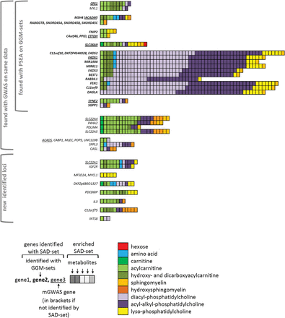
Figure 2. PSEA results on single association-defined metabolite sets (SAD set; threshold: 10⁻⁴) on Biocrates ...
Notes:
Figure 2. PSEA results on single association-defined metabolite sets (SAD set; threshold: 10−4) on Biocrates metabolites. All metabolite sets that were promisingly enriched in KORA F4 and validated in TwinsUK are presented along with the genes at which they were identified. Gene groups are separated by horizontal space. Details of the presentation are explained in below the figure.
Unless provided in the caption above, the following copyright applies to the content of this slide: © The Author 2014. Published by Oxford University Press. All rights reserved. For Permissions, please email: journals.permissions@oup.com

Slide 3
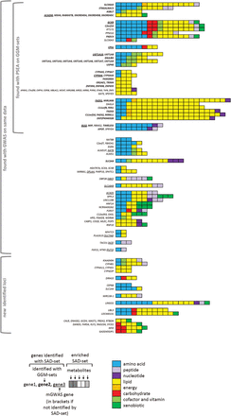
Figure 3. PSEA results on single association-defined metabolite sets (SAD set; threshold: 10⁻⁴) on Metabolon ...
Notes:
Figure 3. PSEA results on single association-defined metabolite sets (SAD set; threshold: 10−4) on Metabolon metabolites. All metabolite sets that were promisingly enriched in KORA F4 and validated in TwinsUK are presented along with their respective genes. Gene groups are separated by a horizontal space. Details of the presentation are explained below the figure.
Unless provided in the caption above, the following copyright applies to the content of this slide: © The Author 2014. Published by Oxford University Press. All rights reserved. For Permissions, please email: journals.permissions@oup.com

