Slide 1
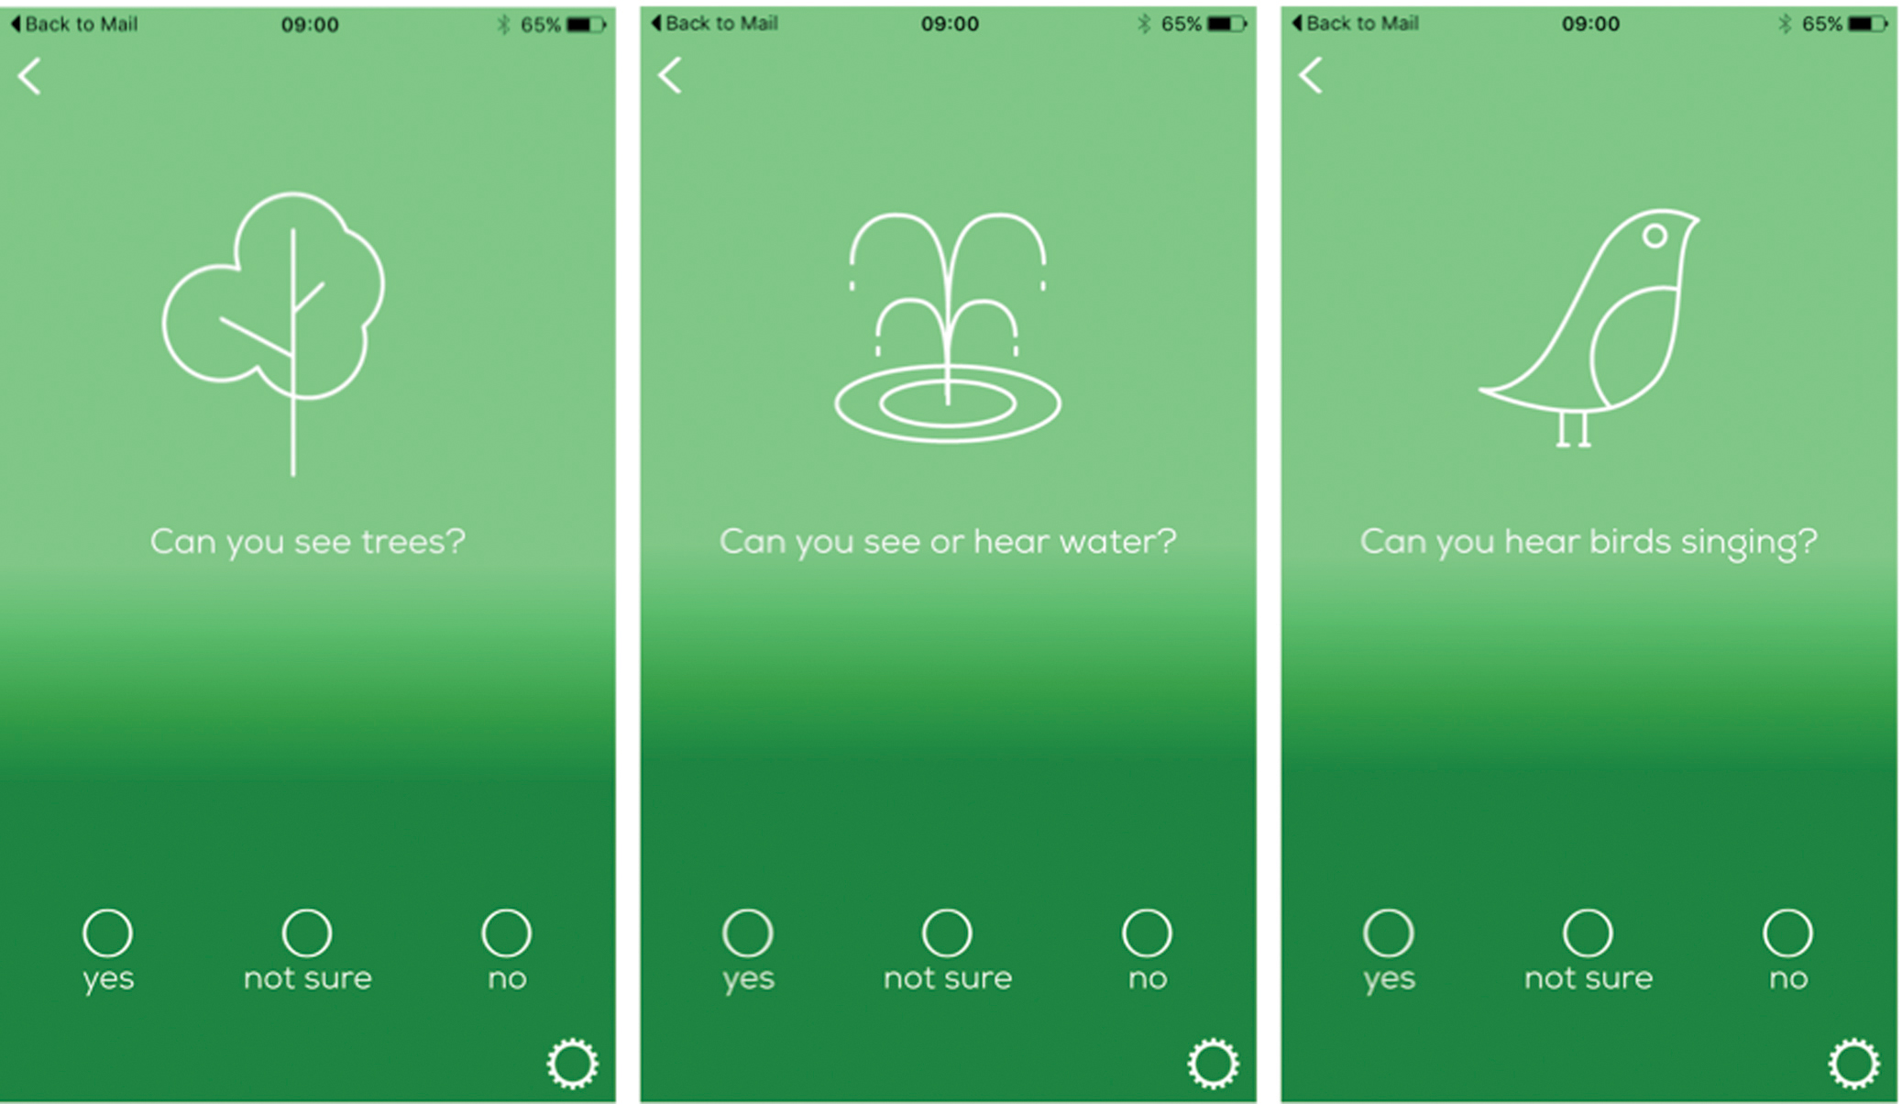
Figure 1. Screenshots of the Urban Mind tool.
Notes:
Figure 1. Screenshots of the Urban Mind tool.
Unless provided in the caption above, the following copyright applies to the content of this slide: © The Author(s) 2018. Published by Oxford University Press on behalf of the American Institute of Biological Sciences.This is an Open Access article distributed under the terms of the Creative Commons Attribution License (http://creativecommons.org/licenses/by/4.0/), which permits unrestricted reuse, distribution, and reproduction in any medium, provided the original work is properly cited.

Slide 2
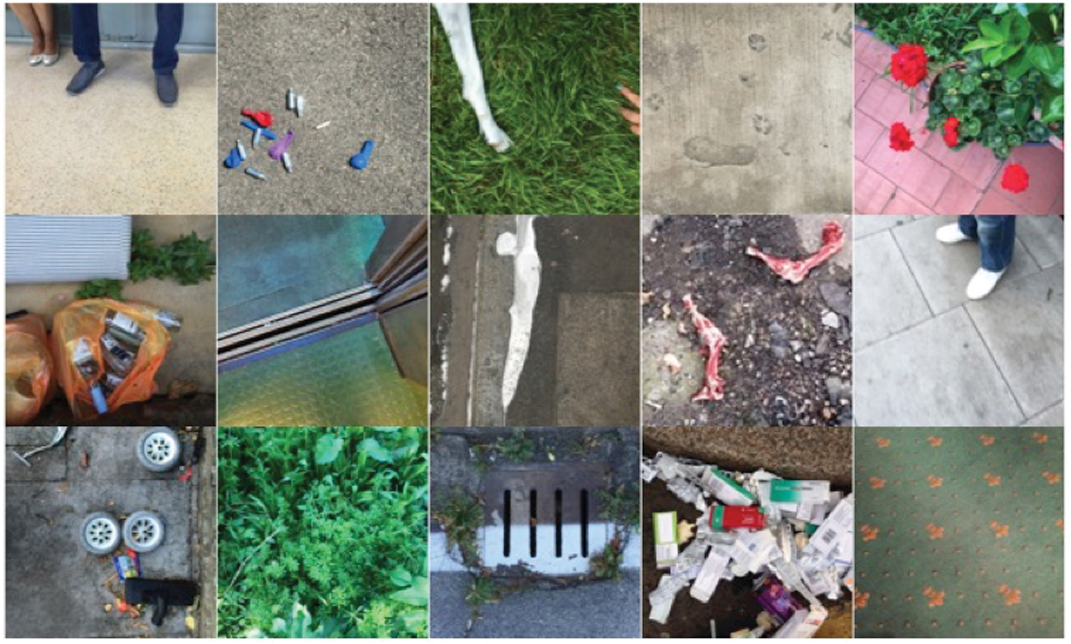
Figure 2. Selection of photographs submitted by participants using the Urban Mind tool.
Notes:
Figure 2. Selection of photographs submitted by participants using the Urban Mind tool.
Unless provided in the caption above, the following copyright applies to the content of this slide: © The Author(s) 2018. Published by Oxford University Press on behalf of the American Institute of Biological Sciences.This is an Open Access article distributed under the terms of the Creative Commons Attribution License (http://creativecommons.org/licenses/by/4.0/), which permits unrestricted reuse, distribution, and reproduction in any medium, provided the original work is properly cited.

Slide 3
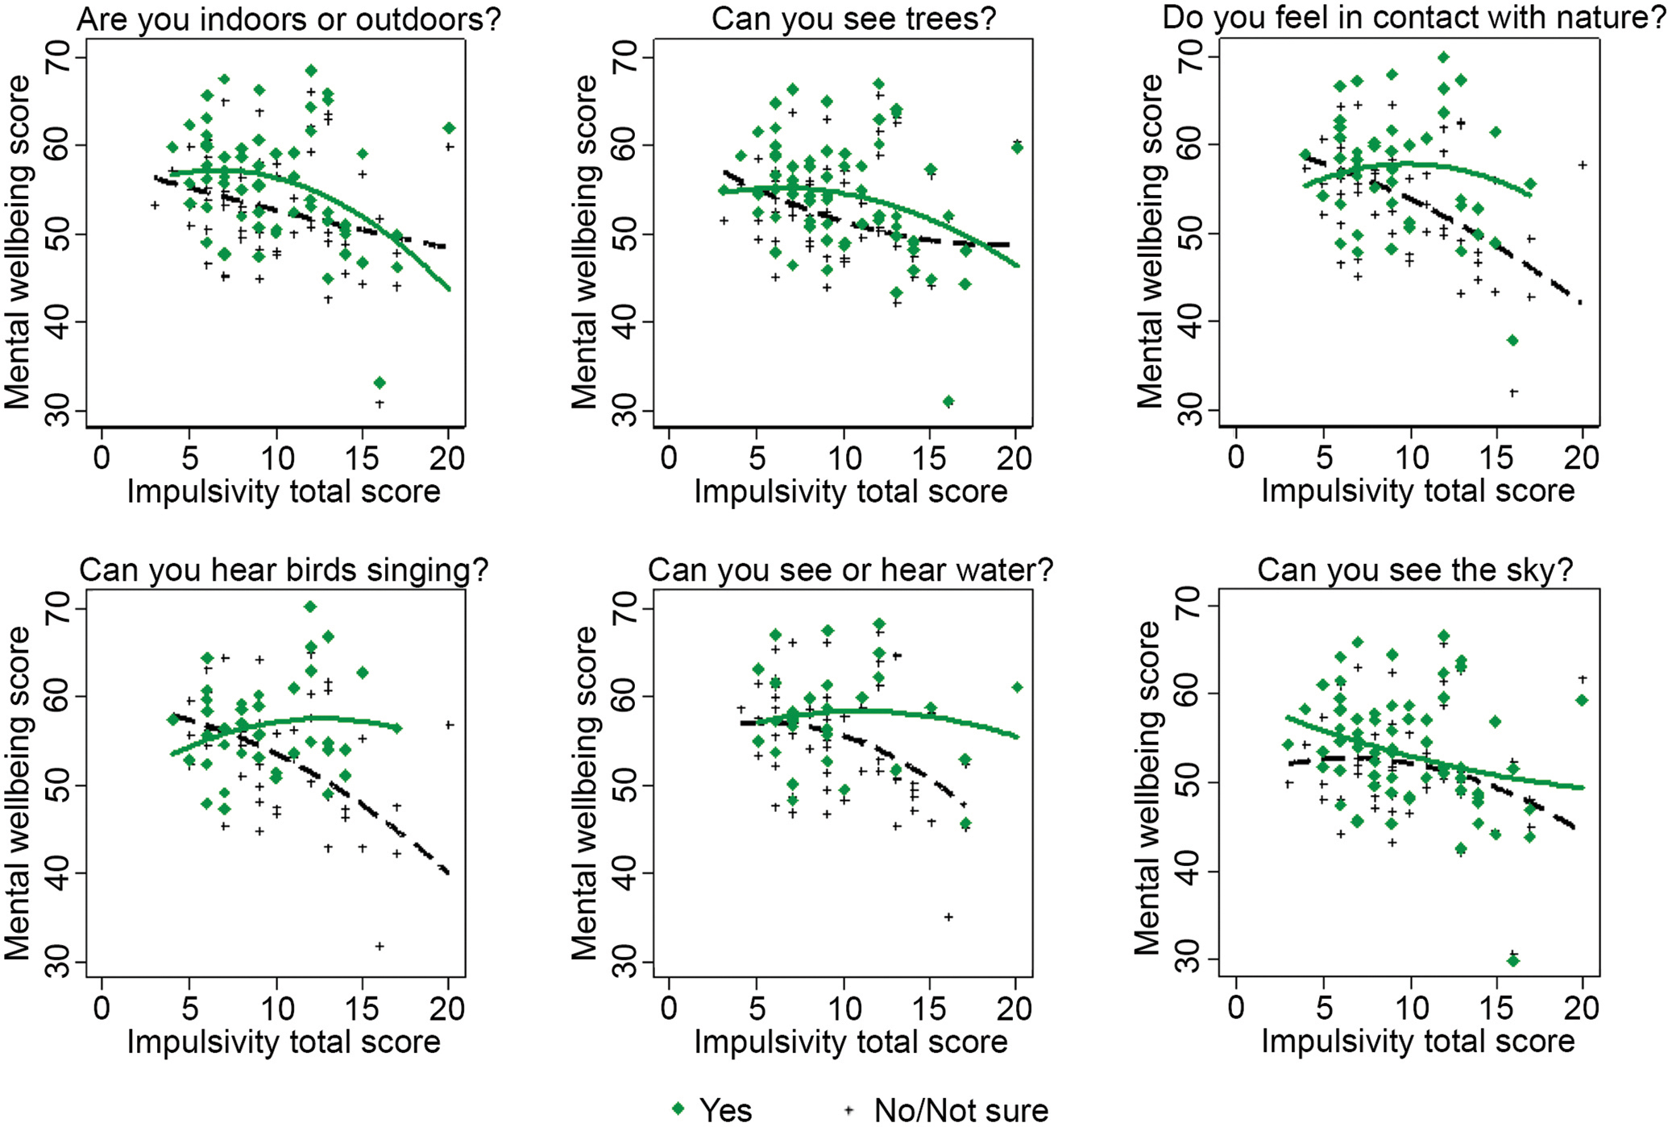
Figure 5. Mental well-being total score versus trait impulsivity score for participants with completed assessments > ...
Notes:
Figure 5. Mental well-being total score versus trait impulsivity score for participants with completed assessments > 50% with the use of random intercept linear models. Group-specific quadratic regression curves are shown for those that responded Yes and for those that responded No/Not sure to the questions “Are you indoors or outdoors?”, “Can you see trees?”, “Do you feel in contact with nature?”, “Can you hear birds singing?”, “Can you see or hear water?”, and “Can you see the sky?”. P-value for interaction term for the question “can you see the sky?” > 0.05. All the other p-values for the interaction terms < 0.05. See supplemental Table S4 for more details.
Unless provided in the caption above, the following copyright applies to the content of this slide: © The Author(s) 2018. Published by Oxford University Press on behalf of the American Institute of Biological Sciences.This is an Open Access article distributed under the terms of the Creative Commons Attribution License (http://creativecommons.org/licenses/by/4.0/), which permits unrestricted reuse, distribution, and reproduction in any medium, provided the original work is properly cited.

Slide 4
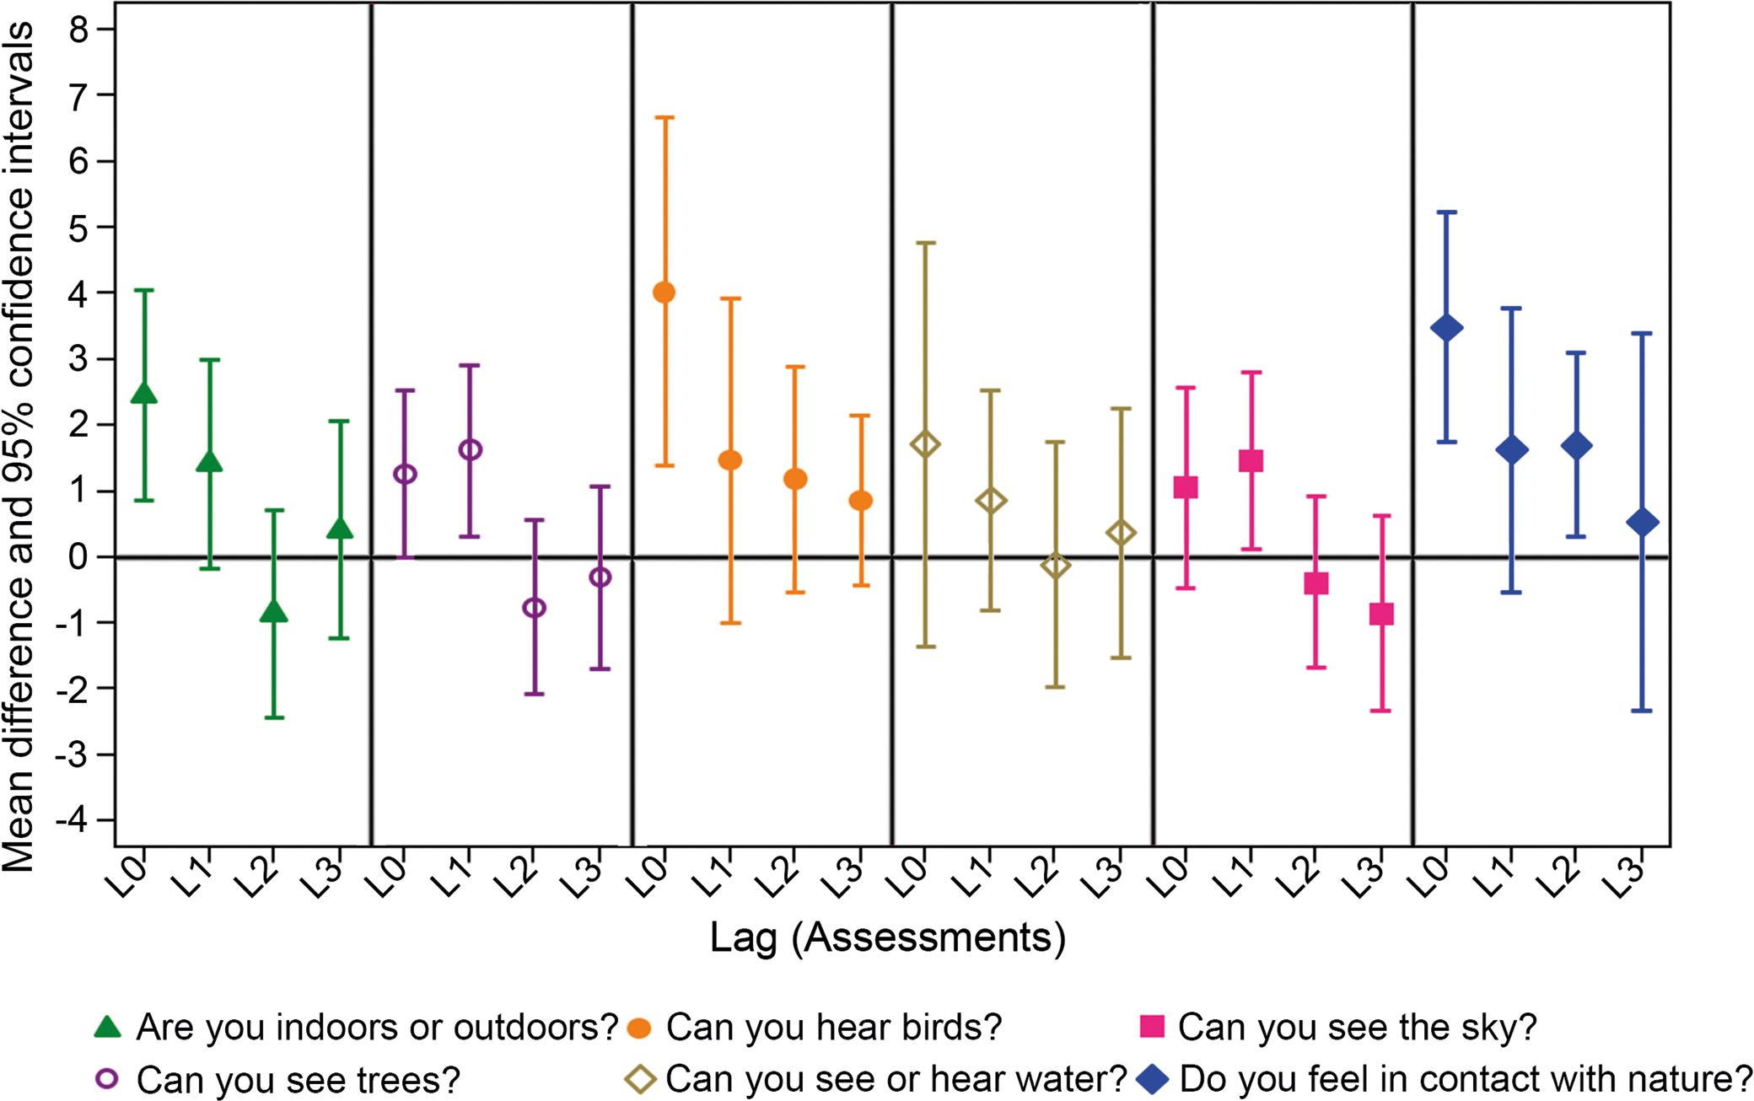
Figure 4. Associations of momentary mental well-being score in relation to self-reported environmental characteristics ...
Notes:
Figure 4. Associations of momentary mental well-being score in relation to self-reported environmental characteristics adjusted for age, gender, occupational status, and mental well-being over the previous two weeks with the use of the MICE procedure. The mean difference (MD) refers to the mean difference in momentary mental well-being score per category increase. The horizontal axis represents the assessments lagged from 0–3, and the vertical axis represents the MD with 95% confidence interval. L0 indicates the impact of a feature of interest on momentary well-being at the time of the first assessment; L1 indicates that the impact of a self-reported environmental feature of interest was still evident after 2 hours and 25 minutes; L2 would indicate that the impact of a feature of interest was still evident after 4 hours and 50 minutes; and L3 would indicate that the impact of a feature of interest was still evident after 7 hours and 15 minutes. See supplemental Table S3 for more details.
Unless provided in the caption above, the following copyright applies to the content of this slide: © The Author(s) 2018. Published by Oxford University Press on behalf of the American Institute of Biological Sciences.This is an Open Access article distributed under the terms of the Creative Commons Attribution License (http://creativecommons.org/licenses/by/4.0/), which permits unrestricted reuse, distribution, and reproduction in any medium, provided the original work is properly cited.

Slide 5
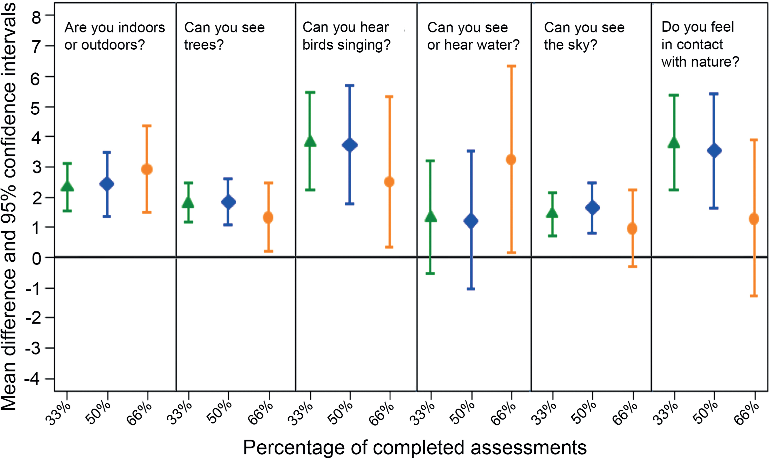
Figure 3. Associations between momentary mental well-being score in relation to self-reported environmental features ...
Notes:
Figure 3. Associations between momentary mental well-being score in relation to self-reported environmental features adjusted for age, gender, occupational status and mental well-being score over the previous two weeks for different thresholds of completed assessments (>33%, >50%, and >66%). The mean difference (MD) refers to the mean difference in momentary mental well-being score per category increase. The horizontal axis represents the different thresholds from 33%, 50%, and 66%, and the vertical axis represents the MD with 95% confidence interval. See supplemental Table S2 for more details.
Unless provided in the caption above, the following copyright applies to the content of this slide: © The Author(s) 2018. Published by Oxford University Press on behalf of the American Institute of Biological Sciences.This is an Open Access article distributed under the terms of the Creative Commons Attribution License (http://creativecommons.org/licenses/by/4.0/), which permits unrestricted reuse, distribution, and reproduction in any medium, provided the original work is properly cited.

