Slide 1
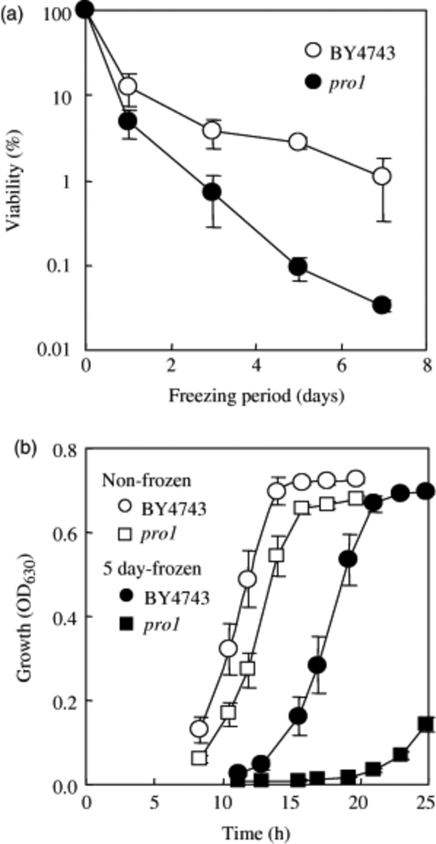
1 Viabilities (a) and growth curves (b) of the wild-type strain (BY 4743) and pro1 deletion mutant under ...
Notes:
1 Viabilities (a) and growth curves (b) of the wild-type strain (BY 4743) and pro1 deletion mutant under freeze–thaw stress conditions. Values are expressed as mean±standard deviation from triplicate experiments.
Unless provided in the caption above, the following copyright applies to the content of this slide: © 2006 Federation of European Microbiological Societies Published by Blackwell Publishing Ltd. All rights reserved

Slide 2
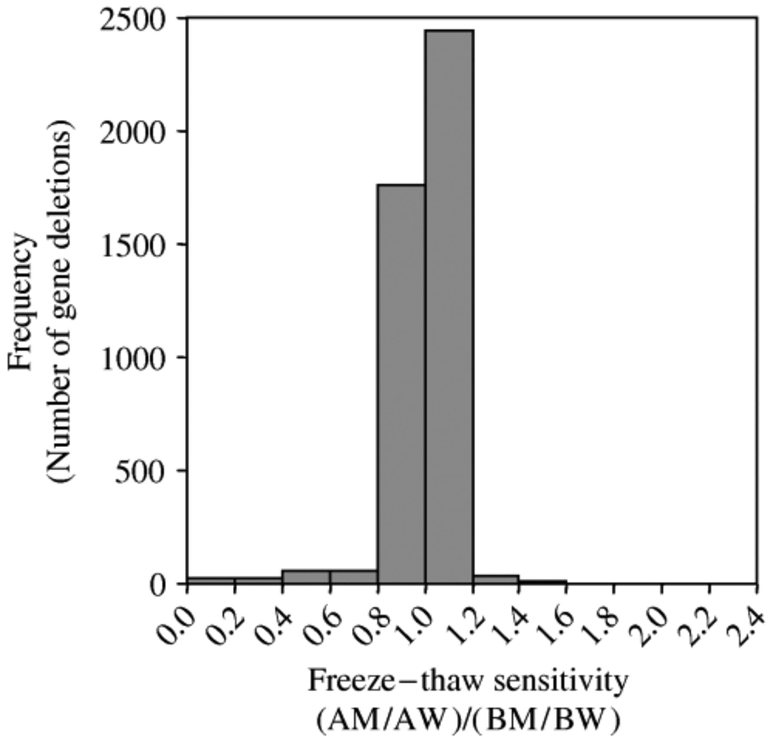
2 Frequency distribution of freeze–thaw tolerance of gene deletion mutants. Freeze–thaw tolerance is expressed ...
Notes:
2 Frequency distribution of freeze–thaw tolerance of gene deletion mutants. Freeze–thaw tolerance is expressed as (AM/AW)/(BM/BW) (see Materials and methods). Mutants with (AM/AW)/(BM/BW) below 0.5 were defined as freeze–thaw sensitive.
Unless provided in the caption above, the following copyright applies to the content of this slide: © 2006 Federation of European Microbiological Societies Published by Blackwell Publishing Ltd. All rights reserved

Slide 3
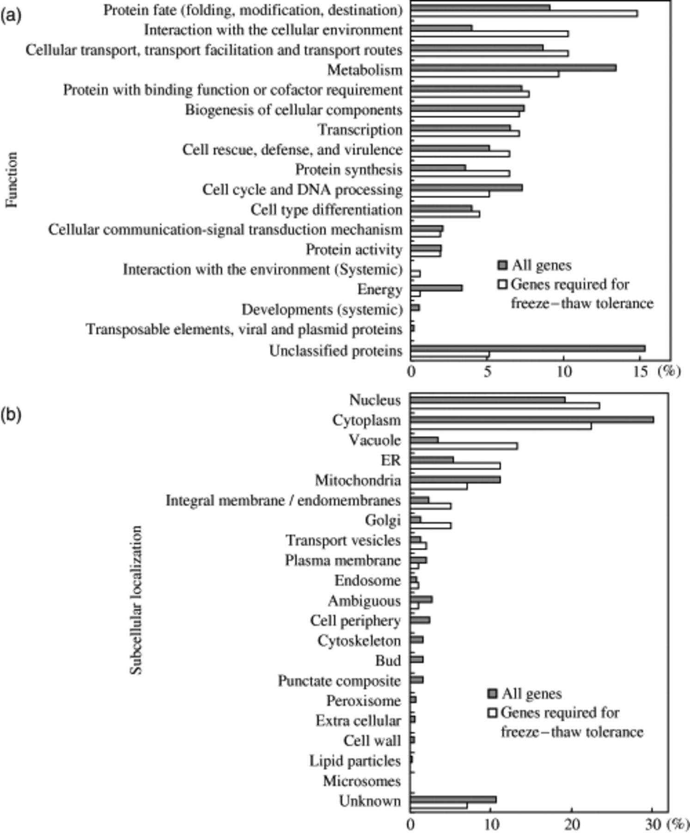
3 Function (a) and subcellular product localization (b) of genes required for tolerance (58 genes) to ...
Notes:
3 Function (a) and subcellular product localization (b) of genes required for tolerance (58 genes) to freeze–thaw stress and of all genes deleted in the complete set of strains. Classifications were determined on the basis of the MIPS database (see Materials and methods).
Unless provided in the caption above, the following copyright applies to the content of this slide: © 2006 Federation of European Microbiological Societies Published by Blackwell Publishing Ltd. All rights reserved

Slide 4
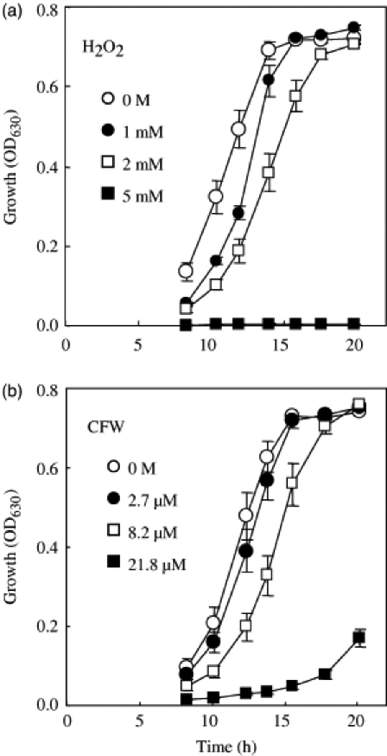
4 Growth of the wild-type strain in YPD medium containing (a) 0–5 mM H₂O₂, and (b) YPD ...
Notes:
4 Growth of the wild-type strain in YPD medium containing (a) 0–5 mM H2O2, and (b) YPD medium containing 0–21.8 μM calcofluor white. OD630 nm values are expressed as mean±standard deviation from triplicate experiments.
Unless provided in the caption above, the following copyright applies to the content of this slide: © 2006 Federation of European Microbiological Societies Published by Blackwell Publishing Ltd. All rights reserved

Slide 5
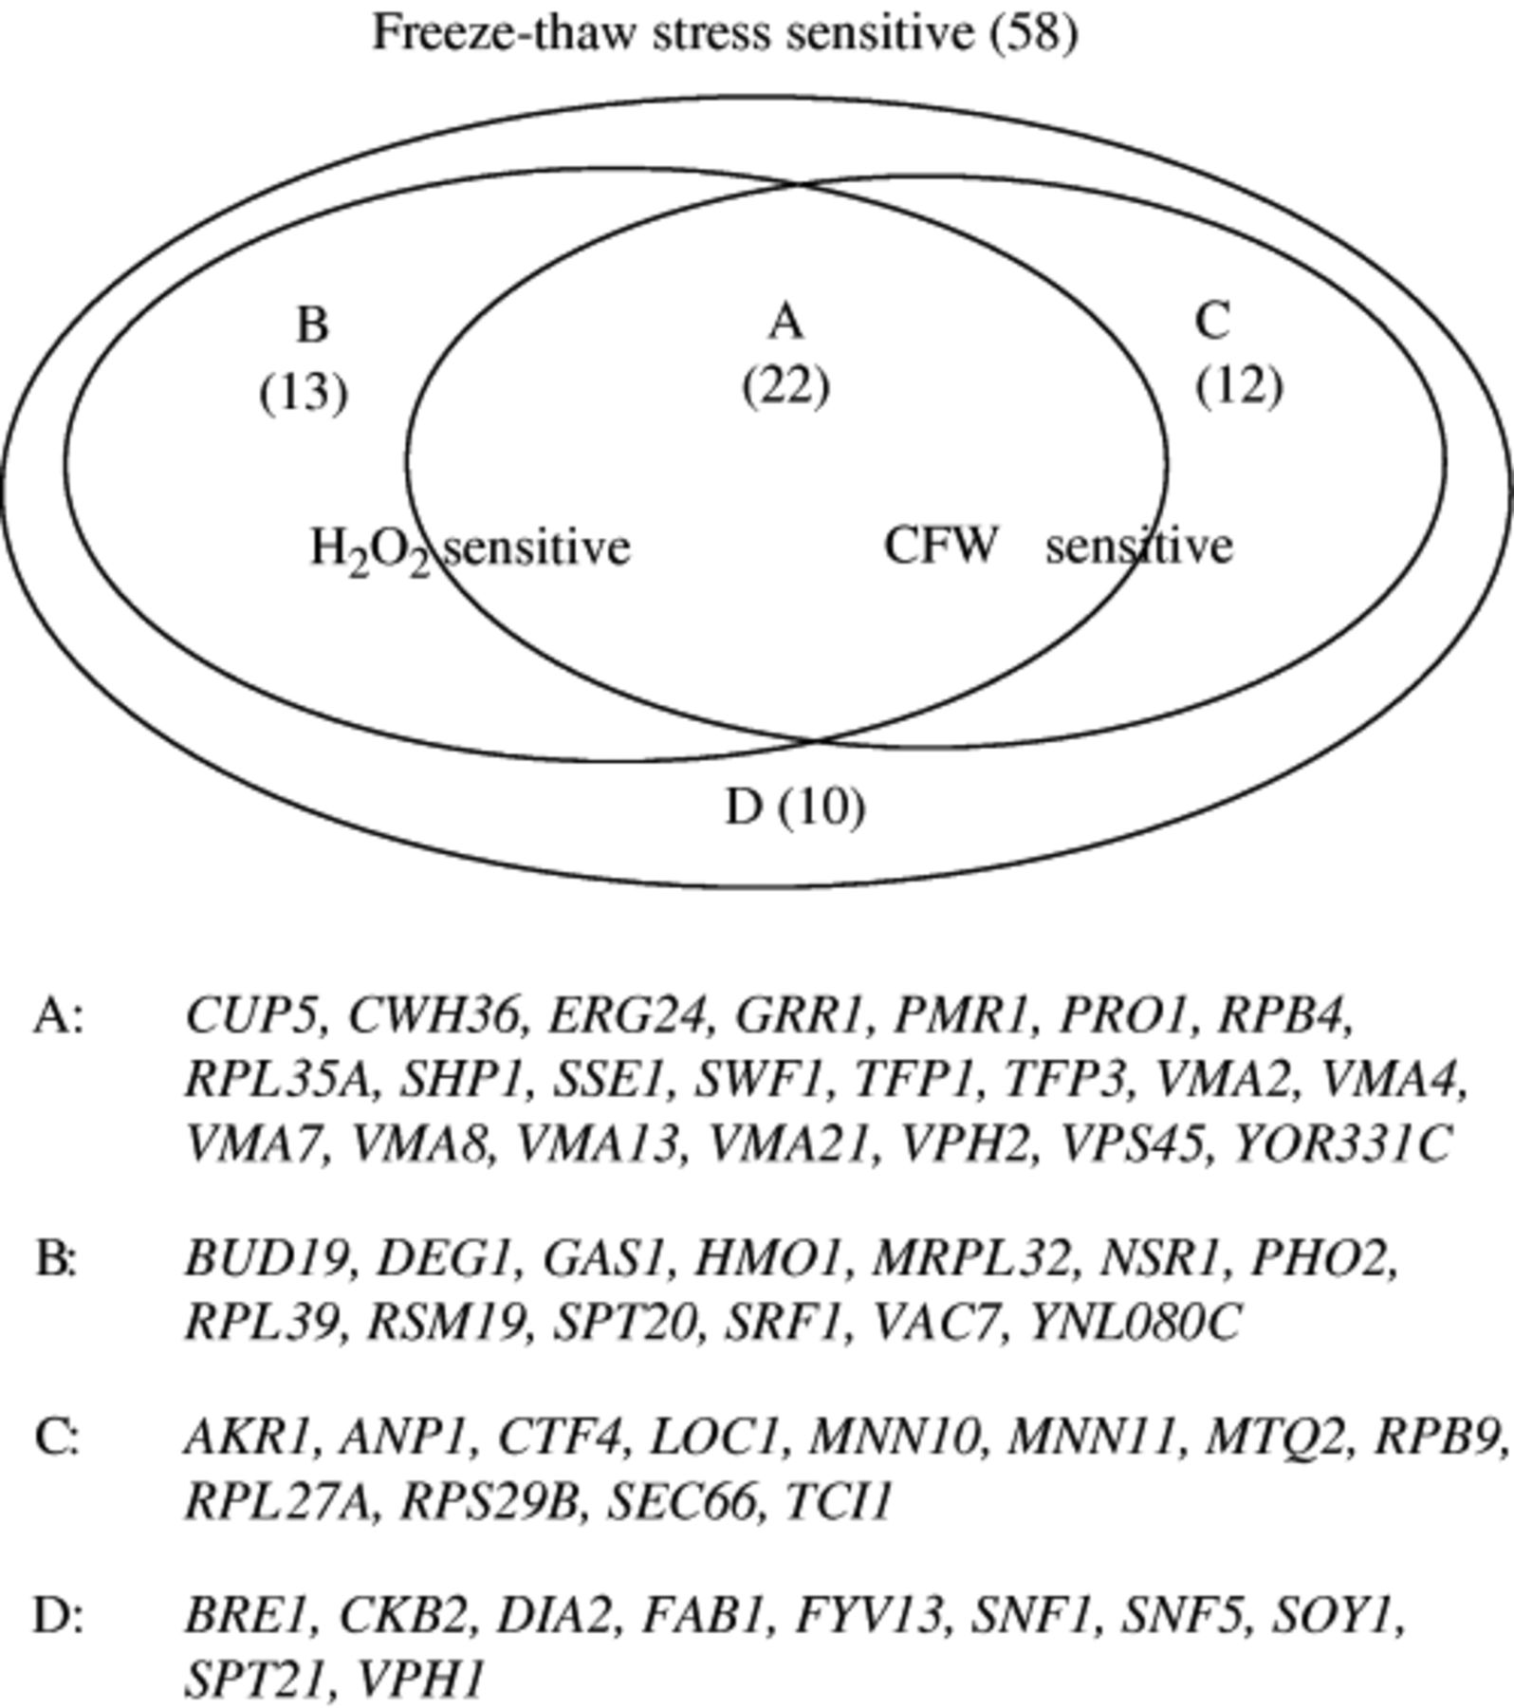
5 Venn diagram of number of freeze–thaw-sensitive deletion mutants that showed cross-sensitivity to oxidative ...
Notes:
5 Venn diagram of number of freeze–thaw-sensitive deletion mutants that showed cross-sensitivity to oxidative stress caused by H2O2 and/or to cell wall stress caused by calcofluor white. Deleted genes in the mutants included in groups A–D are shown.
Unless provided in the caption above, the following copyright applies to the content of this slide: © 2006 Federation of European Microbiological Societies Published by Blackwell Publishing Ltd. All rights reserved

Slide 6
6 Distribution of subcellular product localization of the genes deleted in mutants included in each group ...
Notes:
6 Distribution of subcellular product localization of the genes deleted in mutants included in each group defined in Fig. 5.
Unless provided in the caption above, the following copyright applies to the content of this slide: © 2006 Federation of European Microbiological Societies Published by Blackwell Publishing Ltd. All rights reserved

