Slide 1
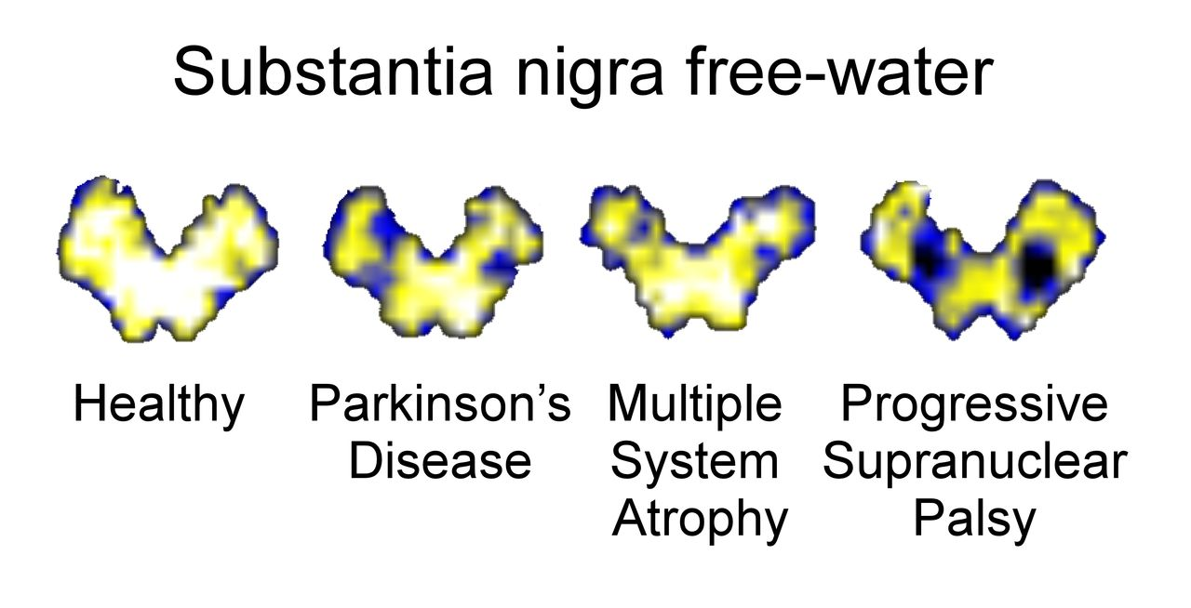
Non-invasive biomarkers are needed to support differential diagnosis in Parkinsonian disorders. Using a ...
Notes:
Non-invasive biomarkers are needed to support differential diagnosis in Parkinsonian disorders. Using a bi-tensor diffusion model, Planetta et al. examine structural differences between Parkinson’s disease, multiple system atrophy, and progressive supranuclear palsy. A cross-validated machine learning procedure using regions of interest consistent with pathology studies separates groups with excellent accuracy.
Unless provided in the caption above, the following copyright applies to the content of this slide: © The Author (2015). Published by Oxford University Press on behalf of the Guarantors of Brain. All rights reserved. For Permissions, please email: journals.permissions@oup.com

Slide 2
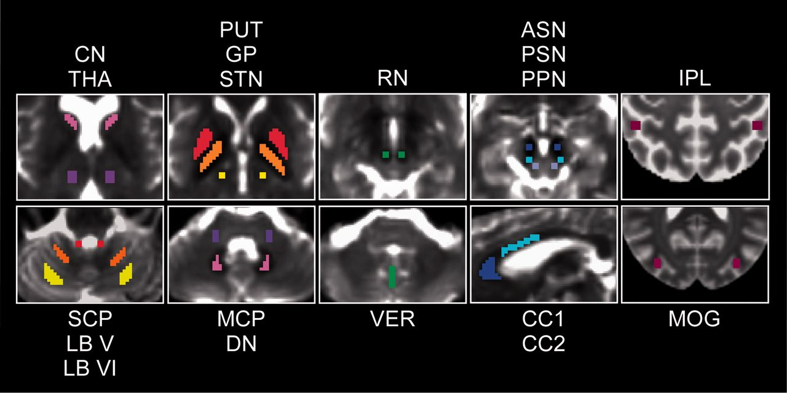
Figure 1 Regions of interest and control regions of interest. ASN = anterior substantia nigra; CC1 = corpus callosum ...
Notes:
Figure 1 Regions of interest and control regions of interest. ASN = anterior substantia nigra; CC1 = corpus callosum region 1; CC2 = corpus callosum region 2; CN = caudate nucleus; DN = dentate nucleus; GP = globus pallidus; IPL = inferior parietal lobule; LB V = cerebellar lobule V; LB VI = cerebellar lobule VI; MCP = middle cerebellar peduncle; MOG = middle occipital gyrus; PPN = pedunculopontine nucleus; PSN = posterior substantia nigra; PUT = putamen; RN = red nucleus; SCP = superior cerebellar peduncle; STN = subthalamic nucleus; THA = thalamus; VER = vermis.
Unless provided in the caption above, the following copyright applies to the content of this slide: © The Author (2015). Published by Oxford University Press on behalf of the Guarantors of Brain. All rights reserved. For Permissions, please email: journals.permissions@oup.com

Slide 3
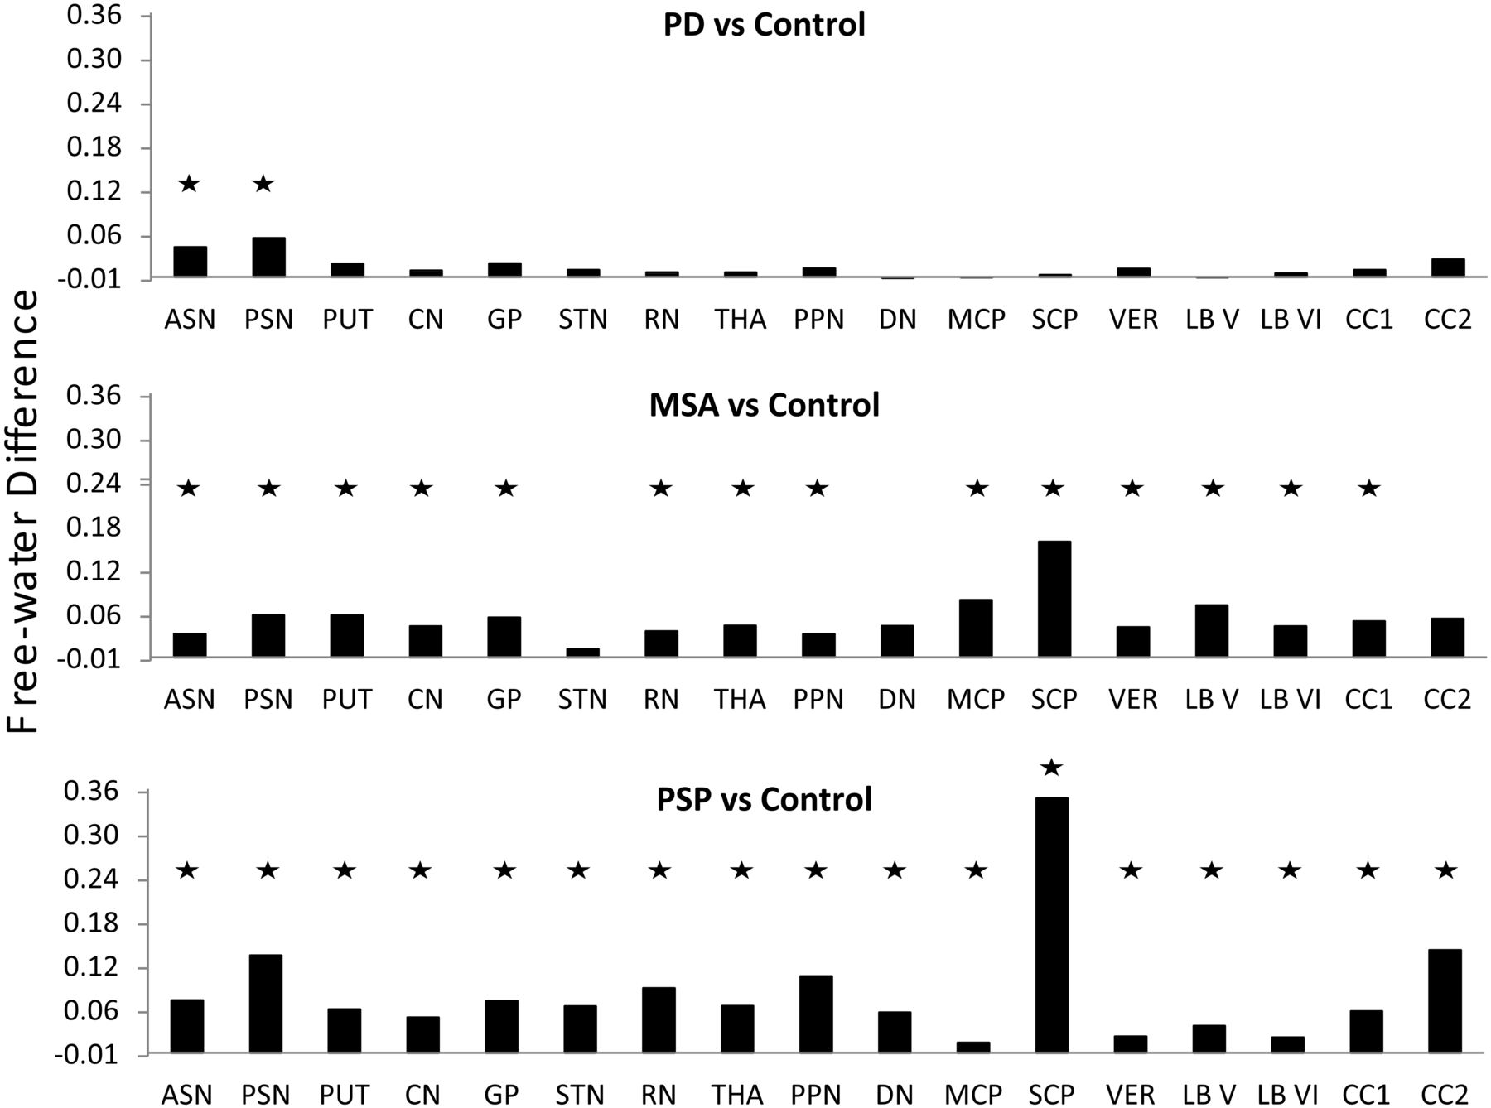
Figure 2 Mean difference in free-water values in each region of interest for Parkinson’s disease-control (top), ...
Notes:
Figure 2 Mean difference in free-water values in each region of interest for Parkinson’s disease-control (top), MSA-control (middle), and PSP-control (bottom). ASN = anterior substantia nigra; CC1 = corpus callosum region 1; CC2 = corpus callosum region 2; CN = caudate nucleus; DN = dentate nucleus; GP = globus pallidus; LB V = cerebellar lobule V; LB VI = cerebellar lobule VI; MCP = middle cerebellar peduncle; MSA = multiple system atrophy; PD = Parkinson’s disease; PPN = pedunculopontine nucleus; PSN = posterior substantia nigra; PSP = progressive supranuclear palsy; PUT = putamen; RN = red nucleus; SCP = superior cerebellar peduncle; STN = subthalamic nucleus; THA = thalamus; VER = vermis. Asterisks denote a significant difference after correction for multiple comparisons.
Unless provided in the caption above, the following copyright applies to the content of this slide: © The Author (2015). Published by Oxford University Press on behalf of the Guarantors of Brain. All rights reserved. For Permissions, please email: journals.permissions@oup.com

Slide 4
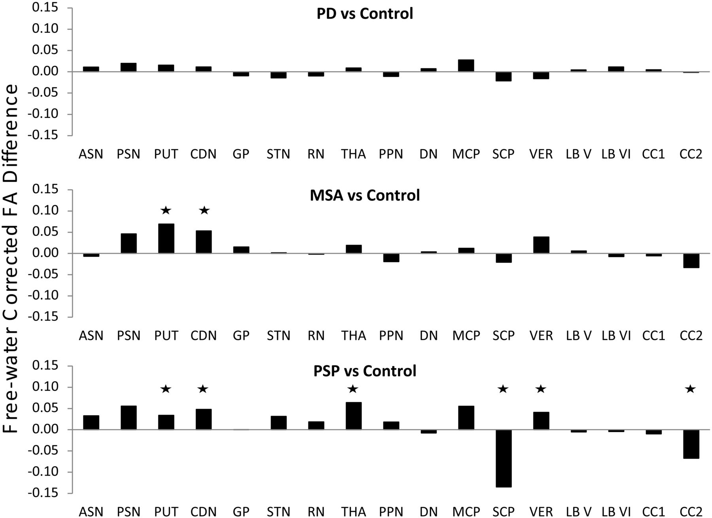
Figure 3 Mean difference in free-water-corrected fractional anisotropy values in each region of interest for ...
Notes:
Figure 3 Mean difference in free-water-corrected fractional anisotropy values in each region of interest for Parkinson’s disease-control (top), MSA-control (middle), and PSP-control (bottom). ASN = anterior substantia nigra; CC2 = corpus callosum region 2; CN = caudate nucleus; LB VI = cerebellar lobule VI; MCP = middle cerebellar peduncle; MSA = multiple system atrophy; PD = Parkinson’s disease; PSN = posterior substantia nigra; PSP = progressive supranuclear palsy; PUT = putamen; SCP = superior cerebellar peduncle; STN = subthalamic nucleus; THA = thalamus; VER = vermis. Asterisks denote a significant difference after correction for multiple comparisons.
Unless provided in the caption above, the following copyright applies to the content of this slide: © The Author (2015). Published by Oxford University Press on behalf of the Guarantors of Brain. All rights reserved. For Permissions, please email: journals.permissions@oup.com

