Slide 1
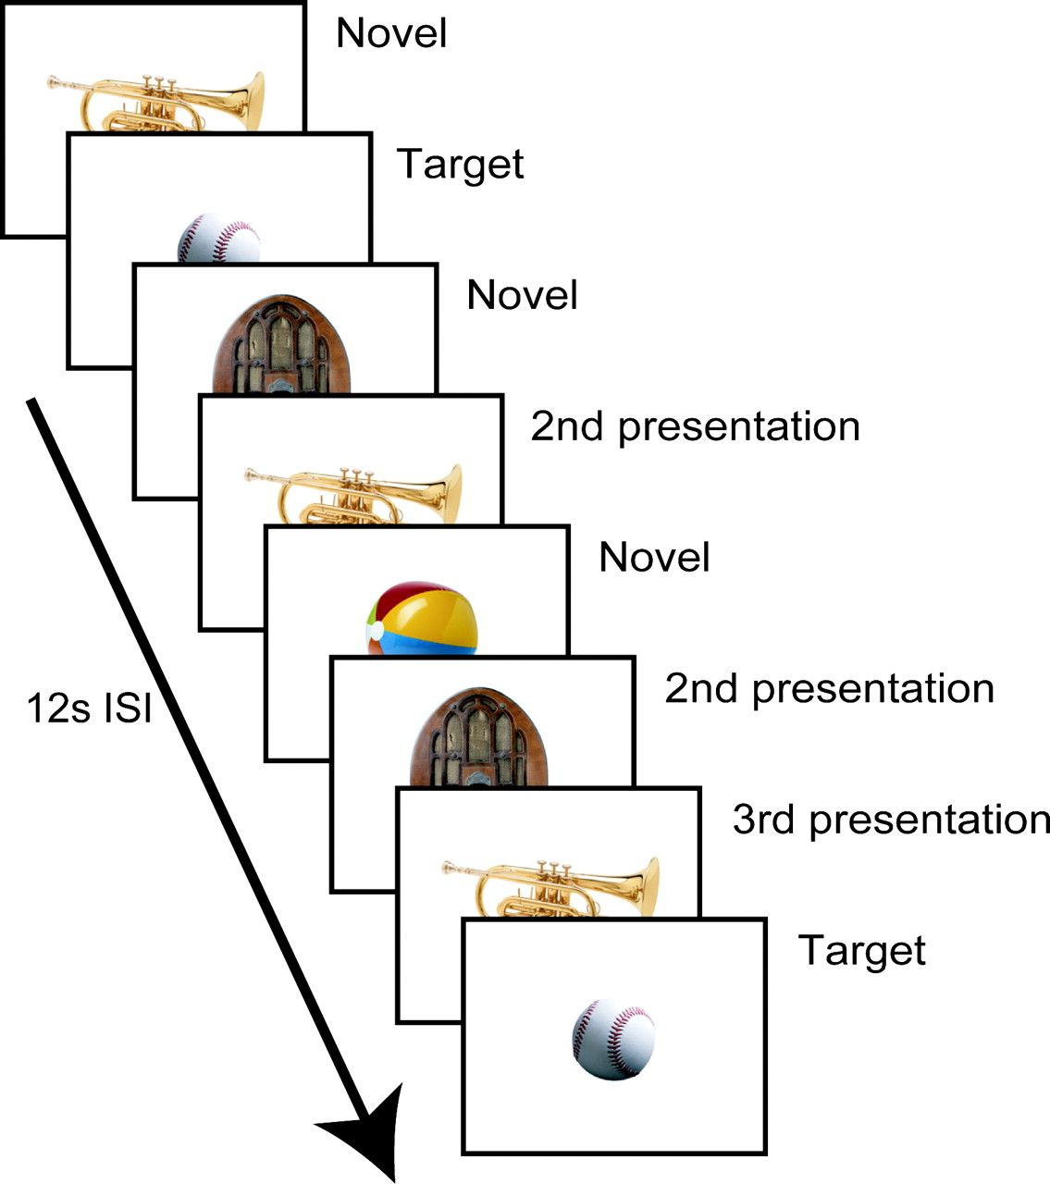
Figure 1. Example stimulus sequence presented during scanning. Participants responded via button press whether or not ...
Notes:
Figure 1. Example stimulus sequence presented during scanning. Participants responded via button press whether or not the object was the target (baseball). Objects were presented every 12 s. Non-target objects repeated up to eight times within a scanning run. All objects were novel to each run (except the target).
Unless provided in the caption above, the following copyright applies to the content of this slide: Cerebral Cortex V 15 N 6 © Oxford University Press 2004; all rights reserved

Slide 2
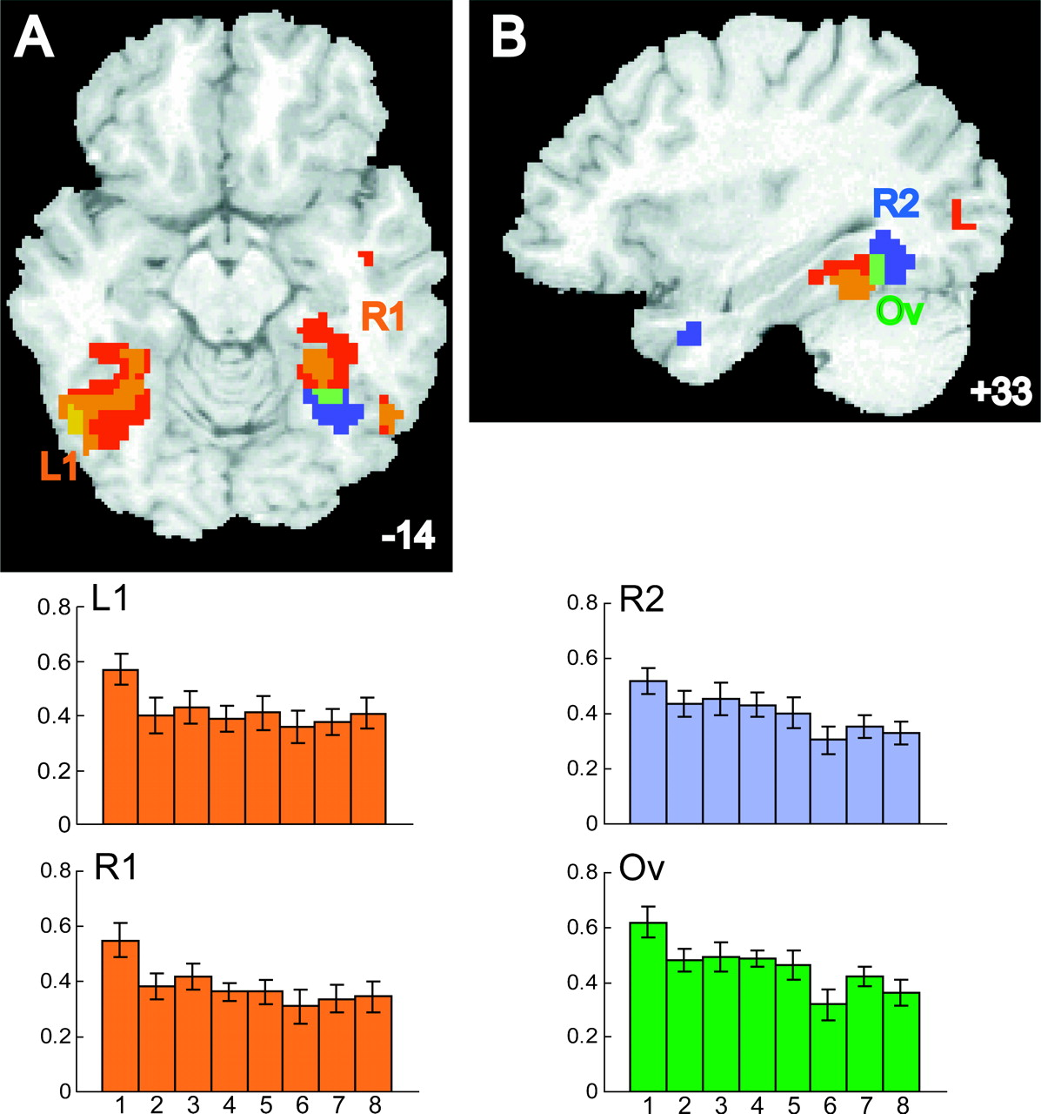
Figure 2. Priming responses in ventral occipito-temporal cortex (BA 19/37). Areas exhibiting a reliable decrease for ...
Notes:
Figure 2. Priming responses in ventral occipito-temporal cortex (BA 19/37). Areas exhibiting a reliable decrease for the second presentation of a stimulus (compared with novel stimuli) are shown in red/orange colors. Areas exhibiting a reliable decrease in activation across the second to the eighth presentation of a repeated stimulus are shown in blue. The green region reflects an area of overlap in which the responses were significantly lower from first to second presentation and then continued to decrease from the second to the eighth presentation. (A) Axial slice at the level of −14 mm in atlas space. Left side of the brain is shown on the left side of the image. (B) Sagittal slice 33 mm right of midline. Average response strength for four regions of interest across the eight presentations is show at the bottom. Values on the y-axis reflect the average strength of respon estimated for each stimulus presentation (see Materials and Methods) from the first to eighth stimulus presentation (x-axis). (L1) Average response in the large left ventral occipito-temporal region exhibiting priming for the second presentation. (R1) Average response in the right ventral occipito-temporal region exhibiting priming for the second presentation. (R2) Average response for the right posterior fusiform region exhibiting a linear decrease in response from the second to the eighth presentation. (O) Average responses in the overlap region.
Unless provided in the caption above, the following copyright applies to the content of this slide: Cerebral Cortex V 15 N 6 © Oxford University Press 2004; all rights reserved

Slide 3
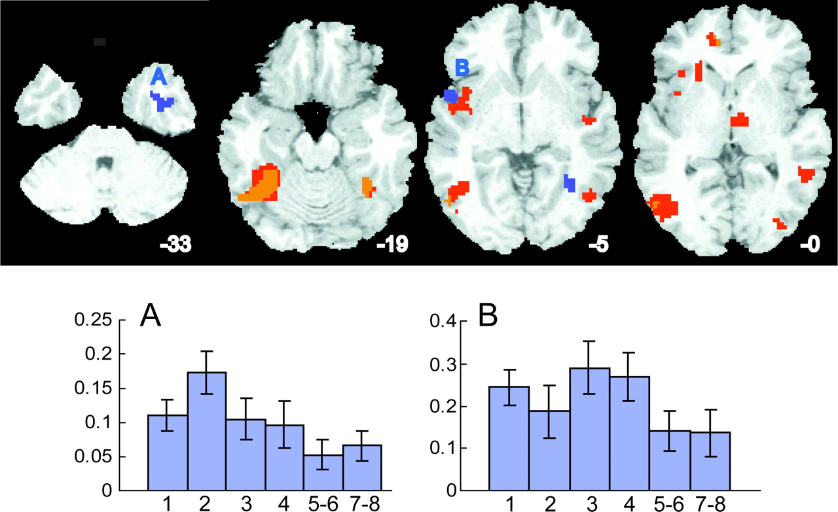
Figure 3. Additional areas of the brain exhibiting priming effects. Areas exhibiting a reliable decrease for the second ...
Notes:
Figure 3. Additional areas of the brain exhibiting priming effects. Areas exhibiting a reliable decrease for the second presentation of a stimulus (compared with novel stimuli) are shown in red/orange colors. Areas exhibiting a reliable decrease in activation across the second to the eighth presentation of a repeated stimulus are shown in blue. Average response strengths are shown at the bottom for two areas exhibiting a reliable linear decrease across the eight presentations. Values on the y-axis reflect the average strength of response parameter for each stimulus presentation (see Materials and Methods). Stimulus presentation numbers are shown on the x-axis with the fifth/sixth and seventh/eighth responses averaged for clarity. (A) Anterior inferior temporal cortex. This region appears to exhibit an increased response for the second presentation although the overall pattern of response is decreasing across stimulus repetitions. (B) Insula. This region appears to exhibit an increased response for the third and fourth presentations although the overall pattern is also decreasing across stimulus repetitions.
Unless provided in the caption above, the following copyright applies to the content of this slide: Cerebral Cortex V 15 N 6 © Oxford University Press 2004; all rights reserved

Slide 4
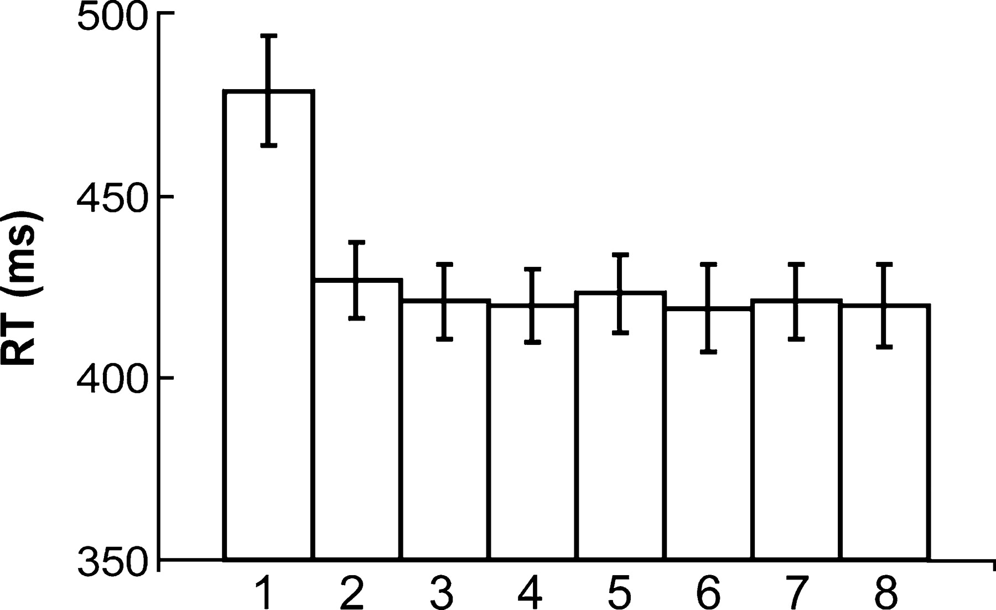
Figure 4. Reaction times over multiple repetitions of stimuli. Participants were faster to identify non-target stimuli ...
Notes:
Figure 4. Reaction times over multiple repetitions of stimuli. Participants were faster to identify non-target stimuli on the second and subsequent repetitions of those stimuli. No reliable decrease in reaction times occurred from the second to the eighth stimulus presentations.
Unless provided in the caption above, the following copyright applies to the content of this slide: Cerebral Cortex V 15 N 6 © Oxford University Press 2004; all rights reserved

