Slide 1
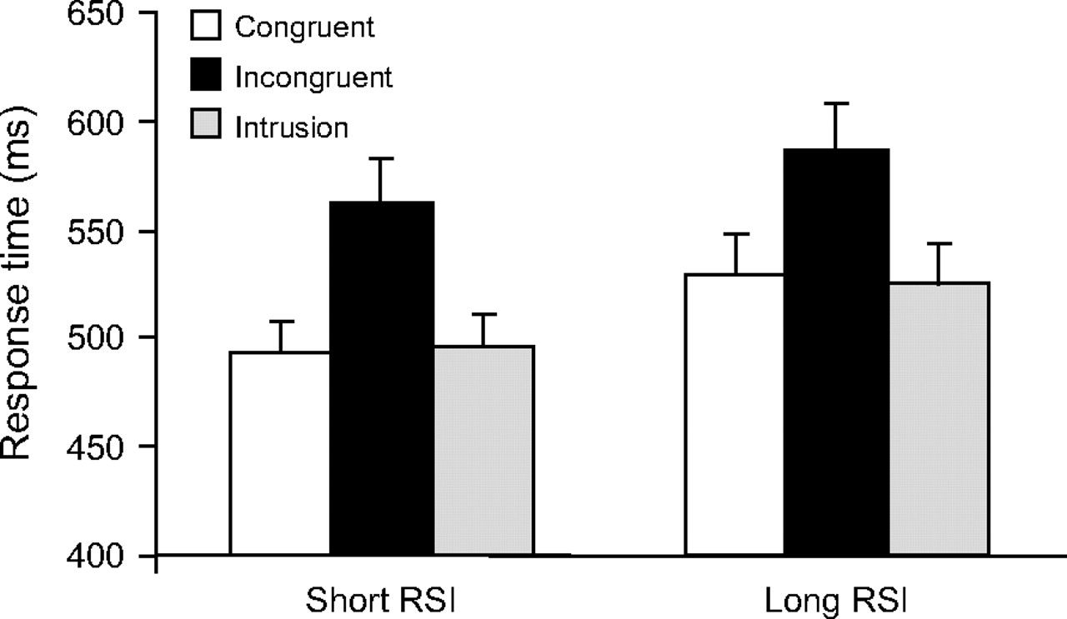
Figure 1. Mean response time as a function of RSI for correct congruent and incongruent trials and intrusion errors in ...
Notes:
Figure 1. Mean response time as a function of RSI for correct congruent and incongruent trials and intrusion errors in Experiment 1. The error bars represent the standard error of the mean.
Unless provided in the caption above, the following copyright applies to the content of this slide: © The Author 2007. Published by Oxford University Press. All rights reserved. For permissions, please e-mail: journals.permissions@oxfordjournals.org

Slide 2
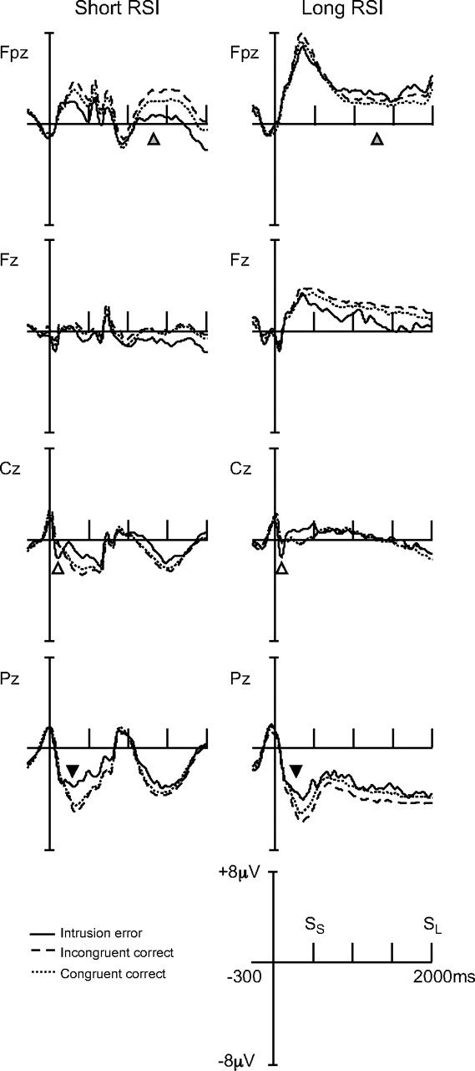
Figure 2. Grand-averaged ERPs at 4 midline electrodes for intrusion errors, incongruent correct trials, and congruent ...
Notes:
Figure 2. Grand-averaged ERPs at 4 midline electrodes for intrusion errors, incongruent correct trials, and congruent correct trials demonstrating the time course of the ERN (open arrow), Pe (filled arrow), and frontal slow wave (gray arrow). The tall bar reflects the response and the short bars reflect 500-ms increments. The SS marks the onset of the next stimulus in the short RSI condition, and the SL marks the onset of the next stimulus in the long RSI condition.
Unless provided in the caption above, the following copyright applies to the content of this slide: © The Author 2007. Published by Oxford University Press. All rights reserved. For permissions, please e-mail: journals.permissions@oxfordjournals.org

Slide 3
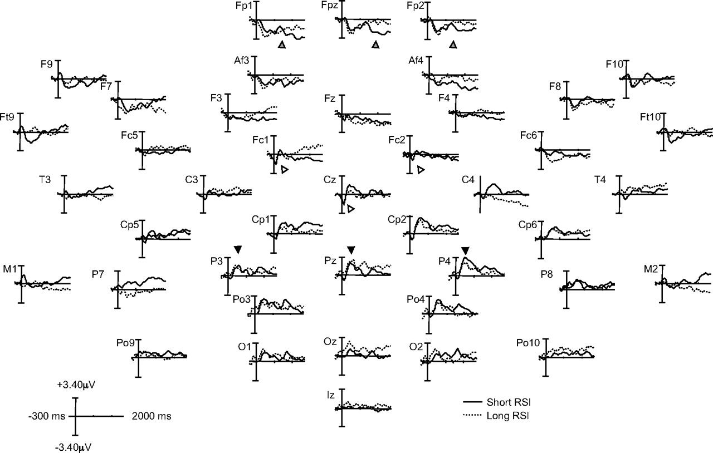
Figure 3. Difference waves (intrusion error—incongruent correct) for 42 scalp electrodes in the short and long RSI ...
Notes:
Figure 3. Difference waves (intrusion error—incongruent correct) for 42 scalp electrodes in the short and long RSI conditions demonstrating the time course and distribution of the ERN, Pe, and frontal slow wave. The ERN is marked by the open arrow, the Pe by the filled arrow, and the frontal slow wave by the gray arrow. The tall bar for the difference waves represents the response.
Unless provided in the caption above, the following copyright applies to the content of this slide: © The Author 2007. Published by Oxford University Press. All rights reserved. For permissions, please e-mail: journals.permissions@oxfordjournals.org

Slide 4
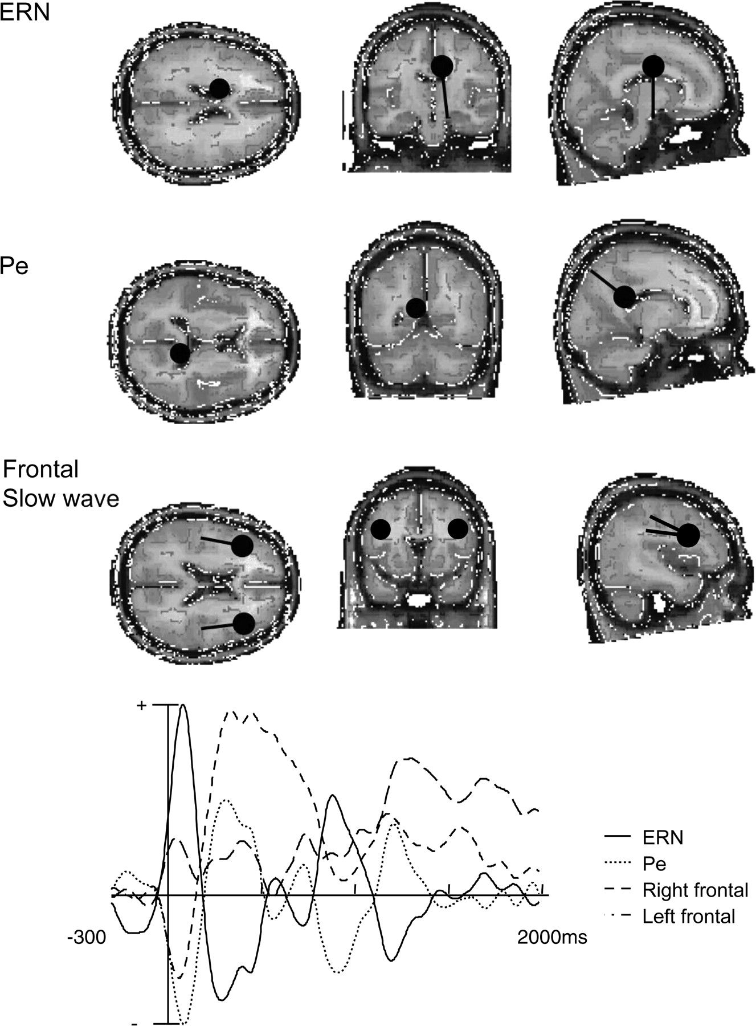
Figure 4. Results of the dipole models for the ERN, Pe, and frontal slow wave in the short RSI condition. The upper ...
Notes:
Figure 4. Results of the dipole models for the ERN, Pe, and frontal slow wave in the short RSI condition. The upper panel portrays the location of the best fitting dipoles for the 3 modulations superimposed on an average brain and the lower panel portrays the time course of activation for the dipoles.
Unless provided in the caption above, the following copyright applies to the content of this slide: © The Author 2007. Published by Oxford University Press. All rights reserved. For permissions, please e-mail: journals.permissions@oxfordjournals.org

Slide 5
Figure 5. Grand-averaged ERPs at 4 midline electrodes for intrusion errors and incongruent trials demonstrating the ...
Notes:
Figure 5. Grand-averaged ERPs at 4 midline electrodes for intrusion errors and incongruent trials demonstrating the time course of the ERN (open arrow), Pe (filled arrow), and frontal slow wave (gray arrow) in Experiment 2. The tall bar reflects the response and the short bars reflect 500-ms increments.
Unless provided in the caption above, the following copyright applies to the content of this slide: © The Author 2007. Published by Oxford University Press. All rights reserved. For permissions, please e-mail: journals.permissions@oxfordjournals.org

Slide 6
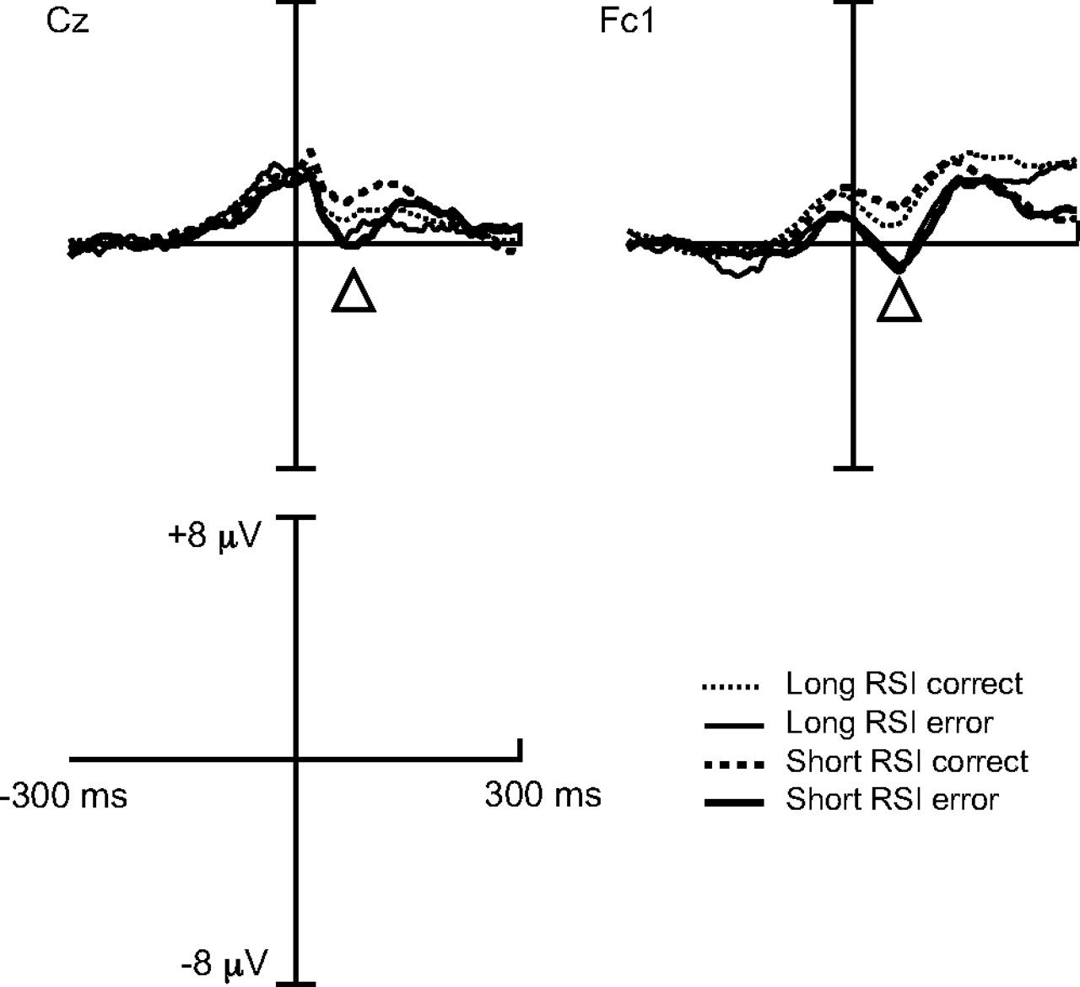
Figure 6. Grand-averaged ERPs at electrodes Cz and Fc1 demonstrating the ERN in Experiment 2. The tall bar reflects the ...
Notes:
Figure 6. Grand-averaged ERPs at electrodes Cz and Fc1 demonstrating the ERN in Experiment 2. The tall bar reflects the response.
Unless provided in the caption above, the following copyright applies to the content of this slide: © The Author 2007. Published by Oxford University Press. All rights reserved. For permissions, please e-mail: journals.permissions@oxfordjournals.org

Slide 7
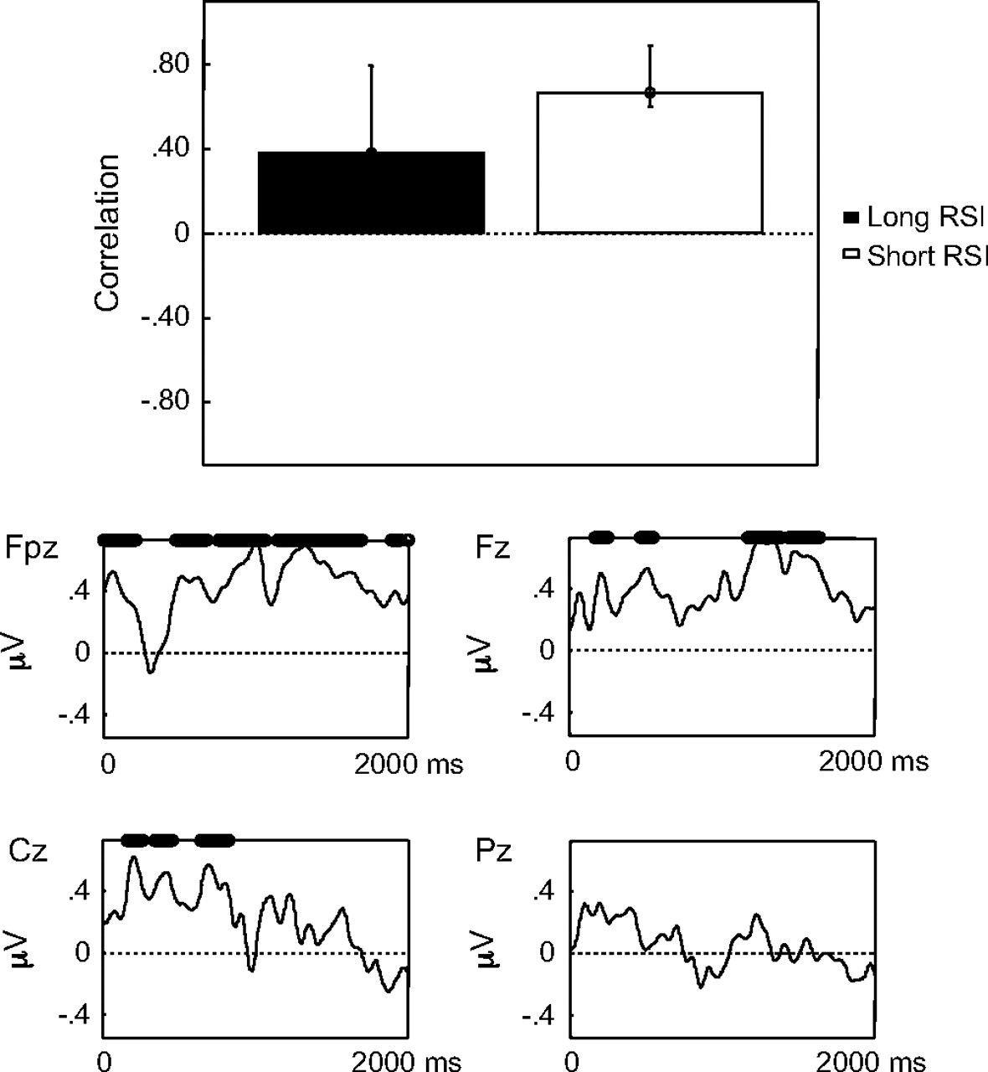
Figure 7. Results of the PLS analysis (behavior saliences and ERP saliences at limited electrodes) examining ...
Notes:
Figure 7. Results of the PLS analysis (behavior saliences and ERP saliences at limited electrodes) examining brain–behavior relationships between posterror slowing and ERP amplitude. Note the early modulation at electrode Cz during the time course of the ERN and the more sustained modulation at electrode Fpz during the time course of the frontal slow wave. The bars for the behavior saliences indicate 95% CIs and the o′s above the x axis mark stable ERP saliences where the bootstrap ratio exceeds 2.0.
Unless provided in the caption above, the following copyright applies to the content of this slide: © The Author 2007. Published by Oxford University Press. All rights reserved. For permissions, please e-mail: journals.permissions@oxfordjournals.org

Slide 8
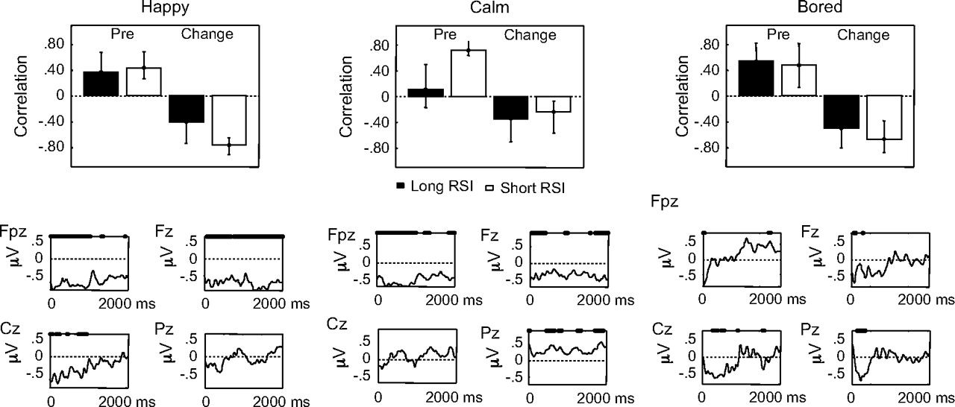
Figure 8. Results of the PLS analyses (behavior saliences and ERP saliences at limited electrodes) examining ...
Notes:
Figure 8. Results of the PLS analyses (behavior saliences and ERP saliences at limited electrodes) examining brain–behavior correlations between levels of happiness, calmness, and boredom and ERP amplitude. For happy note, the early modulation at electrode Cz during the time course of the ERN and the more sustained modulation at electrodes Fz and Fpz during the time course of the frontal slow wave; for calm note, the modulation at electrode Fz during the time course of the ERN and at electrode Fpz during the time course of the frontal slow wave; for bored note, the early modulation at electrode Fz during the time course of the frontal slow wave, the later modulation at electrodes Cz and Pz during the time course of the Pe, and the lack of a sustained modulation at electrodes Fz or Fpz during the time course of the frontal slow wave. The bars for the behavior saliences indicate 95% CIs and the o′s above the x axis mark stable ERP saliences where the bootstrap ratio exceeds 2.0.
Unless provided in the caption above, the following copyright applies to the content of this slide: © The Author 2007. Published by Oxford University Press. All rights reserved. For permissions, please e-mail: journals.permissions@oxfordjournals.org

Slide 9
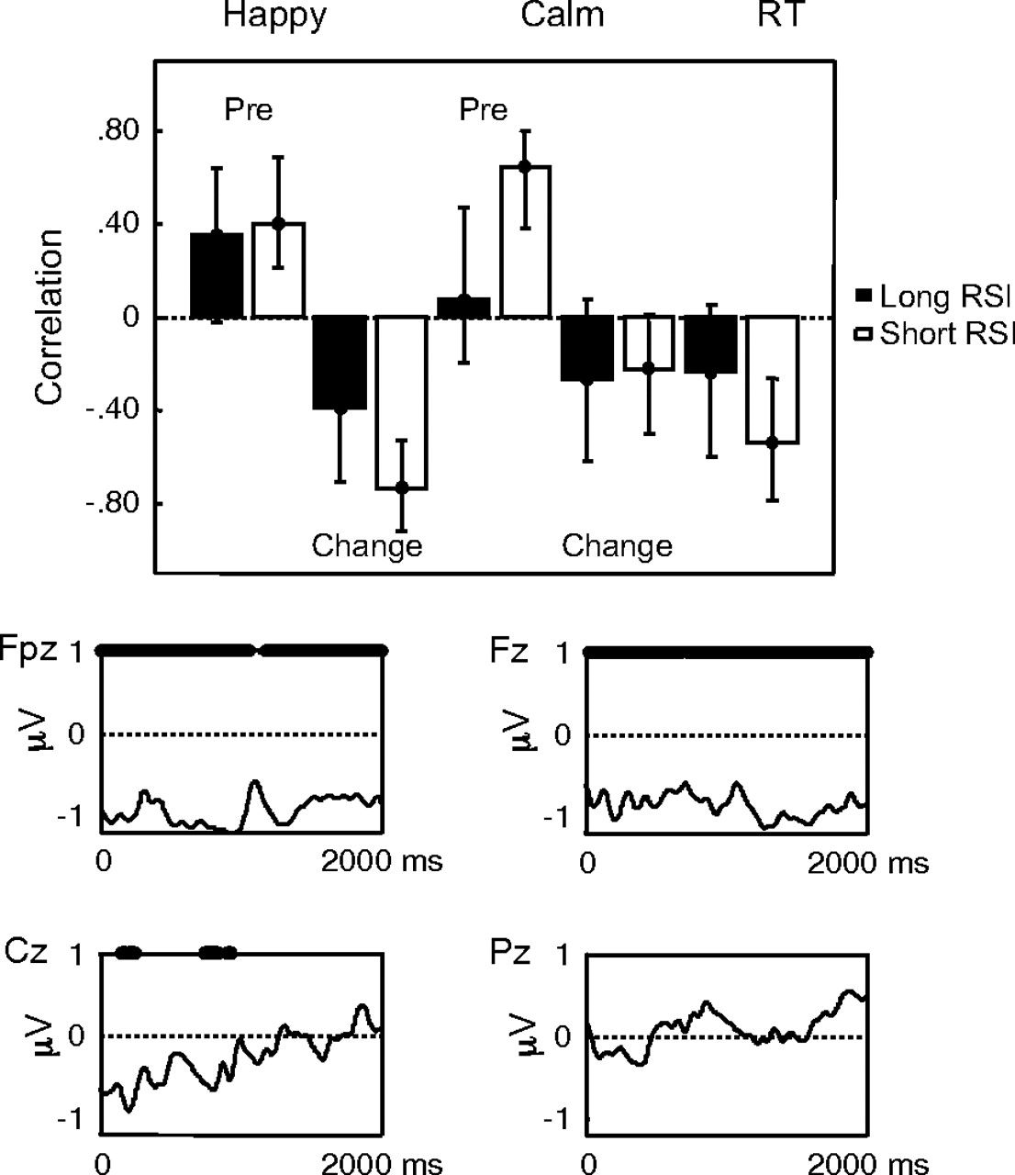
Figure 9. Results of the PLS analysis (behavior saliences and ERP saliences at limited electrodes) examining ...
Notes:
Figure 9. Results of the PLS analysis (behavior saliences and ERP saliences at limited electrodes) examining brain–behavior relationships between happiness, calmness, and posterror slowing and ERP amplitude. Note, the early modulation at electrode Cz during the time course of the ERN and the more sustained modulation at electrodes Fz and Fpz during the time course of the frontal slow wave. The bars for the behavior saliences indicate 95% CIs and the o′s above the x axis mark stable ERP saliences where the bootstrap ratio exceeds 2.0.
Unless provided in the caption above, the following copyright applies to the content of this slide: © The Author 2007. Published by Oxford University Press. All rights reserved. For permissions, please e-mail: journals.permissions@oxfordjournals.org

