Slide 1
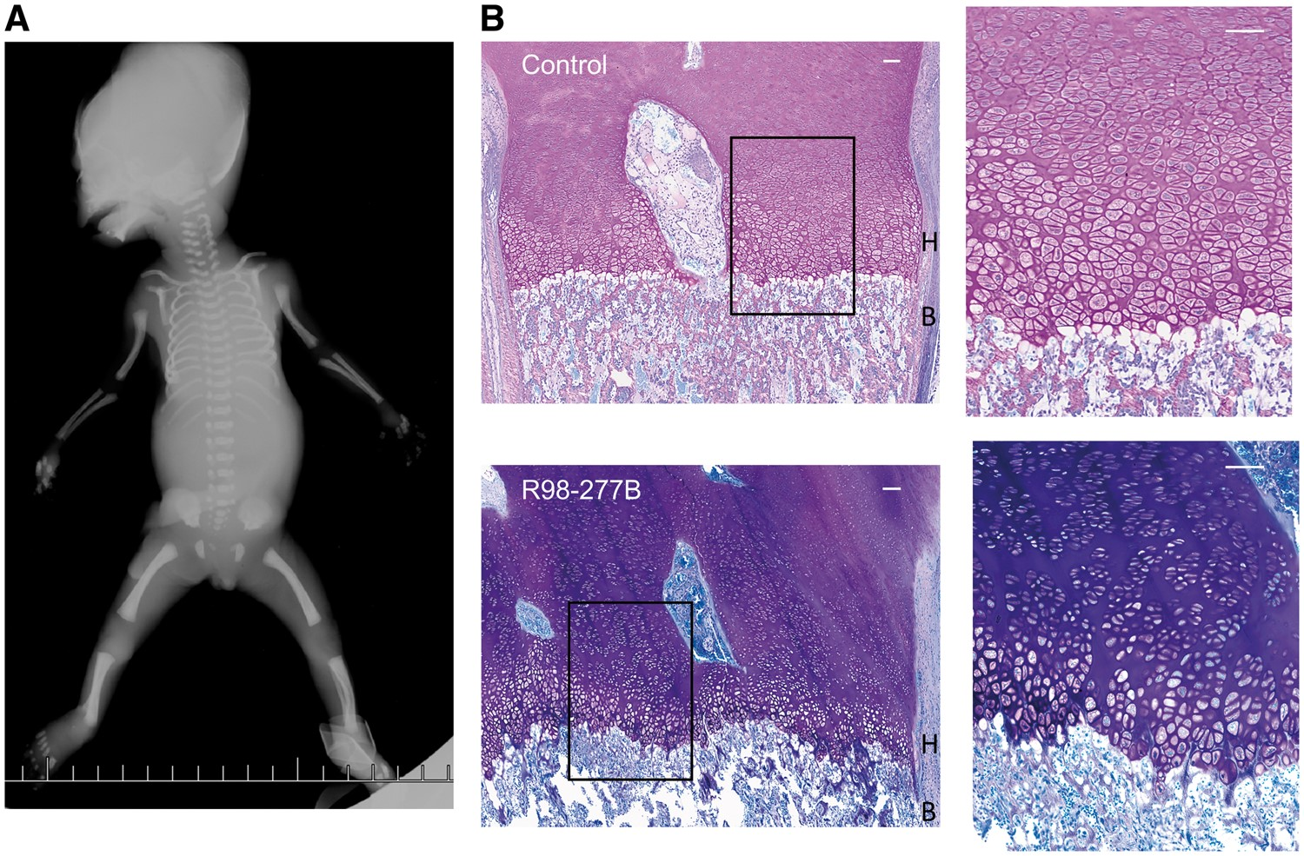
Figure 1. Radiographic phenotype and growth plate histology in SRPS case R98-277B. (A) AP fetal radiograph illustrating ...
Notes:
Figure 1. Radiographic phenotype and growth plate histology in SRPS case R98-277B. (A) AP fetal radiograph illustrating the undermineralized skull, moderately short ribs, flat acetabular roof and shortened long bones with mild femoral/humeral bending. (B) Growth plate histology comparing the control (top) and SRPS case (bottom) demonstrating irregularity of the border between the hypertrophic zone (H) and bone (B) and the very short hypertrophic zone (the boxed area is expanded on the right). Scale bars are 100 µM.
Unless provided in the caption above, the following copyright applies to the content of this slide: © The Author 2016. Published by Oxford University Press. All rights reserved. For Permissions, please email: journals.permissions@oup.com

Slide 2
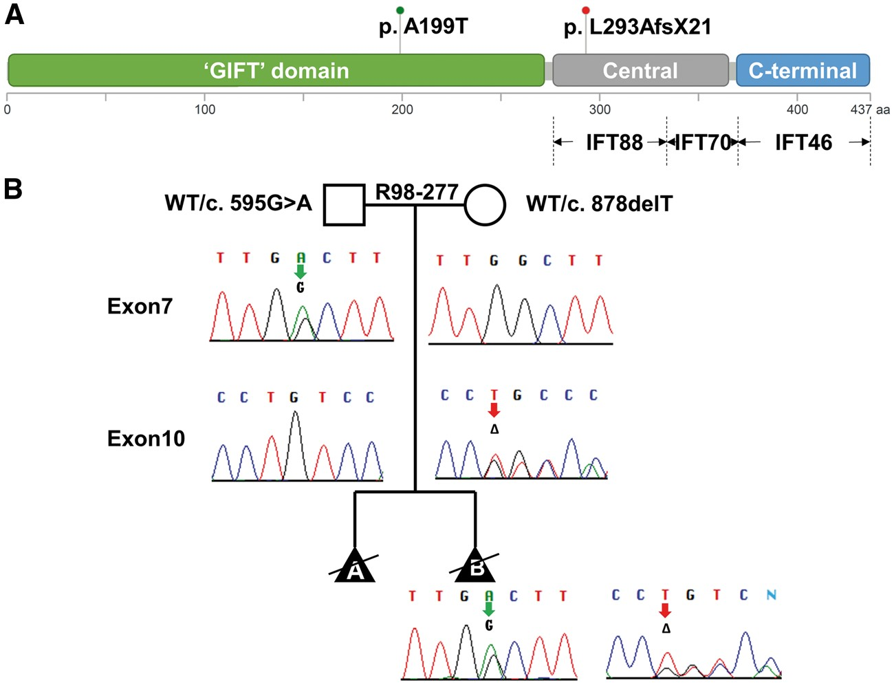
Figure 2. Mutations in IFT52. (A) The two mutations found are shown above a diagram of the domain structure of the ...
Notes:
Figure 2. Mutations in IFT52. (A) The two mutations found are shown above a diagram of the domain structure of the IFT52 protein. Below the diagram, interactions between IFT52 and both IFT88 and IFT70 with the central region and IFT46 with the C-terminal domain are represented. (B) Segregation of the mutations in the family are shown on the pedigree with the paternally- and maternally-derived alleles indicated by red and green arrows, respectively.
Unless provided in the caption above, the following copyright applies to the content of this slide: © The Author 2016. Published by Oxford University Press. All rights reserved. For Permissions, please email: journals.permissions@oup.com

Slide 3
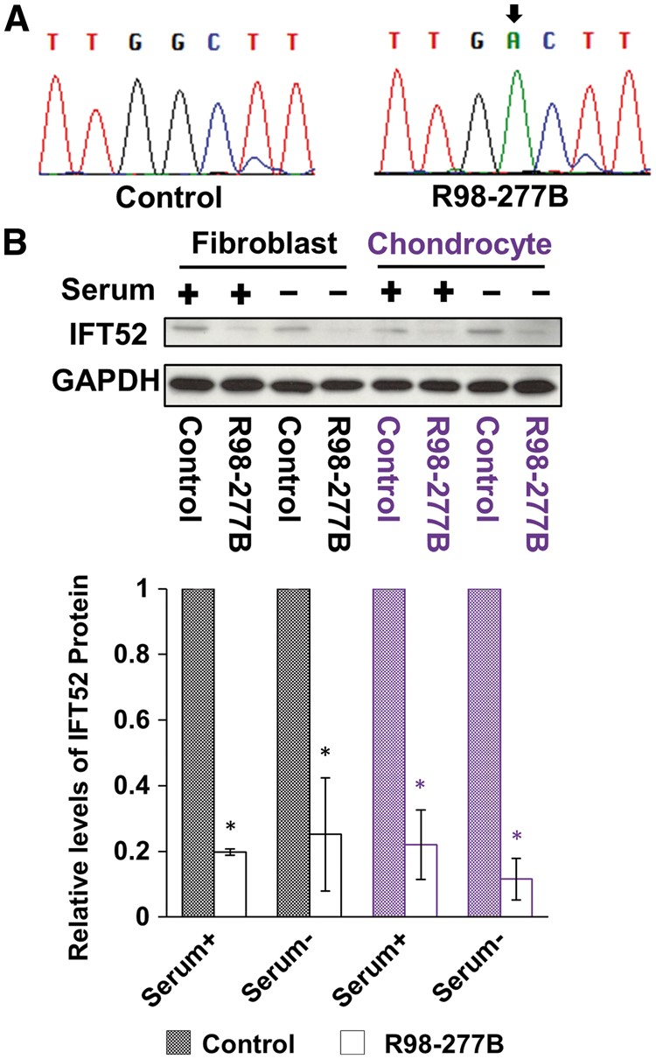
Figure 3. Consequences of IFT52 mutations. (A) Sequences of RT-PCR products derived from IFT52 mutant cells, ...
Notes:
Figure 3. Consequences of IFT52 mutations. (A) Sequences of RT-PCR products derived from IFT52 mutant cells, demonstrating that only products of the missense allele with the c.595G > A mutation were found. The nucleotide change is indicated with a black arrow. (B) Immunoblotting revealed IFT52 protein reduction in the lysates of IFT52 mutant cultured fibroblasts and chondrocytes under both serum replete and serum restricted conditions as compared with controls. Below the Western blots, IFT52 abundance in SRPS cells was normalized to control cells, demonstrating a statistically significant reduction in IFT52 in SRPS cells (n = 3, *P < 0.05).
Unless provided in the caption above, the following copyright applies to the content of this slide: © The Author 2016. Published by Oxford University Press. All rights reserved. For Permissions, please email: journals.permissions@oup.com

Slide 4
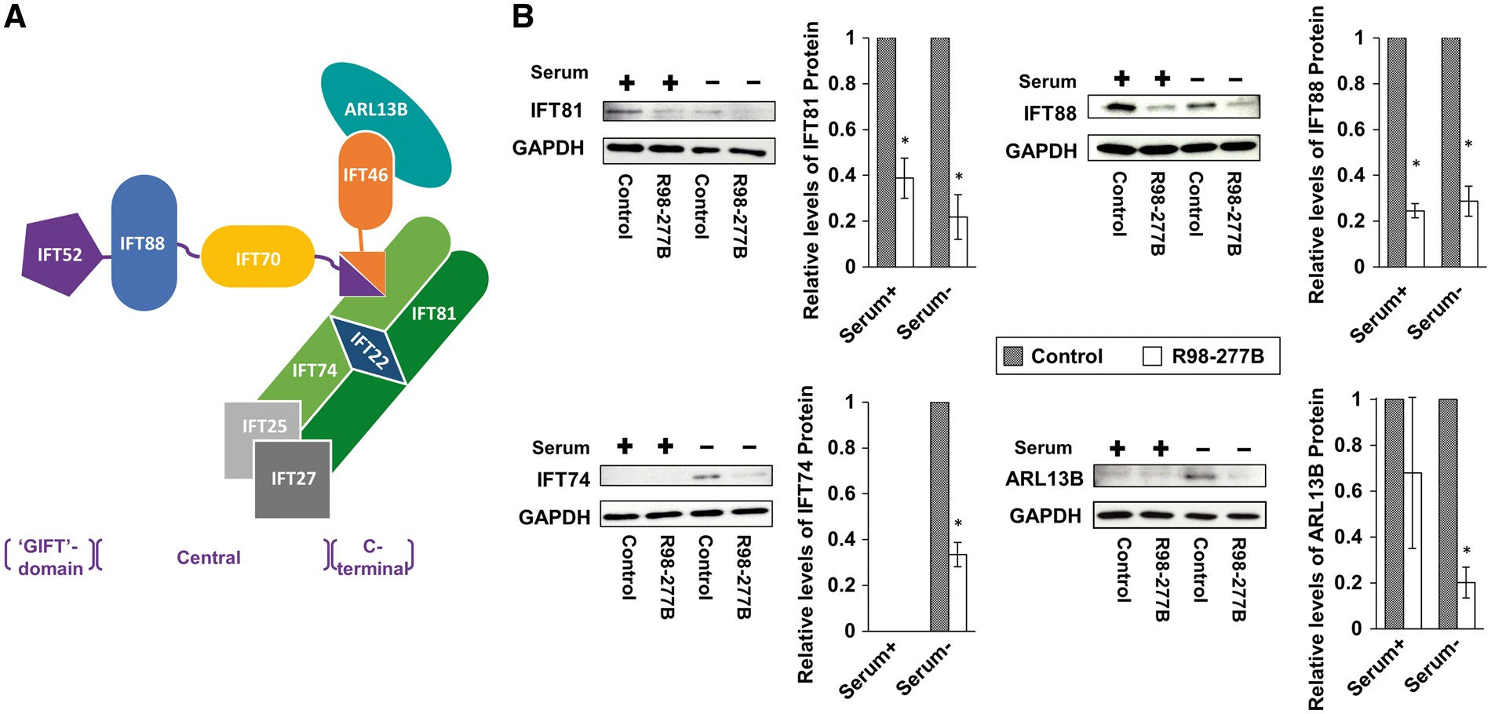
Figure 4. IFT complex B is unstable in the IFT52 mutant. (A) Schematic representation of the interactions among IFT-B ...
Notes:
Figure 4. IFT complex B is unstable in the IFT52 mutant. (A) Schematic representation of the interactions among IFT-B core complex members and ARL13B based on published studies. The corresponding structural domains of IFT52 are indicated with brackets below the figure. (B) Whole-cell lysates from SRPS case and control fibroblasts were analyzed by Western blot using antibodies to IFT-B core proteins and ARL13B. The levels of these proteins in IFT52 mutant cells were markedly decreased, especially upon the stimulation of ciliogenesis in reduced serum media (n = 3, *P < 0.05).
Unless provided in the caption above, the following copyright applies to the content of this slide: © The Author 2016. Published by Oxford University Press. All rights reserved. For Permissions, please email: journals.permissions@oup.com

Slide 5
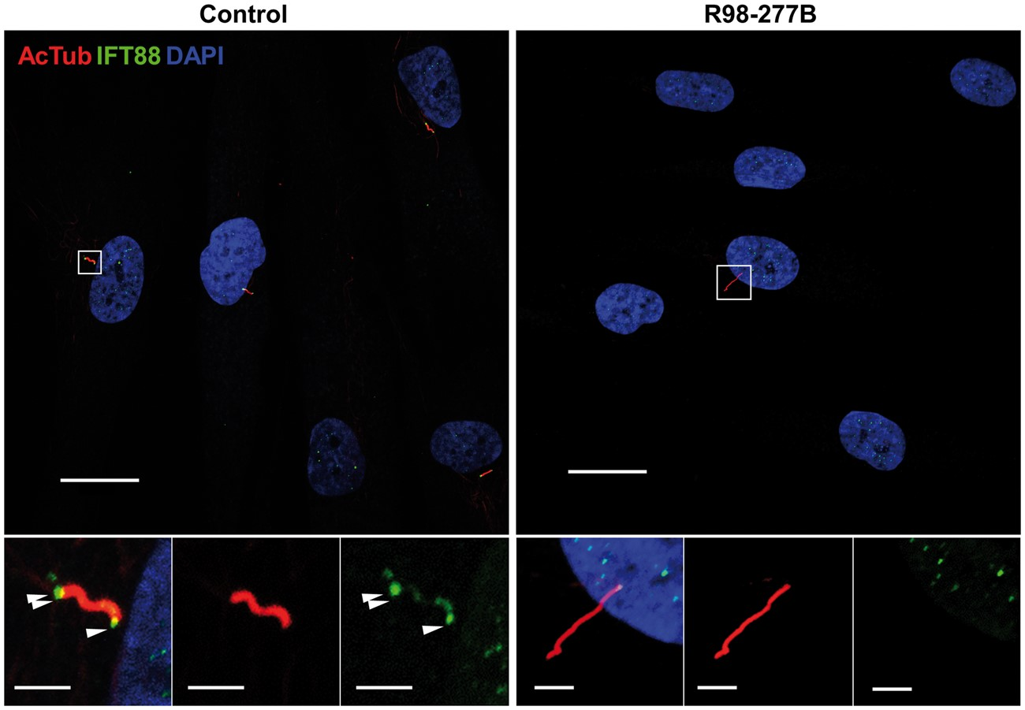
Figure 5. IFT88 distribution in cilia. Immunofluorescence microscopy of SRPS and control ciliated cells stained with ...
Notes:
Figure 5. IFT88 distribution in cilia. Immunofluorescence microscopy of SRPS and control ciliated cells stained with mouse anti-acetylated α-tubulin (red) and rabbit anti-IFT88 (green). The IFT88 signal was enriched at the basal bodies (single arrowhead) and tips of cilia (double arrowheads) in controls while in SRPS cells it could not be detected above background. Boxed regions are expanded at the bottom and separated into single signal panels with anti-acetylated α-tubulin (red) and anti-IFT88 (green). Scale bars represent 20 μm in the upper panels and 1 μm in the insets.
Unless provided in the caption above, the following copyright applies to the content of this slide: © The Author 2016. Published by Oxford University Press. All rights reserved. For Permissions, please email: journals.permissions@oup.com

Slide 6
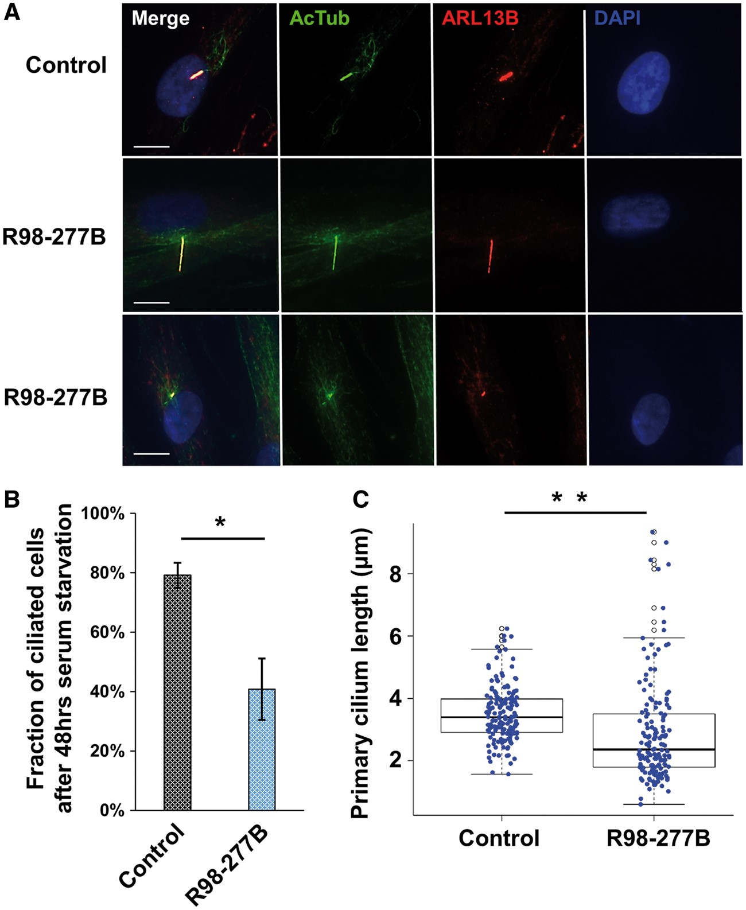
Figure 6. Cilia abundance and ciliary length. (A) Ciliary axonemes and basal bodies of SRPS fibroblasts were stained ...
Notes:
Figure 6. Cilia abundance and ciliary length. (A) Ciliary axonemes and basal bodies of SRPS fibroblasts were stained using mouse monoclonal anti-acetylated α-tubulin (green) and rabbit anti-ARL13B (red) antibodies, respectively. Representative cells with either elongated or shortened cilia as compared with control are shown. Scale bars represent 10 μm. (B) The fraction of ciliated cells in the SRPS case (40.2%) was significantly decreased compared with the control sample (79.2%). Cilia were enumerated from 324 patient cells and 287 control cells observed in four randomly sampled regions; *P = 0.0002. (C) Average cilia length in the SRPS case (2.89 μm) was significantly shorter than cilia length in control cells (3.51 μm), **P = 6.312e-05, and there was also a wider distribution of cilia lengths among SRPS cells. The cilia length data were calculated from 155 ciliated SRPS cells and 159 ciliated control cells.
Unless provided in the caption above, the following copyright applies to the content of this slide: © The Author 2016. Published by Oxford University Press. All rights reserved. For Permissions, please email: journals.permissions@oup.com

