Slide 1
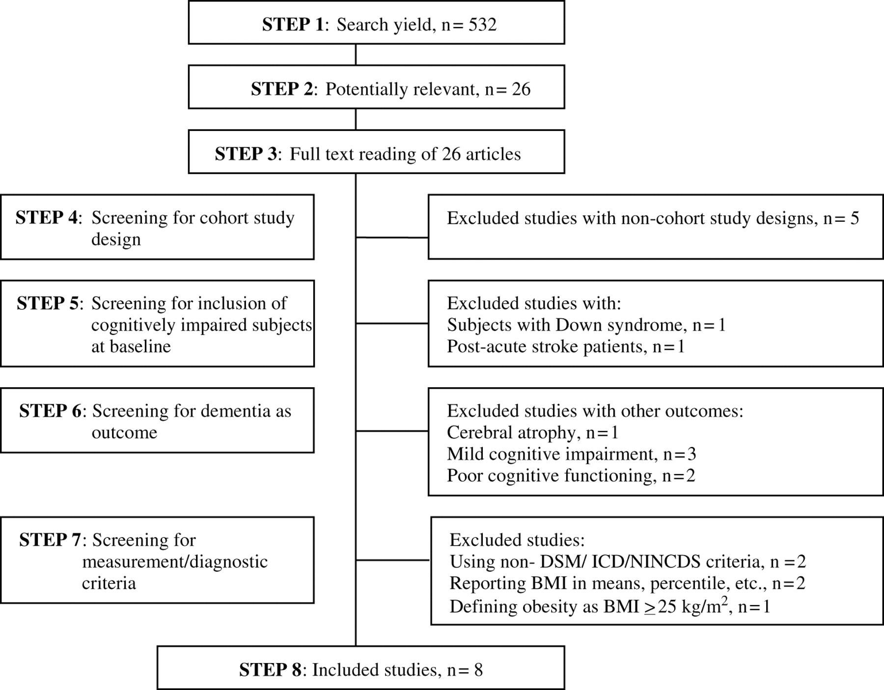
Figure 1 Selection process for relevant studies
Notes:
Figure 1 Selection process for relevant studies
Unless provided in the caption above, the following copyright applies to the content of this slide: Copyright © The Author 2007. Published by Oxford University Press on behalf of the British Geriatrics Society.

