Slide 1
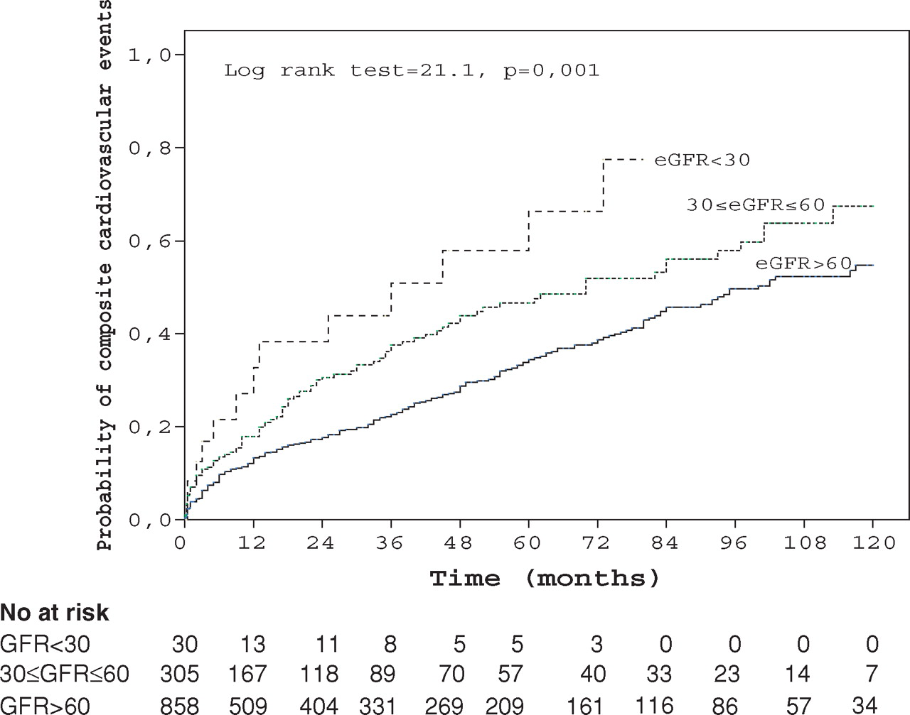
Fig. 3 Kaplan–Meier estimates of probability of composite cardiovascular events in patients with acute stroke over ...
Notes:
Fig. 3 Kaplan–Meier estimates of probability of composite cardiovascular events in patients with acute stroke over a period of 10 years according to estimated GFR (ml/min/1.73 m 2 ) on admission.
Unless provided in the caption above, the following copyright applies to the content of this slide: © Oxford University Press 2008

Slide 2
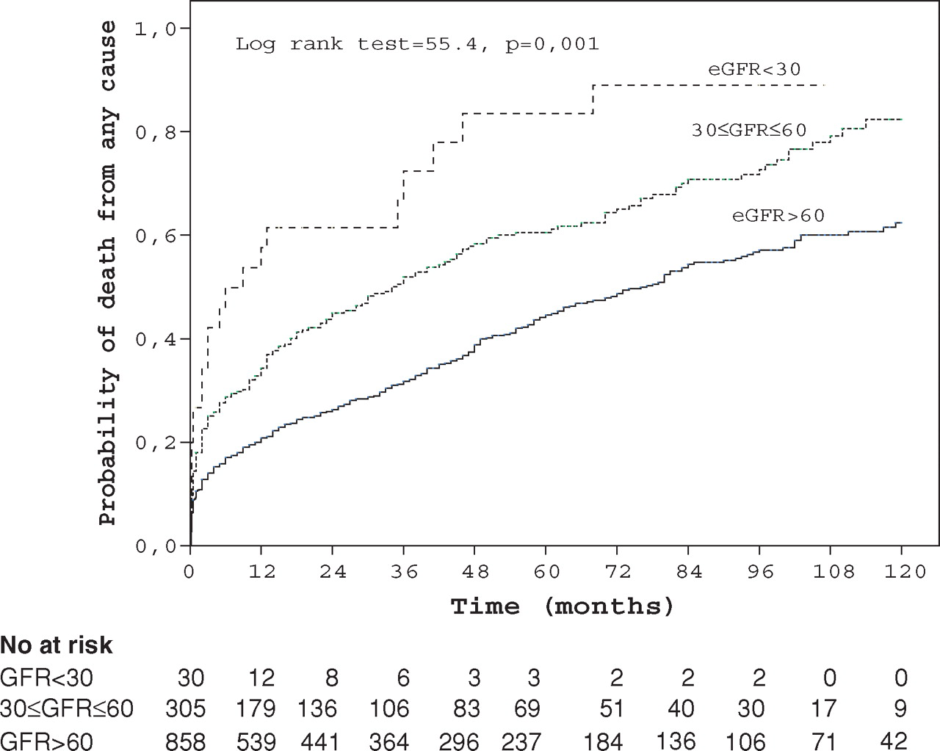
Fig. 2 Kaplan–Meier estimates of probability of death from any cause in patients with acute stroke over a period of ...
Notes:
Fig. 2 Kaplan–Meier estimates of probability of death from any cause in patients with acute stroke over a period of 10 years according to estimated GFR (ml/min/1.73 m 2 ) on admission.
Unless provided in the caption above, the following copyright applies to the content of this slide: © Oxford University Press 2008

Slide 3
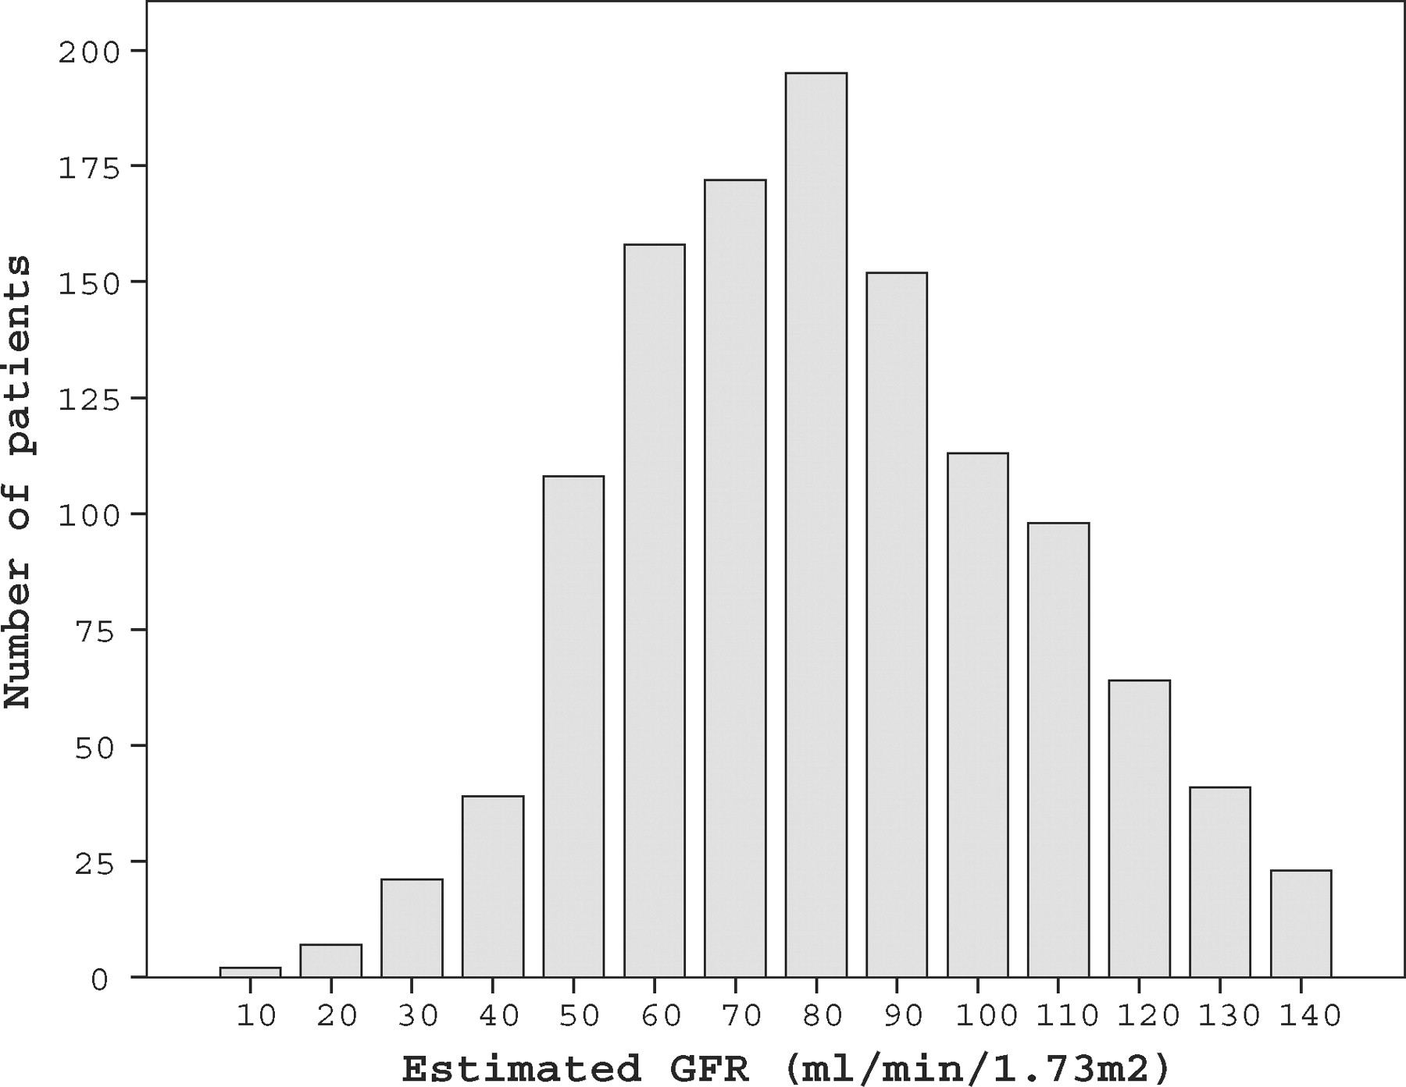
Fig. 1 Distribution of estimated GFR on admission for the 1350 patients with a serum creatinine measurement.
Notes:
Fig. 1 Distribution of estimated GFR on admission for the 1350 patients with a serum creatinine measurement.
Unless provided in the caption above, the following copyright applies to the content of this slide: © Oxford University Press 2008

