Slide 1
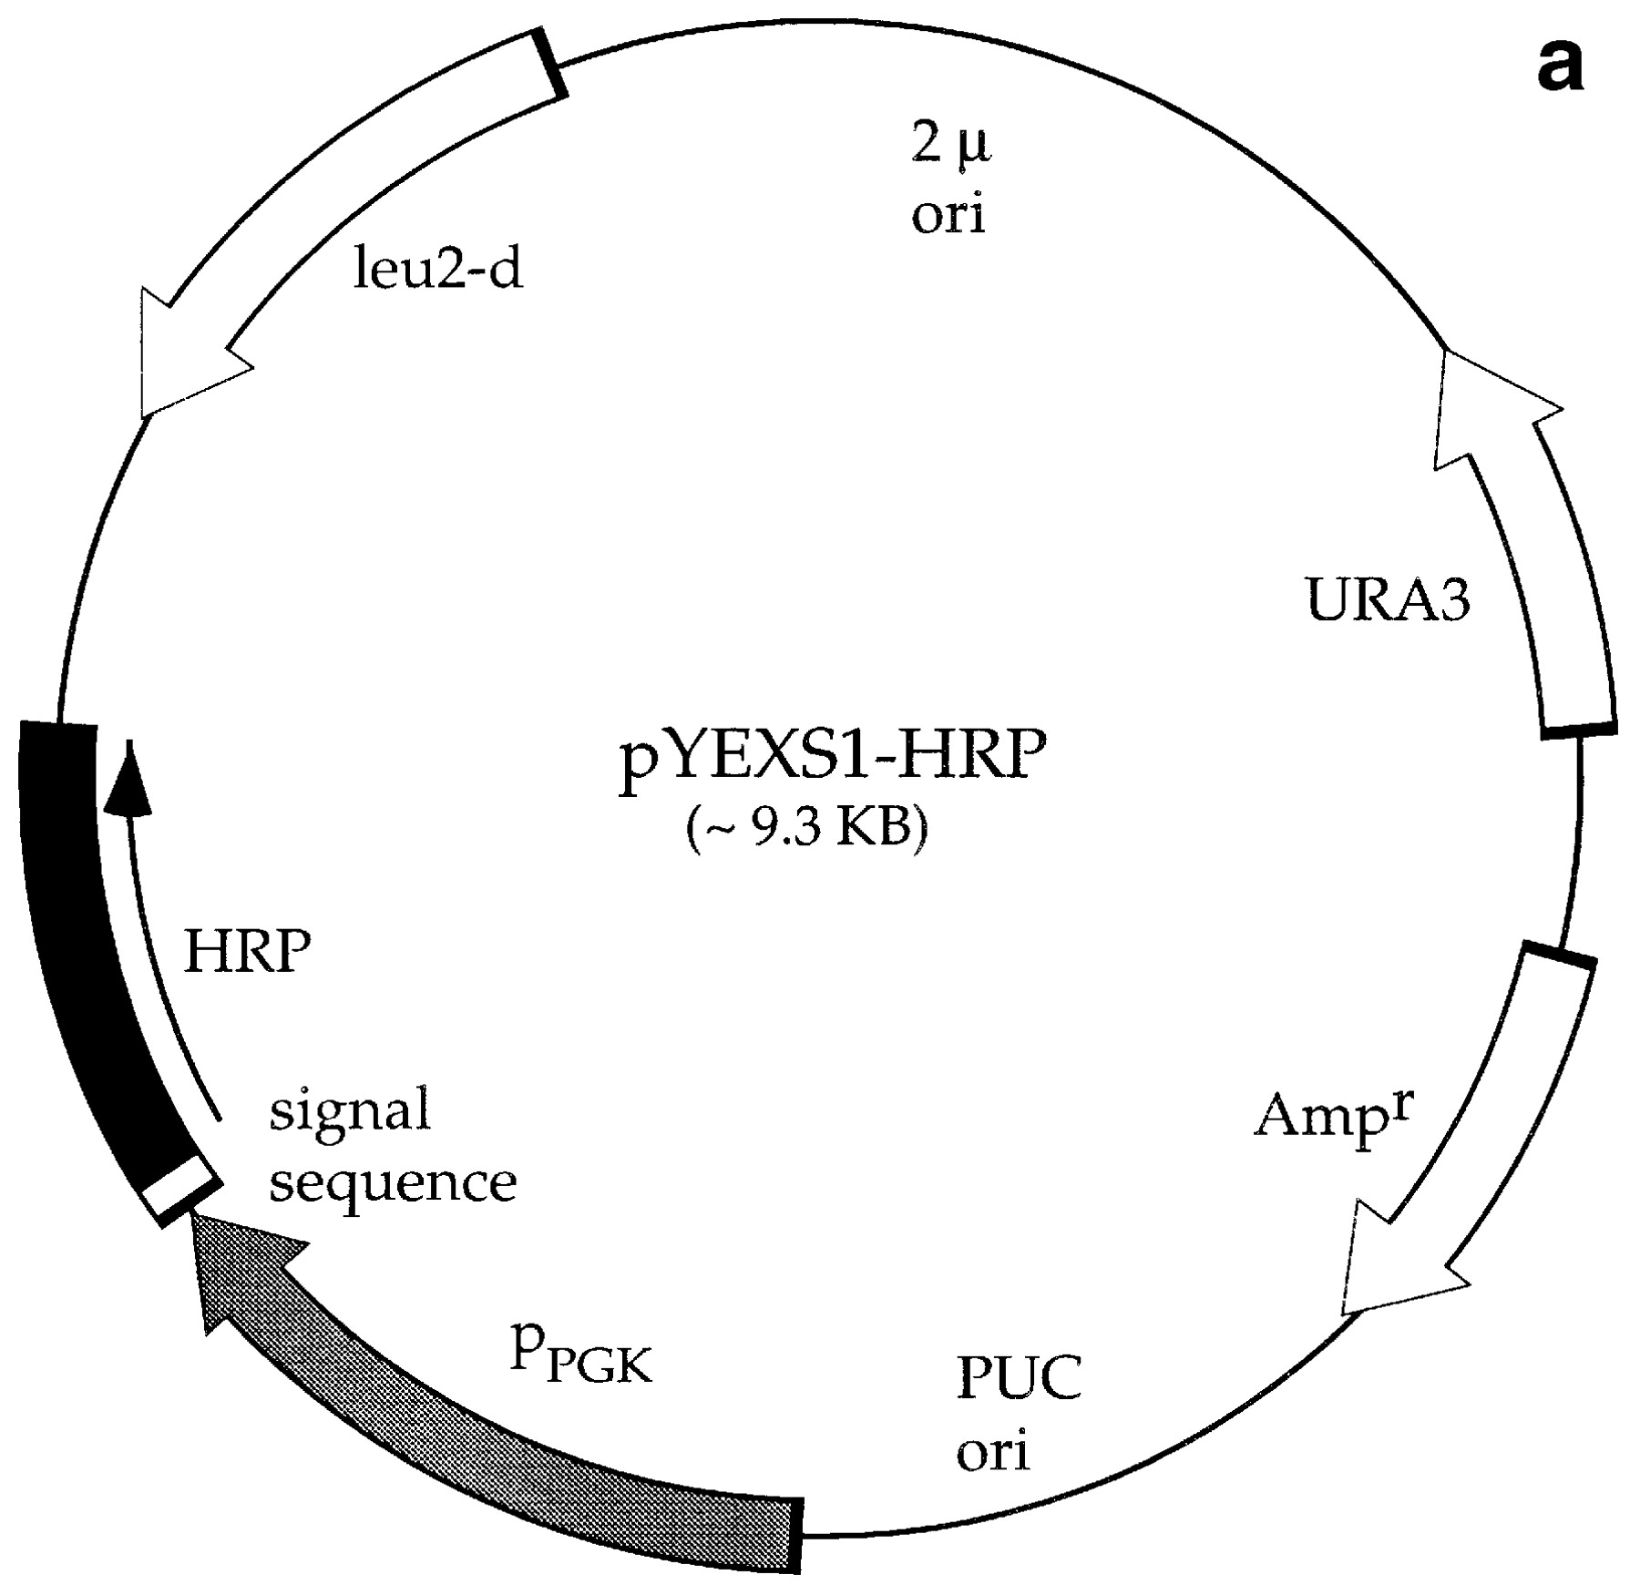
Fig. 1. (a) Map of plasmid pYEXS1-HRP for expression of HRP in S.cerevisiae. The HRP gene was fused in-frame to the ...
Notes:
Fig. 1. (a) Map of plasmid pYEXS1-HRP for expression of HRP in S.cerevisiae. The HRP gene was fused in-frame to the full-length leader sequence of the alpha-subunit of the Kluyveromycees lactis killer toxin. Expression is under the control of the constitutive phosphoglycerate kinase promoter. (b) Map of plasmid pPIZαB-HRP for expression of HRP in P.pastoris. The vector contains the α-factor signal peptide and the methanol-inducible PAOX1 promoter. Upon transformation into Pichia, the HRP is integrated into the genome through homologous recombination.
Unless provided in the caption above, the following copyright applies to the content of this slide: © Oxford University Press

Slide 2
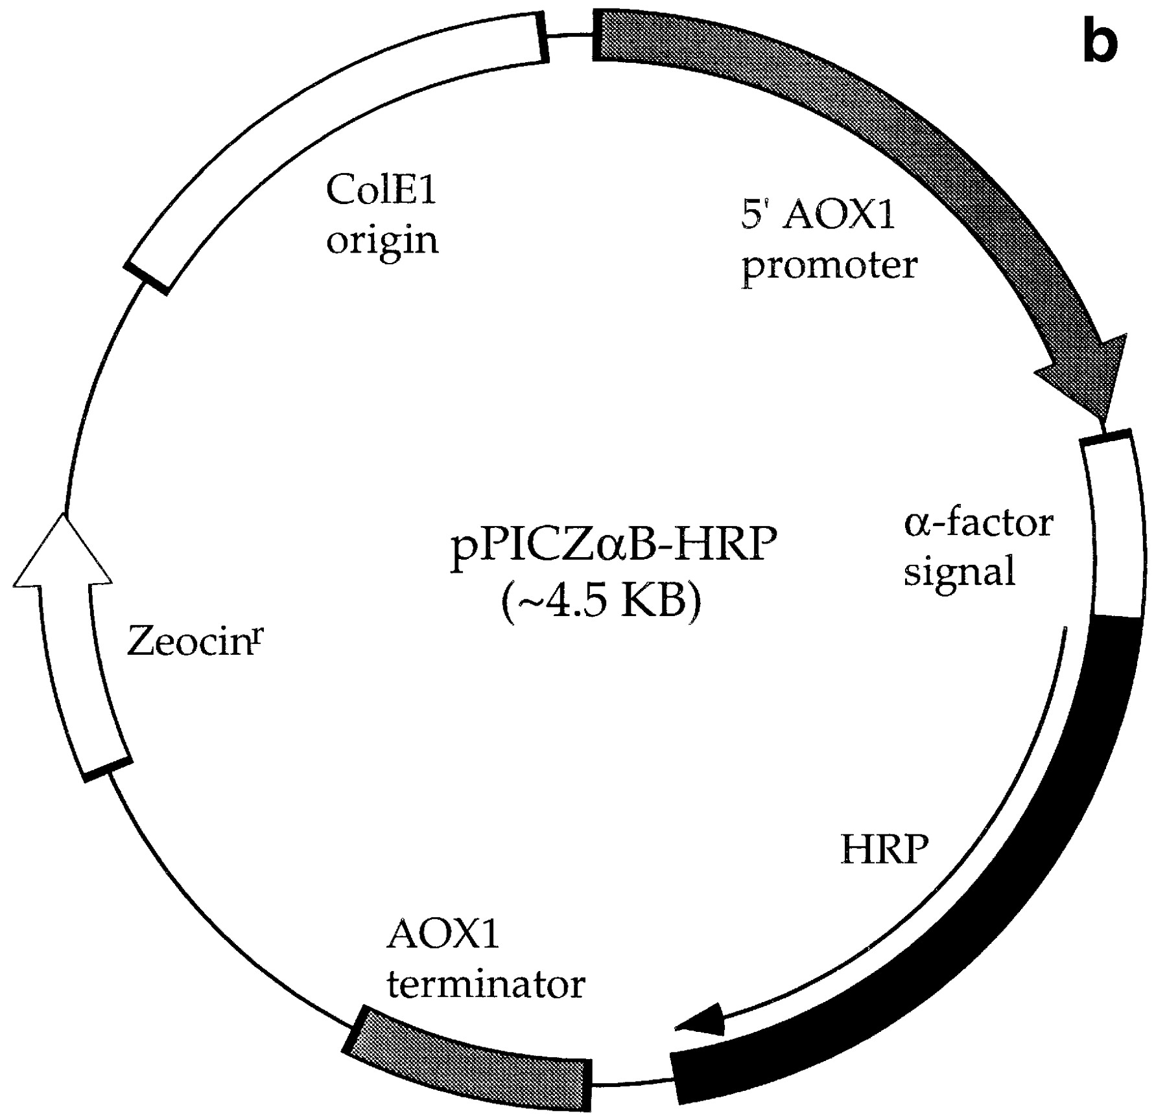
Fig. 1. (a) Map of plasmid pYEXS1-HRP for expression of HRP in S.cerevisiae. The HRP gene was fused in-frame to the ...
Notes:
Fig. 1. (a) Map of plasmid pYEXS1-HRP for expression of HRP in S.cerevisiae. The HRP gene was fused in-frame to the full-length leader sequence of the alpha-subunit of the Kluyveromycees lactis killer toxin. Expression is under the control of the constitutive phosphoglycerate kinase promoter. (b) Map of plasmid pPIZαB-HRP for expression of HRP in P.pastoris. The vector contains the α-factor signal peptide and the methanol-inducible PAOX1 promoter. Upon transformation into Pichia, the HRP is integrated into the genome through homologous recombination.
Unless provided in the caption above, the following copyright applies to the content of this slide: © Oxford University Press

Slide 3
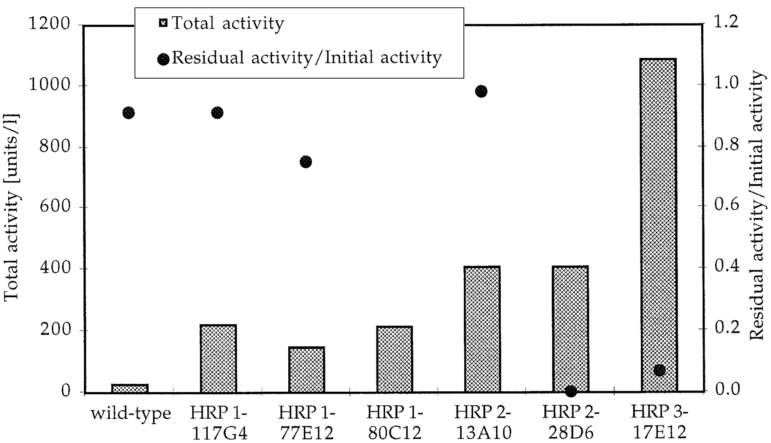
Fig. 2. Activities and thermostabilities of wild-type, parent (HRP1A6) and evolved HRP mutants in S.cerevisiae strain ...
Notes:
Fig. 2. Activities and thermostabilities of wild-type, parent (HRP1A6) and evolved HRP mutants in S.cerevisiae strain BJ5465. The values were obtained with the ABTS assay as described in Materials and methods and are not normalized with respect to cell density (OD600). Little variation in cell density was observed. Cells were grown in 96-well plates at 30°C for 64 h in non-selective YEPD media. Residual activity (Aresid) was measured after 10 min incubation at 50°C. Thermostability was determined from the ratio of residual to initial activity.
Unless provided in the caption above, the following copyright applies to the content of this slide: © Oxford University Press

Slide 4
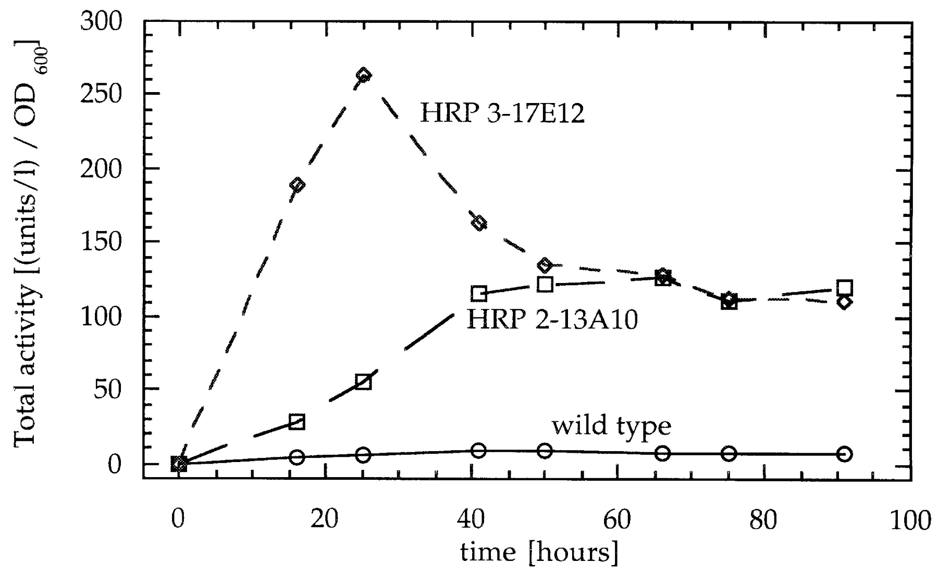
Fig. 3. Expression of HRP-C wild-type, HRP 2-13A10 and HRP 3-17E12 in S.cerevisiae grown in shake flasks in ...
Notes:
Fig. 3. Expression of HRP-C wild-type, HRP 2-13A10 and HRP 3-17E12 in S.cerevisiae grown in shake flasks in non-selective YEPD media. Activities are normalized with respect to OD600.
Unless provided in the caption above, the following copyright applies to the content of this slide: © Oxford University Press

Slide 5
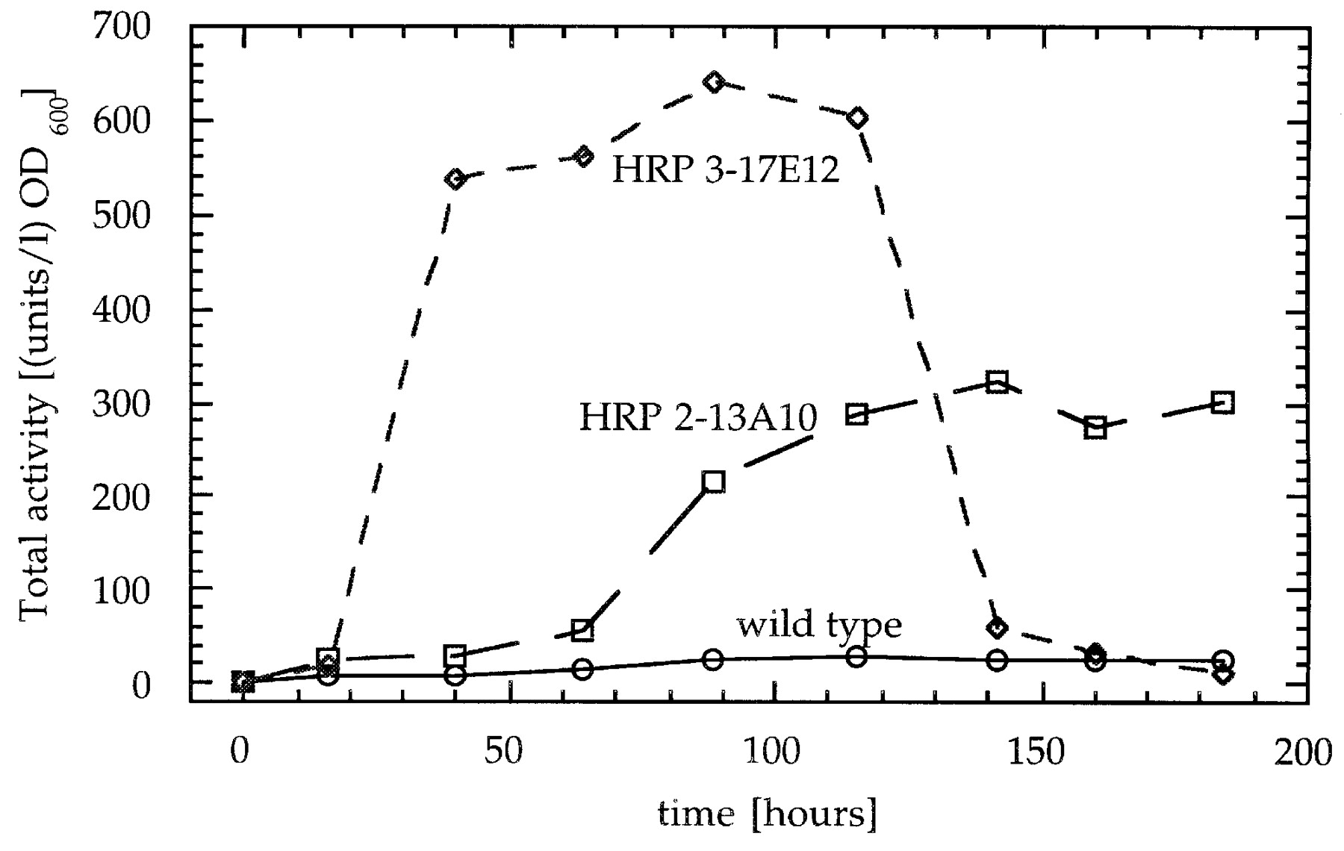
Fig. 4. Typical activity curves for HRP wild-type, HRP-2-13A10 and HRP 3-17E12 in P.pastoris shake flask cultures. ...
Notes:
Fig. 4. Typical activity curves for HRP wild-type, HRP-2-13A10 and HRP 3-17E12 in P.pastoris shake flask cultures. Activities are normalized with respect to OD600.
Unless provided in the caption above, the following copyright applies to the content of this slide: © Oxford University Press

Slide 6
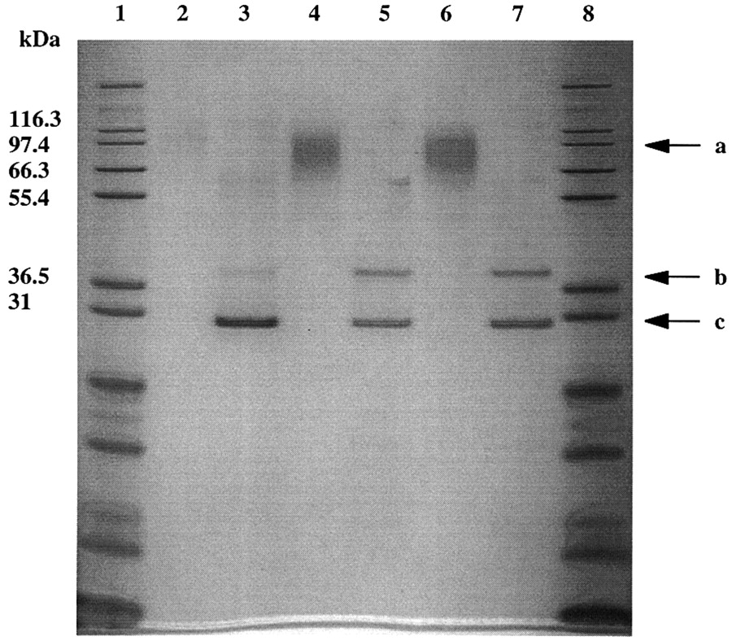
Fig. 5. Electrophoresis of purified HRP-C variants. Samples of combined MonoQ fractions before and after ...
Notes:
Fig. 5. Electrophoresis of purified HRP-C variants. Samples of combined MonoQ fractions before and after deglycosylation with EndH, obtained as described in Materials and methods, were subjected to SDS–PAGE under reducing conditions. Arrows show (a) glycosylated HRP, (b) deglycosylated HRP and (c) deglycosylating enzyme EndH. Samples: 1, MW standard; 2, HRP-C wild-type (0.15 μg ); 3, HRP-C wild-type deglycosylated; 4, HRP 2-13A10 (0.3 μg); 5, HRP 2-13A10 deglycosylated; 6, HRP 3-17E12 (0.3 μg); 7, HRP 3-17E12 deglycosylated; 8, MW standard.
Unless provided in the caption above, the following copyright applies to the content of this slide: © Oxford University Press

Slide 7
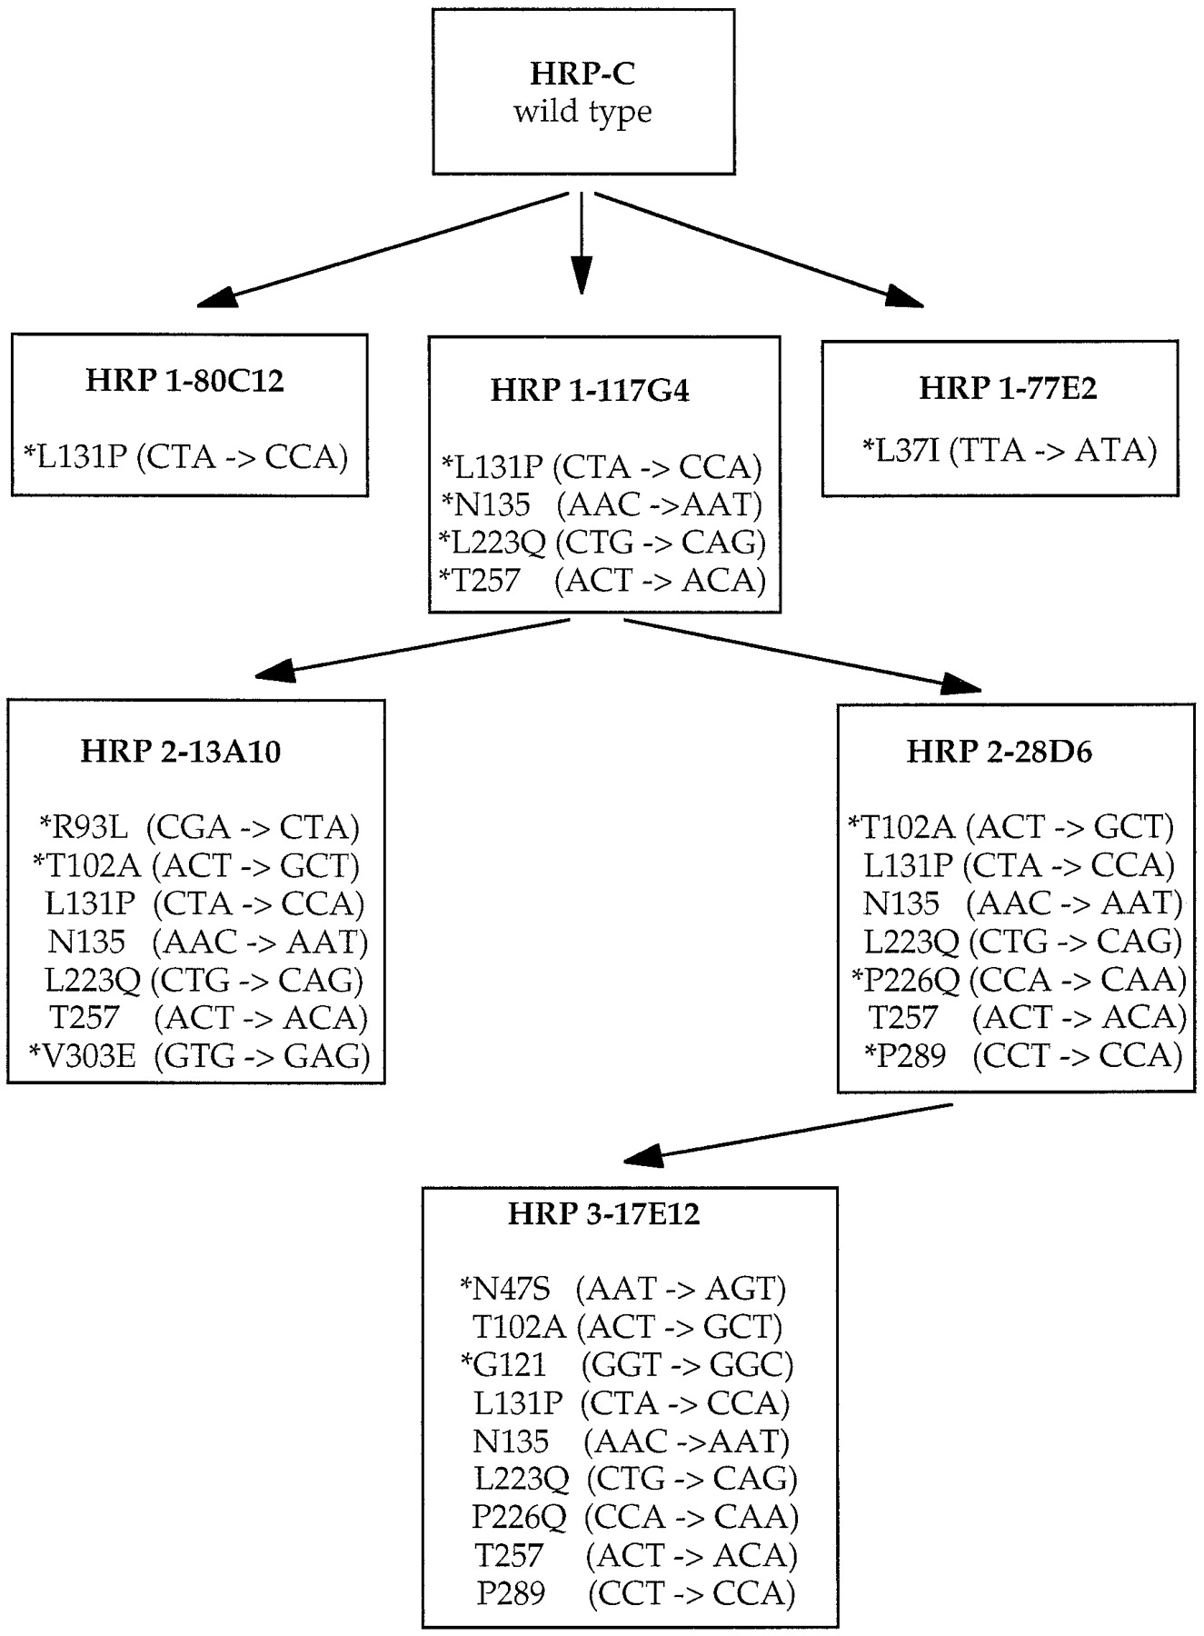
Fig. 6. HRP lineage and mutations. Nucleotide substitutions are shown in parentheses, following the corresponding ...
Notes:
Fig. 6. HRP lineage and mutations. Nucleotide substitutions are shown in parentheses, following the corresponding amino acid substitutions. Synonymous mutations are indicated in italics. New mutations in each generation are indicated by an asterisk.
Unless provided in the caption above, the following copyright applies to the content of this slide: © Oxford University Press

Slide 8
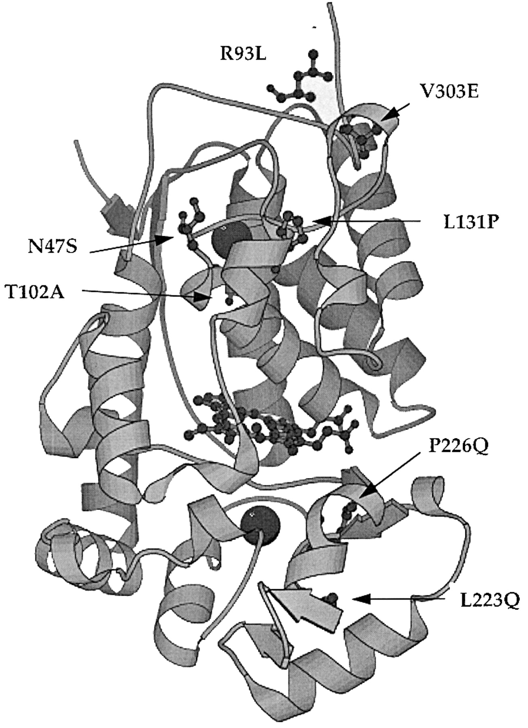
Fig. 7. Amino acid substitutions found in HRP mutants evolved in S.cerevisiae. Introduced mutations for HRP 2-13A10 ...
Notes:
Fig. 7. Amino acid substitutions found in HRP mutants evolved in S.cerevisiae. Introduced mutations for HRP 2-13A10 and HRP 3-17E12 are shown. Mutations N47S and P226Q supposed to be responsible for instability of HRP 3-17E12 are located near to the two Ca2+ ions (black balls). Heme group is shown in the center of the enzyme.
Unless provided in the caption above, the following copyright applies to the content of this slide: © Oxford University Press

