Slide 1
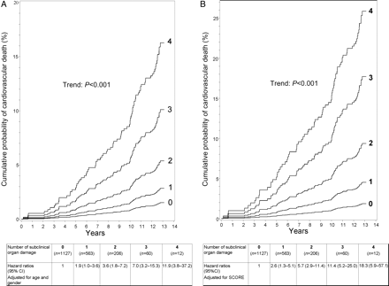
Figure 1 The cumulative probability (%) and hazard ratios of cardiovascular death adjusted for (mean or ratio) age and ...
Notes:
Figure 1 The cumulative probability (%) and hazard ratios of cardiovascular death adjusted for (mean or ratio) age and gender (A) and SCORE ( 12 m/s, and UACR ≥ 90th percentile.
Unless provided in the caption above, the following copyright applies to the content of this slide: Published on behalf of the European Society of Cardiology. All rights reserved. © The Author 2009. For permissions please email: journals.permissions@oxfordjournals.org.

Slide 2
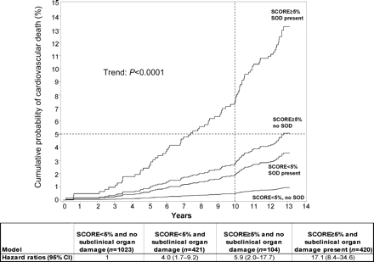
Figure 2 The cumulative probability (%) and hazard ratios of cardiovascular death in subgroups, according to SCORE and ...
Notes:
Figure 2 The cumulative probability (%) and hazard ratios of cardiovascular death in subgroups, according to SCORE and presence of subclinical organ damage. Dotted lines denote the 10 years 5% cumulative probability of cardiovascular death. Subjects with SCORE < 5% and no subclinical organ damage were the reference group. Abbreviation: SOD, subclinical organ damage.
Unless provided in the caption above, the following copyright applies to the content of this slide: Published on behalf of the European Society of Cardiology. All rights reserved. © The Author 2009. For permissions please email: journals.permissions@oxfordjournals.org.

