Slide 1
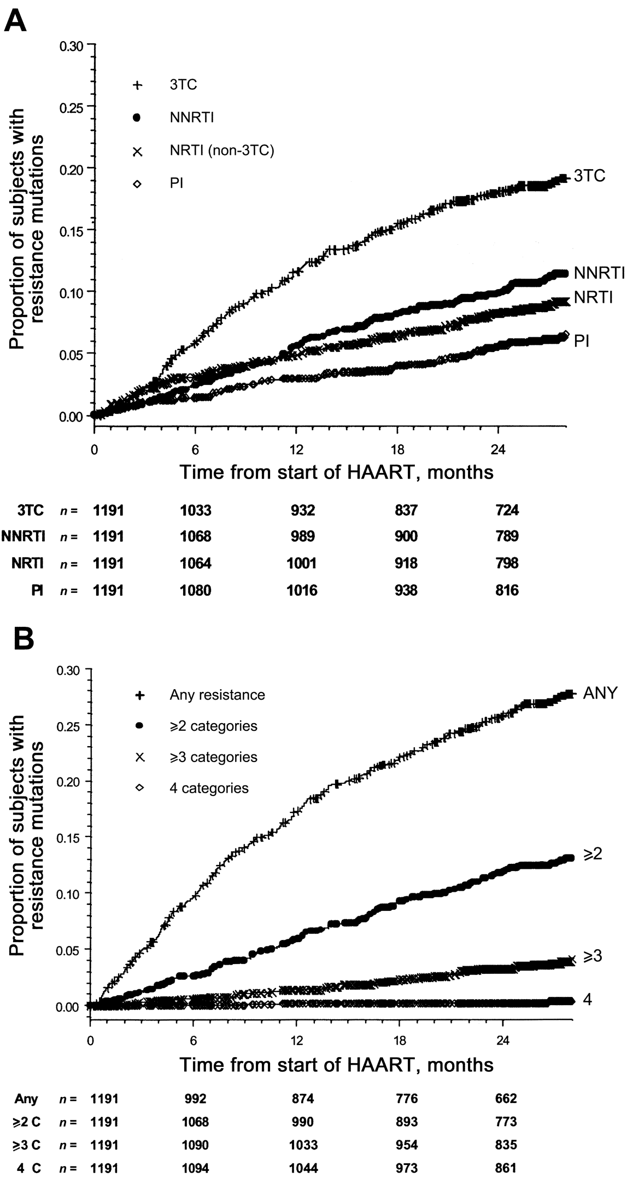
Figure 1. Detection of HIV-1 drug-resistance mutations during the 30 months after initiation of highly active ...
Notes:
Figure 1. Detection of HIV-1 drug-resistance mutations during the 30 months after initiation of highly active antiretroviral therapy (HAART). The graphs show Kaplan-Meier analyses of drug-resistance events assessed in terms of resistance category (A) and combinations of resistance categories (B). Drug-resistance categories were defined as lamivudine (3TC) resistance (184I/V), any other nucleoside reverse-transcriptase inhibitor (NRTI) resistance (41L, 62V, 65R, 67N, 69A/N/D or insertion, 70R, 74V, 75I, 151M, 210W, 215F/Y, or 219E/Q), nonnucloside reverse-transcriptase inhibitor (NNRTI) resistance (100I, 103N, 106A, 108I, 181C/I, 188C/H/L, 190A/S, or 236L), and protease inhibitor (PI) resistance (30N, 46I/L, 48V, 50L/V, 54L/M, 82A/F/S/T, 84V, or 90M). n represents the no. of participants remaining at risk for a resistance event at 0, 6, 12, 18, or 24 months after initiation of HAART.
Unless provided in the caption above, the following copyright applies to the content of this slide: © 2004 by the Infectious Diseases Society of America

Slide 2
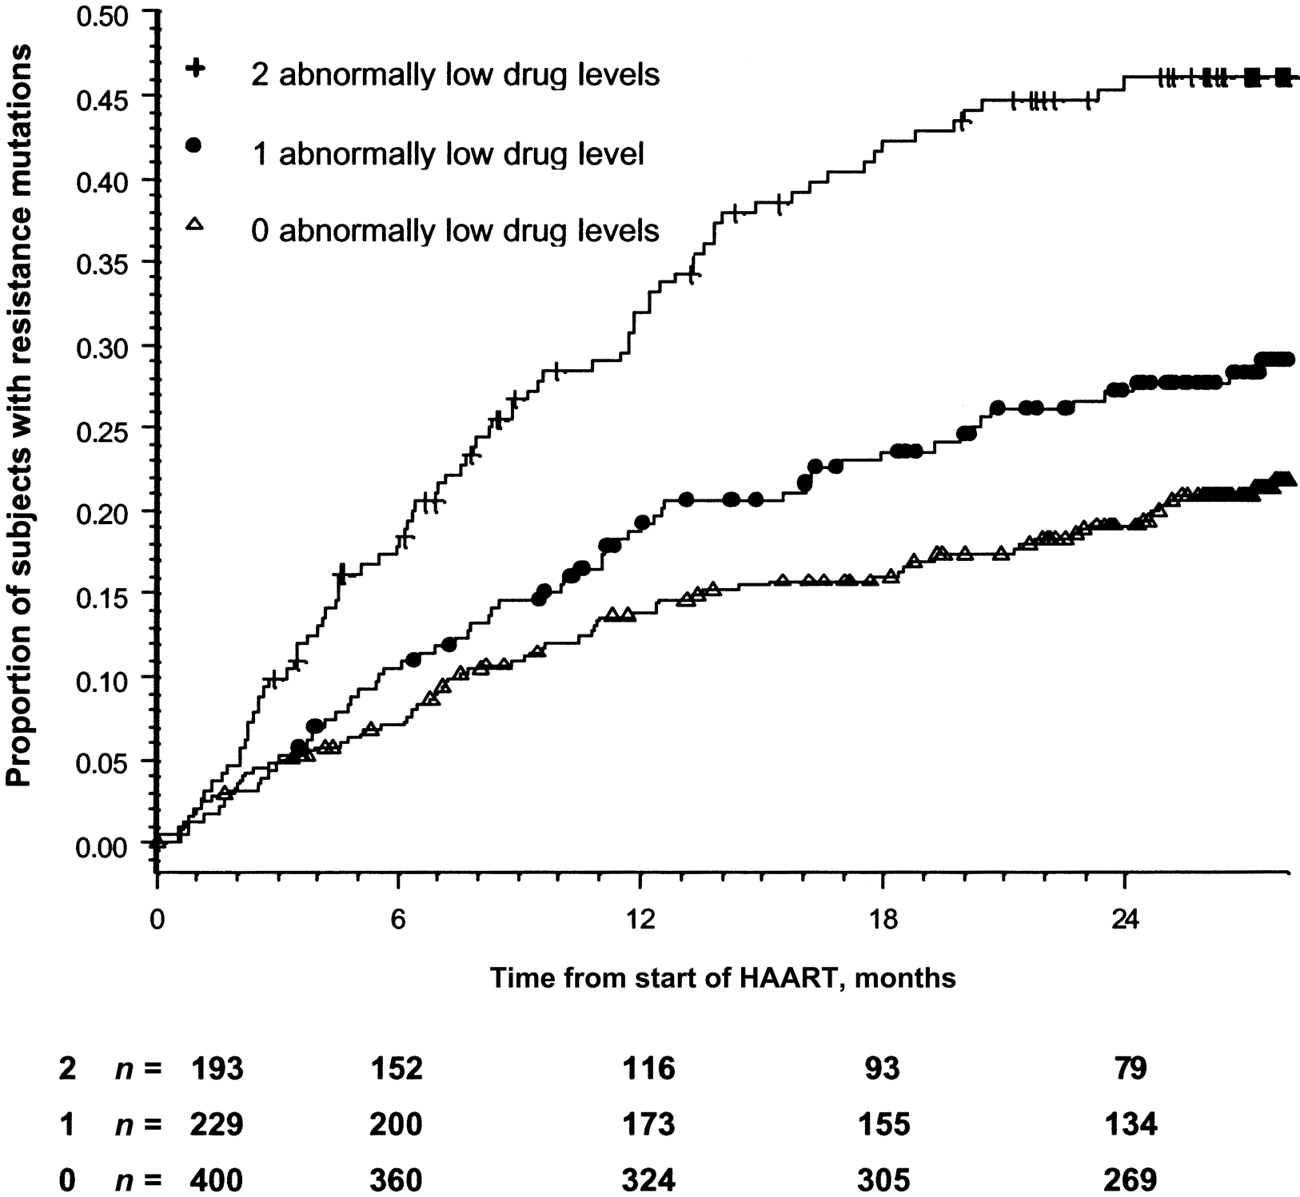
Figure 2. Association between untimed plasma drug concentrations and detection of HIV-1 drug-resistance mutations ...
Notes:
Figure 2. Association between untimed plasma drug concentrations and detection of HIV-1 drug-resistance mutations during the 30 months after initiation of highly active antiretroviral therapy (HAART). The graphs show Kaplan-Meier analyses of drug-resistance events stratified according to results from 2 untimed plasma drug-concentration measurements during the first year of HAART. Drug-resistance categories are defined as in figure 1. n represents the no. of participants remaining at risk for a resistance event at 0, 6, 12, 18, or 24 months after initiation of HAART.
Unless provided in the caption above, the following copyright applies to the content of this slide: © 2004 by the Infectious Diseases Society of America

Slide 3
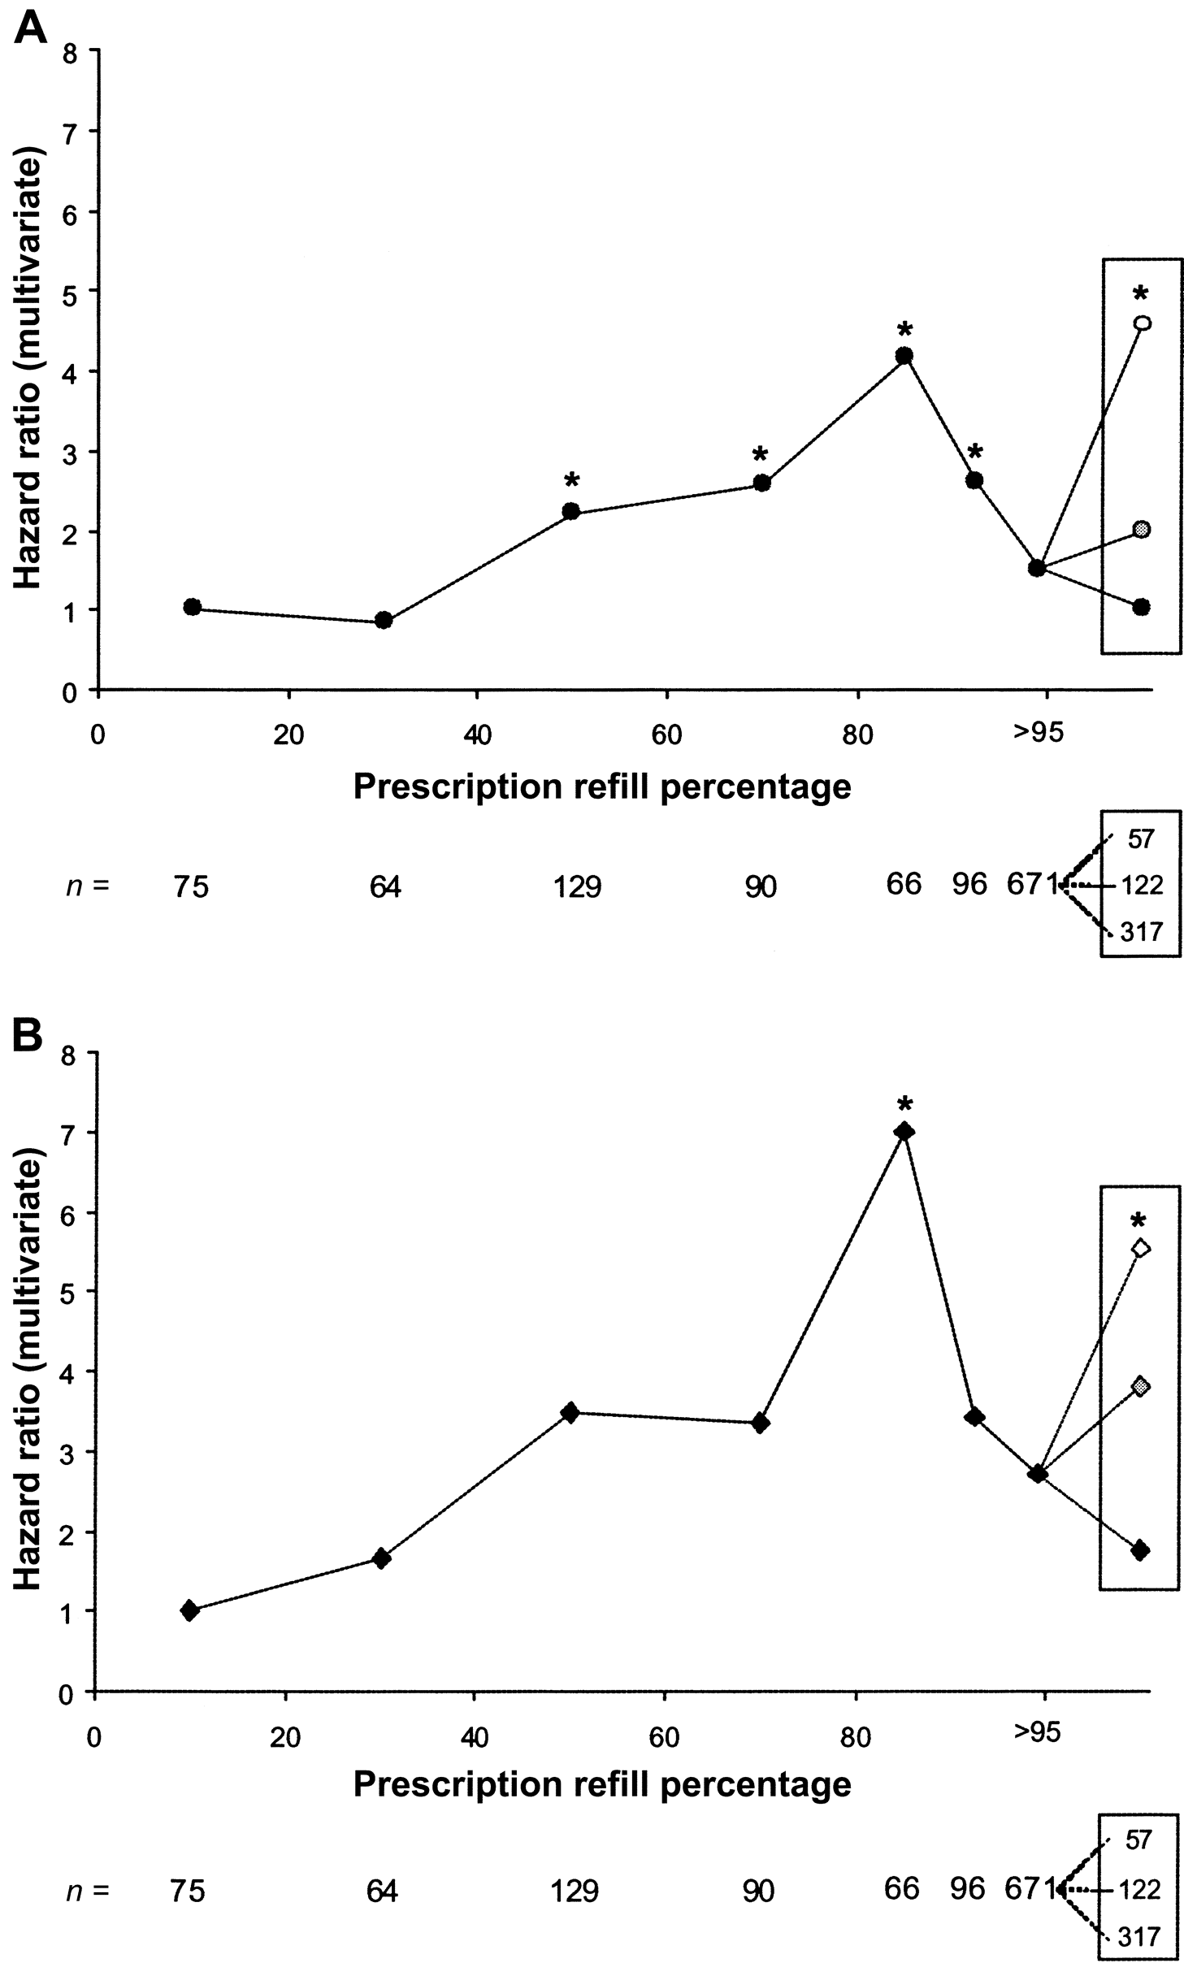
Figure 3. Association between adherence estimates and detection of HIV-1 drug-resistance mutations in ...
Notes:
Figure 3. Association between adherence estimates and detection of HIV-1 drug-resistance mutations in antiretroviral-naive subjects initiating highly active antiretroviral therapy (HAART). The graphs show the association between adherence, estimated using prescription-refill percentages, and the risk of developing any drug resistance (A, circles) or resistance to multiple categories (B, diamonds) among 1191 patients initiating HAART and followed for 30 months. Drug-resistance categories are defined as in figure 1. n represents the no. of participants with prescription-refill percentages of 0%–<20%, 20%–<40%, 40%–<60%, 60%–<80%, 80%–<90%, 90%–<95%, and ⩾95%. A secondary analysis divided the subjects in the ⩾95% prescription-refillpercentage group into 3 subgroups on the basis of results from the first 2 available untimed nonnucleoside reverse-transcriptase inhibitor and protease inhibitor drug-concentration tests within the first year of follow-up (inset). Drug-concentration data were available for 496 of 671 subjects with ⩾95% prescription-refill percentages: 2 abnormally low drug concentrations (white symbols), 1 abnormally low drug concentration (grey symbols), and no abnormally low drug concentrations (black symbols).*P < .05.
Unless provided in the caption above, the following copyright applies to the content of this slide: © 2004 by the Infectious Diseases Society of America

Slide 4
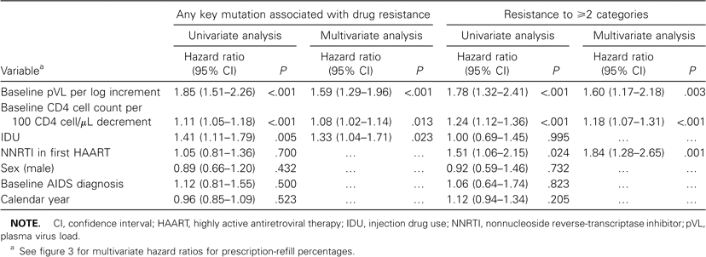
Table 1. Drug-resistance status of antiretroviral-naive subjects initiating highly active antiretroviral therapy and ...
Notes:
Table 1. Drug-resistance status of antiretroviral-naive subjects initiating highly active antiretroviral therapy and followed for 30 months.
Unless provided in the caption above, the following copyright applies to the content of this slide: © 2004 by the Infectious Diseases Society of America

Slide 5
Table 2. Determinants of time to development of drug-resistance mutations in single and multiple categories (n = ...
Notes:
Table 2. Determinants of time to development of drug-resistance mutations in single and multiple categories (n = 1191).
Unless provided in the caption above, the following copyright applies to the content of this slide: © 2004 by the Infectious Diseases Society of America

