Slide 1
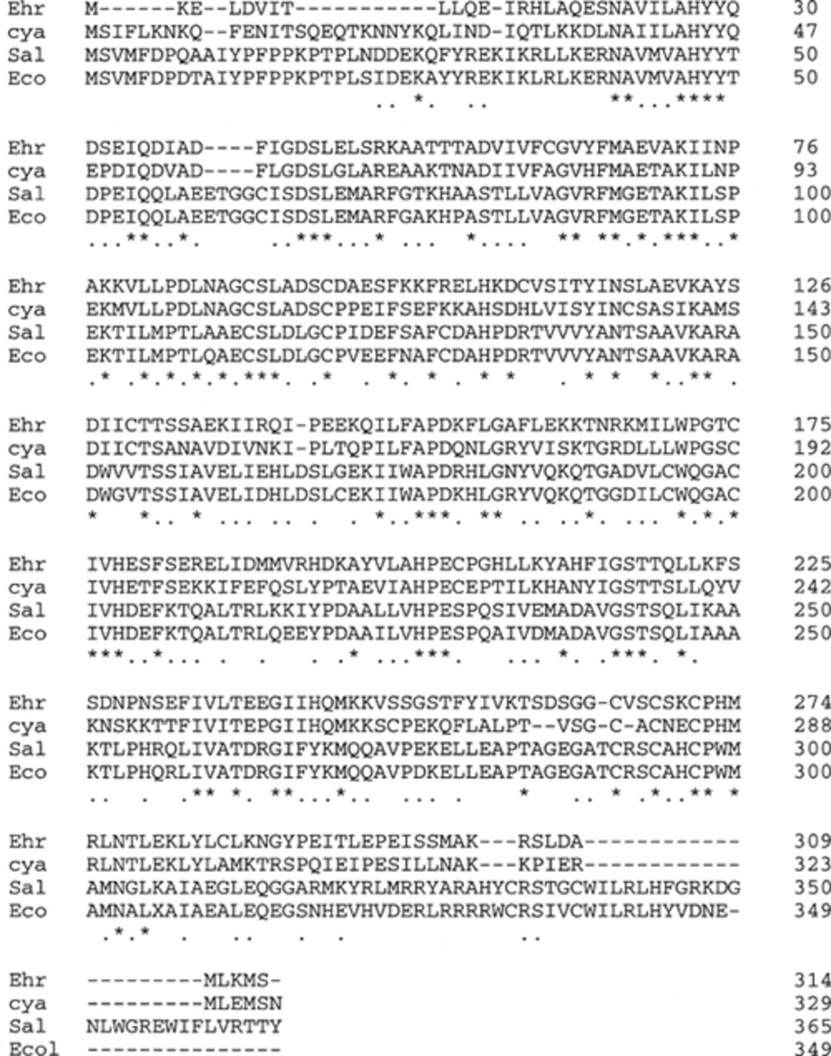
1 Alignment of the amino acid sequence of NAD A of E. chaffeensis (Ehr) with the sequences of NAD A of the ...
Notes:
1 Alignment of the amino acid sequence of NAD A of E. chaffeensis (Ehr) with the sequences of NAD A of the cyanelle of Cyanophora paradoxa (cya), S. typhimurium (Sal), and E. coli (Eco). The identical residues at the corresponding positions of these proteins are indicated by asterisks, whereas the conservative replacements are marked by dots. Gaps are introduced to optimize alignment.
Unless provided in the caption above, the following copyright applies to the content of this slide: © 1997 Federation of European Microbiological Societies. Published by Elsevier Science B.V.

Slide 2
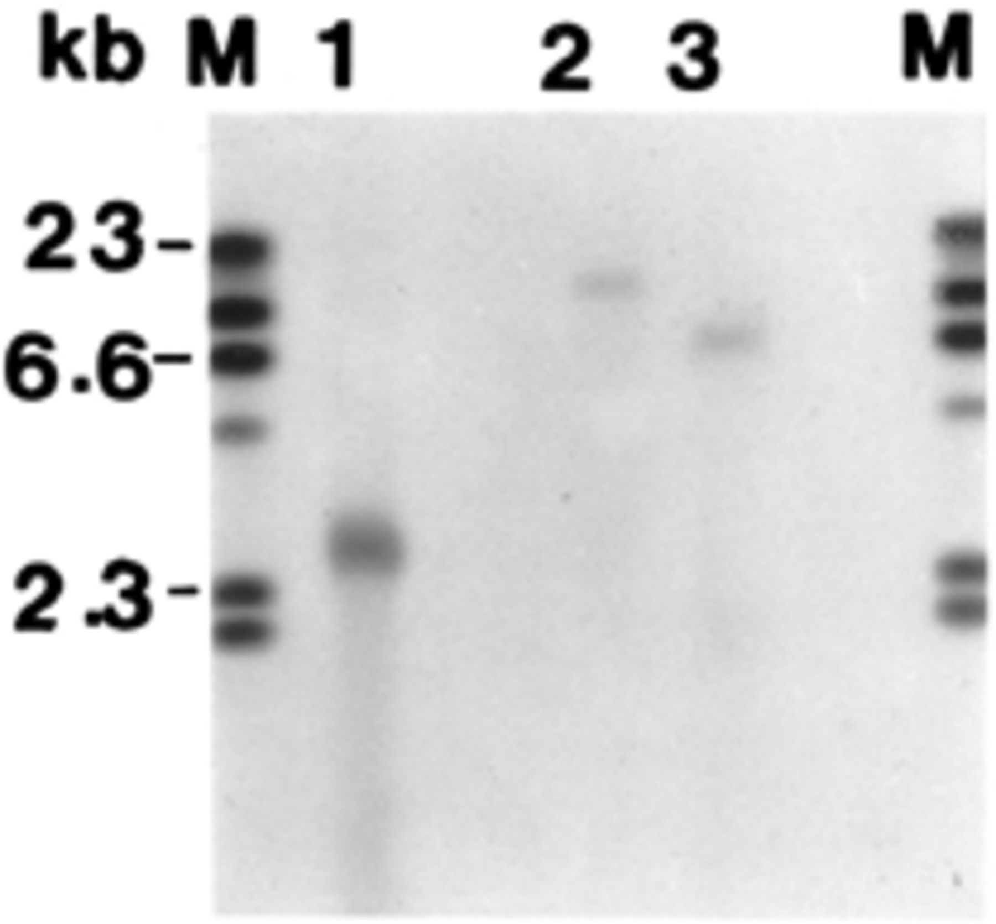
2 DNA hybridization of E. chaffeensis nadA gene with EcoRI digested genomic DNA of E. chaffeensis (lane 1), E. ...
Notes:
2 DNA hybridization of E. chaffeensis nadA gene with EcoRI digested genomic DNA of E. chaffeensis (lane 1), E. canis (lane 2), and E. muris (lane 3). M, digoxigenin-labeled DNA molecular mass markers II (Boehringer Mannheim, Indianapolis, IN).
Unless provided in the caption above, the following copyright applies to the content of this slide: © 1997 Federation of European Microbiological Societies. Published by Elsevier Science B.V.

Slide 3
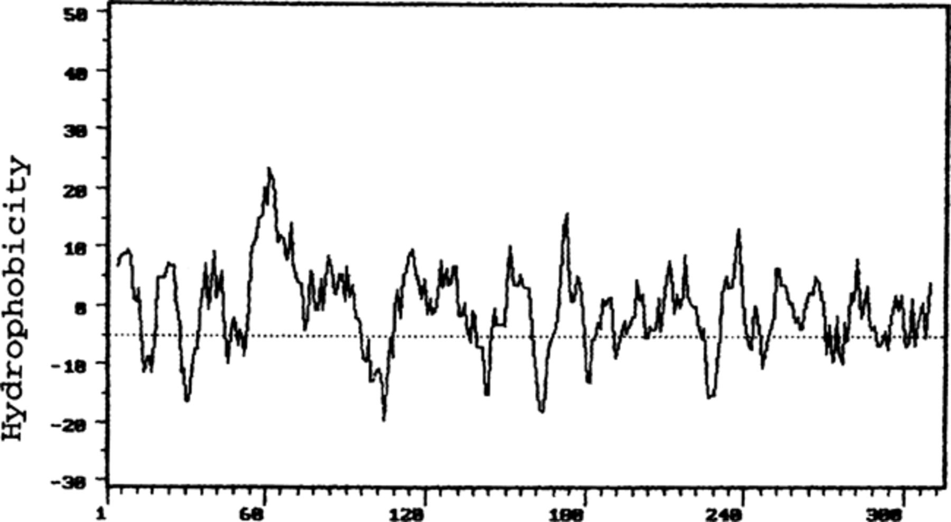
3 Hydropathy analysis of deduced amino acids of E. chaffeensis NAD A. The hydropathicity value of each amino ...
Notes:
3 Hydropathy analysis of deduced amino acids of E. chaffeensis NAD A. The hydropathicity value of each amino acid residue is plotted against its position in the polypeptide (x axis), starting from amino acid 1 to 314.
Unless provided in the caption above, the following copyright applies to the content of this slide: © 1997 Federation of European Microbiological Societies. Published by Elsevier Science B.V.

