Slide 1
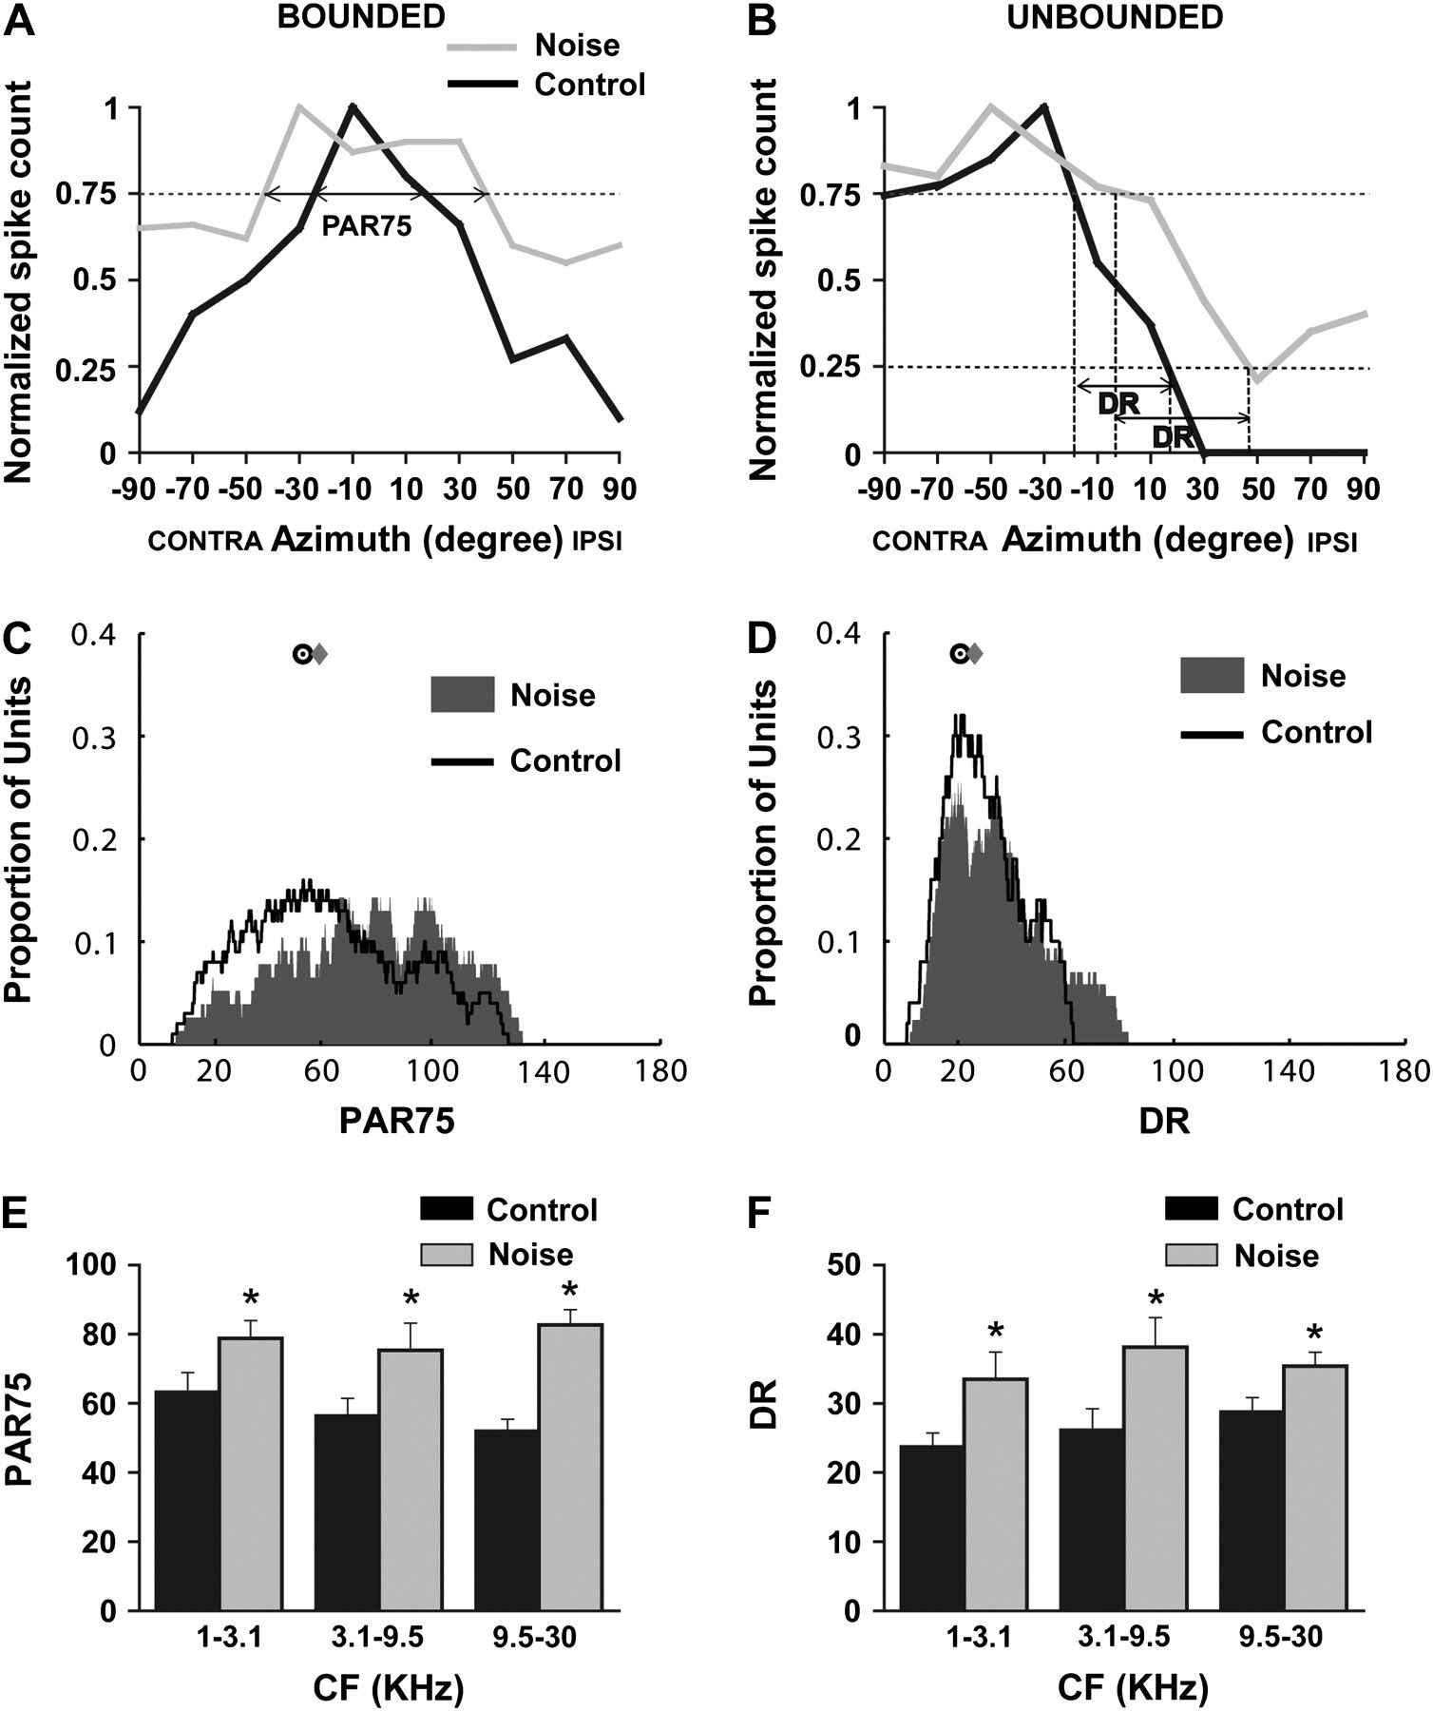
Figure 1. Early noise exposure results in poor azimuth tuning in A1 neurons. (A and B) Representative azimuth-tuning ...
Notes:
Figure 1. Early noise exposure results in poor azimuth tuning in A1 neurons. (A and B) Representative azimuth-tuning curves from normally reared (dark line) and noise-reared (gray line) rats. Azimuth tuning was assessed by the preferred azimuth range (PAR75), which was defined as the range of locations that elicited spike count >75% of the maximum. Neurons were classified as bounded or unbounded. Bounded neurons had PAR75 that were limited to the frontal field as shown in (A). The PAR75 of unbounded neurons extend beyond the contralateral or ipsilateral pole (±90°) as shown in (B). Azimuth selectivity was assessed by the DR for unbounded neurons. (C and D) Distributions of PAR75 and DR in noise-reared and normally reared rats. Values on the y-axis indicate the proportion of units within a range of 10° centered on the x-axis. Median values are plotted as gray diamonds for noise-reared group and dark circles for the control group. (E and F) Comparisons of PAR75 (E) and DR (F) at different CF ranges. Bin size ≈ 1.5 octaves. *P < 0.05. Error bars represent means ± standard error of the mean.
Unless provided in the caption above, the following copyright applies to the content of this slide: © The Author 2009. Published by Oxford University Press. All rights reserved. For permissions, please e-mail: journals.permissions@oxfordjournals.org

Slide 2
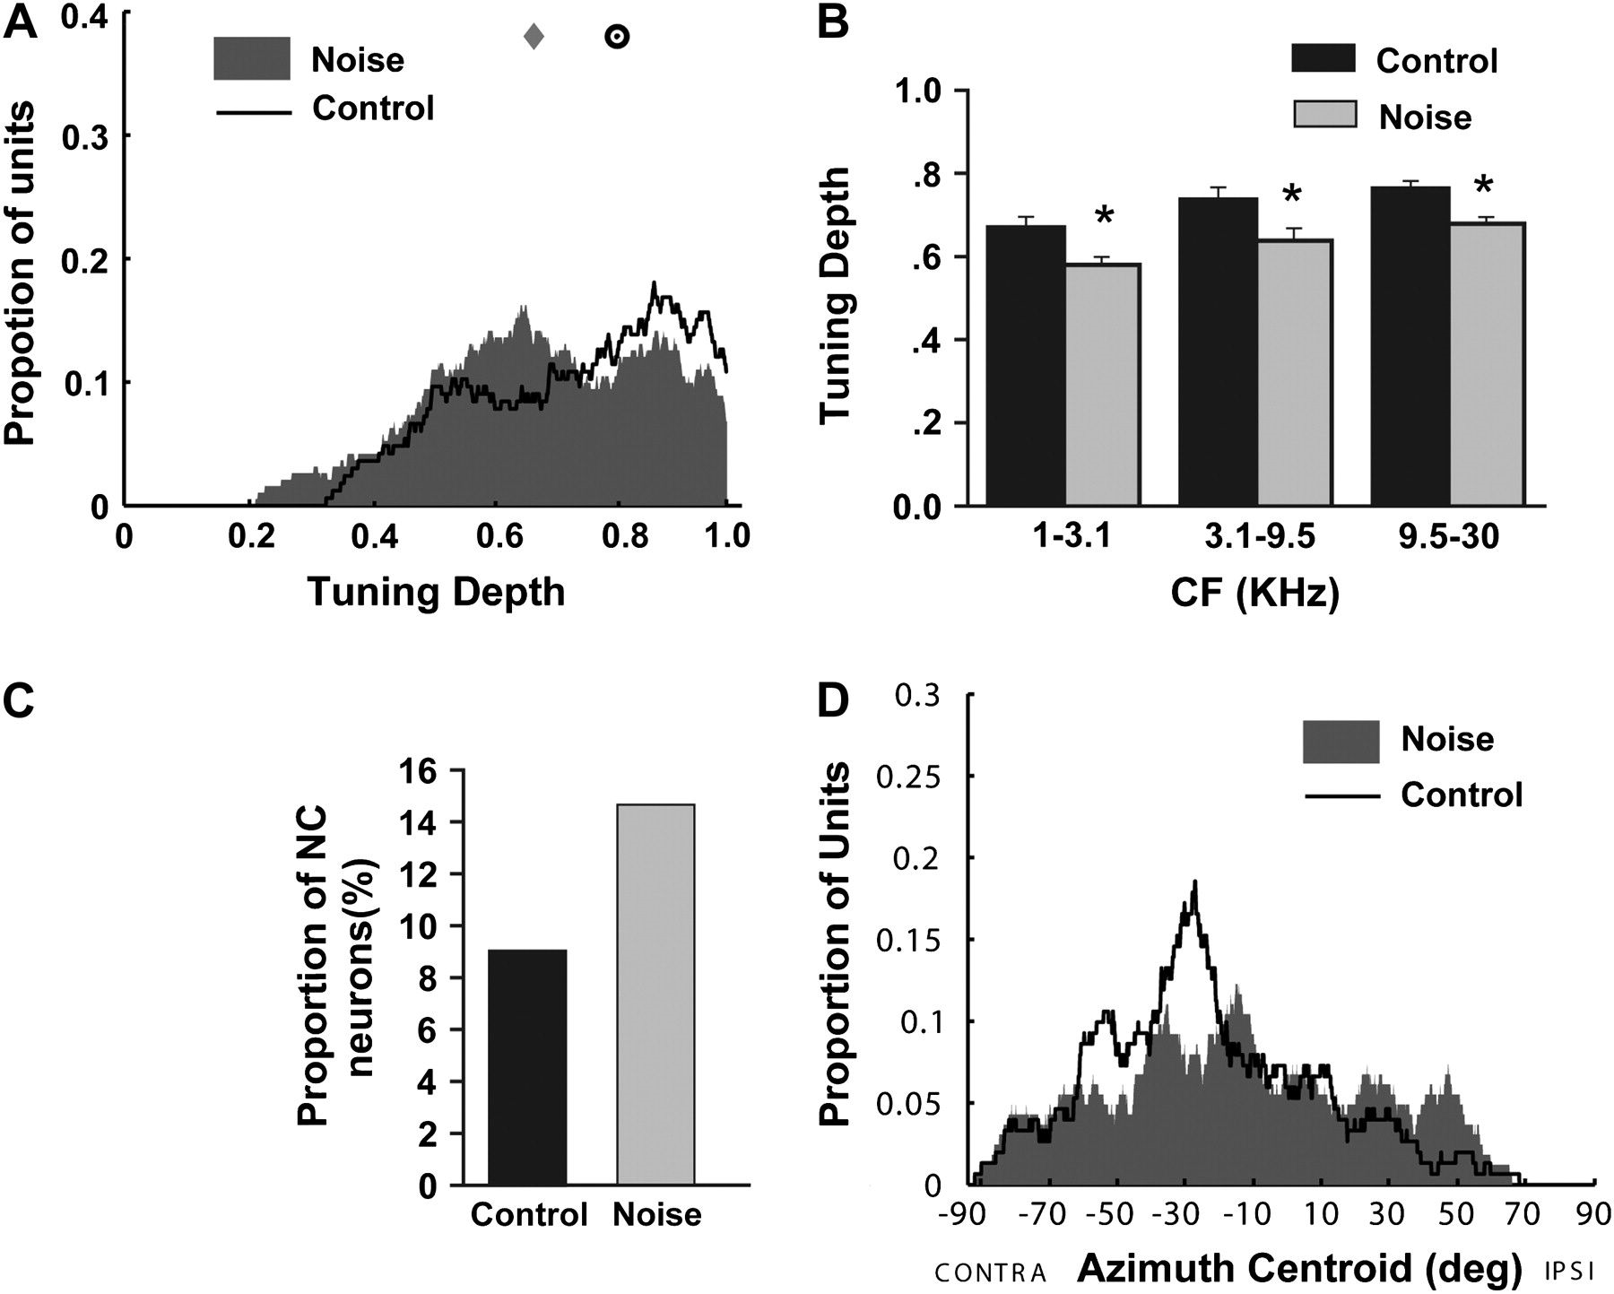
Figure 2. Early continuous noise exposure results in shallower azimuth tuning and wider distribution of azimuth ...
Notes:
Figure 2. Early continuous noise exposure results in shallower azimuth tuning and wider distribution of azimuth centroid. (A) Distribution of the azimuth-tuning depth in noise-reared and normally reared rats. Values on the y-axis indicate proportions of units per bin of 0.1 on the x-axis. Median values are plotted as gray diamonds for the noise-reared group and dark circles for the normally reared group. (B) Average tuning depth values for all recording sites in both rat groups for each 3 CF ranges. Bin size ≈ 1.5 octaves. *P < 0.05. Error bars represent means ± standard error of the mean. (C) Percentage of units with NC. (D) Distributions of azimuth centroids for noise-reared and normally reared rats. Values on the y-axis indicate the proportion of units within a 10° range centered on the x-axis.
Unless provided in the caption above, the following copyright applies to the content of this slide: © The Author 2009. Published by Oxford University Press. All rights reserved. For permissions, please e-mail: journals.permissions@oxfordjournals.org

Slide 3
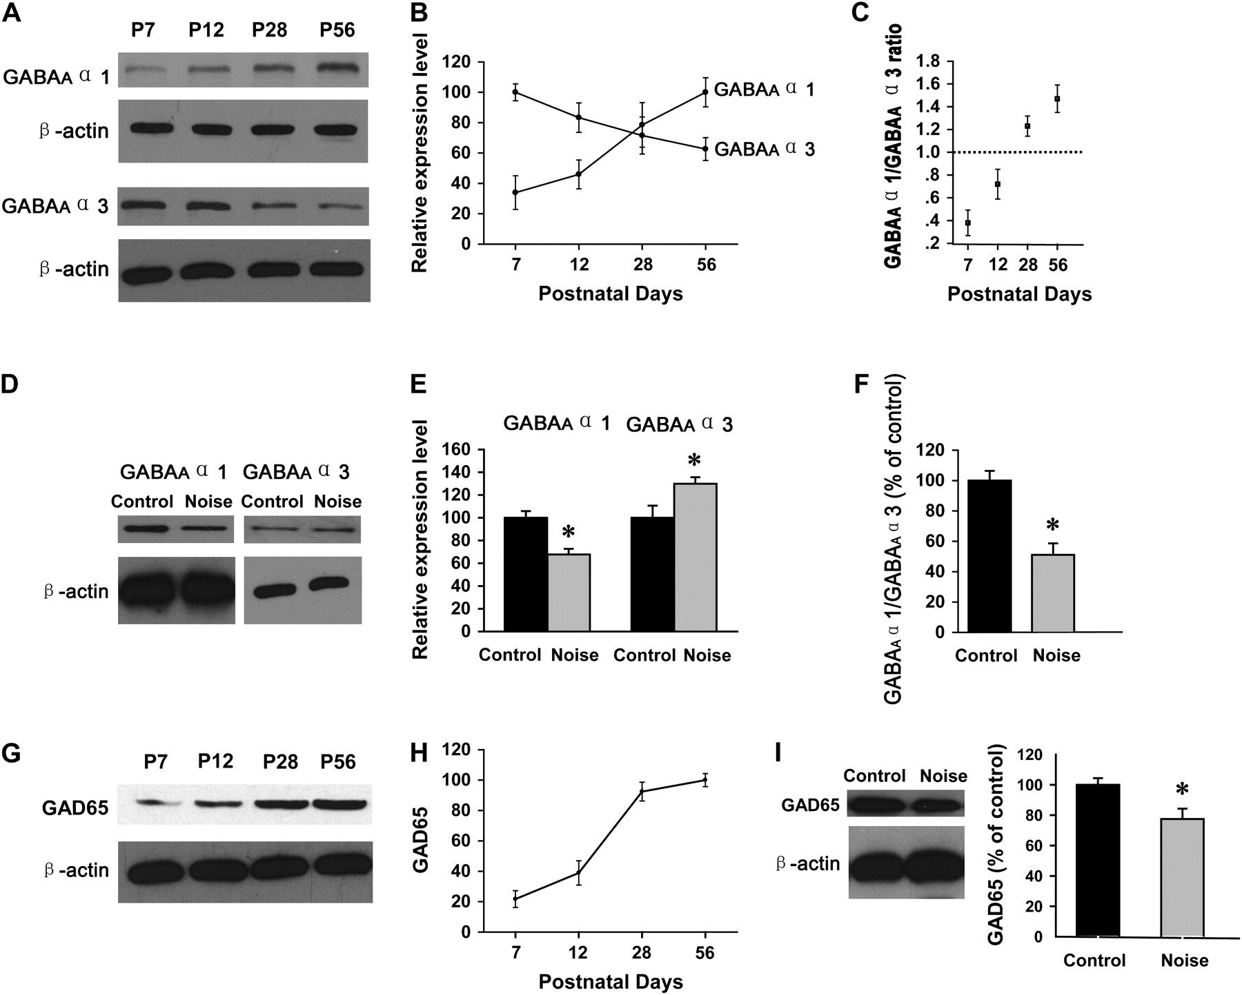
Figure 3. Early continuous noise exposure disturbs normal expression of GABA_{A} receptor subunits and GAD65. ...
Notes:
Figure 3. Early continuous noise exposure disturbs normal expression of GABAA receptor subunits and GAD65. (A) Representative western blots showing developmental changes in expression for GABAAα1 and GABAAα3. (B) Changes in the expression levels of GABAA receptors α1 and α3 during postnatal development of the rat auditory cortex. Values were normalized against the mean of the age showing the highest level of expression. (C) Developmental changes in the GABAAα1/GABAAα3 ratio. (D) Representative western blots for GABAAα1 and GABAAα3 from normal and noise-reared rats. (E) Noise rearing significantly decreases the expression of GABAAα1 and increases the expression of GABAAα3 (P < 0.05). (F) Noise rearing decreases the GABAAα1/GABAAα3 ratio. All values were normalized against the mean of the control rats. (G) Representative western blots showing developmental changes in GAD65. (H) Changes in the expression levels of GAD65 during postnatal development of the rat auditory cortex. Values were normalized against the mean of P56. (I) Noise rearing significantly decreases the expression of GAD65 (P < 0.05). All values were normalized against the mean of the control rats. *P < 0.05. Error bars represent means ± standard error of the mean.
Unless provided in the caption above, the following copyright applies to the content of this slide: © The Author 2009. Published by Oxford University Press. All rights reserved. For permissions, please e-mail: journals.permissions@oxfordjournals.org

Slide 4
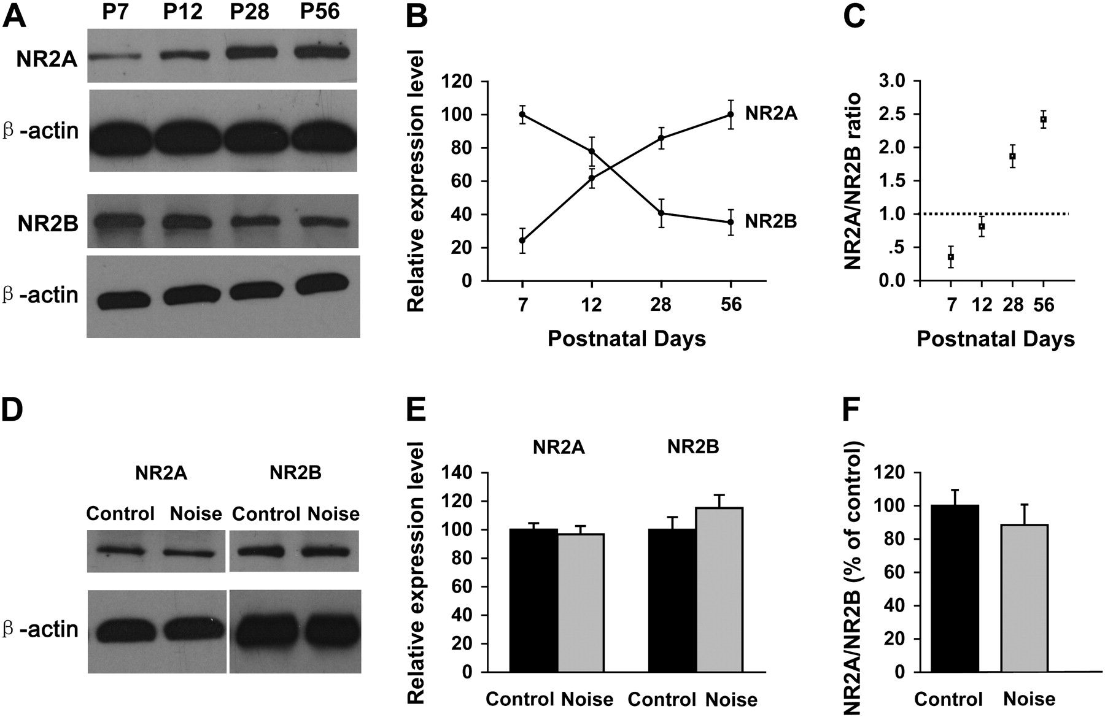
Figure 4. Developmental expression levels of NMDARs are not affected by noise exposure. (A) Representative western ...
Notes:
Figure 4. Developmental expression levels of NMDARs are not affected by noise exposure. (A) Representative western blots showing developmental changes in expression for NR2A and NR2B. (B) Changes in the expression levels of NR2A and NR2B during postnatal development of the rat auditory cortex. Values were normalized against the mean of the age showing the highest level of expression. (C) Developmental changes in the NR2A/NR2B ratio. (D) Representative western blots for NR2A and NR2B from normally and noise-reared rats. (E) Noise rearing has no influence on the expression levels of NR2A and NR2B (P > 0.05). (F) Noise rearing has no influence on NR2A/NR2B ratio (P > 0.05). All values were normalized against the mean of the control rats. *P < 0.05. Error bars represent means ± standard error of the mean.
Unless provided in the caption above, the following copyright applies to the content of this slide: © The Author 2009. Published by Oxford University Press. All rights reserved. For permissions, please e-mail: journals.permissions@oxfordjournals.org

Slide 5
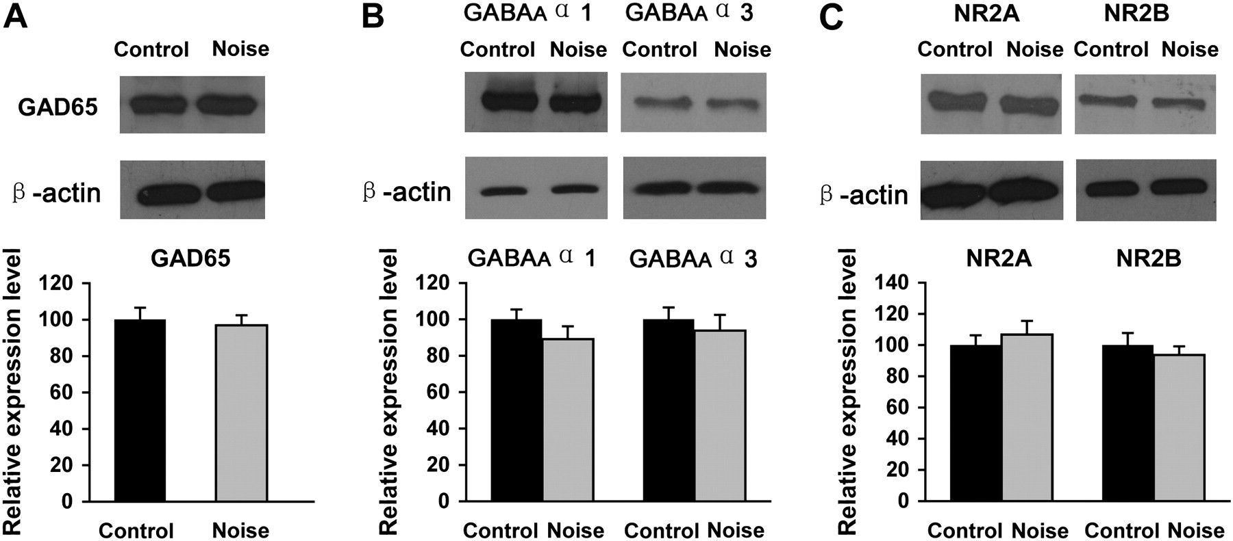
Figure 5. Noise exposure does not influence the expression levels of GAD65, GABA_{A}α1, GABA_{A}α3, ...
Notes:
Figure 5. Noise exposure does not influence the expression levels of GAD65, GABAAα1, GABAAα3, NR2A, and NR2B in the visual cortex. (A) The effect of noise rearing on GAD65 expression. (B) The effect of noise rearing on GABAAα1 and GABAAα3 expression. (C) The effect of noise rearing on the NR2A and NR2B expression. The top of each panel shows representative western blots. All values were normalized against the mean of the control rats.
Unless provided in the caption above, the following copyright applies to the content of this slide: © The Author 2009. Published by Oxford University Press. All rights reserved. For permissions, please e-mail: journals.permissions@oxfordjournals.org

