Slide 1
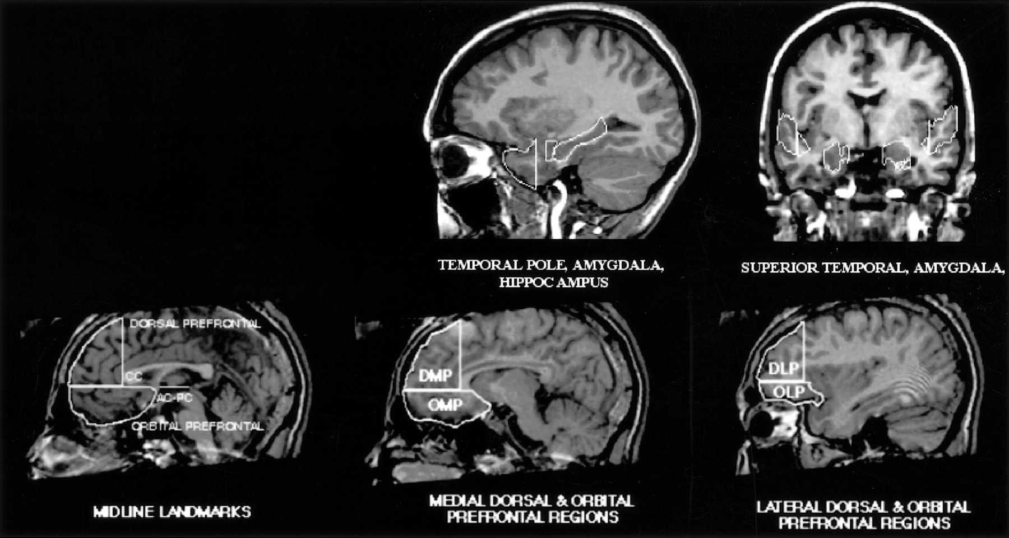
Figure 1. Illustration of ROI placement in temporal (upper row) and frontal (lower row) lobes.
Notes:
Figure 1. Illustration of ROI placement in temporal (upper row) and frontal (lower row) lobes.
Unless provided in the caption above, the following copyright applies to the content of this slide: © Oxford University Press

Slide 2
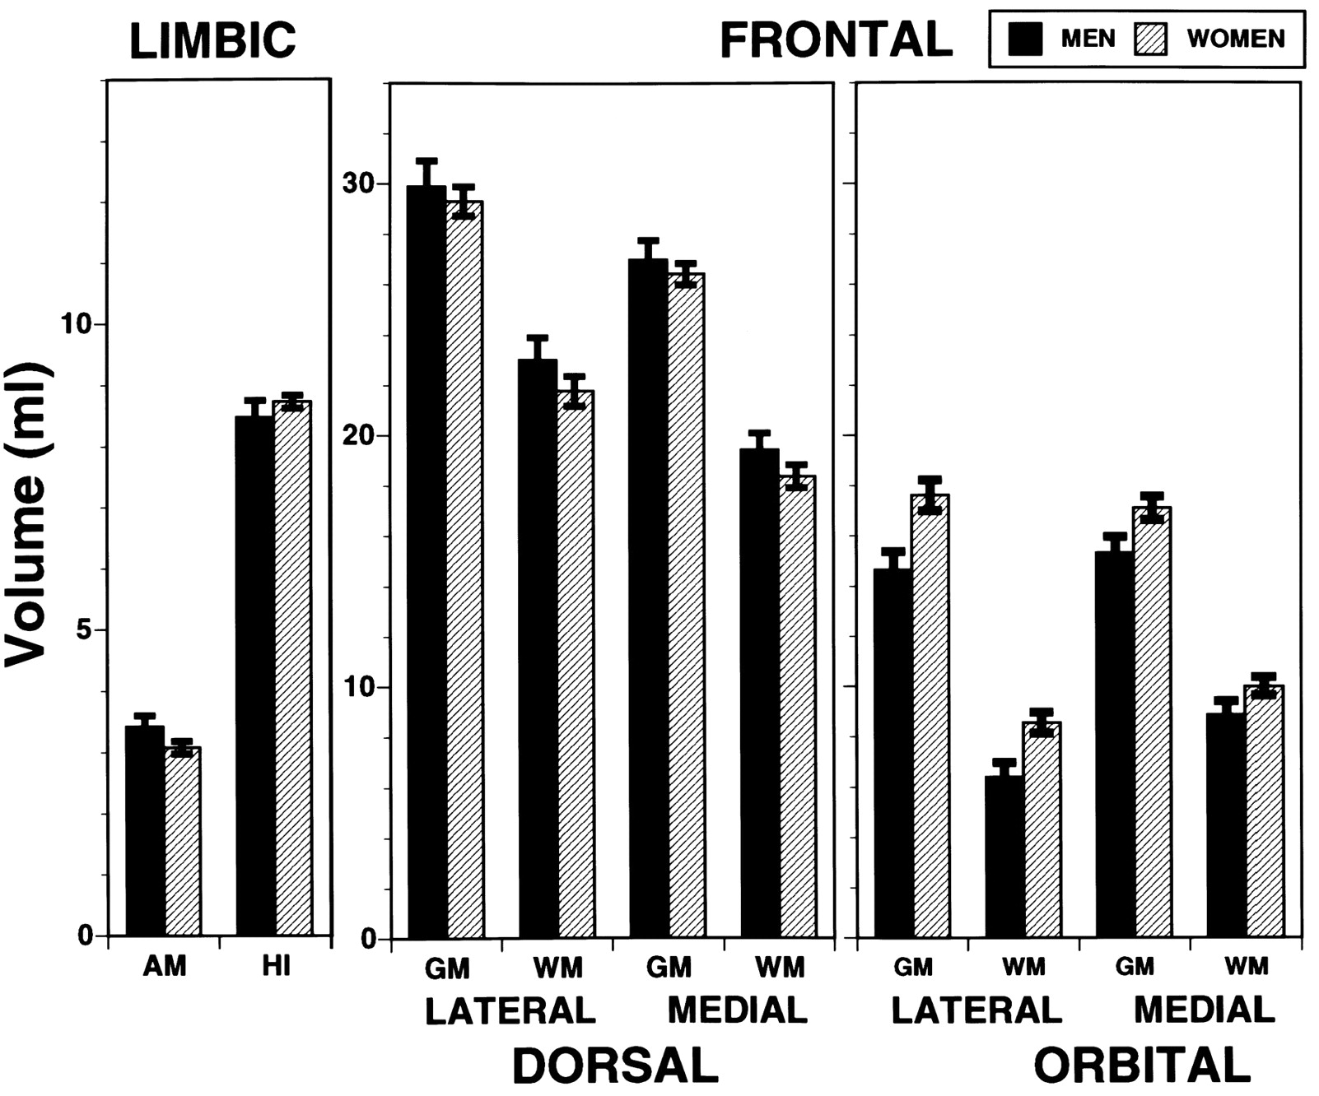
Figure 2. Regional means (±SEM) for men and women adjusted for intracranial volume.
Notes:
Figure 2. Regional means (±SEM) for men and women adjusted for intracranial volume.
Unless provided in the caption above, the following copyright applies to the content of this slide: © Oxford University Press

Slide 3
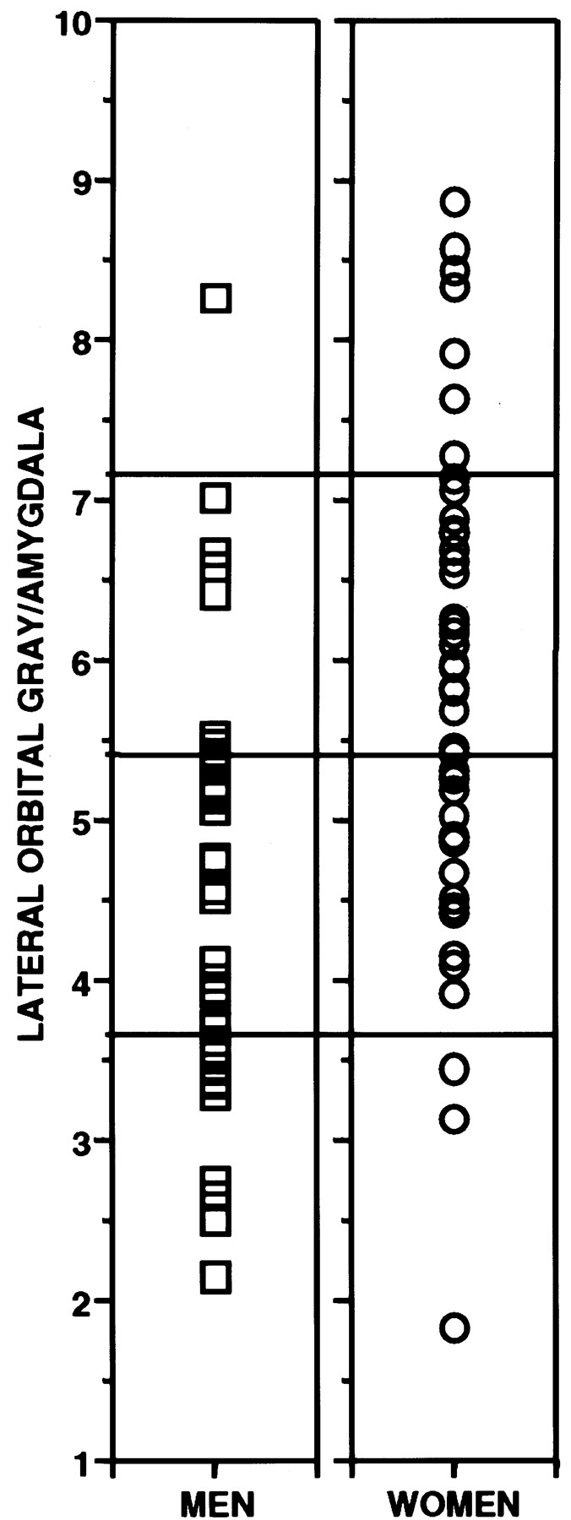
Figure 3. Scatterplots showing the distribution of the OARs in men (squares) and women (circles). Dashed lines indicate ...
Notes:
Figure 3. Scatterplots showing the distribution of the OARs in men (squares) and women (circles). Dashed lines indicate cut-offs for the four equally spaced intervals from the smallest to the largest observed used in the Fisher exact test.
Unless provided in the caption above, the following copyright applies to the content of this slide: © Oxford University Press

