Slide 1
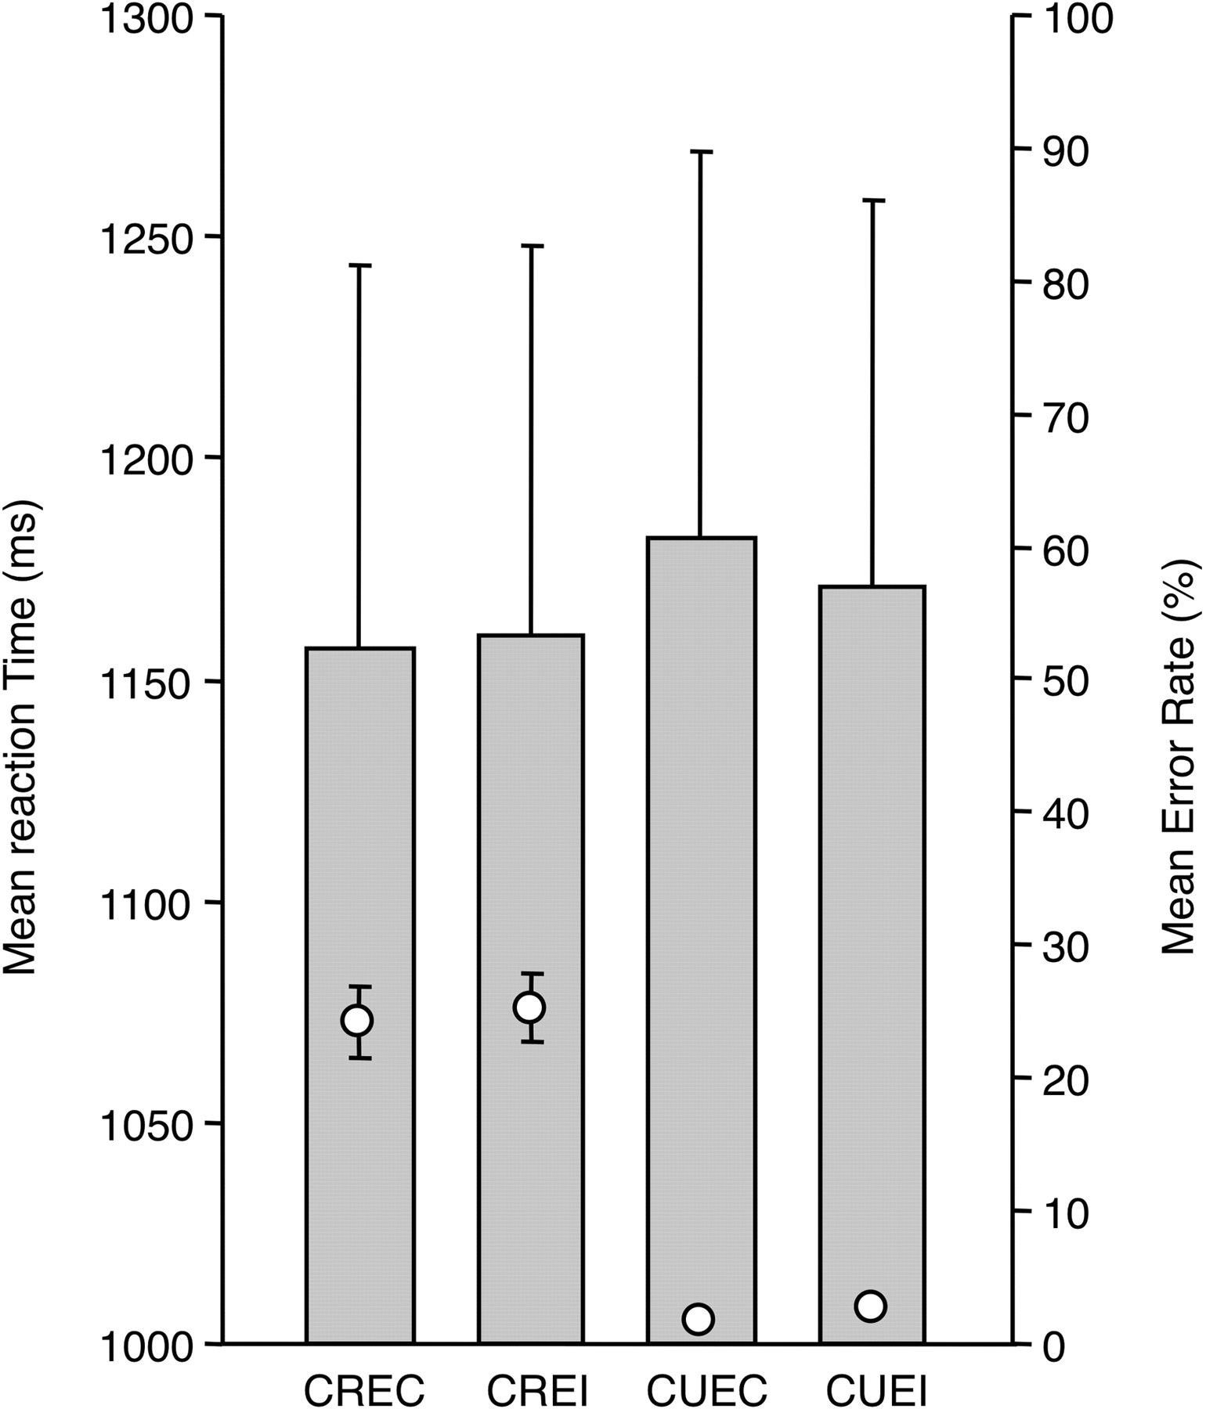
Figure 1. Behavioral results in the conceptual relatedness judgment task (Experiment 1). Mean reaction times (bars, ...
Notes:
Figure 1. Behavioral results in the conceptual relatedness judgment task (Experiment 1). Mean reaction times (bars, left-hand scale) and error rates (circle, right-hand scale) in the 4 experimental conditions: CR/U conceptually related/unrelated, EC/I: emotionally congruent/incongruent. Error bars depict standard error of the mean in all cases. Note that the error bars are too small to show in the case of mean error rates in conditions CUEC and CUEI.
Unless provided in the caption above, the following copyright applies to the content of this slide: © The Author 2011. Published by Oxford University Press. All rights reserved. For permissions, please e-mail: journals.permissions@oup.com

Slide 2
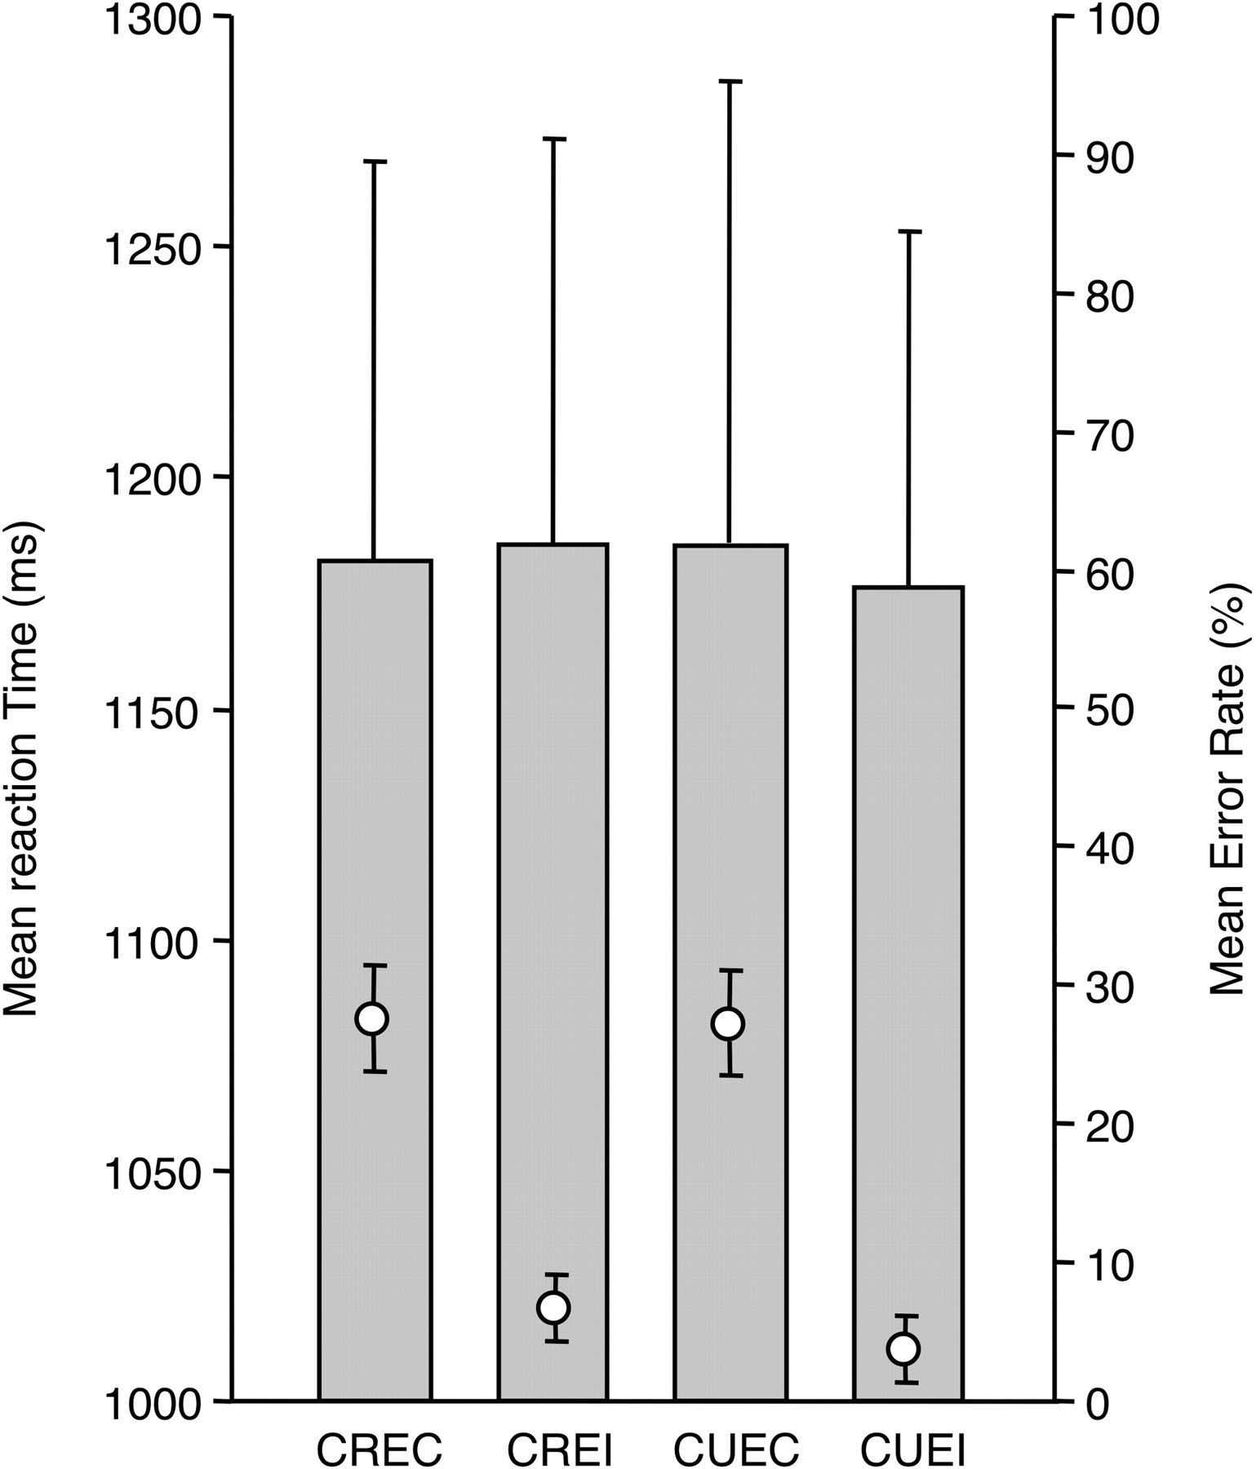
Figure 2. Behavioral results in the emotional congruence judgment task (Experiment 2). Mean reaction times (bars, ...
Notes:
Figure 2. Behavioral results in the emotional congruence judgment task (Experiment 2). Mean reaction times (bars, left-hand scale) and error rates (circle, right-hand scale) in the 4 experimental conditions: CR/U conceptually related/unrelated, EC/I: emotionally congruent/incongruent. Error bars depict standard error of the mean in all cases.
Unless provided in the caption above, the following copyright applies to the content of this slide: © The Author 2011. Published by Oxford University Press. All rights reserved. For permissions, please e-mail: journals.permissions@oup.com

Slide 3
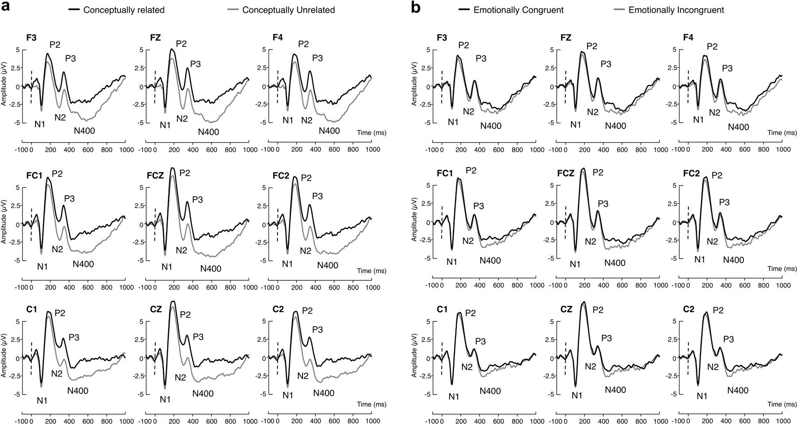
Figure 3. Event-related potentials elicited at 9 electrode sites in Experiment 1. (a) Main effect of conceptual ...
Notes:
Figure 3. Event-related potentials elicited at 9 electrode sites in Experiment 1. (a) Main effect of conceptual relatedness. (b) Main effect of emotional congruence.
Unless provided in the caption above, the following copyright applies to the content of this slide: © The Author 2011. Published by Oxford University Press. All rights reserved. For permissions, please e-mail: journals.permissions@oup.com

Slide 4
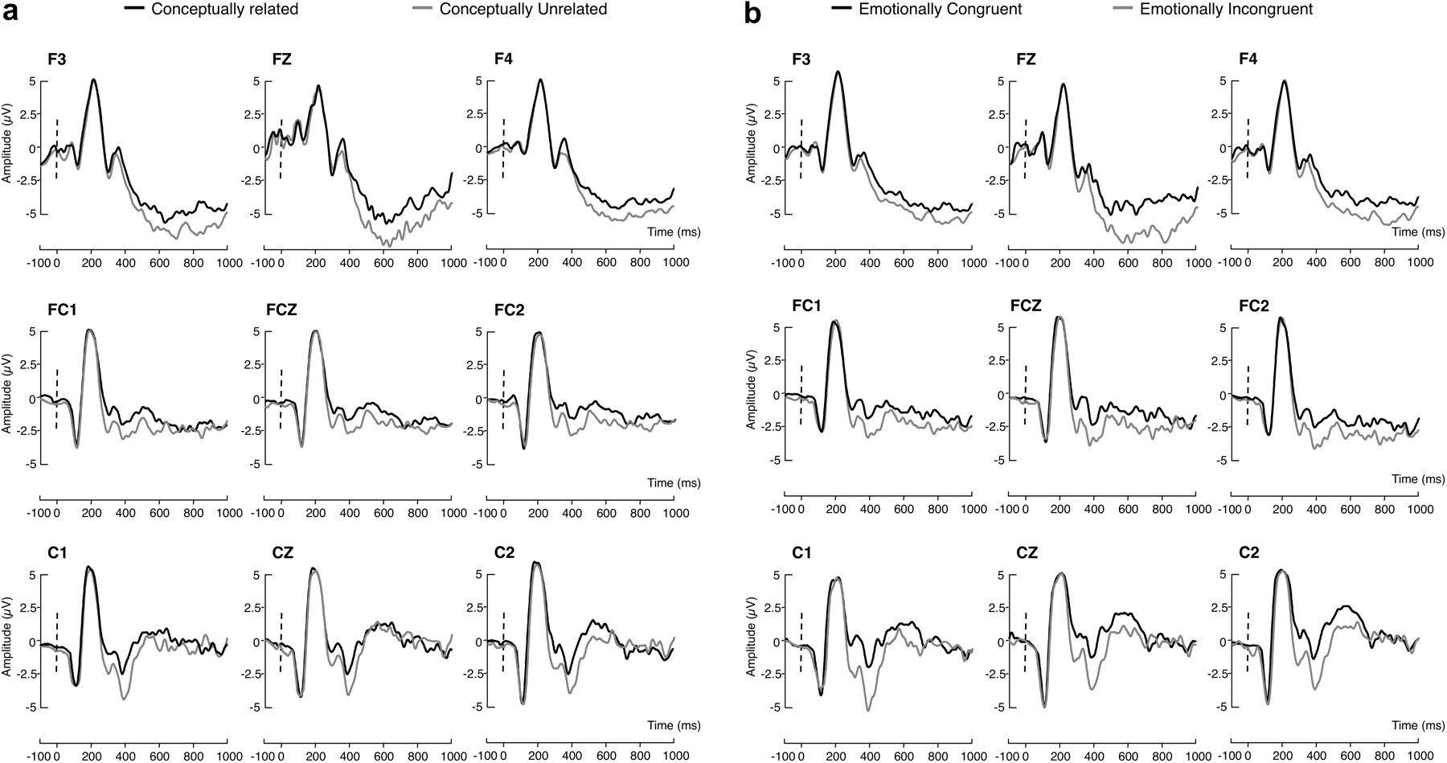
Figure 4. Event-related potentials elicited at 9 electrode sites in Experiment 2. (a) Main effect of conceptual ...
Notes:
Figure 4. Event-related potentials elicited at 9 electrode sites in Experiment 2. (a) Main effect of conceptual relatedness. (b) Main effect of emotional congruence.
Unless provided in the caption above, the following copyright applies to the content of this slide: © The Author 2011. Published by Oxford University Press. All rights reserved. For permissions, please e-mail: journals.permissions@oup.com

