Slide 1
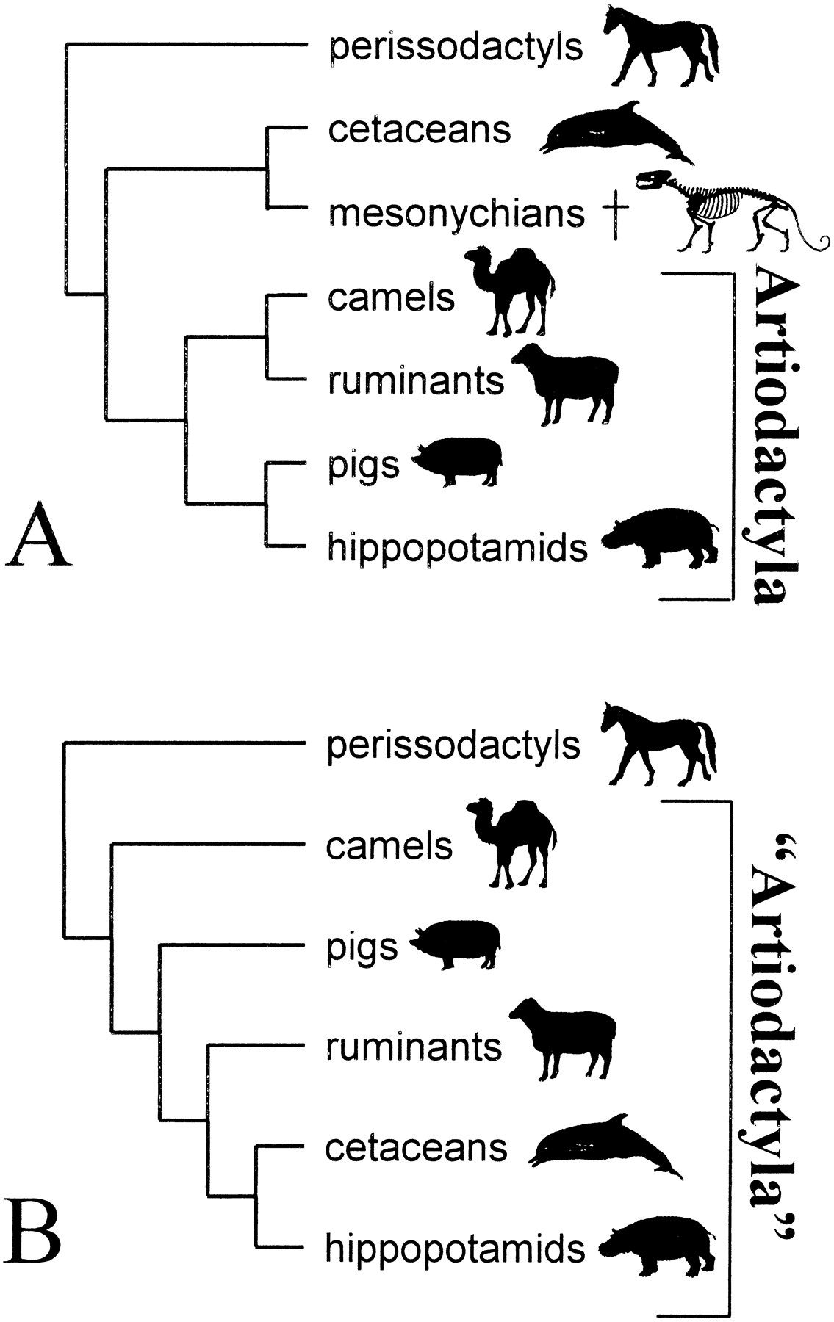
Fig. 1. Cladograms depicting competing phylogenetic hypotheses for the position of cetaceans among ungulates. ...
Notes:
Fig. 1. Cladograms depicting competing phylogenetic hypotheses for the position of cetaceans among ungulates. (A) traditional hypothesis of relationships with a monophyletic Artiodactyla containing two major clades and the extinct (†) clade Mesonychia is the sister taxon of cetaceans; also the hypothesis supported by data that fossilize (i.e., osteological and dental data, see O'Leary, 1999); and (B) the cladogram supported by molecular data (e.g.,Gatesy et al., 1999a), “Artiodactyla” is paraphyletic. Molecular sequence data alone cannot inform on the position of the wholly extinct clade Mesonychia
Unless provided in the caption above, the following copyright applies to the content of this slide: The Society for Integrative and Comparative Biology

Slide 2
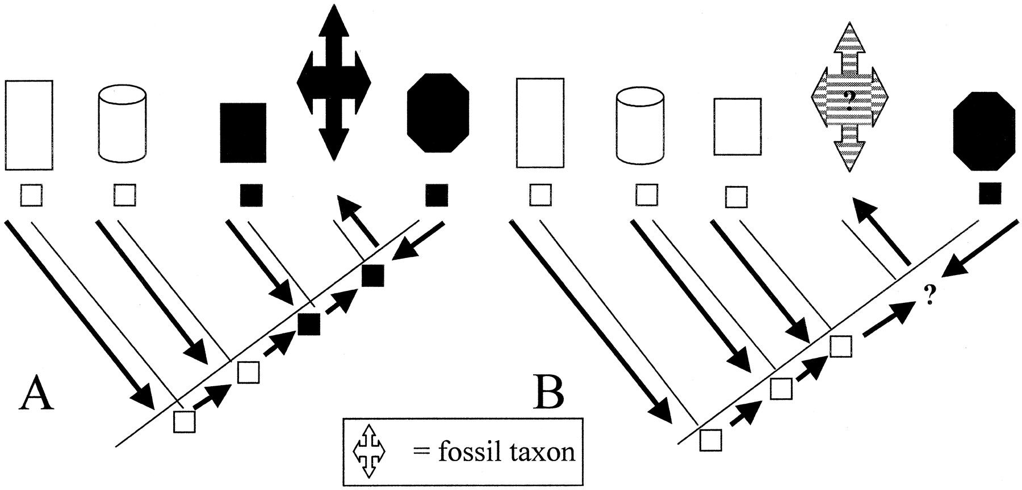
Fig. 2. Optimization of missing data for fossils that are terminal taxa on a cladogram (e.g., skeletal data ...
Notes:
Fig. 2. Optimization of missing data for fossils that are terminal taxa on a cladogram (e.g., skeletal data that have not been recovered or soft tissue, behavioral or molecular data that rarely, if ever, fossilize). Each example shows the optimization of the color black (squares represent observations), unknown in the fossil taxon. A) Unequivocal optimization of black for the fossil taxon using both ACCTRAN and DELTRAN optimization algorithms; B) equivocal optimization for the fossil taxon using either ACCTRAN or DELTRAN both of which reconstruct the ancestral node differently because the two taxa bracketing the fossil in question have different character states
Unless provided in the caption above, the following copyright applies to the content of this slide: The Society for Integrative and Comparative Biology

Slide 3
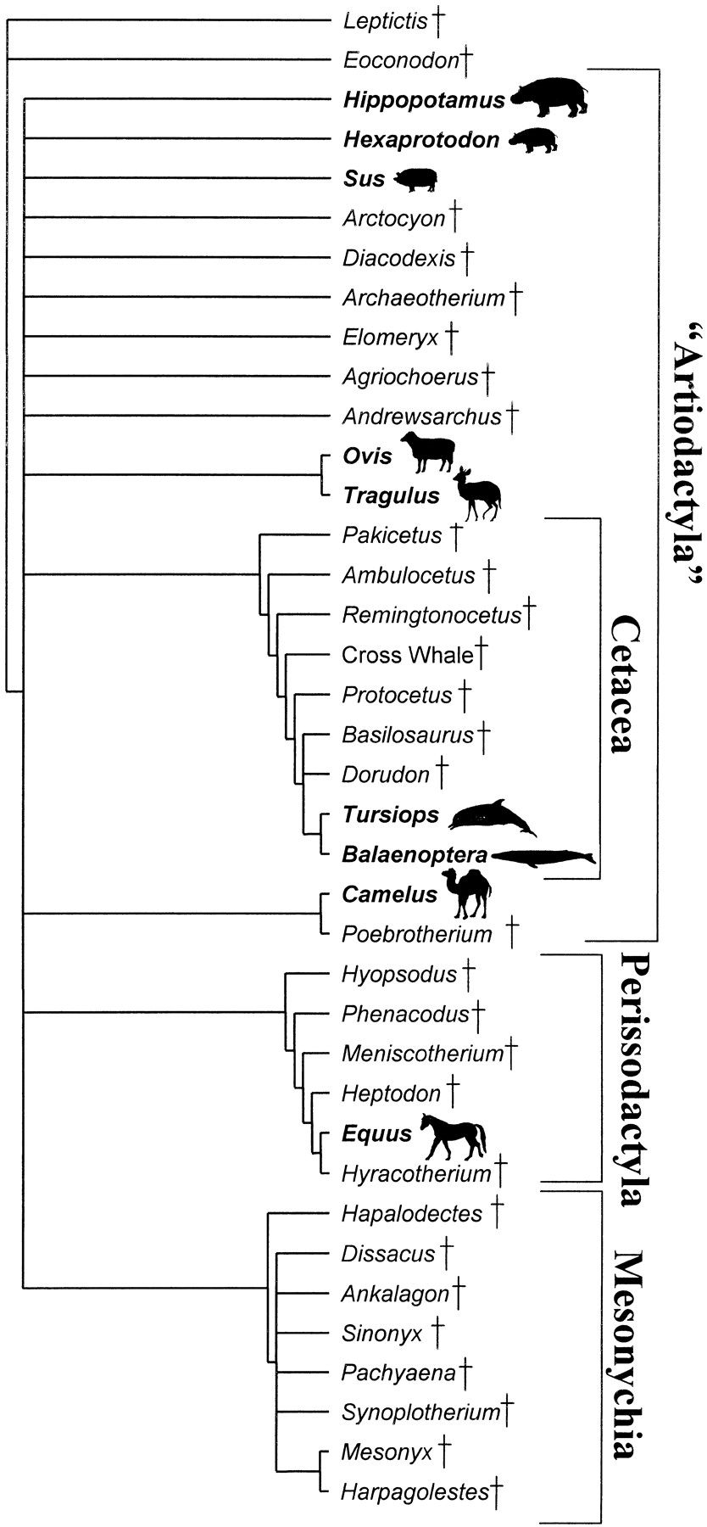
Fig. 3. Strict consensus of 33 most parsimonious trees generated from simultaneous parsimony analysis of all ...
Notes:
Fig. 3. Strict consensus of 33 most parsimonious trees generated from simultaneous parsimony analysis of all characters (total evidence analysis). Extinct taxa in plain typeface, extant taxa in bold. “Artiodactyla” is in quotations because it cannot be described as monophyletic without including taxa not traditionally part of the clade (i.e., cetaceans). All taxa from Pakicetus through Balaenoptera are considered part of Cetacea (following McKenna and Bell, 1997; Geisler and Luo, 1998; O'Leary and Uhen, 1999) even though many of these taxa are stem taxa that fall outside the crown clade Cetacea (here represented only by Tursiops and Balaeonoptera)
Unless provided in the caption above, the following copyright applies to the content of this slide: The Society for Integrative and Comparative Biology

Slide 4
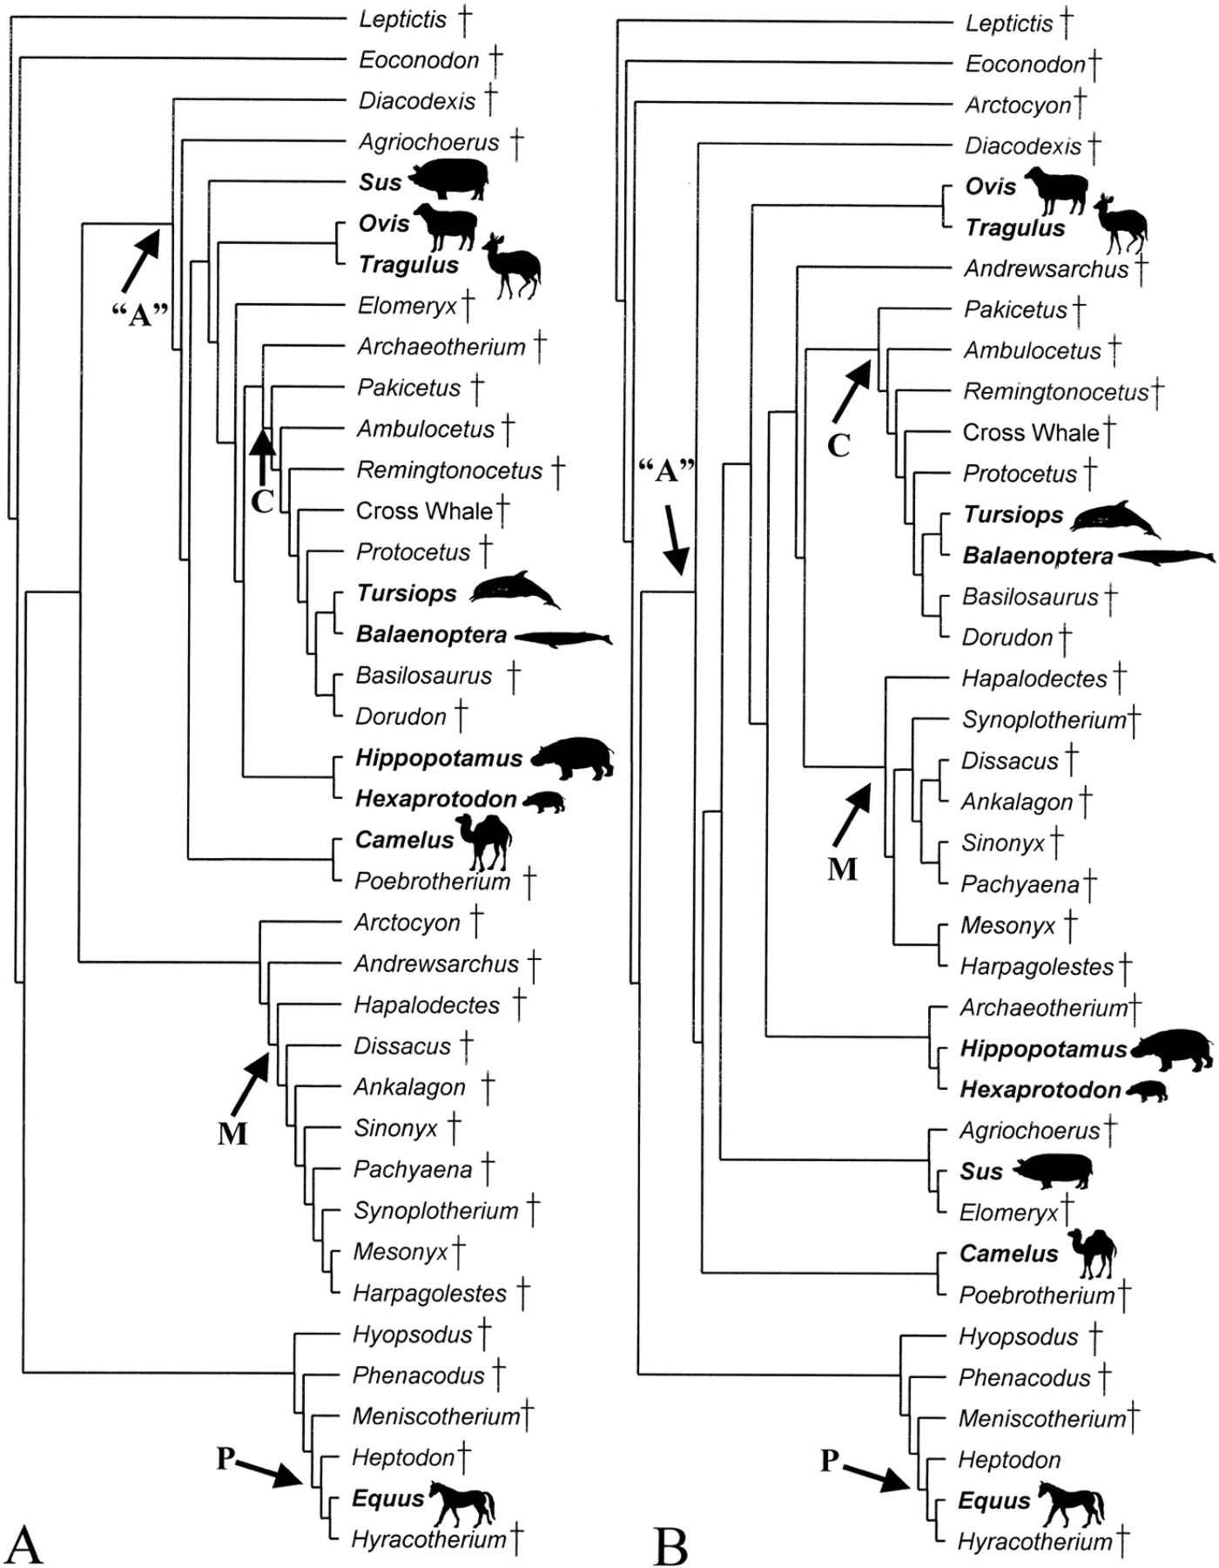
Fig. 4. (A) One of 33 most parsimonious trees generated in the total evidence analysis that shows Mesonychia ...
Notes:
Fig. 4. (A) One of 33 most parsimonious trees generated in the total evidence analysis that shows Mesonychia outside of Artiodactyla and relatively distantly related to Cetacea; (B) a second most parsimonious tree from the same analysis showing Mesonychia inside of “Artiodactyla” as the sister taxon of Cetacea; (C) strict consensus of two trees generated from parsimony analysis of fossilized data only. Extinct taxa in plain typeface, extant taxa in bold. Artiodactyla is monophyletic and comprised of two clades containing extant forms as well as stem taxa, Mesonychia is the sister taxon of Cetacea and perissodactylans and their relatives fall outside this clade. Cetacea, Artiodactyla and Perissodactyla here again include stem taxa to the crown clade, not just the crown clade itself
Unless provided in the caption above, the following copyright applies to the content of this slide: The Society for Integrative and Comparative Biology

Slide 5
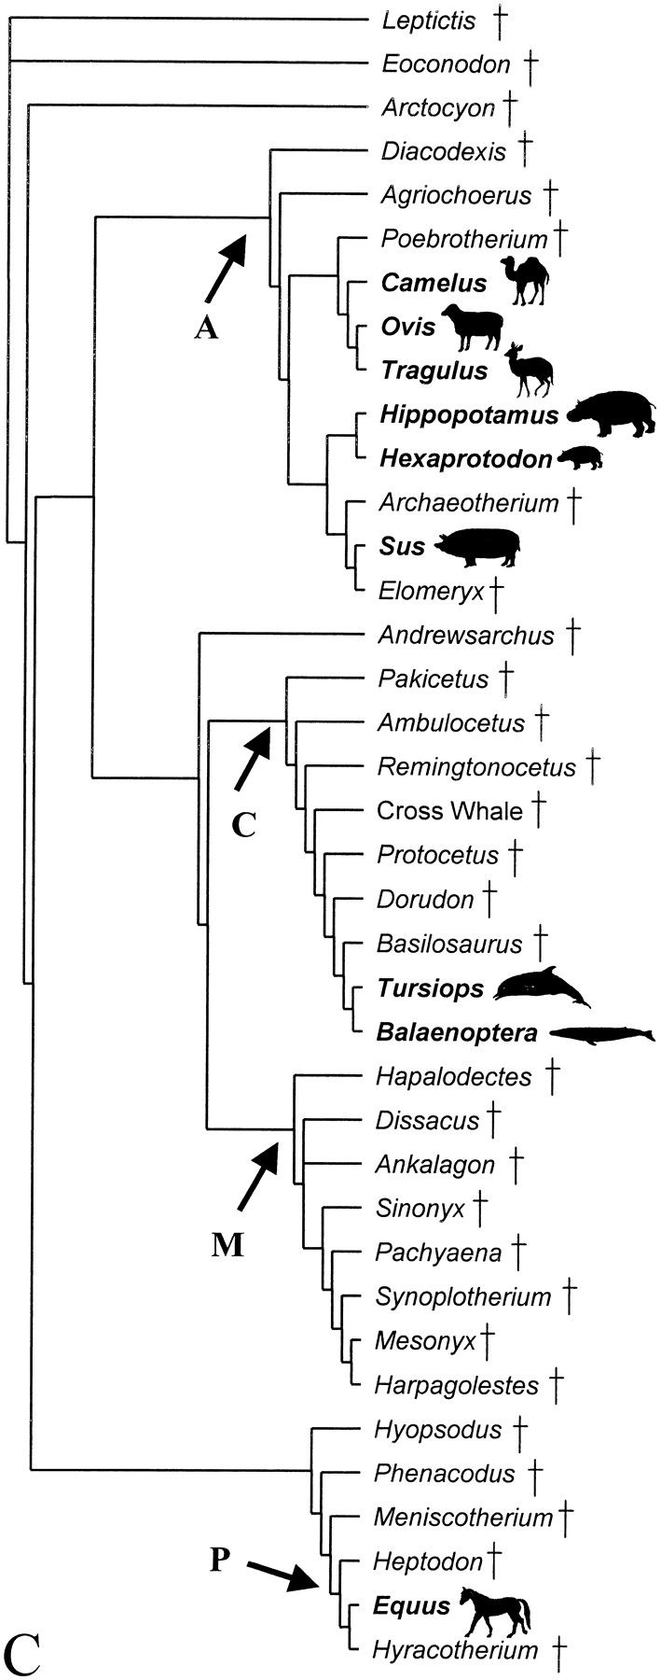
Fig. 4. Continued
Notes:
Fig. 4. Continued
Unless provided in the caption above, the following copyright applies to the content of this slide: The Society for Integrative and Comparative Biology

Slide 6
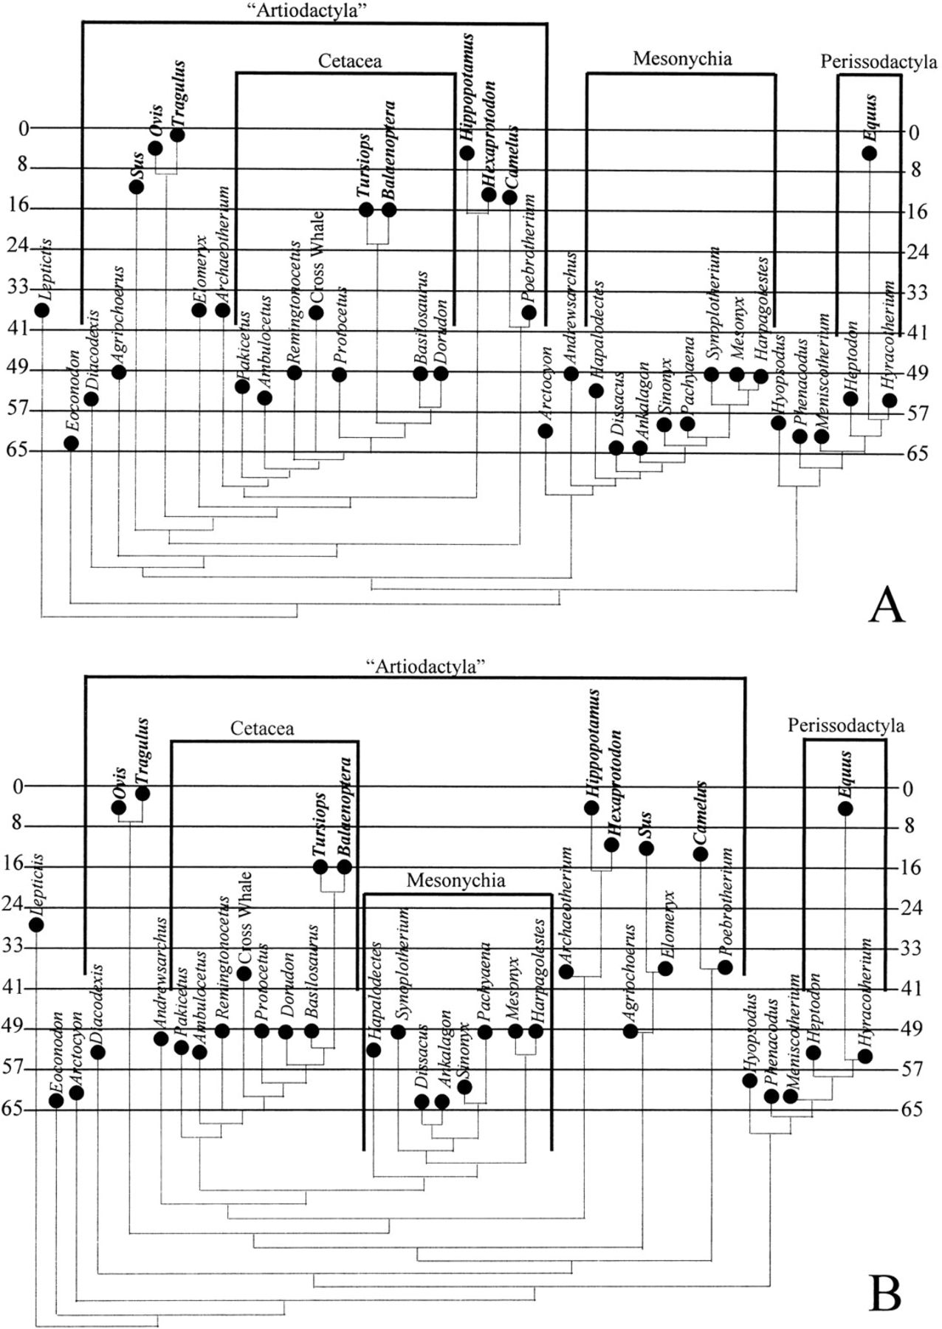
Fig. 5. Trees from Figure 4 plotted against the stratigraphic record. Extant taxa in bold, extinct taxa in ...
Notes:
Fig. 5. Trees from Figure 4 plotted against the stratigraphic record. Extant taxa in bold, extinct taxa in plain type. Black dots indicate the first appearance of a taxon (dates from McKenna and Bell [1997]; see also O'Leary
Unless provided in the caption above, the following copyright applies to the content of this slide: The Society for Integrative and Comparative Biology

Slide 7
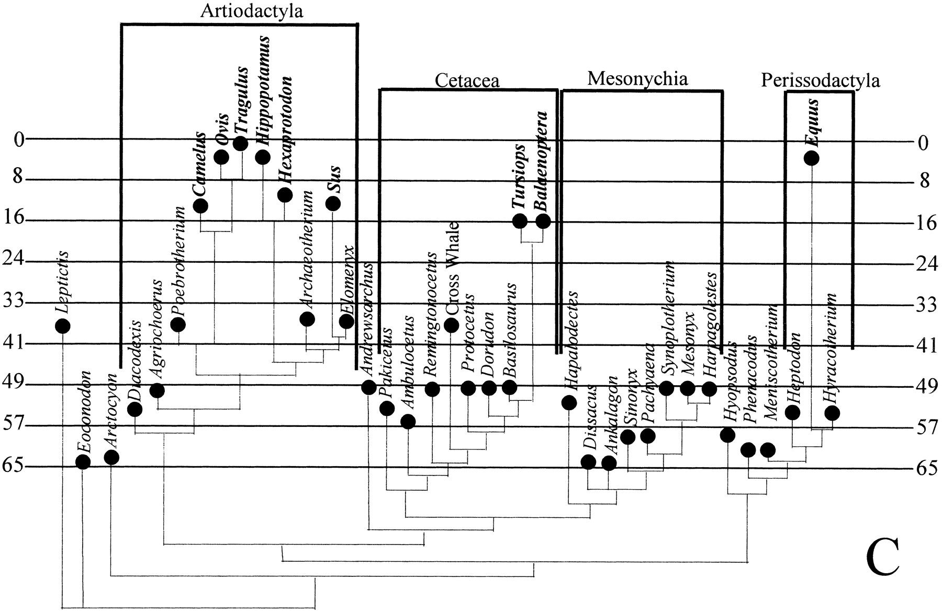
Fig. 5. Continued. and Uhen [1999]). A and B are two of 33 most parsimonious trees resulting from the total ...
Notes:
Fig. 5. Continued. and Uhen [1999]). A and B are two of 33 most parsimonious trees resulting from the total evidence analysis. C reflects the traditional hypothesis of relationships (with artiodactylan monophyly) and is the strict consensus of two most parsimonious trees from the analysis of fossilized data alone
Unless provided in the caption above, the following copyright applies to the content of this slide: The Society for Integrative and Comparative Biology

Slide 8
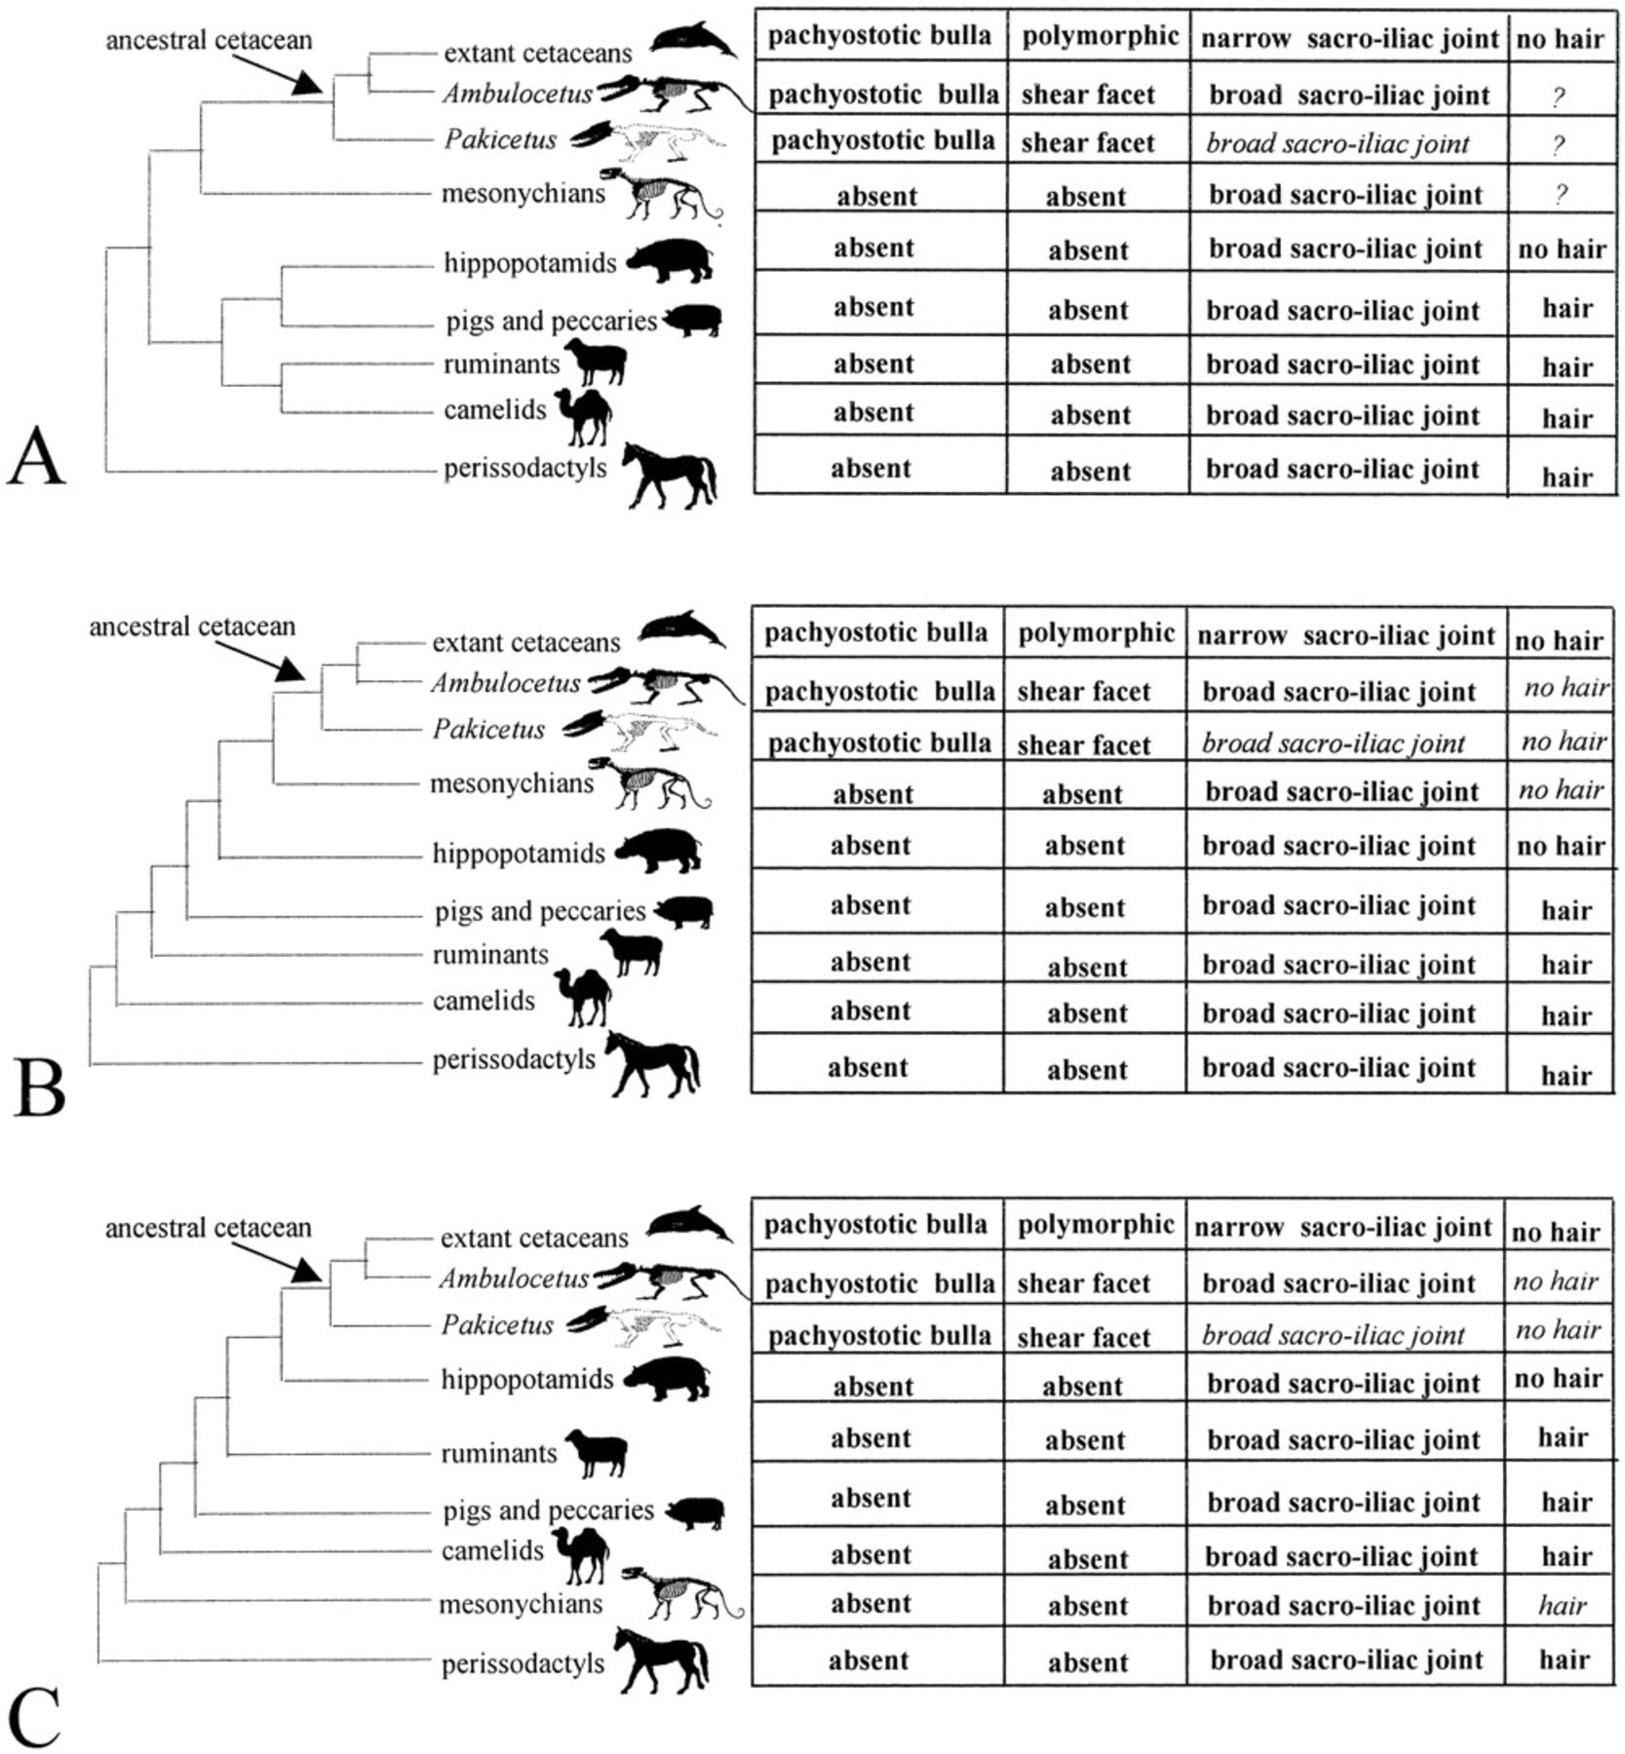
Fig. 6. Three different tree topologies (modified from Gatesy et al., 1996) for cetacean phylogeny with ...
Notes:
Fig. 6. Three different tree topologies (modified from Gatesy et al., 1996) for cetacean phylogeny with silhouettes of the bodies of extant taxa and preserved bones of fossil taxa. Distributions of four different characters on the tree; those in bold have actually been observed; those in italics are optimized (using both ACCTRAN and DELTRAN). In all trees the ancestral cetacean is reconstructed unambiguously as having a pachyostotic bulla, an elongate molar shear facet and a broad sacro-iliac articulation, the last of these is also reconstructed in the terminal taxon, Pakicetus, using optimization. Reconstruction of the soft tissue, hair, however, differs depending on the tree topology. In A where Artiodactyla is monophyletic, this optimization is ambiguous for stem cetaceans and for mesonychians, in B both mesonychians and stem cetaceans are reconstructed unambiguously as having no hair, and in C stem cetaceans are reconstructed as having no hair and mesonychians as having hair. The character state “narrow sacro-iliac joint” listed here as present in extant cetaceans was actually scored as a “?” in O'Leary and Geisler (1999). The “narrow sacro-iliac joint” occurs in stem taxa to extant whales and extant whales are highly transformed so as to make the character difficult to score. The information is shown this way for brevity and to indicate at the same time that Ambulocetus and Pakicetus differ from the morphology of most members of the cetacean clade
Unless provided in the caption above, the following copyright applies to the content of this slide: The Society for Integrative and Comparative Biology

Slide 9
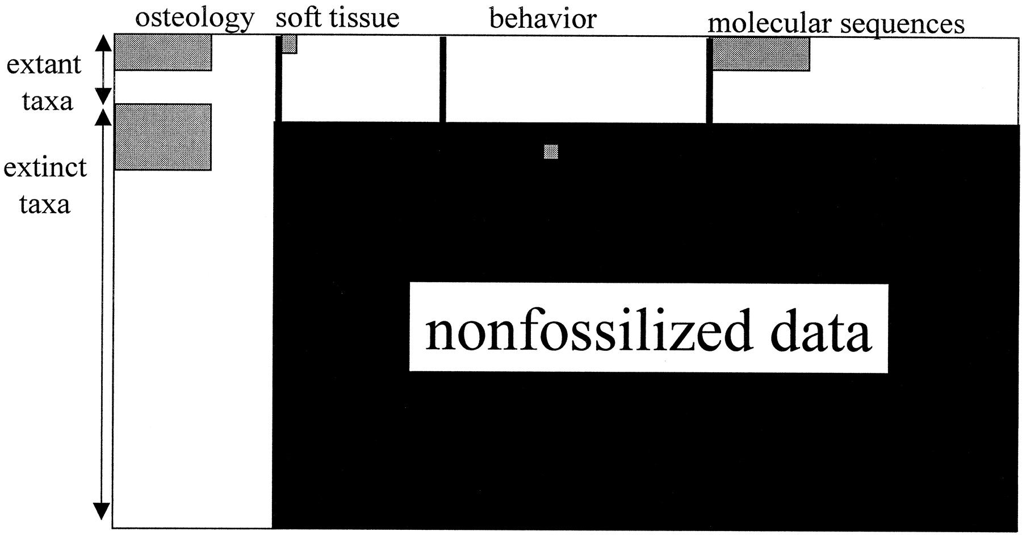
Fig. 7. Cartoon of the universe of character data available and/or collected pertaining to the phylogenetic ...
Notes:
Fig. 7. Cartoon of the universe of character data available and/or collected pertaining to the phylogenetic position of cetaceans among mammals. Gray blocks indicate data of a given type that have already been collected. White areas indicate data that could be collected but that have not been collected, and black block indicates data that may never be collected because they do not fossilize. The latter category currently describes the majority of cells (O'Leary, 1999). The gray box in the category of behavior for an extinct taxon refers to the preservation of stomach contents in extinct Cetacea. This figure does not show inapplicable characters, which would increase the amount of missing data even further and would affect all different types of data. Ancient DNA from extinct organisms has yet to be collected or incorporated into phylogenetic analyses of the position of cetaceans. The figure is not to scale in terms of the relative numbers of molecular characters to other types of characters
Unless provided in the caption above, the following copyright applies to the content of this slide: The Society for Integrative and Comparative Biology

