Slide 1
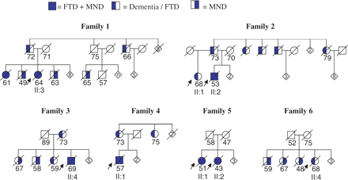
Fig. 1 Familial FTD + MND cases. Numbers are age of death or current age. Arrows indicate index patients.
Notes:
Fig. 1 Familial FTD + MND cases. Numbers are age of death or current age. Arrows indicate index patients.
Unless provided in the caption above, the following copyright applies to the content of this slide: © The Author (2007). Published by Oxford University Press on behalf of the Guarantors of Brain. All rights reserved. For Permissions, please email: journals.permissions@oxfordjournals.org

Slide 2
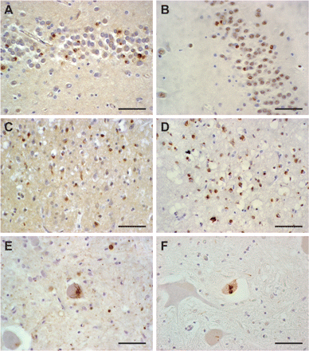
Fig. 2 Positive staining with anti-ubiquitin and TDP-43 antibody of neuronal cytoplasmatic inclusions in the ...
Notes:
Fig. 2 Positive staining with anti-ubiquitin and TDP-43 antibody of neuronal cytoplasmatic inclusions in the granular cells of the dentate gyrus was seen in the hippocampus in all cases with ubiquitin (A) and TDP-43 (B). NCI in the neocortex with ubiquitin (C) and TDP43 (D) and (skein-like) inclusions were seen in all spinal cords with both ubiquitin (E) and TDP-43 (F). Scale bar = 100 µm.
Unless provided in the caption above, the following copyright applies to the content of this slide: © The Author (2007). Published by Oxford University Press on behalf of the Guarantors of Brain. All rights reserved. For Permissions, please email: journals.permissions@oxfordjournals.org

Slide 3
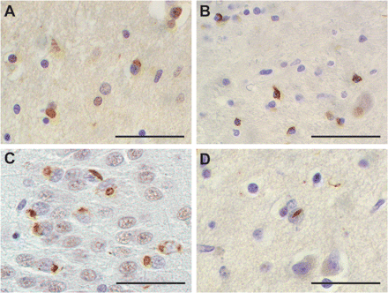
Fig. 3 Ub-positive neuronal cytoplasmatic inclusions were found in the caudatus (A) and the glial cells stained ...
Notes:
Fig. 3 Ub-positive neuronal cytoplasmatic inclusions were found in the caudatus (A) and the glial cells stained positive with TDP-43 (B). Lentiform or cat-eye shaped NII in the dentate gyrus (C) and neocortex (D) also stained positive with TDP-43. Scale bar = 100 µm.
Unless provided in the caption above, the following copyright applies to the content of this slide: © The Author (2007). Published by Oxford University Press on behalf of the Guarantors of Brain. All rights reserved. For Permissions, please email: journals.permissions@oxfordjournals.org

