Slide 1
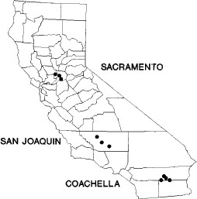
Fig. 1 California locations of sampling sites in Sacramento and Yolo Counties, Sacramento Valley, Kern County, San ...
Notes:
Fig. 1 California locations of sampling sites in Sacramento and Yolo Counties, Sacramento Valley, Kern County, San Joaquin Valley, and Coachella Valley, Riverside County.
Unless provided in the caption above, the following copyright applies to the content of this slide: © 2000 Entomological Society of America

Slide 2
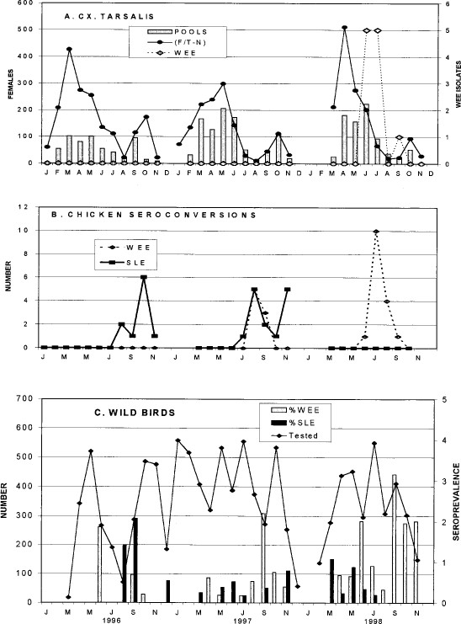
Fig. 2 Virus activity at study sites in Coachella Valley, 1996–1998.(A) Cx. tarsalis females per trap-night (n=25 ...
Notes:
Fig. 2 Virus activity at study sites in Coachella Valley, 1996–1998.(A) Cx. tarsalis females per trap-night (n=25 traps),number of pools tested for virus infection and number of isolations of WEE per month. (B) Number of seroconversions to WEE and SLE at flocks near bird collection sites. (C) Number of birds tested and percent positive for WEE and SLE antibodies per month.
Unless provided in the caption above, the following copyright applies to the content of this slide: © 2000 Entomological Society of America

Slide 3
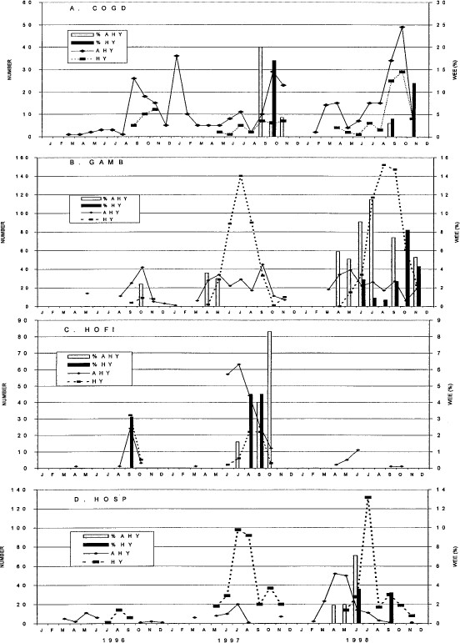
Fig. 3 Temporal changes in age structure (number of AHY and HY birds tested per month) and percent positive for WEE ...
Notes:
Fig. 3 Temporal changes in age structure (number of AHY and HY birds tested per month) and percent positive for WEE antibodies in Coachella Valley during 1996–1998. (A) COGD, common ground dove. (B) GAMB, Gambel's quail. (C) HOFI, house finch. (D) HOSP, house sparrow.
Unless provided in the caption above, the following copyright applies to the content of this slide: © 2000 Entomological Society of America

Slide 4
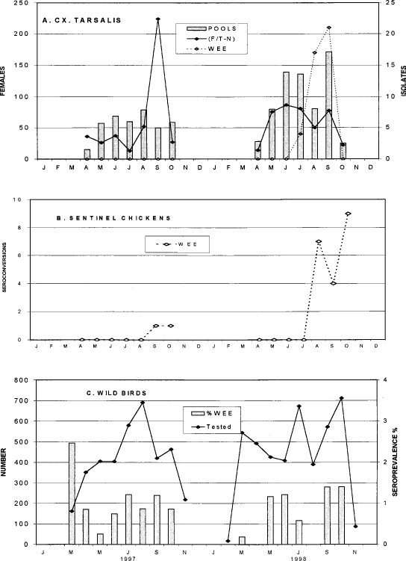
Fig. 4 Virus activity at study areas in southern San Joaquin Valley, 1997–1998. (A) Cx. tarsalis females per ...
Notes:
Fig. 4 Virus activity at study areas in southern San Joaquin Valley, 1997–1998. (A) Cx. tarsalis females per trap-night (n = 15 traps), number of pools tested for virus infection and number of isolations of WEE per month, regional Kern MVCD data combined with special collections. (B) Number of seroconversions to WEE at flocks near bird collection sites. (C) Number of birds tested and percent positive for WEE antibodies per month.
Unless provided in the caption above, the following copyright applies to the content of this slide: © 2000 Entomological Society of America

Slide 5
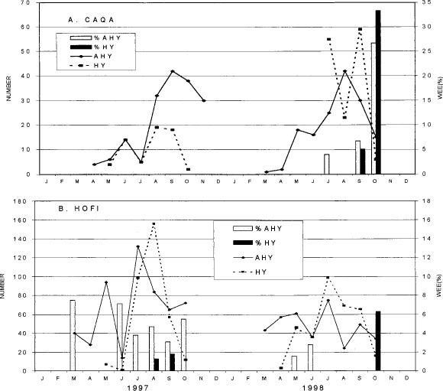
Fig. 5 Temporal changes in age structure (number of AHY and HY birds tested per month) and percent positive for WEE ...
Notes:
Fig. 5 Temporal changes in age structure (number of AHY and HY birds tested per month) and percent positive for WEE antibodies in the San Joaquin Valley during 1997–1998. (A) CAQA, California quail at the Kern River. (B) HOFI, house finches at the Tracy Ranch.
Unless provided in the caption above, the following copyright applies to the content of this slide: © 2000 Entomological Society of America

Slide 6
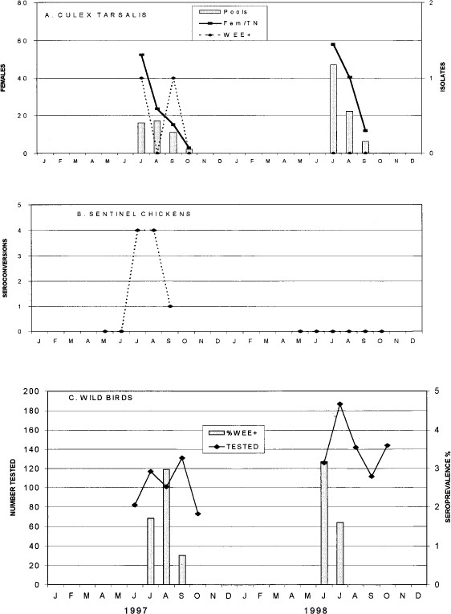
Fig. 6 Virus activity at study areas in Sacramento County, 1997–1998. (A) Cx. tarsalis females per trap-night (n=15 ...
Notes:
Fig. 6 Virus activity at study areas in Sacramento County, 1997–1998. (A) Cx. tarsalis females per trap-night (n=15 traps), number of pools tested for virus infection and number of isolations of WEE per month. (B) Number of seroconversions to WEE at flocks near bird collection sites. (C) Number of birds tested and percent seroprevalence for WEE per month.
Unless provided in the caption above, the following copyright applies to the content of this slide: © 2000 Entomological Society of America

Slide 7
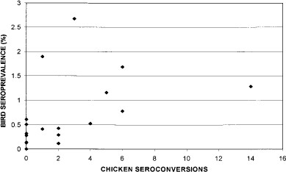
Fig. 7 Percent wild bird seroprevalence plotted as a function of the number of sentinel chicken seroconversions to ...
Notes:
Fig. 7 Percent wild bird seroprevalence plotted as a function of the number of sentinel chicken seroconversions to WEE at each site in Coachella and San Joaquin valleys during 1996–1998.
Unless provided in the caption above, the following copyright applies to the content of this slide: © 2000 Entomological Society of America

