Slide 1
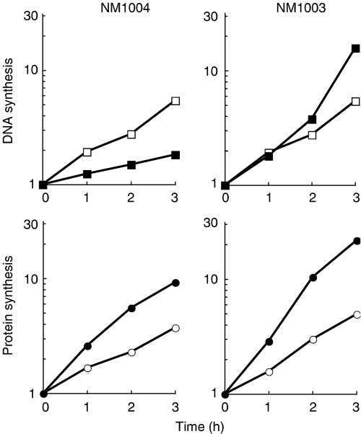
1 Temperature‐sensitive DNA synthesis in the Staphylococcus aureus dnaA8822 mutant. Luria–Bertani medium ...
Notes:
1 Temperature‐sensitive DNA synthesis in the Staphylococcus aureus dnaA8822 mutant. Luria–Bertani medium (5 mL) containing 50 μg mL−1 thymine and [3H]thymine or [35S]methionine was inoculated with exponentially growing NM1003 or NM1004 (dnaA8822) cells (50 μL) cultured in the same radiolabeled medium and grown at 30°C until OD600 nm=0.08. Cultures were shifted to 43°C (closed symbols) or continued at 30°C (open symbols), followed by incubation for the indicated time. Incorporation of [3H]thymine (squares) or [35S]methionine (circles) into acid‐insoluble fractions was measured. Incorporation at each time point is expressed as a ratio of incorporation at time 0. Data are representative of more than three independent experiments.
Unless provided in the caption above, the following copyright applies to the content of this slide: © 2005 Federation of European Microbiological Societies

Slide 2
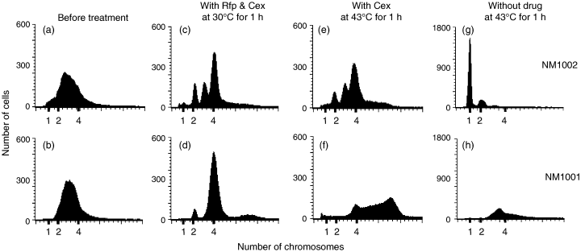
2 Defects in the initiation step of chromosomal replication and in its synchronous regulation in the ...
Notes:
2 Defects in the initiation step of chromosomal replication and in its synchronous regulation in the Staphylococcus aureus dnaA8822 mutant. Exponentially growing NM1001 (b, d, f, and h) and NM1002 (dnaA8822) cells (a, c, e, and g) at 30°C in Luria–Bertani medium (OD600 nm=0.15) were sampled for flow cytometry directly (a and b), after the addition of rifampicin (Rfp) and cephalexin (Cex) followed by incubation at 30°C for 1 h (c and d), after the addition of cephalexin and incubation at 43°C for 1 h (e and f), or after the incubation at 43°C for 1 h (g and h). Harvested cells were fixed, stained with SYTOX green, and analyzed for chromosome content using a FACSCaliber. Data are representative of more than three independent experiments.
Unless provided in the caption above, the following copyright applies to the content of this slide: © 2005 Federation of European Microbiological Societies

Slide 3
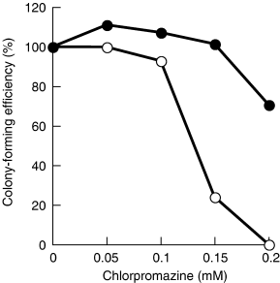
3 Chlorpromazine sensitivity of the Staphylococcus aureus dnaA8822 mutant. Freshly prepared full growths of ...
Notes:
3 Chlorpromazine sensitivity of the Staphylococcus aureus dnaA8822 mutant. Freshly prepared full growths of wild‐type NM1001 (closed circle) and NM1002 (dnaA8822; open circle) cells were serially diluted, plated on Luria–Bertani medium containing 0–0.2 mM chlorpromazine, and incubated for 20 h at the semipermissive temperature of 37°C. Colony numbers were counted and represented as the ratio compared with colony numbers at 0 mM.
Unless provided in the caption above, the following copyright applies to the content of this slide: © 2005 Federation of European Microbiological Societies

Slide 4
4 Decreased amount of DnaA in the Staphylococcus aureus dnaA8822 mutant cells. Exponentially growing NM1001 ...
Notes:
4 Decreased amount of DnaA in the Staphylococcus aureus dnaA8822 mutant cells. Exponentially growing NM1001 and NM1002 (dnaA8822) cells at 30°C in Luria–Bertani medium (OD600 nm=0.3) were sampled for counting viable cell number and for Western blotting. Whole cell extracts from 108 cells or purified S. aureus DnaA were loaded. Data are representative of more than three independent experiments.
Unless provided in the caption above, the following copyright applies to the content of this slide: © 2005 Federation of European Microbiological Societies

