Slide 1
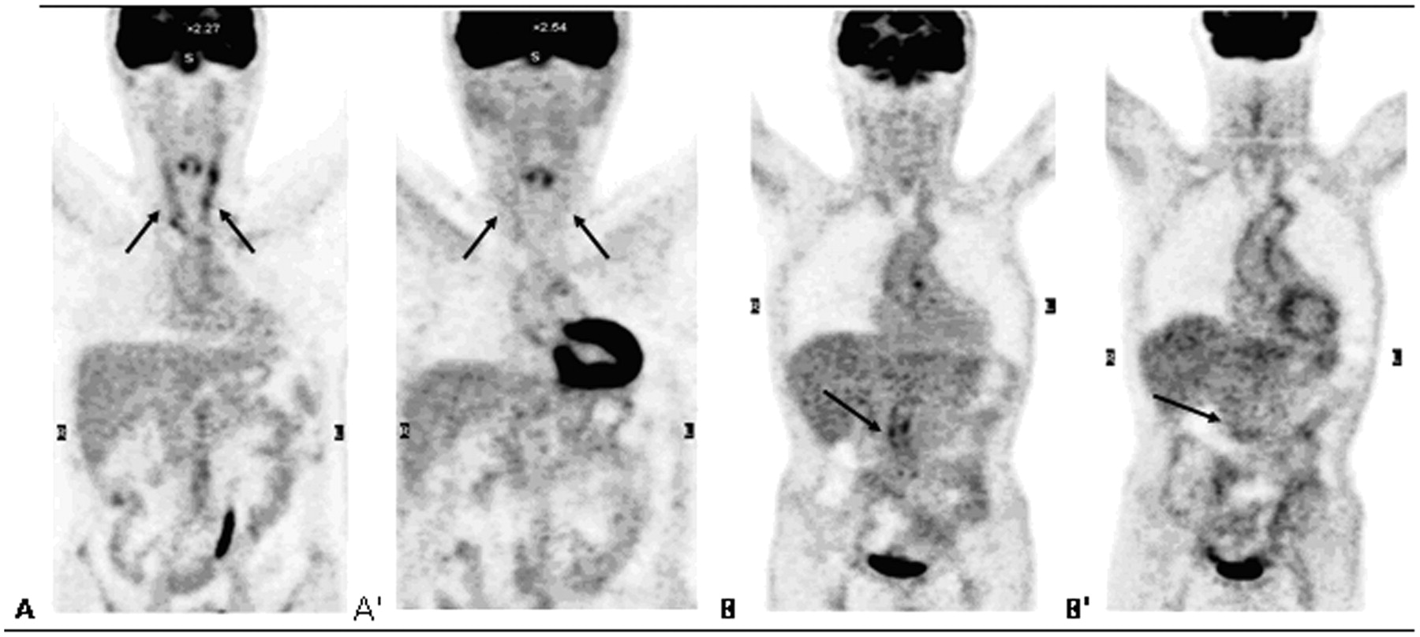
Fig. 1 PET/CT scans of Patients 2 and 3 before (A, B) and after (A′, B′) TCZ therapy. Patient 2 (A and A′): ...
Notes:
Fig. 1 PET/CT scans of Patients 2 and 3 before (A, B) and after (A′, B′) TCZ therapy. Patient 2 (A and A′): bilateral Grade 3 carotid artery FDG uptake before TCZ (→) (A). After TCZ therapy, FDG uptake markedly decreases to Grade 1 (A′). Patient 3 (B and B′): Grade 3 FDG uptake in the abdominal aorta before TCZ (→) (B). Note the marked decrease to Grade 1 after TCZ therapy (B′).
Unless provided in the caption above, the following copyright applies to the content of this slide: © The Author 2011. Published by Oxford University Press on behalf of the British Society for Rheumatology. All rights reserved. For Permissions, please email: journals.permissions@oup.com

