Slide 1
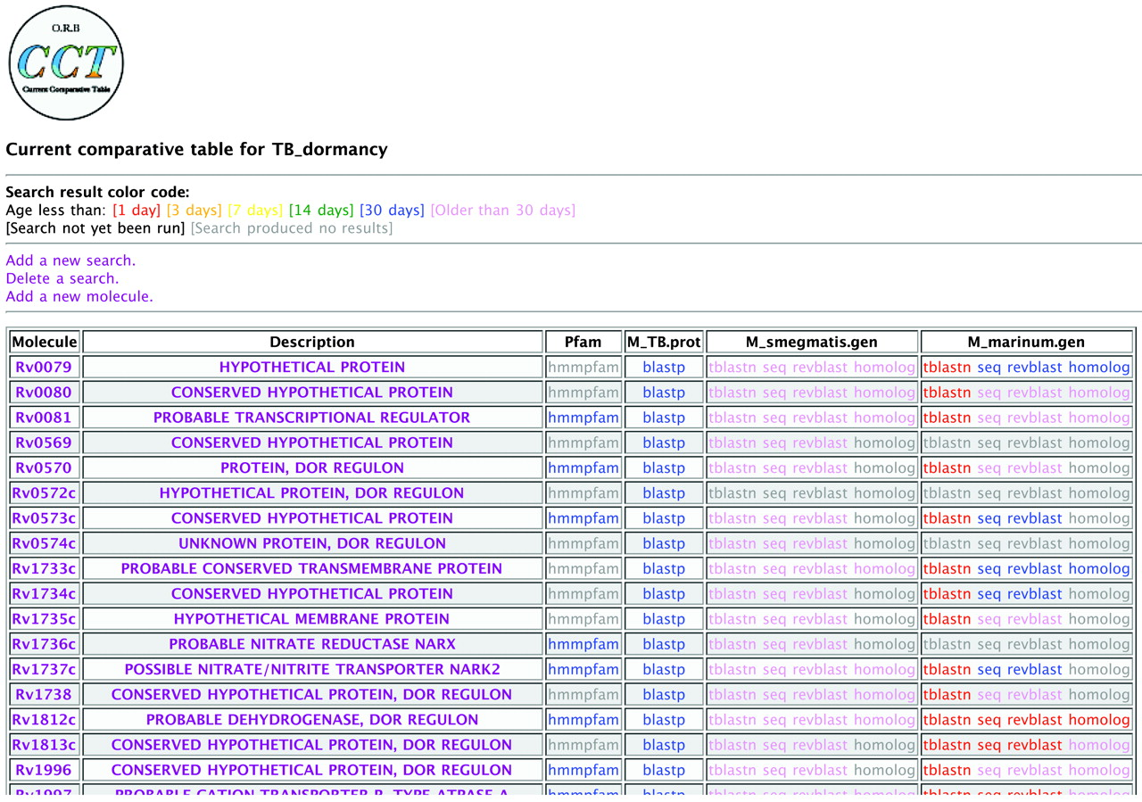
Figure 1 A small part of a sample current comparative table. The molecule and description columns contain information ...
Notes:
Figure 1 A small part of a sample current comparative table. The molecule and description columns contain information supplied by the user; the other columns contain data generated by automated searches against user-specified databases. In these database columns, the cells contain links to the result of each search. Links are color-coded to reflect the length of time since the search result last changed. To generate the table shown, CCT was given a set of 48 genes in the Mycobacterium tuberculosis (MTB) Dormancy regulon ( 10 ) and directed to monitor four remote databases (Pfam, the MTB proteome and two incomplete genomes, M.smegmatis and M.marinum ). The pattern of red indicates that a new release of the M.marinum genome was downloaded in the past 24 h (generating many new red tblastn links), and that a new sequence (seq program) of an ortholog (homolog program) was found for the TB protein Rv1812c. The predicted ortholog for Rv0079, in contrast, did not change as a result of the update and the corresponding links remain blue. More detail concerning any result can be viewed by clicking on the corresponding link(s).
Unless provided in the caption above, the following copyright applies to the content of this slide: © The Author 2005. Published by Oxford University Press. All rights reserved The online version of this article has been published under an open access model. Users are entitled to use, reproduce, disseminate, or display the open access version of this article for non-commercial purposes provided that: the original authorship is properly and fully attributed; the Journal and Oxford University Press are attributed as the original place of publication with the correct citation details given; if an article is subsequently reproduced or disseminated not in its entirety but only in part or as a derivative work this must be clearly indicated. For commercial re-use, please contact journals.permissions@oupjournals.org

Slide 2
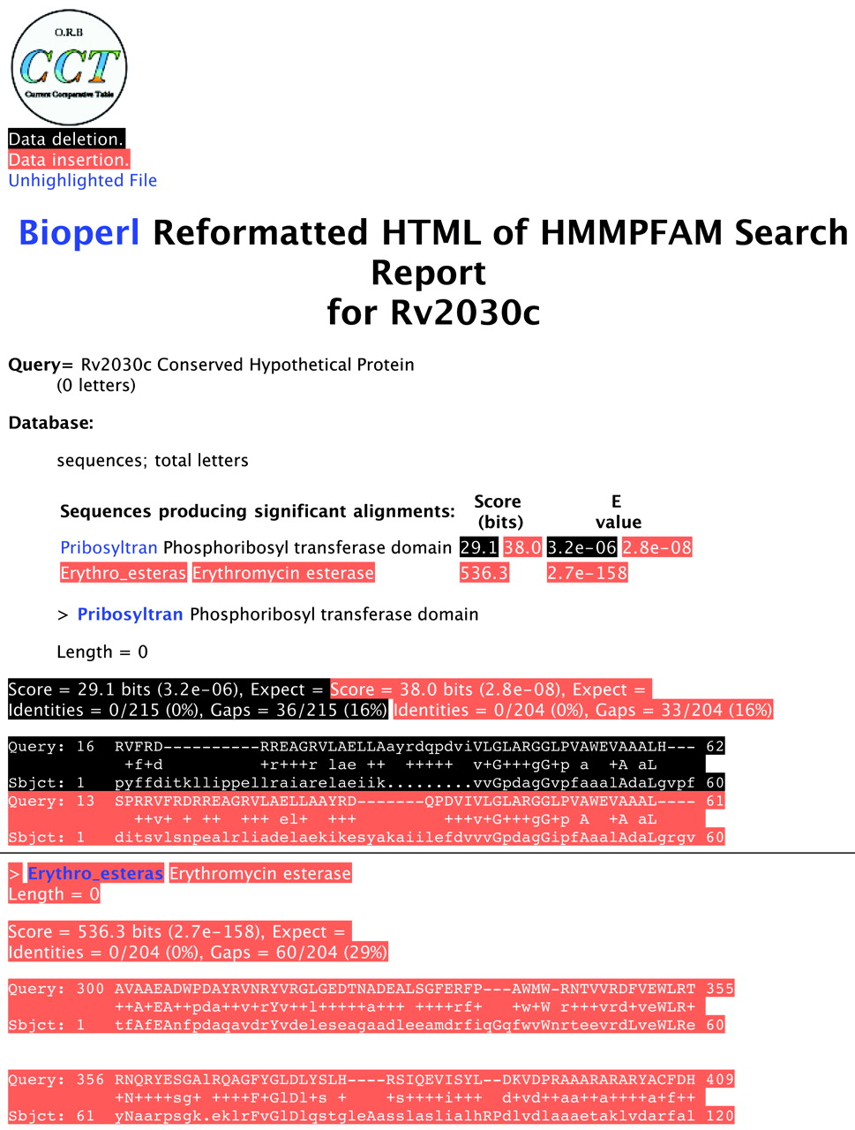
Figure 2 Example of a result file revised to reflect a new release of the Pfam database. Red highlighting indicates ...
Notes:
Figure 2 Example of a result file revised to reflect a new release of the Pfam database. Red highlighting indicates new data; black highlighting shows removed data. The regions above and below the horizontal line show different parts of the same result file. This hmmpfam search result shows that the ‘Conserved Hypothetical Protein’ Rv2030c matches a new domain in Pfam, specifically the ‘erythromycin esterase’ domain. CCT's highlighting also shows a second finding: the model for the ‘phosphoribosyl’ domain has been changed subtly (note the changed amino acids in the subject line). Taken together with the change in database size for the new release, the E -value for this search has changed somewhat. To view the newest results only (without highlighting to show changes) a user can click on the ‘Unhighlighted File’ link.
Unless provided in the caption above, the following copyright applies to the content of this slide: © The Author 2005. Published by Oxford University Press. All rights reserved The online version of this article has been published under an open access model. Users are entitled to use, reproduce, disseminate, or display the open access version of this article for non-commercial purposes provided that: the original authorship is properly and fully attributed; the Journal and Oxford University Press are attributed as the original place of publication with the correct citation details given; if an article is subsequently reproduced or disseminated not in its entirety but only in part or as a derivative work this must be clearly indicated. For commercial re-use, please contact journals.permissions@oupjournals.org

