Slide 1
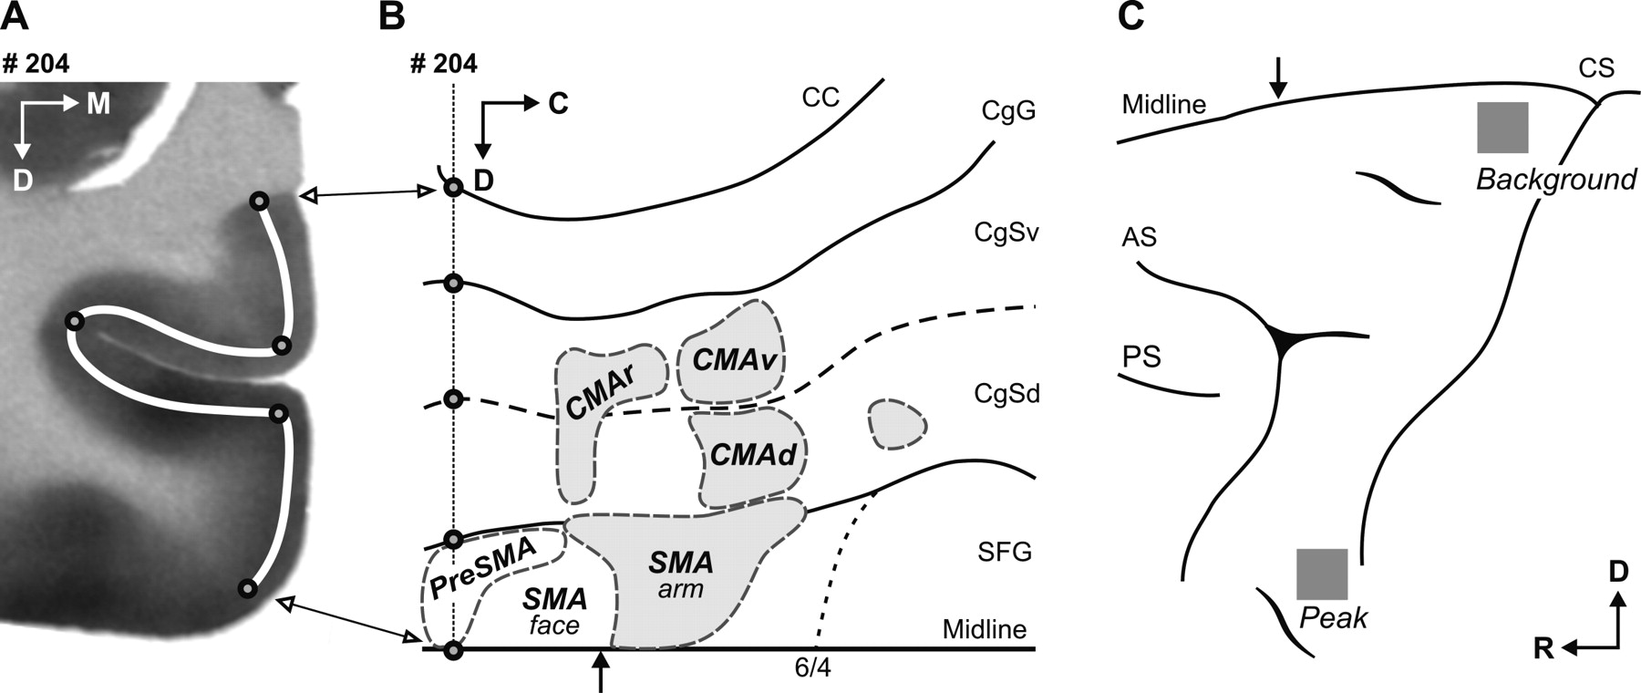
Figure 1. Analytical procedure. On sections spaced 90 μm apart, we measured ¹⁴C concentration along an ...
Notes:
Figure 1. Analytical procedure. On sections spaced 90 μm apart, we measured 14C concentration along an ~200–300 μm thick line drawn in middle cortical layers (white line in A). These values were then used as the local measurements of activation in our flattened maps of the medial wall as illustrated in B [for details, see Dum and Strick (Dum and Strick, 1991)]. The cingulate sulcus was ‘opened up’ to show both banks. The dashed line indicates the fundus of the sulcus. Anatomical landmarks such as sulcal borders were marked (black circles) and projected on the unfolded map. The shaded areas in B illustrate the approximate location of the arm representations in the motor areas [adapted from He et al. (He et al., 1995)]. To compare between animals, 2DG uptake was normalized based on background and peak uptake in each monkey. The regions where these values were measured are illustrated in C (see Materials and Methods for details). C, caudal; D, dorsal; M, medial; R, rostral; AS, arcuate sulcus; CC, corpus callosum; CgG, cingulate gyrus; CgSv, cingulate sulcus, ventral bank; CgSd, cingulate sulcus, dorsal bank; CS, central sulcus; PS, principal sulcus; SFG, superior frontal gyrus. The black arrows in B and C indicate the level of the genu of the arcuate sulcus.
Unless provided in the caption above, the following copyright applies to the content of this slide: © Oxford University Press

Slide 2
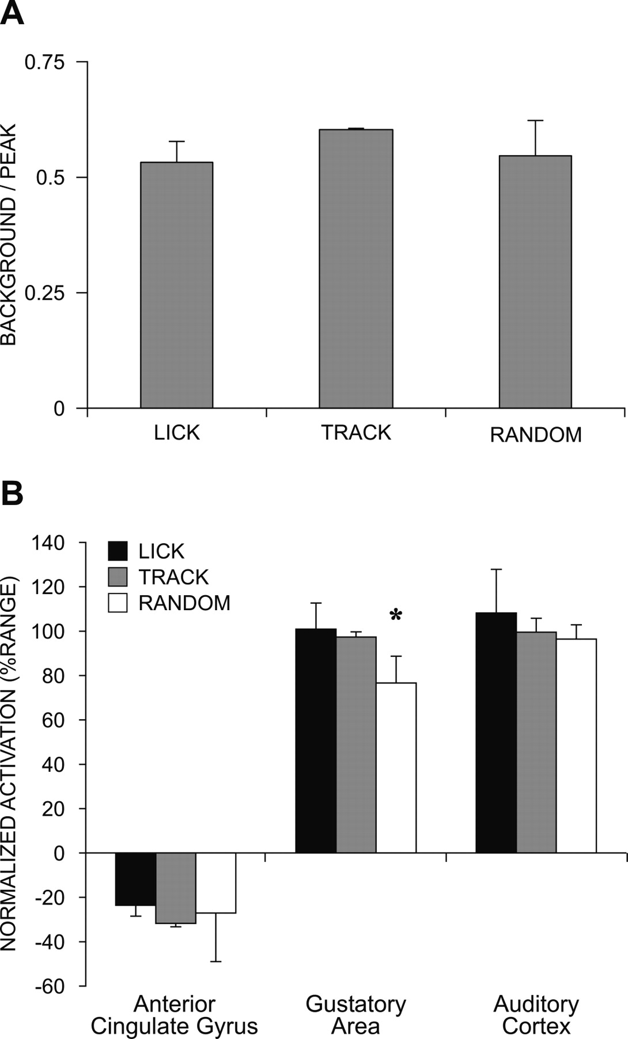
Figure 2. Validation of the normalization procedure for comparing 2DG uptake. (A) The ratio of our measures of ...
Notes:
Figure 2. Validation of the normalization procedure for comparing 2DG uptake. (A) The ratio of our measures of background and peak 2DG uptake used for normalization was not significantly different between groups. (B) Normalized activations measured in a portion of the anterior cingulate gyrus and in the auditory cortex were not significantly different between tasks. In the secondary gustatory area, activation was significantly lower for the monkeys who were rewarded with water (RANDOM) instead of fruit juice (LICK, TRACK). Values are the mean ± SD normalized activation (see Materials and Methods).
Unless provided in the caption above, the following copyright applies to the content of this slide: © Oxford University Press

Slide 3
Figure 3. Maps of activations on the medial wall of the hemisphere during the tasks. Each map is from one ...
Notes:
Figure 3. Maps of activations on the medial wall of the hemisphere during the tasks. Each map is from one representative monkey. Activations present during the LICK task and the corresponding activations found during the TRACK and RANDOM tasks are shown in grayscale. Activations specifically related to the performance of visually guided reaching movements are represented in color. The scale represents the % range of activation defined for each monkey (see Materials and Methods). The white arrow heads on the CgG mark the tip of the corpus callosum. The dotted line on the SFG indicates the border between areas 6 and 4. The black arrow indicates the level of the genu of the arcuate sulcus. The black arrow heads mark the level of sections through the medial wall of the hemisphere shown in Figure 5. See Figure 1 for other conventions. Scale bars = 5 mm.
Unless provided in the caption above, the following copyright applies to the content of this slide: © Oxford University Press

Slide 4
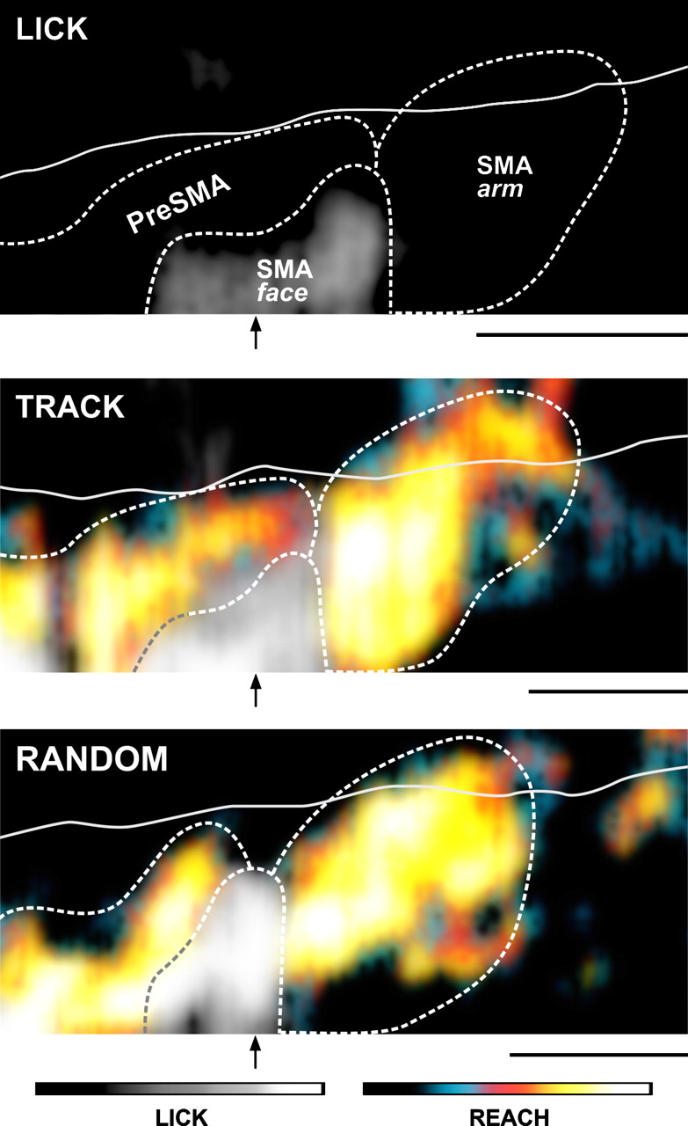
Figure 4. Activations in the SMA and PreSMA during the tasks. These maps are based on activations shown in Figure 3, ...
Notes:
Figure 4. Activations in the SMA and PreSMA during the tasks. These maps are based on activations shown in Figure 3, which were low-pass filtered to enhance the global features of the activated regions of the superior frontal gyrus. The dashed lines trace the areas of activation corresponding to the PreSMA, and the regions of the SMA corresponding to ‘face’ (see Results) and arm representations. The solid lines running approximately horizontal across the figure mark the beginning of the dorsal bank of the cingulate sulcus (CgSd in Figs 1 and 3). The black arrows indicate the level of the genu of the arcuate sulcus. Scale bars = 5 mm.
Unless provided in the caption above, the following copyright applies to the content of this slide: © Oxford University Press

Slide 5
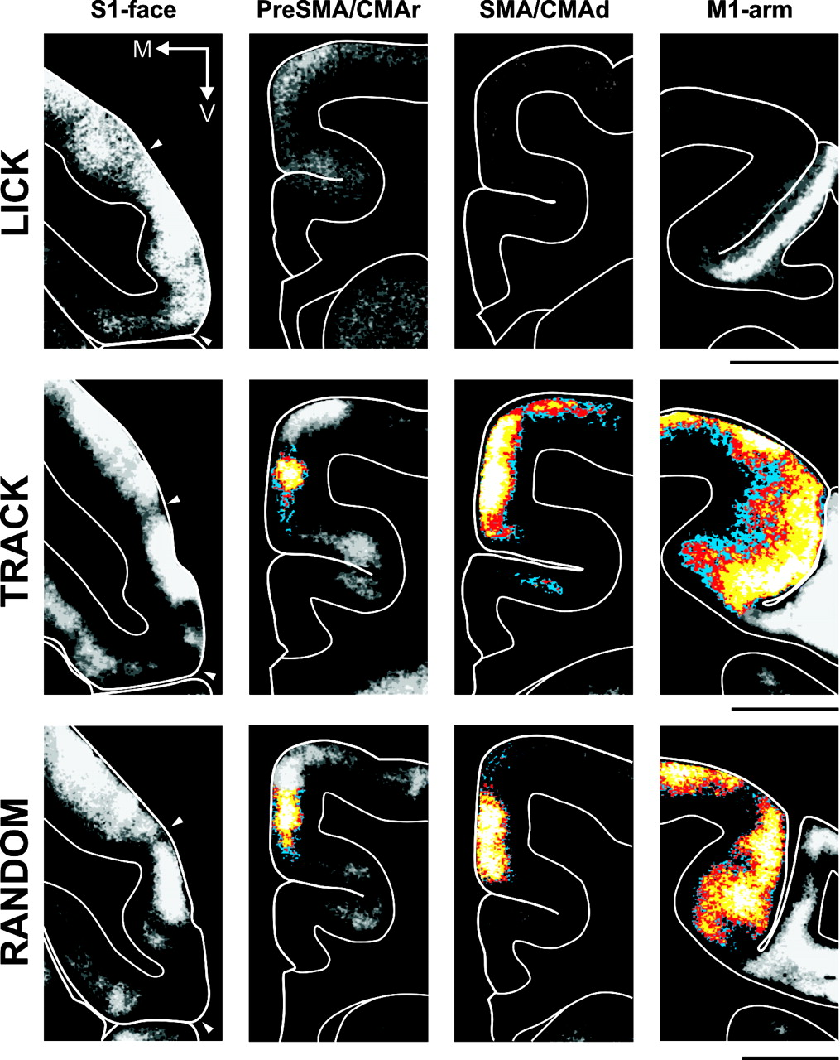
Figure 5. Activations in coronal sections through selected cortical areas. The outline of the cortex and the ...
Notes:
Figure 5. Activations in coronal sections through selected cortical areas. The outline of the cortex and the approximate border with the white matter were traced from digitized images of 2DG uptake in 30 μm thick coronal sections (Fig. 1A). In the first column, filled triangles delimit the portion of the precentral gyrus corresponding to S1-face where peak activation was present in all monkeys. The levels of the sections through the PreSMA/CMAr and the SMA/CMAd are indicated by arrow heads in Figure 3. Color scale as in Figure 3. M, medial; V, ventral. Scale bars = 5 mm.
Unless provided in the caption above, the following copyright applies to the content of this slide: © Oxford University Press

