Slide 1
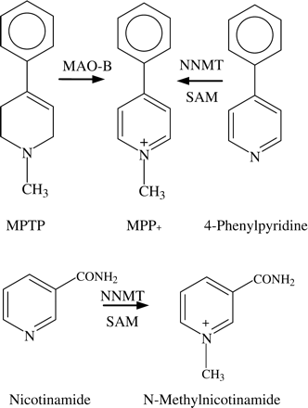
Figure 1. Formation of MPP⁺ from either MPTP by MAO-B, or methylation of 4-phenylpyridine by NNMT (top). ...
Notes:
Figure 1. Formation of MPP+ from either MPTP by MAO-B, or methylation of 4-phenylpyridine by NNMT (top). Methylation of nicotinamide by NNMT (bottom).
Unless provided in the caption above, the following copyright applies to the content of this slide: The Author 2005. Published by Oxford University Press on behalf of the Association of Physicians. All rights reserved. For Permissions, please email: journals.permissions@oupjournals.org

Slide 2
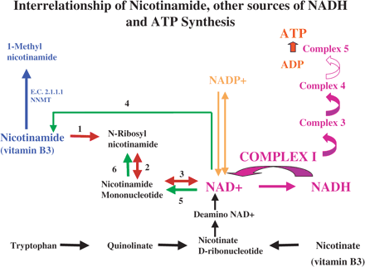
Figure 2. Pathways of synthesis of NADH, the essential cofactor for mitochondrial Complex 1, from nicotinamide, ...
Notes:
Figure 2. Pathways of synthesis of NADH, the essential cofactor for mitochondrial Complex 1, from nicotinamide, nicotinate and tryptophan. The enzymes involved in the nicotinamide pathway are listed below. Also shown schematically is the relationship between Complex 1 and Complex 5 of the mitochondrial oxidative phosphorylation pathway, the major source of ATP. The hypothesis proposed is that high levels of NNMT diminish the availability of nicotinamide for NADH synthesis at the same time that Complex 1 is inhibited, both resulting in diminished ATP synthesis. The tryptophan pathway occurs only to a very limited extent in brain, and therefore would not be able to compensate, and the nicotinate pathway would be affected by levels of NNMT because of the shuttling between NADH and nicotinamide. 1, purine-nucleoside phosphorylase [E.C. 2.4.2.1]; 2, nicotinamide ribonucleoside kinase [E.C. 2.7.1.22]; 3, nicotinamide mononucleotide adenylyltransferase [E.C. 2.7.7.1]; 4, NAD glycohydrolase (NADase CD38) [E.C. 3.2.2.5]; 5, nucleotide pyrophosphatase (Autotaxin) [E.C. 3.6.1.9]; 6, 5′ nucleotidase (CD73) [E.C. 3.1.3.5]. Alternative names shown in italics.
Unless provided in the caption above, the following copyright applies to the content of this slide: The Author 2005. Published by Oxford University Press on behalf of the Association of Physicians. All rights reserved. For Permissions, please email: journals.permissions@oupjournals.org

Slide 3
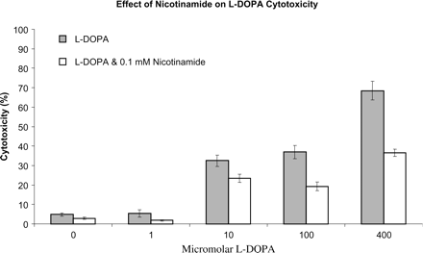
Figure 3. Nicotinamide protection against the cytotoxic effects of L-DOPA. TE671 cells exposed to increasing ...
Notes:
Figure 3. Nicotinamide protection against the cytotoxic effects of L-DOPA. TE671 cells exposed to increasing concentrations of L-DOPA for 24 h in the presence or absence of 0.1 mM nicotinamide. Cytotoxicity determined by assay of LDH release. Nicotinamide produced a statistically significant reduction in cytotoxicity across the range of L-DOPA concentration (p<0.0001). Results previously presented in abstract form (Cartwright L, Williams AC, Ramsden DB. Nicotinamide: neuroprotective effects against dopamine and MPP+. Proceedings of The Global College of Neuroprotection and Neuroregeneration, Annual Conference 2004, Zermatt).
Unless provided in the caption above, the following copyright applies to the content of this slide: The Author 2005. Published by Oxford University Press on behalf of the Association of Physicians. All rights reserved. For Permissions, please email: journals.permissions@oupjournals.org

Slide 4
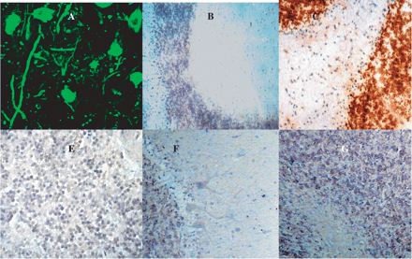
Figure 4. A Fluorescent microscopy of control human substantia nigra with FITC-labelled anti-NNMT, showing presence of ...
Notes:
Figure 4. A Fluorescent microscopy of control human substantia nigra with FITC-labelled anti-NNMT, showing presence of NNMT in dopaminergic neurones (cell bodies and projections). B Conventional microscopy of control human cerebellum. Section stained with anti-NNMT and peroxidase-conjugated second antibody. Brown indicates presence of NNMT; blue is due to counterstain. Light positive (brown) staining indicates low levels of NNMT in granular layer neurones. C Conventional microscopy of parkinsonian human cerebellum. Section stained with anti-NNMT and peroxidase-conjugated second antibody. Brown indicates presence of NNMT; blue is due to counterstain. Heavy positive (brown) staining indicates high levels of NNMT in granular layer neurones. D, EIn situ hybridization with control human cerebellum, using antisense NNMT probe. Low levels of NNMT mRNA evidenced by low levels of bright purple staining. E shows Purkinje cells in addition to granular layer neurones. FIn situ hybridization with parkinsonian human cerebellum using antisense NNMT probe. High level of NNMT mRNA evidenced by high levels of bright purple staining.
Unless provided in the caption above, the following copyright applies to the content of this slide: The Author 2005. Published by Oxford University Press on behalf of the Association of Physicians. All rights reserved. For Permissions, please email: journals.permissions@oupjournals.org

Slide 5
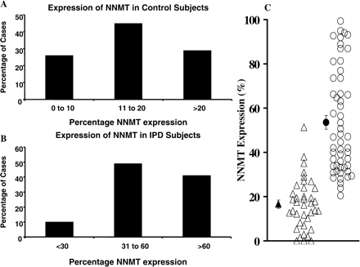
Figure 5. NNMT expression in cerebellar granular layer neurones. A Frequency of control subjects with low, intermediate ...
Notes:
Figure 5. NNMT expression in cerebellar granular layer neurones. A Frequency of control subjects with low, intermediate or high expression. B Frequency of parkinsonian subjects with low, intermediate or high expression. C Comparison of expression in control and parkinsonian subjects; means are shown as solid symbols. Reprinted from Neuroscience Letters, Parsons RB, Smith SW, Waring RH, Williams AC, Ramsden DB, High expression of nicotinamide N-methyltransferase in patients with idiopathic Parkinson's disease, 342:13–16, 2003, with permission from Elsevier.
Unless provided in the caption above, the following copyright applies to the content of this slide: The Author 2005. Published by Oxford University Press on behalf of the Association of Physicians. All rights reserved. For Permissions, please email: journals.permissions@oupjournals.org

Slide 6
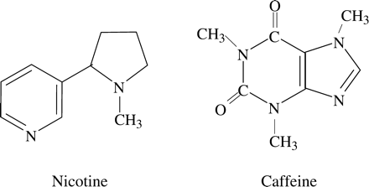
Figure 6. Structural formulae of nicotine and caffeine.
Notes:
Figure 6. Structural formulae of nicotine and caffeine.
Unless provided in the caption above, the following copyright applies to the content of this slide: The Author 2005. Published by Oxford University Press on behalf of the Association of Physicians. All rights reserved. For Permissions, please email: journals.permissions@oupjournals.org

