Slide 1
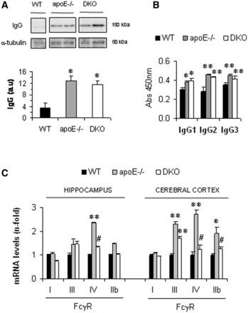
Figure 1 Levels of IgG and expression of FcγR isoforms in hypercholesterolaemic and control mice at middle-age ...
Notes:
Figure 1 Levels of IgG and expression of FcγR isoforms in hypercholesterolaemic and control mice at middle-age (12-month-old). (A) Western blot of IgG in the cerebral cortex of wild-type (WT), apoE−/− and DKO mice. Representative blots from each group (wild-type, n = 5; apoE −/− , n = 8; DKO, n = 7) are shown. Summary of densitometric analysis is expressed in arbitrary units (a.u.). (B) Immunoglobulin isotype distribution in mouse sera measured by ELISA. Values are expressed as absorbance units at λ = 450 nm. Values are mean ± SEM of five animals per group. (C) Real-time PCR analysis of activating and inhibitory FcγRs in the hippocampus and cerebral cortex of mice. Values are mean ± SEM of studied animals per group (wild-type, n = 5; apoE−/−, n = 8; DKO, n = 7). *P < 0.05 and **P < 0.01 versus wild-type; #P < 0.05 versus apoE−/−.
Unless provided in the caption above, the following copyright applies to the content of this slide: © The Author (2012). Published by Oxford University Press on behalf of the Guarantors of Brain. All rights reserved. For Permissions, please email: journals.permissions@oup.com

Slide 2
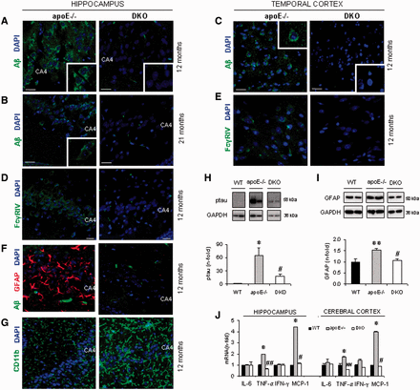
Figure 2 Functional deficiency in activating FcγRs protects against amyloid β deposition, tau phosphorylation, ...
Notes:
Figure 2 Functional deficiency in activating FcγRs protects against amyloid β deposition, tau phosphorylation, astrogliosis and cytokine expression in hypercholesterolaemic mice. Role of FcγRIV. (A and B) Representative confocal images (scale bar = 20 μm) and magnification details showing amyloid β (Ab) immunostaining (green) and nuclei (blue) taken from the hippocampus of apoE−/− and DKO mice aged 12 and 21 months, as indicated. (C) Amyloid β immunostaining in the cerebral cortex from middle-aged (12-month-old) mice. Note the increase in both intracellular and extracellular amyloid β immunostaining in apoE−/− brains. (D and E) Representative FcγRIV immunofluorescence in hippocampus (D, scale bar = 10 μm) and cerebral cortex (E, scale bar = 20 μm) from middle-aged mice, showing FcγRIV in green and cell nuclei in blue. Note the similar cellular distribution of amyloid β and FcγRIV and the absence of FcγRIV in glial cells. (F and G) Representative confocal images of astrogliosis (F, red) and microgliosis (G, green) in the hippocampus from middle-aged mice (nuclear staining in blue). (H and I) Western blot analysis of tau phosphorylation (ptau, H) and astrogliosis (GFAP marker, I) in the cerebral cortex of middle-aged mice. Representative blots from each group are shown. Summary of densitometric analysis is expressed as fold increases. (J) Cytokine gene expression in the hippocampus and cerebral cortex of middle-aged mice measured by real-time PCR. IL-6 = interleukin 6; IFN-γ = interferon γ. Values are mean ± SEM of studied animals per group [for 12-month-old mice: wild-type (WT), n = 5; apoE−/−, n = 8, DKO, n = 7; for 21-month-old mice: **P < 0.01, n = 5; apoE−/−, n = 12; DKO, n = 11]. *P < 0.05 and **P < 0.01 versus wild-type; #P < 0.05 versus apoE−/−.
Unless provided in the caption above, the following copyright applies to the content of this slide: © The Author (2012). Published by Oxford University Press on behalf of the Guarantors of Brain. All rights reserved. For Permissions, please email: journals.permissions@oup.com

Slide 3
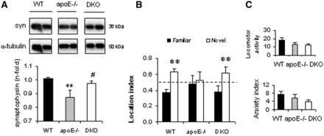
Figure 3 Synapse loss and cognitive dysfunction are prevented by FcγR deletion. (A) Representative immunoblots and ...
Notes:
Figure 3 Synapse loss and cognitive dysfunction are prevented by FcγR deletion. (A) Representative immunoblots and quantification of synaptophysin (syn) expression in the cerebral cortex of middle-aged mice. Values are mean ± SEM of the total of studied animals per group: wild-type (WT), n = 5; apoE−/−, n = 8; DKO, n = 7. **P < 0.01 versus wild-type; #P < 0.05 versus apoE−/−. (B) Spatial learning and memory measured using the object location test index (exploration time of a given location relative to total object exploration time). (C) Anxiety levels and locomotor activity measured with the elevated plus maze test. Anxiety index was calculated as the relative time in open arms, and locomotor activity as frequency of entry into closed arms. All behavioural studies were performed in middle-aged mice (wild-type, n = 9; apoE−/−, n = 9; DKO, n = 10). **P < 0.01 versus familiar location.
Unless provided in the caption above, the following copyright applies to the content of this slide: © The Author (2012). Published by Oxford University Press on behalf of the Guarantors of Brain. All rights reserved. For Permissions, please email: journals.permissions@oup.com

Slide 4
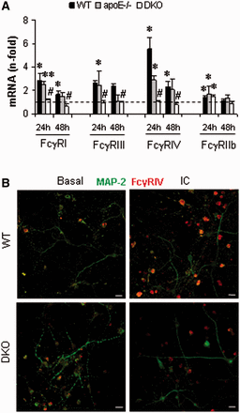
Figure 4 Immune complexes induce FcγR overexpression in primary neurons. (A) The expression profile of activating ...
Notes:
Figure 4 Immune complexes induce FcγR overexpression in primary neurons. (A) The expression profile of activating FcγRs (I, III and IV) and inhibitory FcγRIIb in primary neuronal cultures from wild-type (WT), apoE−/−, and DKO mice was measured by real-time PCR after stimulation with immune complexes (IC). Basal is represented as a dashed line. Data are mean ± SEM of three to six experiments. *P < 0.05 and **P < 0.01 versus basal; #P < 0.05 versus stimulated wild-type cells. (B) Immunofluorescence of FcγRIV (red) and the neuronal marker microtubule associated protein 2 (MAP-2, green) in wild-type and DKO neuronal cultures under basal conditions and after 24-h treatment with IC. Representative of three independent experiments. Scale bar = 20 μm.
Unless provided in the caption above, the following copyright applies to the content of this slide: © The Author (2012). Published by Oxford University Press on behalf of the Guarantors of Brain. All rights reserved. For Permissions, please email: journals.permissions@oup.com

Slide 5
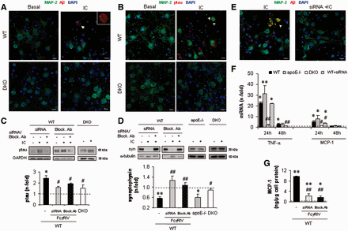
Figure 5 Over-activation of neuronal FcγRs, and particularly the FcγRIV isoform, induces Alzheimer-like pathology in ...
Notes:
Figure 5 Over-activation of neuronal FcγRs, and particularly the FcγRIV isoform, induces Alzheimer-like pathology in vitro. Representative immunofluorescence images from three independent experiments showing amyloid β (A) and phosphorylated tau (ptau, B) in red combined with the neuronal marker microtubule associated protein 2 (MAP-2, green) and cell nuclei (blue), both in wild-type (WT) and DKO neurons under basal conditions or following a 48-h exposure to immune complexes (IC). Arrow indicates typical intracellular amyloid β deposit in a pyramidal neuron resembling a senile plaque. Arrowheads indicate basal and apical dendrites from pyramidal neurons stained for AT8 in stimulated cells. Scale bars = 10 μm. (C and D) Western blot analysis of phosphorylated tau (ptau, C) and synaptophysisn (syn, D) in primary neurons after a 48-h treatment with immune complexes. The effect of FcγRIV inhibition in wild-type neurons was assessed with small interfering RNA (siRNA) and blocking antibody (Block. Ab). Representative immunoblots of three to six independent experiments are shown. (E) Photomicrographs of triple-colour immunofluorescence (red, amyloid β; green, microtubule associated protein 2; and blue, nuclei) from wild-type neurons transfected with FcγRIV small interfering RNA before stimulation with immune complexes. Arrowhead denotes neuronal debris (irregular morphology without nuclear staining) strongly stained for amyloid β, suggestive of a senile plaque derived from intracellular deposits. Scale bar = 20 μm; representative of three independent experiments. (F) Time-dependent induction of TNFα and MCP1 by immune complexes in primary cultures from WT, apoE−/− and DKO mice, measured by real-time PCR. The involvement of FcγRIV was assessed with small interfering RNA. (G) MCP1 protein production in wild-type neurons was measured by ELISA. Dashed lines represent basal conditions. Data are mean ± SEM of three to six experiments per group. *P < 0.05 and **P < 0.01 versus basal; #P < 0.05 and ##P < 0.01 versus stimulated wild-type cells.
Unless provided in the caption above, the following copyright applies to the content of this slide: © The Author (2012). Published by Oxford University Press on behalf of the Guarantors of Brain. All rights reserved. For Permissions, please email: journals.permissions@oup.com

Slide 6
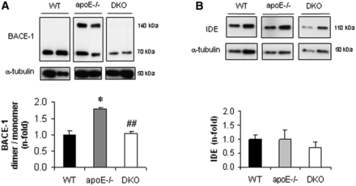
Figure 6 FcγR deletion precludes the apparent increase in active BACE1 induced by hypercholesterolaemia. Western blot ...
Notes:
Figure 6 FcγR deletion precludes the apparent increase in active BACE1 induced by hypercholesterolaemia. Western blot analysis of BACE1 (A) and insulin degrading enzyme (IDE, B) protein levels in the cerebral cortex from middle-aged mice. Representative blots from each group are shown. Values are mean ± SEM (wild-type, n = 5; apoE−/−, n = 8; DKO, n = 7). *P < 0.05 versus wild-type; ##P < 0.01 versus apoE−/−.
Unless provided in the caption above, the following copyright applies to the content of this slide: © The Author (2012). Published by Oxford University Press on behalf of the Guarantors of Brain. All rights reserved. For Permissions, please email: journals.permissions@oup.com

Slide 7
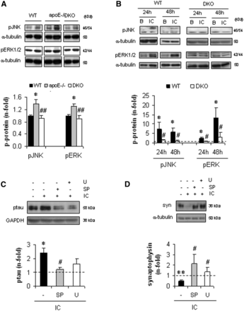
Figure 7 JNK and ERK activation are involved in the neuroprotective actions of FcγR deletion. (A) JNK and ERK activity ...
Notes:
Figure 7 JNK and ERK activation are involved in the neuroprotective actions of FcγR deletion. (A) JNK and ERK activity was measured by western blot analysis of phosphorylated proteins (p-proteins: pJNK and pERK) in the cerebral cortex from middle-aged mice. (B) JNK and ERK activation in primary neurons under basal conditions (B) or following 48-h stimulation with immune complexes (IC). (C and D) Western blot analysis of tau phosphorylation (ptau, C) and synaptophysin levels (syn, D) in wild-type neurons pretreated with inhibitors of JNK (SP600125, SP) and ERK (U0126, U) before stimulation. Basal condition is represented as a dashed line. Summary of densitometric analysis is expressed as fold increases. Representative blots from in each group are shown. Values are mean ± SEM of studied animals per group (wild-type, n = 5; apoE−/−, n = 8; DKO, n = 7; A) and of three to six independent experiments (B–D). *P < 0.05 versus wild-type (WT) mice or basal cells; #P < 0.05 versus apoE−/− mice or stimulated wild-type cells.
Unless provided in the caption above, the following copyright applies to the content of this slide: © The Author (2012). Published by Oxford University Press on behalf of the Guarantors of Brain. All rights reserved. For Permissions, please email: journals.permissions@oup.com

