Slide 1
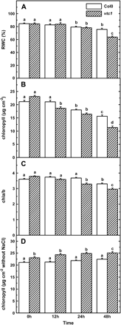
Fig. 1. Changes in relative water contents (RWC, A), chlorophyll contents (B), and the ratio of Chl a to Chl b (Chl ...
Notes:
Fig. 1. Changes in relative water contents (RWC, A), chlorophyll contents (B), and the ratio of Chl a to Chl b (Chl a/b) (C) under salt stress, and chlorophyll contents without salt treatment in the WT and the ascorbate-deficiency vtc-1 mutant of Arabidopsis (D). After growing for 5 weeks, the Arabidopsis seedlings were irrigated with 200 mM NaCl for 12, 24, and 48 h, and the fully expanded leaves were collected for the measurement of RWC and chlorophyll contents. Mean values and SE were calculated from five independent experiments. Within each set of experiments, bars with different letters were significantly different at the 0.05 level.
Unless provided in the caption above, the following copyright applies to the content of this slide: © The Author [2005]. Published by Oxford University Press [on behalf of the Society for Experimental Biology]. All rights reserved. For Permissions, please e-mail: journals.permissions@oxfordjournals.org

Slide 2
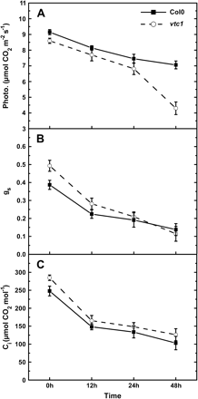
Fig. 2. Changes in photosynthetic rate (Photo., A), stomatal conductance (g_{s,} B), and intercellular ...
Notes:
Fig. 2. Changes in photosynthetic rate (Photo., A), stomatal conductance (gs, B), and intercellular CO2 concentration (Ci, C) in the WT and vtc-1 mutant of Arabidopsis. After growing for 5 weeks, the Arabidopsis seedlings were treated as described in Fig. 1. Mean values and SE were calculated from five independent experiments.
Unless provided in the caption above, the following copyright applies to the content of this slide: © The Author [2005]. Published by Oxford University Press [on behalf of the Society for Experimental Biology]. All rights reserved. For Permissions, please e-mail: journals.permissions@oxfordjournals.org

Slide 3
Fig. 3. Photosystem II functions in the WT and vtc-1 mutant of Arabidopsis under salt stress. After growing for 5 ...
Notes:
Fig. 3. Photosystem II functions in the WT and vtc-1 mutant of Arabidopsis under salt stress. After growing for 5 weeks, the Arabidopsis seedlings were treated as described in Fig. 1. The maximal efficiency of PSII photochemistry (Fv/Fm, A), the efficiency of excitation capture by open PSII reaction centres (\batchmode \documentclass[fleqn,10pt,legalpaper]{article} \usepackage{amssymb} \usepackage{amsfonts} \usepackage{amsmath} \pagestyle{empty} \begin{document} \(F_{\mathrm{v}}{^\prime}/F_{\mathrm{m}}{^\prime},\) \end{document} B), the photochemical quenching coefficient (qP, C), the actual PSII efficiency (ΦPSII, D), and the non-photochemical quenching (NPQ, E) were measured according to the Materials and methods. PAR was approximately 140 μmol photons m−2 s−1 in the measure of \batchmode \documentclass[fleqn,10pt,legalpaper]{article} \usepackage{amssymb} \usepackage{amsfonts} \usepackage{amsmath} \pagestyle{empty} \begin{document} \(F_{\mathrm{v}}{^\prime}/F_{\mathrm{m}}{^\prime}\) \end{document} and NPQ. Mean values and SE were calculated from five independent experiments.
Unless provided in the caption above, the following copyright applies to the content of this slide: © The Author [2005]. Published by Oxford University Press [on behalf of the Society for Experimental Biology]. All rights reserved. For Permissions, please e-mail: journals.permissions@oxfordjournals.org

Slide 4
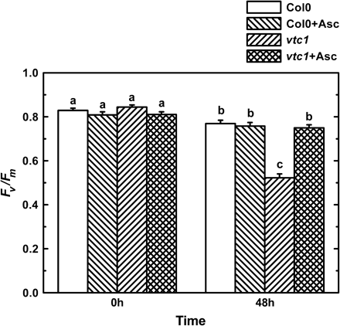
Fig. 4. Effects of exogenous ascorbate on the maximal efficiency of PSII photochemistry in the WT and vtc-1 mutant of ...
Notes:
Fig. 4. Effects of exogenous ascorbate on the maximal efficiency of PSII photochemistry in the WT and vtc-1 mutant of Arabidopsis under salt stress. One week before salt treatment, 20 mM ascorbate was dissolved into half-strength Hoagland solution to water Arabidopsis. During the salt treatment experiment, 20 mM ascorbate was also added to the solution used above. After salt treatment for 48 h, Fv/Fm was measured according to the Materials and methods. Mean values and SE were calculated from five independent experiments. Within each set of experiments, bars with different letters were significantly different at the 0.05 level.
Unless provided in the caption above, the following copyright applies to the content of this slide: © The Author [2005]. Published by Oxford University Press [on behalf of the Society for Experimental Biology]. All rights reserved. For Permissions, please e-mail: journals.permissions@oxfordjournals.org

Slide 5
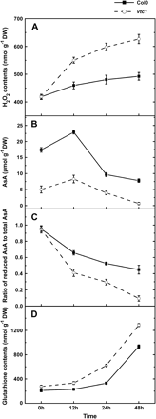
Fig. 5. Changes in H₂O₂ contents (A), total ascorbate contents (B), ratio of reduced to total ...
Notes:
Fig. 5. Changes in H2O2 contents (A), total ascorbate contents (B), ratio of reduced to total ascorbate contents (C), and glutatione contents (D) in the WT and vtc-1 mutant of Arabidopsis under salt stress. After growing for 5 weeks, the Arabidopsis seedlings were treated as described in Fig. 1. The contents of H2O2, ascorbate, and glutathione were expressed on the basis of dry weight. Mean values and SE were calculated from five independent experiments.
Unless provided in the caption above, the following copyright applies to the content of this slide: © The Author [2005]. Published by Oxford University Press [on behalf of the Society for Experimental Biology]. All rights reserved. For Permissions, please e-mail: journals.permissions@oxfordjournals.org

Slide 6
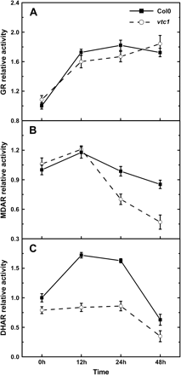
Fig. 6. Changes in relative activities of GR (A), MDAR (B), and DHAR (C) in the ascorbate–glutathione cycle, in the ...
Notes:
Fig. 6. Changes in relative activities of GR (A), MDAR (B), and DHAR (C) in the ascorbate–glutathione cycle, in the WT and vtc-1 mutant of Arabidopsis under salt stress. After growing for 5 weeks, the Arabidopsis seedlings were treated as described in Fig. 1. Mean values and SE were calculated from five independent experiments.
Unless provided in the caption above, the following copyright applies to the content of this slide: © The Author [2005]. Published by Oxford University Press [on behalf of the Society for Experimental Biology]. All rights reserved. For Permissions, please e-mail: journals.permissions@oxfordjournals.org

