Slide 1
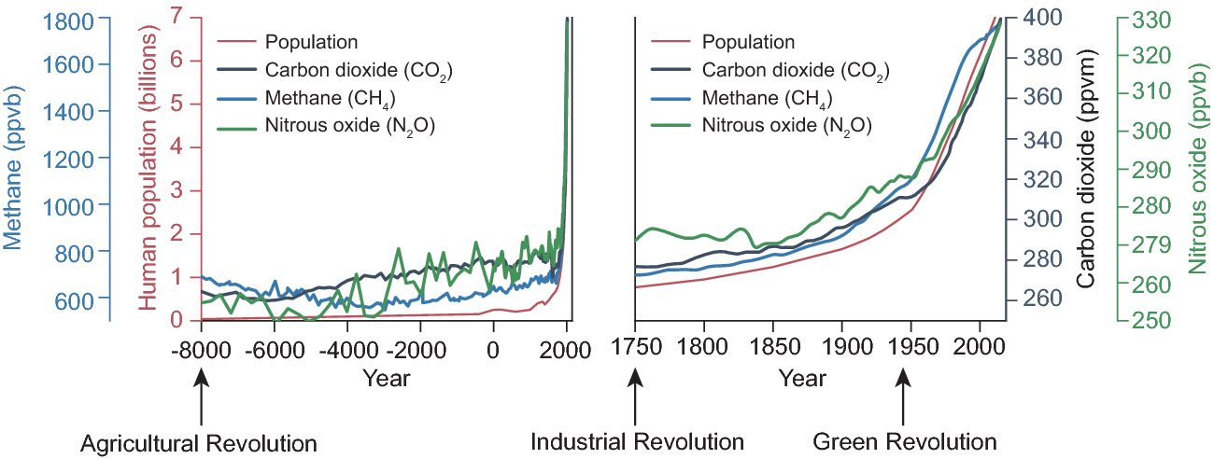
Figure 1. World population and atmospheric concentrations of major greenhouse gases since the beginning of the ...
Notes:
Figure 1. World population and atmospheric concentrations of major greenhouse gases since the beginning of the Agricultural Revolution about 10 000 years ago until the present (left), with a magnified timescale for the period after the beginning of the Industrial Revolution (right). Code, data, data sources, calculation of the rates of change and additional configurations of the figure are available at https://dx.doi.org/10.6084/m9.figshare.4029369.
Unless provided in the caption above, the following copyright applies to the content of this slide: © The Author(s) 2016. Published by Oxford University Press on behalf of China Science Publishing & Media Ltd. All rights reserved. For permissions, please e-mail: journals.permissions@oup.comThis is an Open Access article distributed under the terms of the Creative Commons Attribution License (http://creativecommons.org/licenses/by/4.0/), which permits non-commercial reuse, distribution, and reproduction in any medium, provided the original work is properly cited. for commercial re-use, please contact journals.permissions@oup.com

