Slide 1
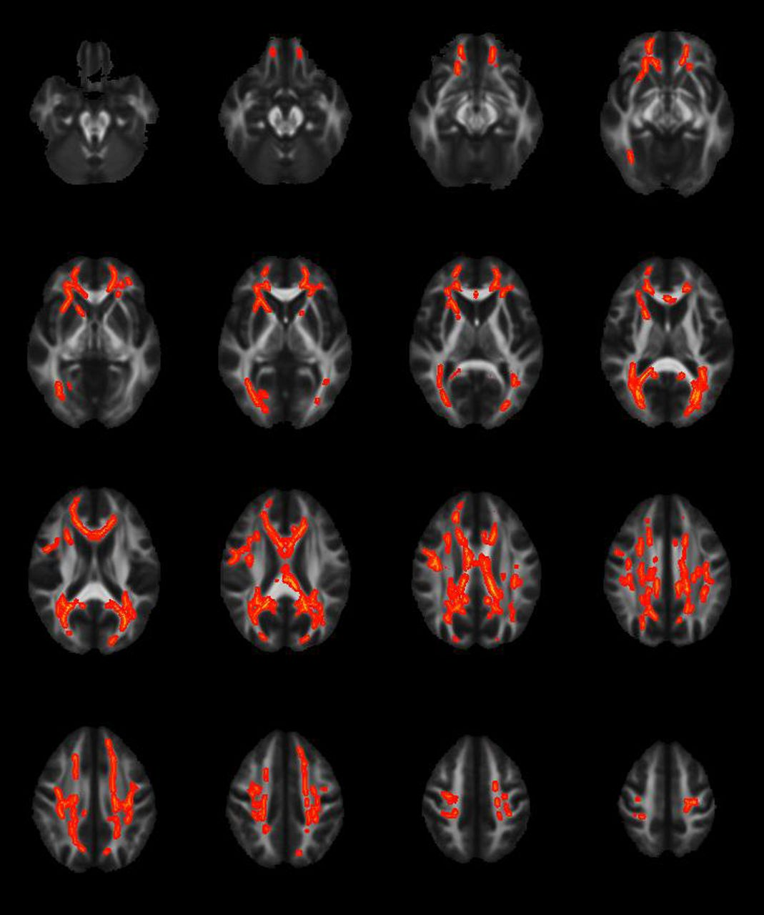
Fig. 1. Tract-based spatial statistics lightbox comparing MTBI-PCS-present patients and controls on RD. Voxels ...
Notes:
Fig. 1. Tract-based spatial statistics lightbox comparing MTBI-PCS-present patients and controls on RD. Voxels highlighted in yellow/orange indicated areas of significant increase in RD at the p< .05 level in the MTBI-PCS-present patients. Neuroanatomical areas where significant increases were noted include the genu, body, and splenium of the corpus callosum, bilateral anterior, superior and posterior corona radiata, bilateral superior longitudinal fasciculus, bilateral cingulum, bilateral posterior thalamic radiations, bilateral anterior limb of the internal capsule, and bilateral external capsule.
Unless provided in the caption above, the following copyright applies to the content of this slide: © The Author 2014. Published by Oxford University Press. All rights reserved. For permissions, please e-mail: journals.permissions@oup.com.

Slide 2
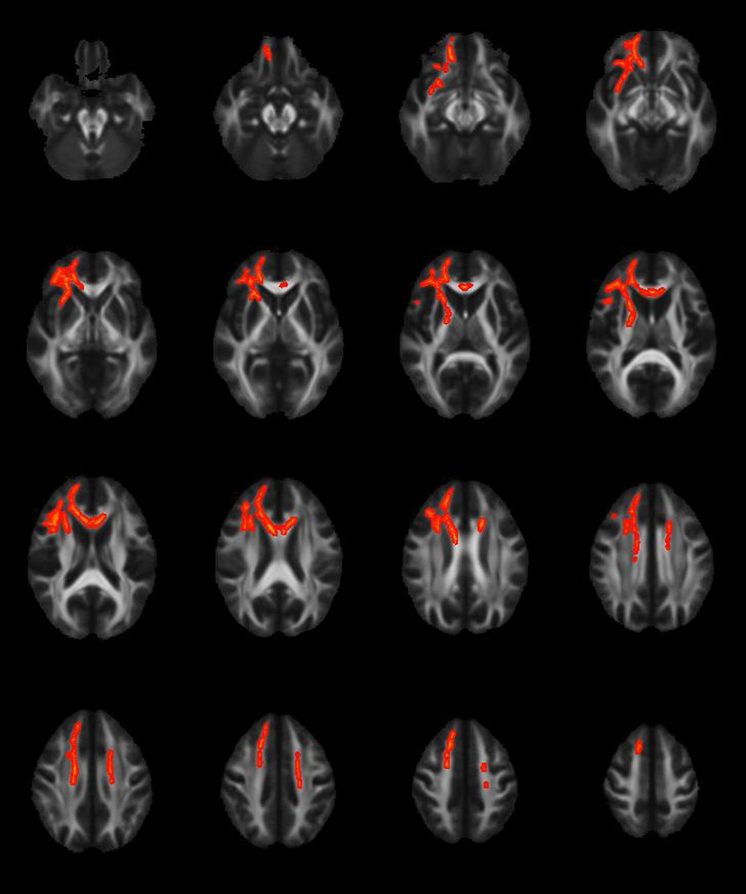
Fig. 2. Tract-based spatial statistics lightbox comparing MTBI-PCS-present patients and controls on MD. Voxels ...
Notes:
Fig. 2. Tract-based spatial statistics lightbox comparing MTBI-PCS-present patients and controls on MD. Voxels highlighted in yellow/orange indicated areas of significant increase in MD at the p < .05 level in the MTI-PCS-present group. Neuroanatomical areas where significant increases were observed included genu and body of the corpus callosum, bilateral superior corona radiata, right anterior corona radiata, right anterior and posterior limb of the internal capsule and the right superior longitudinal fasciculus.
Unless provided in the caption above, the following copyright applies to the content of this slide: © The Author 2014. Published by Oxford University Press. All rights reserved. For permissions, please e-mail: journals.permissions@oup.com.

