Slide 1
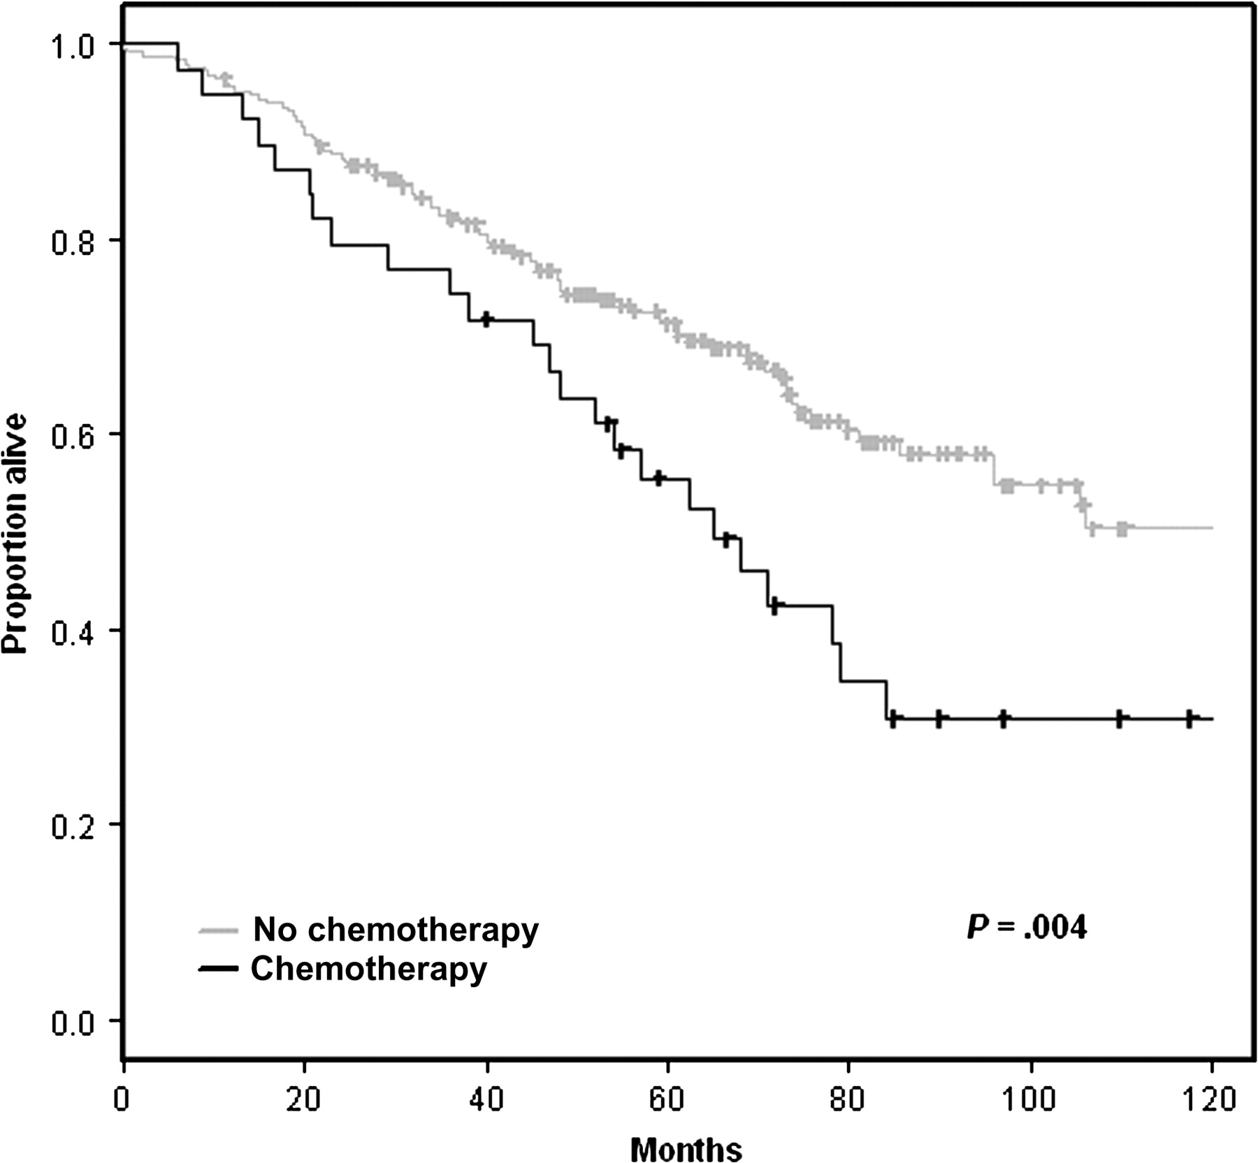
Figure 4 Effect of adjuvant chemotherapy on survival. These survival curves are based on the combined University of ...
Notes:
Figure 4 Effect of adjuvant chemotherapy on survival. These survival curves are based on the combined University of Michigan Cancer Center and Moffitt Cancer Center (HLM), Memorial Sloan-Kettering Cancer Center (MSK), and Dana-Farber Cancer Institute (CAN/DF) datasets reported in Shedden et al. (11). Tick marks indicate censored observations. The (two-sided) P value is from the log-rank test.
Unless provided in the caption above, the following copyright applies to the content of this slide: Published by Oxford University Press 2010.

Slide 2
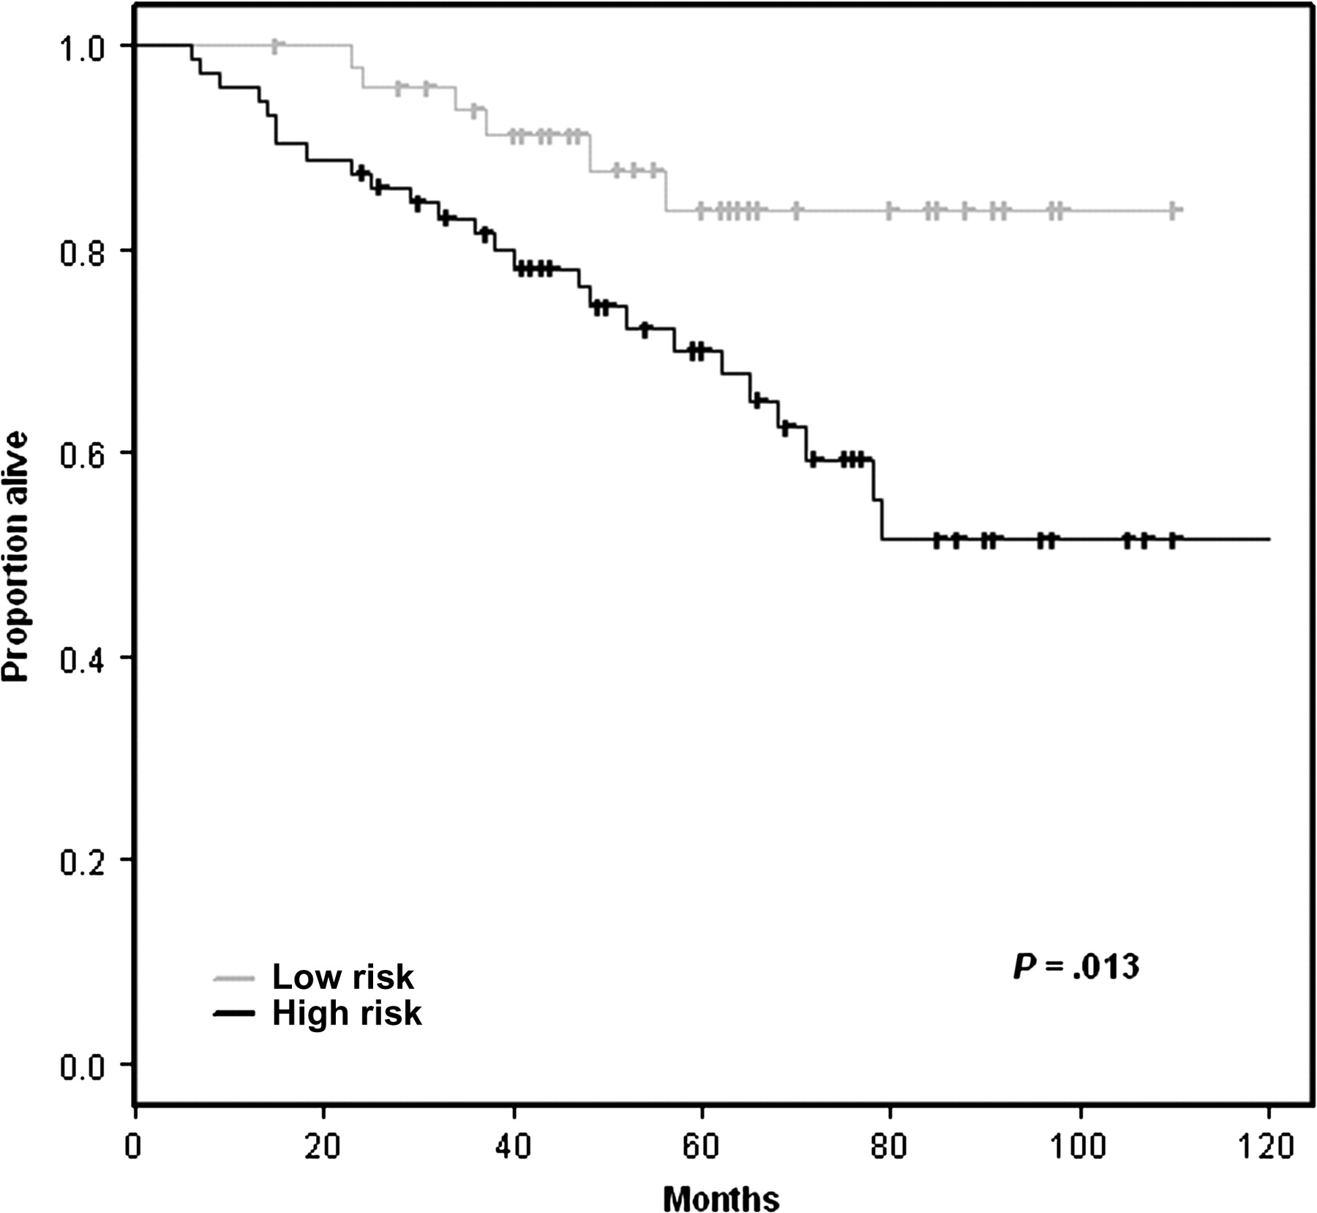
Figure 3 Evaluation of the prognostic models for stage I samples developed using clinical information alone (Table 3) ...
Notes:
Figure 3 Evaluation of the prognostic models for stage I samples developed using clinical information alone (Table 3) on the Memorial Sloan-Kettering Cancer Center (MSK) and Dana-Farber Cancer Institute (CAN/DF) test datasets of Shedden et al. (11). The (two-sided) P value is from the log-rank test. Tick marks indicate censored observations. Each patient was classified into the high- or low-risk group based on whether his predicted risk score was greater or less than the median risk score for the training set. Further details on the methodology for developing these prognostic models are given in Supplementary Methods (available online).
Unless provided in the caption above, the following copyright applies to the content of this slide: Published by Oxford University Press 2010.

Slide 3
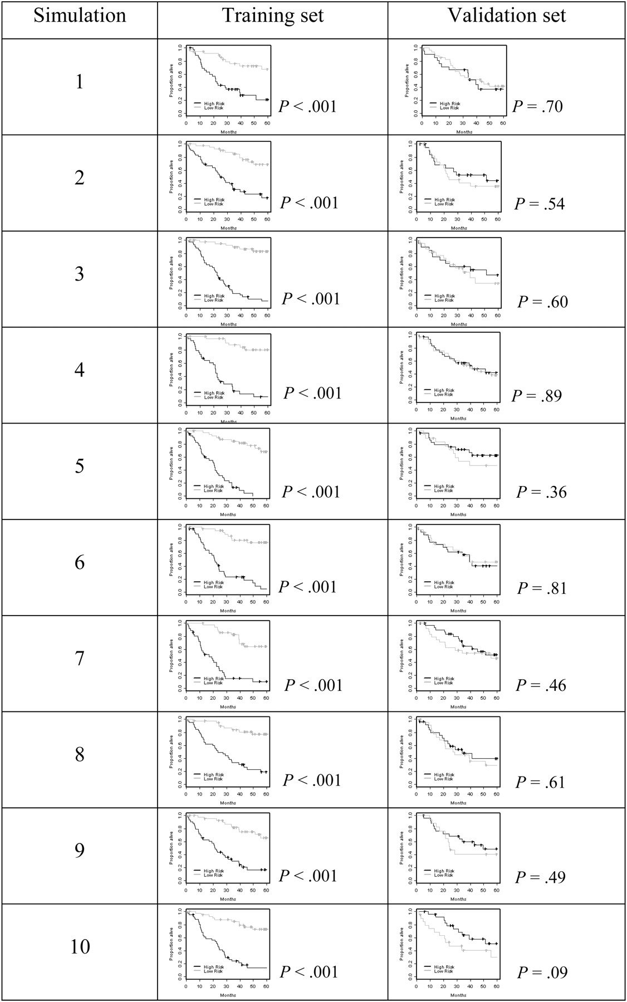
Figure 2 Kaplan–Meier survival estimates for the simulation study. *Prediction accuracy for the training and ...
Notes:
Figure 2 Kaplan–Meier survival estimates for the simulation study. *Prediction accuracy for the training and validation datasets with random gene expression profiles. For this simulation, survival data on 129 patients were obtained from Bild et al. (32). For each patient, 5000 random numbers obtained from the standard normal distribution formed the gene expression profile. This master dataset was divided randomly into training and validation sets. A model predicting survival based on gene expression was developed from the training data. This model was used to classify survival risk group for patients in the training set and the validation set. The Kaplan–Meier curves show the proportion alive (vertical axis) vs time in months (horizontal axis) for predicted high-risk (black line) and low-risk (gray line) groups. Tick marks indicate censored observations. The P values are two-sided and are from the log-rank test. The Kaplan–Meier survival curves for the training set are “resubstitution” estimates because the same data are used to develop the model and to test it. Additional details of the simulation methodology are provided in the Supplementary Methods (available online).
Unless provided in the caption above, the following copyright applies to the content of this slide: Published by Oxford University Press 2010.

Slide 4
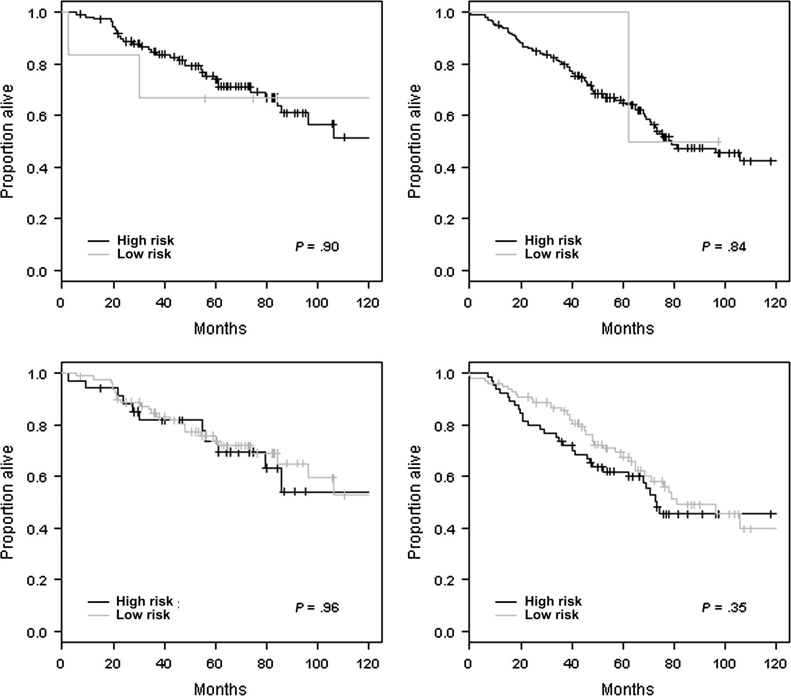
Figure 1 Independent validation of gene expression–based prognostic signatures on stage IA (left) and stage IB (right) ...
Notes:
Figure 1 Independent validation of gene expression–based prognostic signatures on stage IA (left) and stage IB (right) samples obtained from the datasets reported by Shedden et al. (11). Kaplan–Meier survival curves for the five-gene signature reported by Chen et al. (15) (top panels) and for the three-gene signature reported by Lau et al. (16) (bottom panels). The P values (two-sided) are from the log-rank test. Tick marks indicate censored observations. Each patient was classified into the high- or low-risk group as outlined in Chen et al. (15) and Lau et al. (16). Further details on methodology for this independent validation study are given in Supplementary Material (available online).
Unless provided in the caption above, the following copyright applies to the content of this slide: Published by Oxford University Press 2010.

