Slide 1
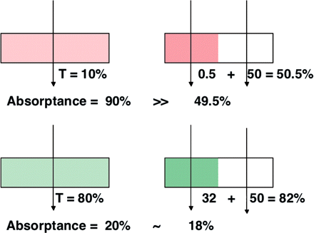
Fig. 1 Model explaining the sieve effect on absorptance. Left: a cuvette containing a pigment solution. Right: the ...
Notes:
Fig. 1 Model explaining the sieve effect on absorptance. Left: a cuvette containing a pigment solution. Right: the pigment is concentrated in a half-cuvette, while another half-cuvette contains only the solvent. When the cuvette is uniformly irradiated with a strongly absorbed monochromatic light, the decrease in absorptance by the sieve effect was large (above), while in the case of weakly absorbed monochromatic light the decrease in absorptance is small (below).
Unless provided in the caption above, the following copyright applies to the content of this slide: © The Author 2009. Published by Oxford University Press on behalf of Japanese Society of Plant Physiologists. All rights reserved. For permissions, please email: journals.permissions@oxfordjournals.org

Slide 2
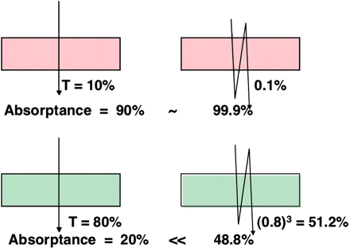
Fig. 2 Model explaining the détour effect on absorptance. Left: no détour effect. Right: the light path is ...
Notes:
Fig. 2 Model explaining the détour effect on absorptance. Left: no détour effect. Right: the light path is lengthened 3-fold by the détour effect. For strongly absorbed monochromatic light, the increase in absorptance by the détour effect is small (above), while for weakly absorbed light the increase is marked (below).
Unless provided in the caption above, the following copyright applies to the content of this slide: © The Author 2009. Published by Oxford University Press on behalf of Japanese Society of Plant Physiologists. All rights reserved. For permissions, please email: journals.permissions@oxfordjournals.org

Slide 3
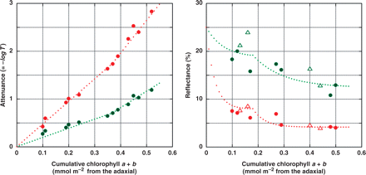
Fig. 3 Fitting of the Kubelka–Munk theory to the transmittance and reflectance data of the paradermal sections of ...
Notes:
Fig. 3 Fitting of the Kubelka–Munk theory to the transmittance and reflectance data of the paradermal sections of leaves of Camellia japonica. Left: attenuance = –log10T of paradermal sections with adaxial epidermes. Although attenuance can be defined by the same mathematical equation that defines absorbance (A), attenuance is used when the decrease in T due to R is substantial. The monochromatic light at 680 or 550 nm was applied to the adaxial epidermis. Right: reflectance of the paradermal sections having the abaxial epidermes. Monochromatic light was irradiated from the cut surface. Reflectance was measured with an integrating sphere. Different symbols indicate different leaves. The reflectance of the abaxial epidermis was assumed to be 0.25, for both 680 and 550 nm. The boundary between the palisade and spongy tissues was assumed to be at 0.37 mmol chlorophyll m–2 (note the inflections of the curves). k680 and s680 for the palisade tissue were 10,000 and 900, and k680 and s680 for the spongy tissue were 13,400 and 2,500, respectively. k550 and s550 for the palisade tissue were 3,400 and 1,100, and k550 and s550 for the spongy tissue were 5,300 and 3,500, respectively. For the unit of these numbers, see the text. The data of transmittance and reflectance were adopted from Terashima and Saeki (1983).
Unless provided in the caption above, the following copyright applies to the content of this slide: © The Author 2009. Published by Oxford University Press on behalf of Japanese Society of Plant Physiologists. All rights reserved. For permissions, please email: journals.permissions@oxfordjournals.org

Slide 4
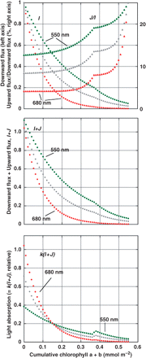
Fig. 4 Light environment and light absorption profile within a Camellia japonica leaf predicted by the Kubelka–Munk ...
Notes:
Fig. 4 Light environment and light absorption profile within a Camellia japonica leaf predicted by the Kubelka–Munk theory. The k and s values fitted to the data (Fig. 3) were used. I, downward flux; J, upward flux; and k·(I + J), absorptance per unit chlorophyll (relative value). The calculated results for 680 and 550 nm are shown together with the mean values of 680 and 550 nm values (in gray). Unpublished results of I. Terashima.
Unless provided in the caption above, the following copyright applies to the content of this slide: © The Author 2009. Published by Oxford University Press on behalf of Japanese Society of Plant Physiologists. All rights reserved. For permissions, please email: journals.permissions@oxfordjournals.org

Slide 5
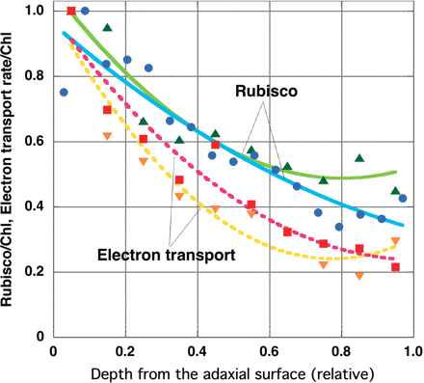
Fig. 5 Intra-leaf profiles of photosynthetic capacities in leaves of Spinacia oleracea. Green triangles, Rubisco ...
Notes:
Fig. 5 Intra-leaf profiles of photosynthetic capacities in leaves of Spinacia oleracea. Green triangles, Rubisco content/Chl (Terashima and Inoue 1985); blue circles, Rubisco content/Chl (Nishio et al. 1993); red squares, dichloroindophenol reduction rate/Chl (Terashima and Inoue 1985); and orange triangles, dichloroindophenol reduction rate/Chl (Terashima 1989). Quadratic equations were fitted to the data.
Unless provided in the caption above, the following copyright applies to the content of this slide: © The Author 2009. Published by Oxford University Press on behalf of Japanese Society of Plant Physiologists. All rights reserved. For permissions, please email: journals.permissions@oxfordjournals.org

Slide 6
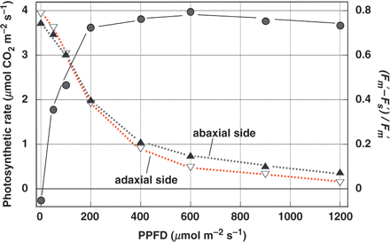
Fig. 6 Light response curves of the rate of photosynthesis (A_{n}) and quantum yield of PSII in the light in ...
Notes:
Fig. 6 Light response curves of the rate of photosynthesis (An) and quantum yield of PSII in the light in a leaf of a shade-grown Alocasia odora plant. An was measured with a portable gas-exchange system (LI-6400, Li-Cor, Lincoln, NE, USA) at a cuvette temperature of 25°C in air containing 380 μl l–1 CO2. The leaf was sandwiched with two half-chambers that had transparent windows. White light from a metal-halide lamp was provided via an optical fiber with a rectangular light emitter. The fluorescence signals were measured from the adaxial and abaxial sides with two PAM fluorometers (PAM 101/102/103, Walz, Effltliche, Germany). The optical fiber connected to one of the fluorometers was placed in the central space of the rectangular emitter for the actinic light. The other probe was placed below the lower half-chamber. Unpublished results of T. Inoue.
Unless provided in the caption above, the following copyright applies to the content of this slide: © The Author 2009. Published by Oxford University Press on behalf of Japanese Society of Plant Physiologists. All rights reserved. For permissions, please email: journals.permissions@oxfordjournals.org

Slide 7
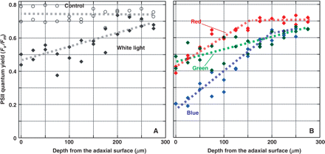
Fig. 7 Intra-leal profiles of F_{v}/F_{m} in leaves of Capsicum annuum. Leaf discs of C. annuum were ...
Notes:
Fig. 7 Intra-leal profiles of Fv/Fm in leaves of Capsicum annuum. Leaf discs of C. annuum were treated with lincomycin, an inhibitor of protein synthesis, and subsequently photoinhibited at 2,000 μmol photon m–2 s–1 at room temperature for 60 min by white light, broad-band blue (400–500 nm), green (500–600 nm) or red (600–700 nm, right). A (left), results with white light; B (right), results with broad-band monochromatic lights. A Microfiber PAM (Walz, Effelt, Germany) having an optical microfiber of 30 μm diameter was used to measure intra-leaf profiles of Fv/Fm. The micro optical fiber was inserted into the leaf tissues with the aid of a three-dimensional water-pressure micromanipulator (WR-60, Narishige, Tokyo, Japan). Unpublished data of R. Oguchi.
Unless provided in the caption above, the following copyright applies to the content of this slide: © The Author 2009. Published by Oxford University Press on behalf of Japanese Society of Plant Physiologists. All rights reserved. For permissions, please email: journals.permissions@oxfordjournals.org

Slide 8
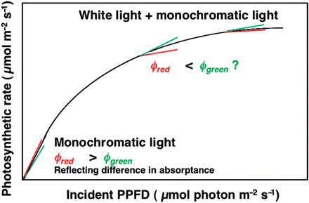
Fig. 8 The differential quantum yield measurement. In the presence of white light at PPFD of I, weak monochromatic ...
Notes:
Fig. 8 The differential quantum yield measurement. In the presence of white light at PPFD of I, weak monochromatic light (dI) is given. The ratio of increment of the photosynthetic rate (dAn) to PPFD of the monochromatic light (dI), dAn/dI, gives the differential quantum yield φ(I). When I = 0, the differential quantum yield is the same as the ordinary quantum yield on an incident PPFD basis.
Unless provided in the caption above, the following copyright applies to the content of this slide: © The Author 2009. Published by Oxford University Press on behalf of Japanese Society of Plant Physiologists. All rights reserved. For permissions, please email: journals.permissions@oxfordjournals.org

Slide 9
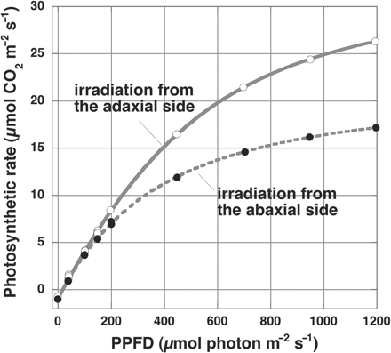
Fig. 9 Light response curves of the rate of net photosynthesis (A_{n}) in a leaf of Helianthus annuus ...
Notes:
Fig. 9 Light response curves of the rate of net photosynthesis (An) in a leaf of Helianthus annuus obtained with irradiation to the adaxial or abaxial side. The rate of photosynthesis was measured with a portable gas-exchange system (LI-6400, Li-Cor), at a leaf temperature of 25°C in air containing 390 μl l–1 CO2. Vapor pressure deficit was <0.7 kPa. The light from a halogen lamp in a slide projector was delivered by a tri-furcated optical fiber. Helianthus annuus plants were grown at 350 μmol m–2 s–1 at canopy height at 23°C with a photoperiod of 12 h. Unpublished data of T. Fujita.
Unless provided in the caption above, the following copyright applies to the content of this slide: © The Author 2009. Published by Oxford University Press on behalf of Japanese Society of Plant Physiologists. All rights reserved. For permissions, please email: journals.permissions@oxfordjournals.org

Slide 10
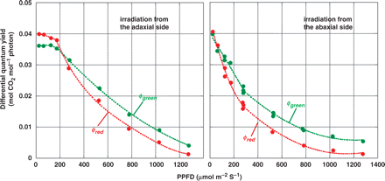
Fig. 10 Differential quantum yields for red and green monochromatic light in a leaf of Helianthus annuus. Left: data ...
Notes:
Fig. 10 Differential quantum yields for red and green monochromatic light in a leaf of Helianthus annuus. Left: data obtained by irradiation to the adaxial side. Right: data obtained by irradiation to the abaxial side. The white light source was a halogen lamp delivered through a tri-furcated optical fiber. Red or green monochromatic light was obtained by passing the light from a halogen lamp through optical filters and delivered through another tri-furcated optical fiber. A hexagonal holder made of Plexiglas was used to hold six optical fibers to secure uniform and constant irradiation. The peak of the green monochromatic light was 550 nm with the half-band width of ±30 nm. The red light had a maximum at 668 nm. Half the maximum transmittance occurred at 641 and 690 nm. The PPFDs of the white light were 0, 40, 100, 150, 200, 450, 700, 950 and 1,200 μmol photons m–2 s–1. The light response curves obtained by irradiation with the white light are shown in Fig. 9. The PPFD of the monochromatic light was either 50 μmol m–2 s–1 (for the white light at 0, 40, 100 and 150 μmol m–2 s–1) or 150 μmol m–2 s–1 (for the white light at 200, 450, 700, 950 and 1,200 μmol m–2 s–1). The differential quantum yield is plotted against the PPFD (PPFD of the white light + half the PPFD of the monochromatic light). The data were obtained with the same leaf of H. annuus that was used for Fig. 9. Once An attained a stable value in the white light at the ambient CO2 concentration (Ca) at 390 nm, then monochromatic light was added, keeping the intercellular CO2 concentration (Ci) constant by manipulating Ca. Therefore, Ci was constant for three measurements, in the white light, the white light + red monochromatic light and the white light + green monochromatic light. Quadratic or quadruple equations were fitted to the data. φgreen,adax (I ≤ 180 μmol m–2 s–1) = –1.0938·10–7 I2 + 1.7422·10–5 I + 3.5598·10–2 (r2 = 0.803); φgreen,adax (I ≥ 180 μmol m–2 s–1) = 1.1978·10–8 I2 – 4.5847·10–5 I + 4.3115·10–2 (r2 = 0.999); φred,adax (I ≤180 μmol m–2 s–1) = –3.8099·10–8 I2 – 6.3947·10–6 I + 4.0115·10–2 (r2 = 0.980); φred,adax (I ≥180 μmol m–2 s–1) = 4.1802·10–14I4 – 1.4411·10–10I3 + 1.9467·10–7I2 + 1.264·10–10I + 5.7508·10–2 (r2 = 0.999); φgreen,abax (I ≤280 μmol m–2 s–1) = –1.0914·10–8I2 – 6.1311·10–5I + 3.9941·10–2 (r2 = 0.968); φgreen,abax (I ≥280 μmol m–2 s–1) = 1.8263·10–8I2 – 4.4363·10–5I + 3.2675·10–2 (r2 = 0.990); φred,abax (I ≤280 μmol m–2 s–1) = 2.0084·10–7I2 – 1.556·10–4I + 4.4579·10–2 (r2 = 0.985), and φred,abax (I ≥280 μmol m–2 s–1) = 2.0539·10–8I2 – 4.6917·10–5I + 2.8126·10–2 (r2 = 0.988) Unpublished data of T. Fujita and I. Terashima.
Unless provided in the caption above, the following copyright applies to the content of this slide: © The Author 2009. Published by Oxford University Press on behalf of Japanese Society of Plant Physiologists. All rights reserved. For permissions, please email: journals.permissions@oxfordjournals.org

Slide 11
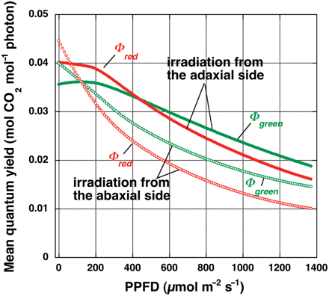
Fig. 11 Calculated mean quantum yield of monochromatic light in white light, Φ (I). The values were obtained by ...
Notes:
Fig. 11 Calculated mean quantum yield of monochromatic light in white light, Φ (I). The values were obtained by integration of each of the curves shown in Fig. 10 with respect to I from 0 to I. Unpublished results of T. Fujita and I. Terashima.
Unless provided in the caption above, the following copyright applies to the content of this slide: © The Author 2009. Published by Oxford University Press on behalf of Japanese Society of Plant Physiologists. All rights reserved. For permissions, please email: journals.permissions@oxfordjournals.org

