Slide 1
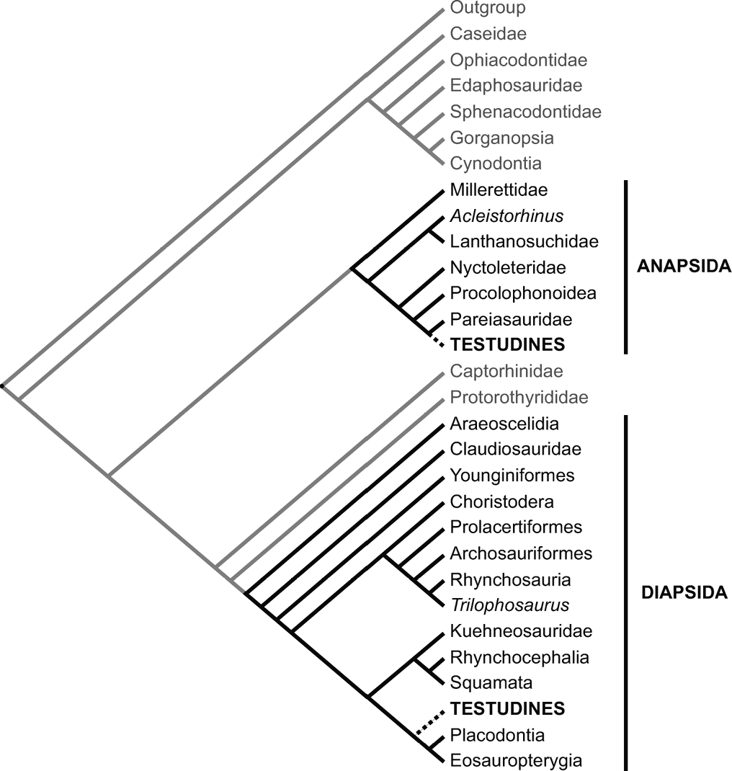
Figure 1 Phylogenetic tree showing with dashed lines the diapsid and anapsid placements of Testudines (turtles) ...
Notes:
Figure 1 Phylogenetic tree showing with dashed lines the diapsid and anapsid placements of Testudines (turtles) favored by Rieppel and Reisz (1999) and Lee (2001), respectively, relative to most parsimonious relationships (solid lines) upon which these authors and the consensus data agree. Taxa in grey are neither diapsid nor anapsid.
Unless provided in the caption above, the following copyright applies to the content of this slide: © 2007 Society of Systematic Biologists

