Slide 1
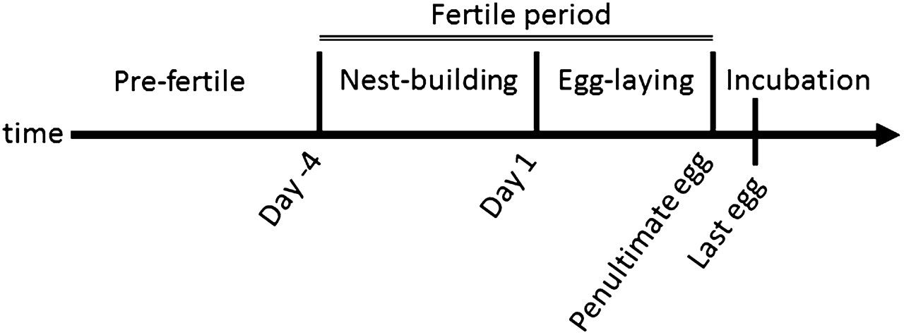
Figure 1 Definitions of the time periods employed in the study. Day 1 was defined as the day of the first egg. ...
Notes:
Figure 1 Definitions of the time periods employed in the study. Day 1 was defined as the day of the first egg. Prefertile period extended from the time of tagging to day −4 (5 days before the first egg), nest-building period was from day −4 to day 0 (the day before the first egg), egg-laying period was from day 1 to the day of penultimate egg (day 2 or 3 depending on clutch size), and incubation period started after that. Nest-building and egg-laying periods were considered the fertile period of the female.
Unless provided in the caption above, the following copyright applies to the content of this slide: © The Author 2011. Published by Oxford University Press on behalf of the International Society for Behavioral Ecology. All rights reserved. For permissions, please e-mail: journals.permissions@oup.com

Slide 2
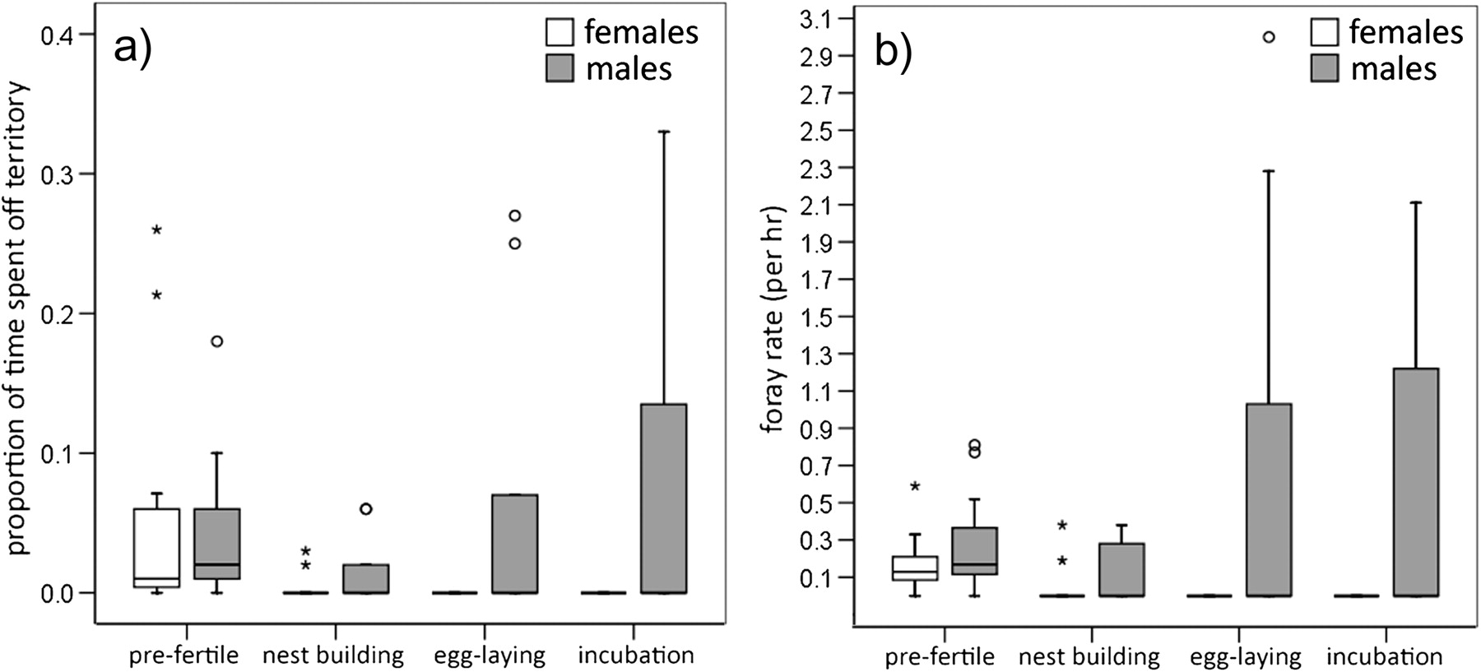
Figure 2 Proportion of time spent off territory (a) and foray rates (b) by females and males. The lines indicate ...
Notes:
Figure 2 Proportion of time spent off territory (a) and foray rates (b) by females and males. The lines indicate medians, boxes indicate the quartiles, the whiskers 95% confidence intervals, and the asterisk and circles indicate outliers for females and males, respectively.
Unless provided in the caption above, the following copyright applies to the content of this slide: © The Author 2011. Published by Oxford University Press on behalf of the International Society for Behavioral Ecology. All rights reserved. For permissions, please e-mail: journals.permissions@oup.com

Slide 3
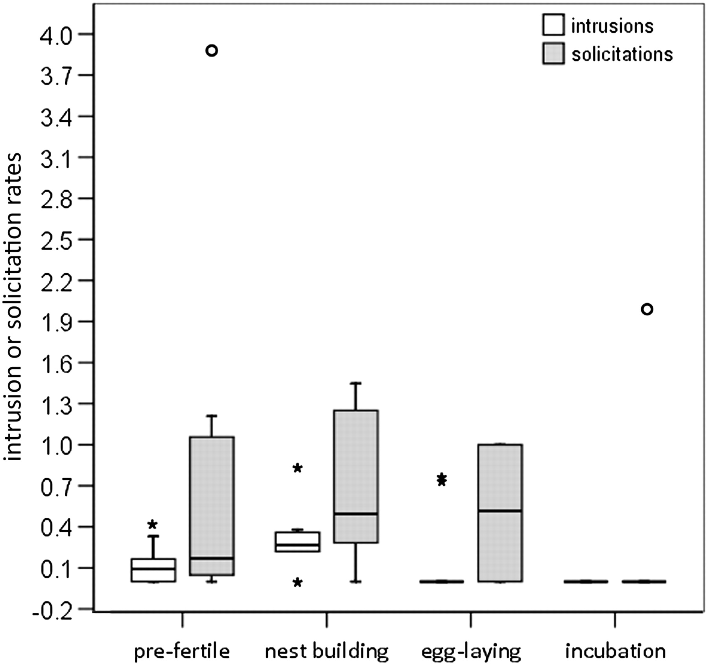
Figure 3 Intrusion and solicitation rates. Boxplots as in Figure 2, except that asterisks and circles indicate ...
Notes:
Figure 3 Intrusion and solicitation rates. Boxplots as in Figure 2, except that asterisks and circles indicate outliers for the intrusion and solicitation rates, respectively.
Unless provided in the caption above, the following copyright applies to the content of this slide: © The Author 2011. Published by Oxford University Press on behalf of the International Society for Behavioral Ecology. All rights reserved. For permissions, please e-mail: journals.permissions@oup.com

Slide 4
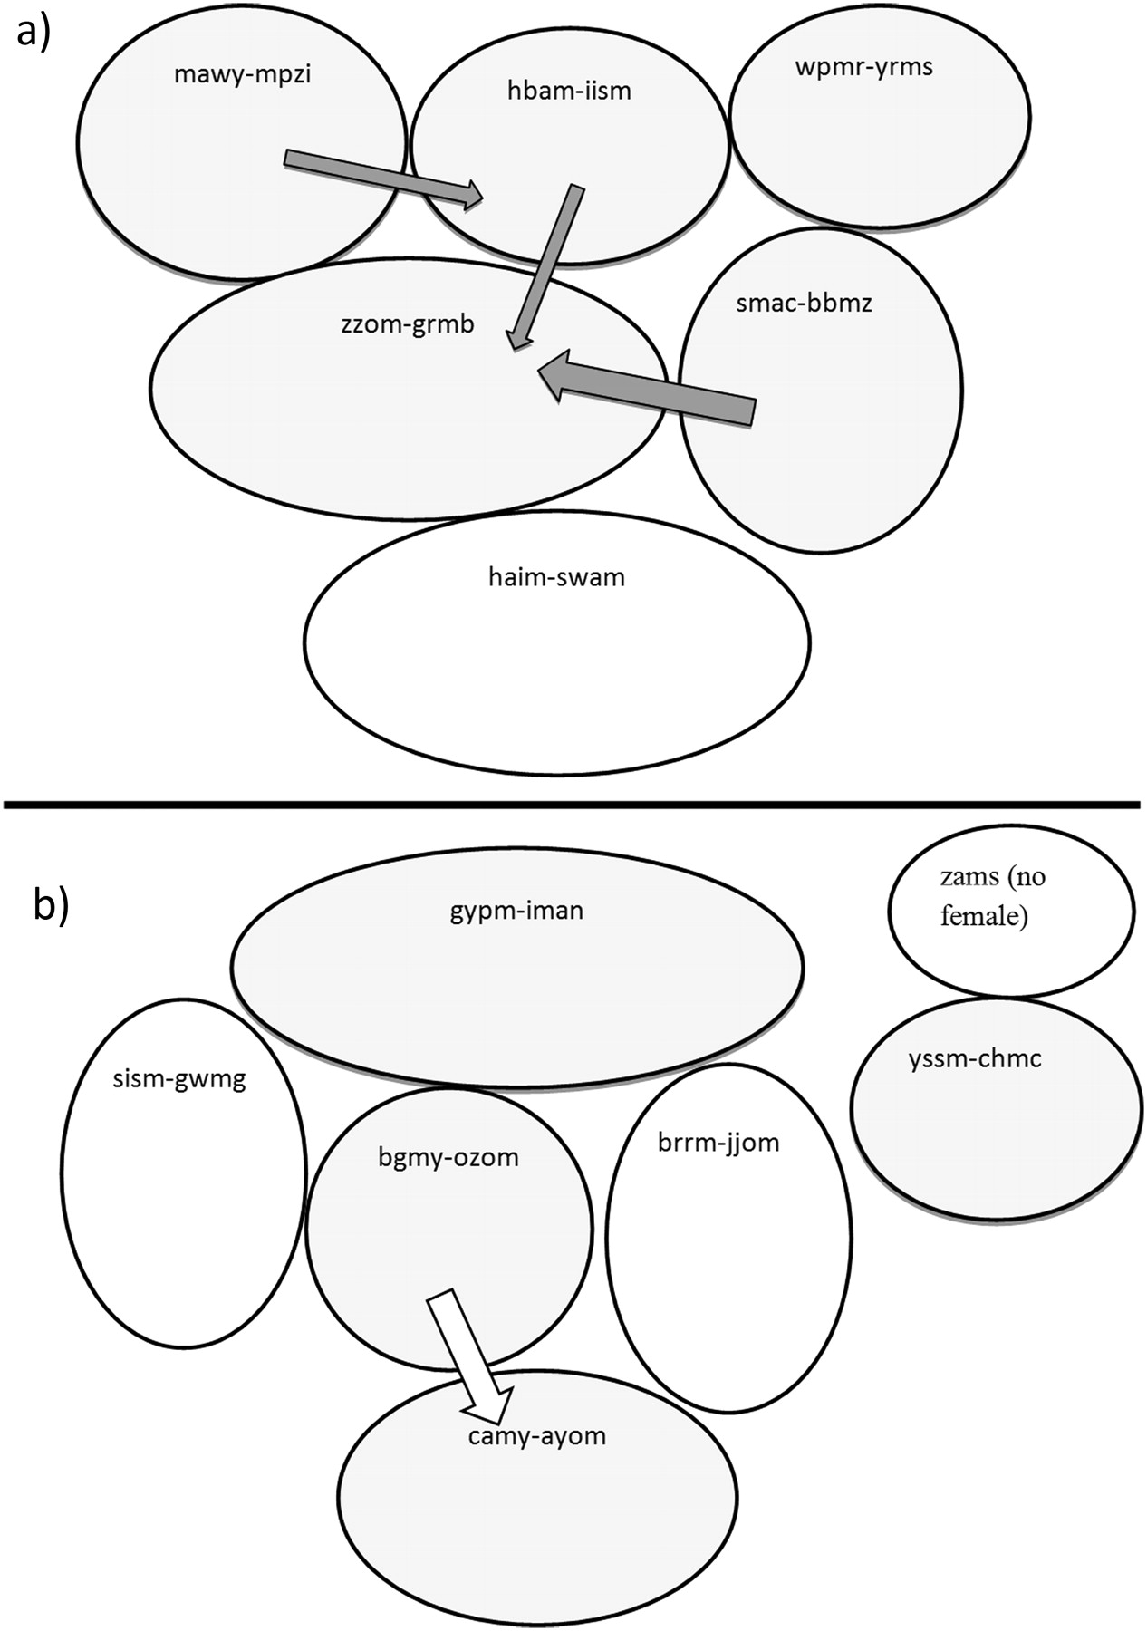
Figure 4 Schematics of 2 neighborhoods (a, b) where the tagged birds lived in 2009. Shaded territories, are where the ...
Notes:
Figure 4 Schematics of 2 neighborhoods (a, b) where the tagged birds lived in 2009. Shaded territories, are where the pair was tagged (male–female). The shaded arrows denote single-male forays into neighboring territories when the female on that territory was fertile. The open arrow denotes that the female was not fertile during the single-male forays. The thickness of the arrow is correlated with foray rate.
Unless provided in the caption above, the following copyright applies to the content of this slide: © The Author 2011. Published by Oxford University Press on behalf of the International Society for Behavioral Ecology. All rights reserved. For permissions, please e-mail: journals.permissions@oup.com

