Slide 1
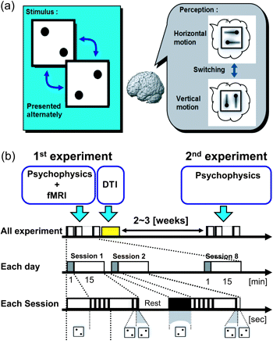
Figure 1. Schematic of DDQ paradigm. (a) The DDQ stimuli consist of alternately presented pairs of dots at one position ...
Notes:
Figure 1. Schematic of DDQ paradigm. (a) The DDQ stimuli consist of alternately presented pairs of dots at one position (the upper left and lower right of the visual field) and an alternative position (at the lower left and upper right of it). Participants recognized horizontal motion or vertical motion by identifying the upper side dots with the lower side dots or by identifying the right-hand dots with the left-hand dots. (b) Time courses of stimuli for all experiments. On the first day, we requested participants to perform a psychophysical task and recorded their fMRI data. After this psychophysical task, we recorded their DTI data. On the second experiment, we recorded only the psychophysical data of the same participants. The interval time between 2 days was 2–3 weeks. The sequence of stimulus presentation for 1 day during the whole experiment is enlarged on the second arrow. The psychophysical experiment for 1 day involves 8 sessions. Each session is also enlarged on the third arrow. During the first minute of each session, the visual stimulus is stationary, and the next 15 min, the stimulus flashes alternately between 2 different pairs of dots (upper right and lower left or lower right and upper left).
Unless provided in the caption above, the following copyright applies to the content of this slide: © The Author 2011. Published by Oxford University Press. All rights reserved. For permissions, please e-mail: journals.permissions@oup.com

Slide 2
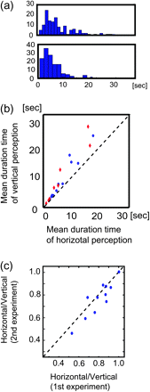
Figure 2. Results of psychophysical experiment. (a) Histograms of durations of horizontal/vertical perception of a ...
Notes:
Figure 2. Results of psychophysical experiment. (a) Histograms of durations of horizontal/vertical perception of a typical participant. (b) The relationship between mean duration of perception of horizontal compared with vertical motion. Blue dots indicate the results of the first experiment and red dots indicate the results of the second. (c) The relation between the ratio of the sum of durations (vertical perception/horizontal perception) in the first experiment and the ratio in the second experiment. The ratio was stable between these 2 experiments.
Unless provided in the caption above, the following copyright applies to the content of this slide: © The Author 2011. Published by Oxford University Press. All rights reserved. For permissions, please e-mail: journals.permissions@oup.com

Slide 3
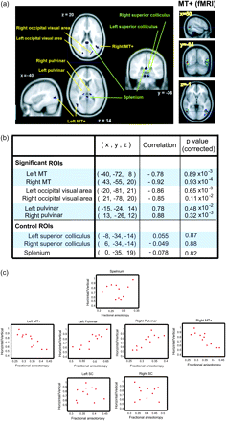
Figure 3. (a) The positions of ROIs in MNI space are shown in the left figure. In 6 of 9 ROIs (occipital visual area, ...
Notes:
Figure 3. (a) The positions of ROIs in MNI space are shown in the left figure. In 6 of 9 ROIs (occipital visual area, MT+ areas, left and right pulvinar), the ratio of the sum of durations of the 2 directions of perceived motion (horizontal perception/vertical perception) showed a significant correlation with the mean FA value. Three of 9 regions (splenium, left and right SC) were selected as control ROIs. The right figure is MT+ ROIs defined by significant activity of fMRI. (b) The table shows peak positions, correlations, and P values of these ROIs. (c) Regression plots between maximum FA value in 9 ROIs and the ratio of the sum of vertical phase durations and the sum of horizontal phase durations. These analyses were conducted on unsmoothed FA images in a native space.
Unless provided in the caption above, the following copyright applies to the content of this slide: © The Author 2011. Published by Oxford University Press. All rights reserved. For permissions, please e-mail: journals.permissions@oup.com

Slide 4
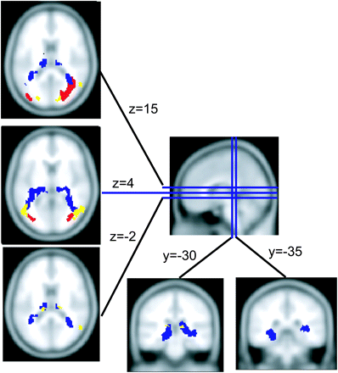
Figure 4. Tracts between significant ROIs. Blue tracts represent PN-MT+ tracts; The tract was defined as the common ...
Notes:
Figure 4. Tracts between significant ROIs. Blue tracts represent PN-MT+ tracts; The tract was defined as the common region of 7 of 11 participants in MNI coordinates, and, in the region, FA values of all participants exceeded 0.2. Yellow regions are ROIs of pulvinars, bilateral MT+, and occipital visual area.
Unless provided in the caption above, the following copyright applies to the content of this slide: © The Author 2011. Published by Oxford University Press. All rights reserved. For permissions, please e-mail: journals.permissions@oup.com

