Slide 1
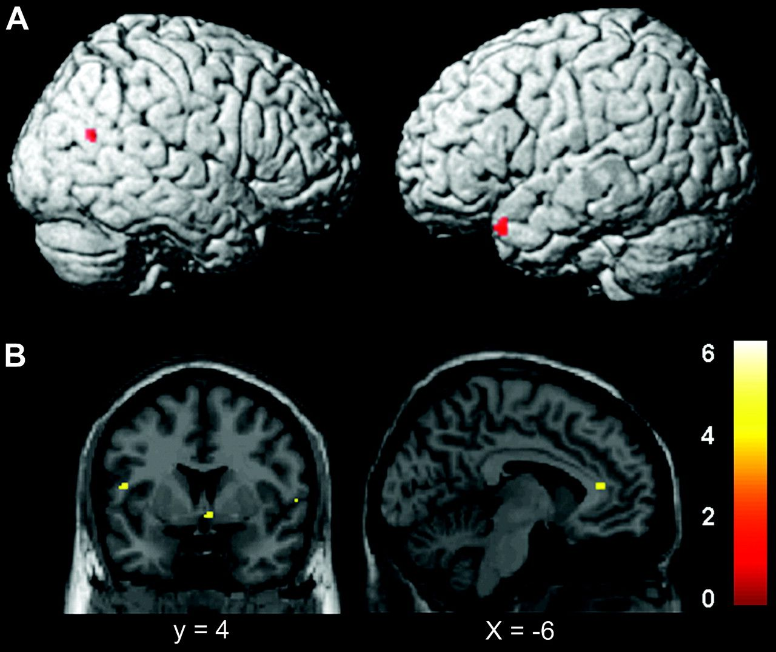
Figure 1. Images showing brain activation in joy and pride conditions relative to neutral condition. (A) Pride minus ...
Notes:
Figure 1. Images showing brain activation in joy and pride conditions relative to neutral condition. (A) Pride minus neutral. Activated regions were in the right posterior STS and left temporal pole. (B) Joy minus neutral. Activations in the ventral striatum, insula/operculum, and anterior cingulate were shown. Significant differences were recognized at a height threshold (t > 4.07; P < 0.0005, uncorrected) and extent threshold (10 voxels).
Unless provided in the caption above, the following copyright applies to the content of this slide: © The Author 2007. Published by Oxford University Press. All rights reserved. For permissions, please e-mail: journals.permissions@oxfordjournals.org

Slide 2
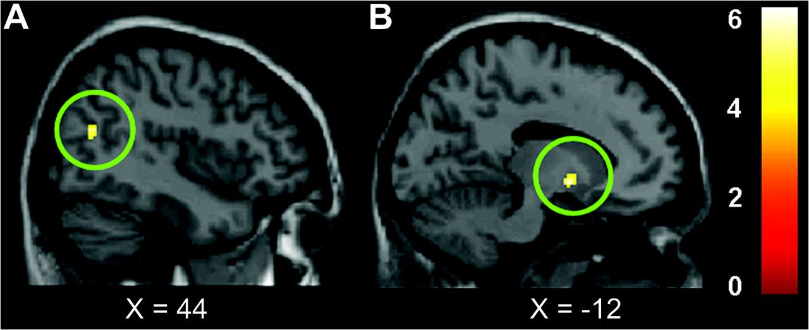
Figure 2. Correlation between brain activation and the self-ratings of pride and joy, with height threshold (P < 0.001) ...
Notes:
Figure 2. Correlation between brain activation and the self-ratings of pride and joy, with height threshold (P < 0.001) and extent threshold (5 voxels). (A) There was positive linear correlations between self-rating of pride and the degree of activation in the pSTS. (B) There was positive linear correlations between self-rating of joy and the degree of activation in the ventral striatum. The bar shows the range of the t-score. Within the image, L indicates left. Numbers in the bottom low indicate the z-coordinates of the Montreal Neurological Institute brain.
Unless provided in the caption above, the following copyright applies to the content of this slide: © The Author 2007. Published by Oxford University Press. All rights reserved. For permissions, please e-mail: journals.permissions@oxfordjournals.org

Slide 3
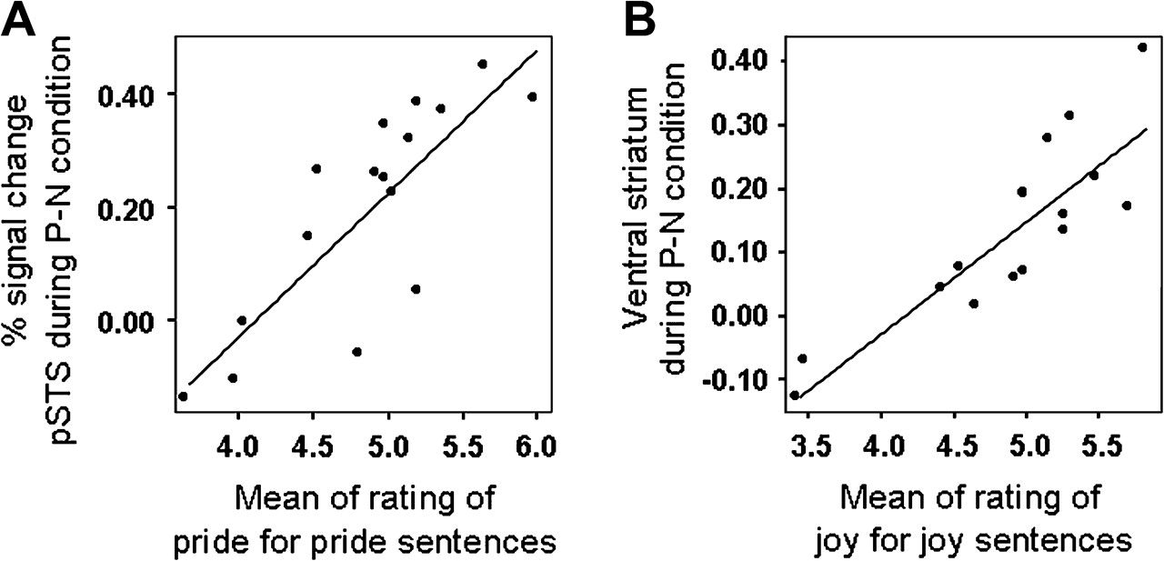
Figure 3. Plots and regression lines of correlations between self-ratings and the degree of activation in the brain ...
Notes:
Figure 3. Plots and regression lines of correlations between self-ratings and the degree of activation in the brain regions. (A) Positive correlations (r = 0.81, df = 14, P < 0.001) between self-rating of pride and the degree of activation in the pSTS. (B) Positive linear correlations (r = 0.86, df = 14, P < 0.001) between self-rating of joy and the degree of activation in the ventral striatum.
Unless provided in the caption above, the following copyright applies to the content of this slide: © The Author 2007. Published by Oxford University Press. All rights reserved. For permissions, please e-mail: journals.permissions@oxfordjournals.org

